Slide 1

Statics
Chapter seven
7.1. Dry friction –solved examples
By
Laith Batarseh
Home
Next
Previous
End

Slide 2
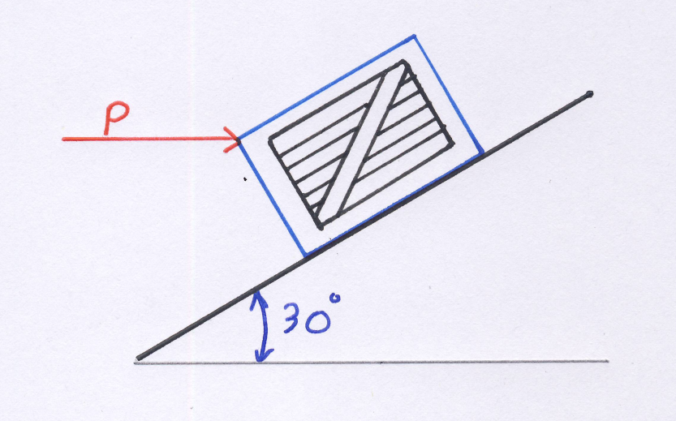
Dry friction
Statics
Example [1]
Problem 8-3
Determine the minimum horizontal force P required to hold the crate from sliding down the plane. The crate has a mass of 50 kg and the coefficient of static friction between the crate and the plane is μ_{s} = 0.25.

Slide 3
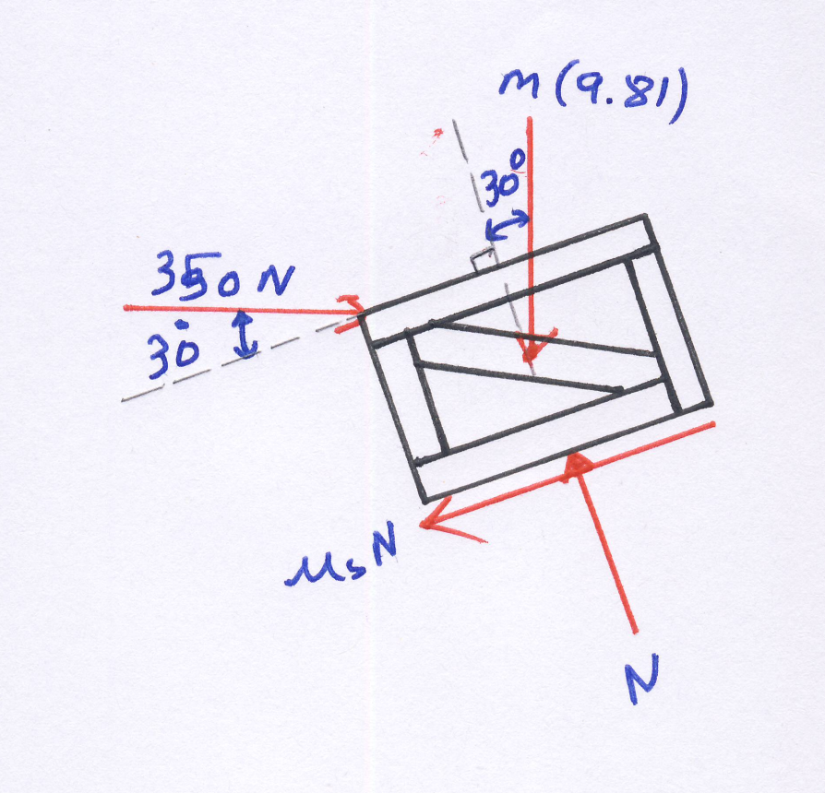
Dry friction
Statics
Example [1]
Solution
F.B.D

Slide 4
Dry friction
Statics
Example [1]
Solution
Equilibrium equations
Solve equations 1and 2 to find P and N:

Slide 5
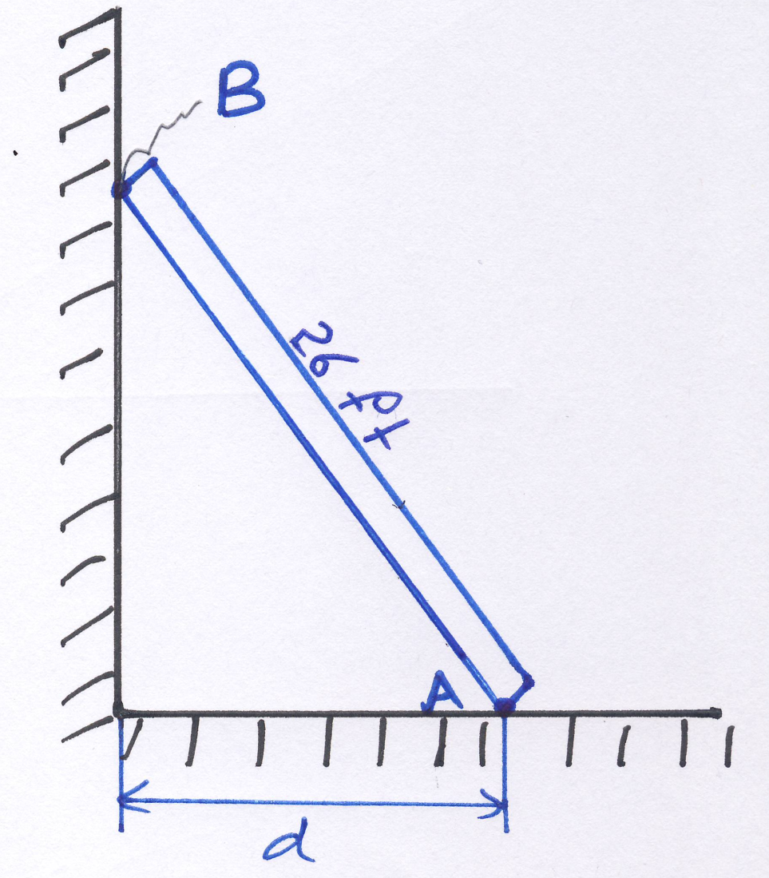
Dry friction
Statics
Example [2]
Problem 8-7
The uniform thin pole has a weight of 30 lb and a length of 26 ft. If it is placed against the smooth wall and on the rough floor in the position d= 10ft , will it remain in this position when it is released? The coefficient of static friction is μ_{s} = 0.25.

Slide 6
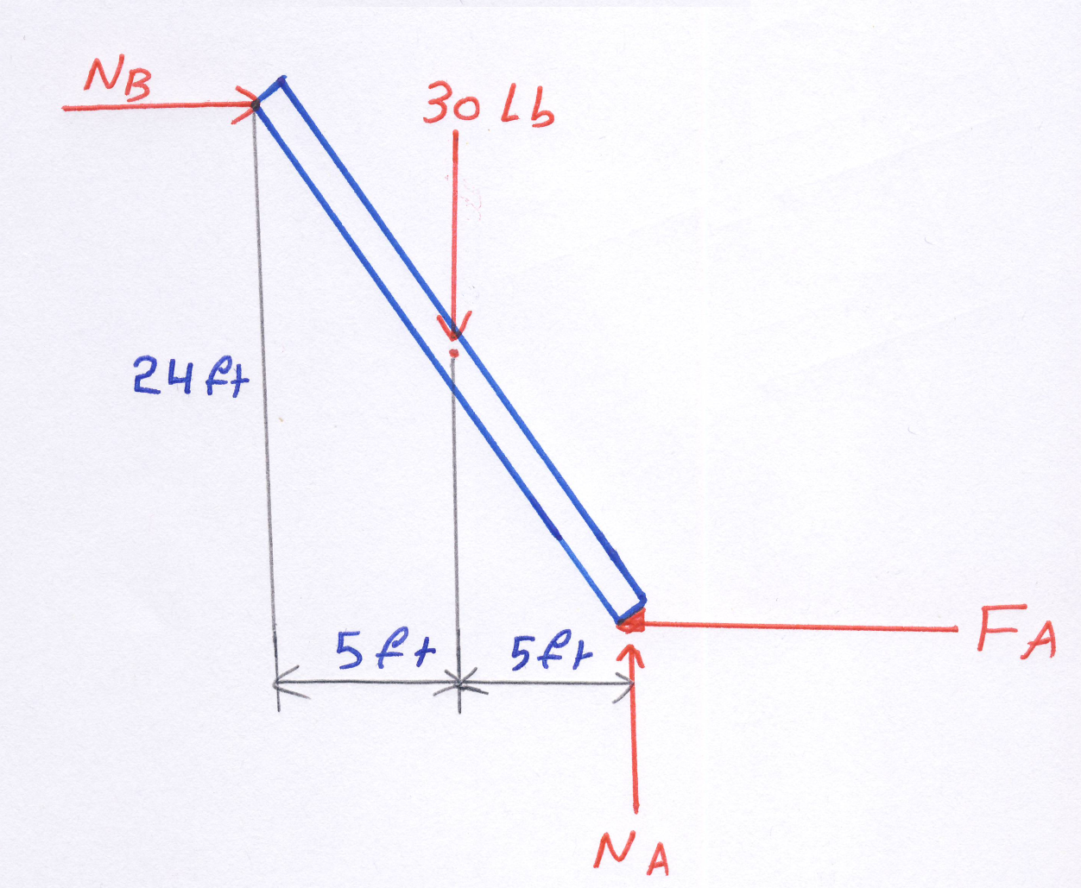
Dry friction
Statics
Example [2]
Solution
F.B.D

Slide 7
Dry friction
Statics
Example [2]
Solution
Equilibrium equations
First, let us find the reaction N_{B}:
Now , let us find the forces F_{A} and N_{A}:
Finally, maximum possible friction
F_{max} > load (9>6.25); the pole will remain stationary

Slide 8
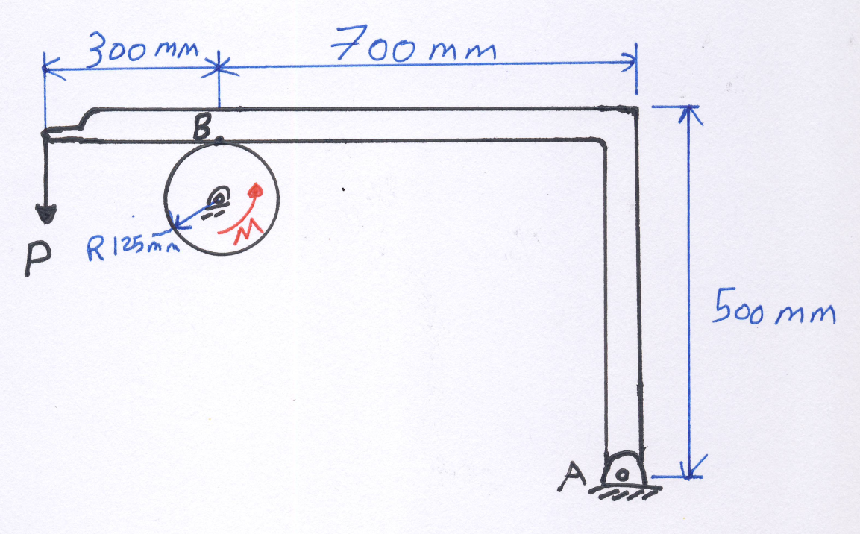
Dry friction
Statics
Example [3]
Problem 8-12
The coefficients of static and kinetic friction between the drum and brake bar are: μ_{s}=0.4 and μ_{k} = 0.3 respectively. If M =50N.m and P= 85N, determine the horizontal and vertical components of reaction at the pin O. Neglect the weight and thickness of the brake. The drum has a mass of 25 kg.

Slide 9
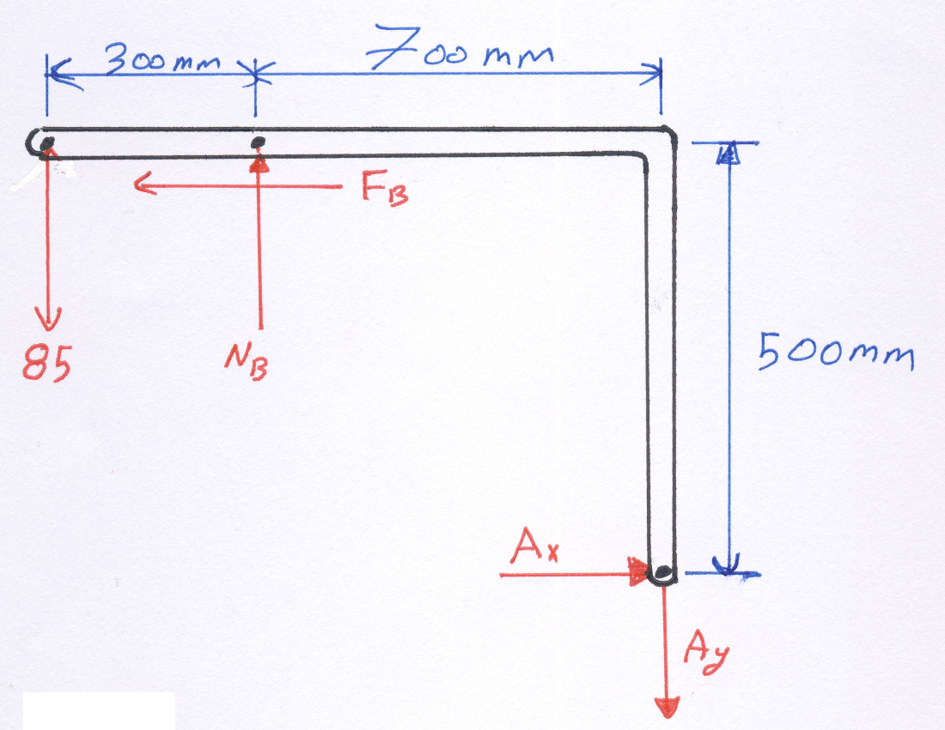
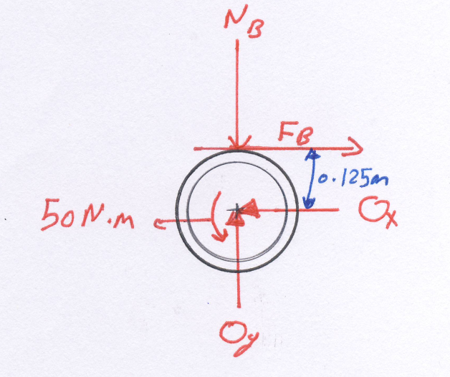
Dry friction
Statics
Example [3]
Solution
F.B.D

Slide 10
Dry friction
Statics
Example [3]
Solution
Equilibrium equations
The static friction is : 0.4*407 = 162 N < F_{B}. So, the drum will rotate.
Therefore, we must use the kinetic friction : F_{B}=μ_{k}N_{B} = 0.3 N_{B}.

Slide 11
Dry friction
Statics
Example [3]
Solution
The pulley

Slide 12
Dry friction
Statics
End of lecture
See you in the next lecture
Don’t forget to answer the quiz
Home
Next
Previous
End

