Slide 1

Statics
Chapter seven
7.2. Friction in screws and belts
By
Laith Batarseh
Home
Next
Previous
End

Slide 2
Friction in Screws and Belts
Statics
In this lecture we will
  Determine the formula of friction in screws
  Determine the formula of friction in belt – pulley configuration.

Slide 3
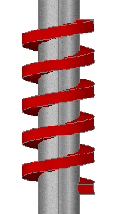
Friction in Screws and Belts
Statics
Screws
  Screws are threaded cylindrical peaces of metals and used as fasteners (to join parts) or to transmit power (power screws).
  In the case of power screw, the shape of thread is mainly square as the one shown below.

Slide 4
Friction in Screws and Belts
Statics
Screws
r
l
l
Ө
2πr
  the motion of screw is done by a moment (M):
  M = r W tan(ф_{s}+Ө)
  Where:
  W is the vertical force acting on thread
  Ф_{s} is angle of static friction = tan⁻¹(F/N) = tan⁻¹(μ_{s})
  Ө = tan⁻¹(l/2πr)

Slide 5
Friction in Screws and Belts
Statics
Belts
T₂
T₁
β
T₂
T₁

Slide 6
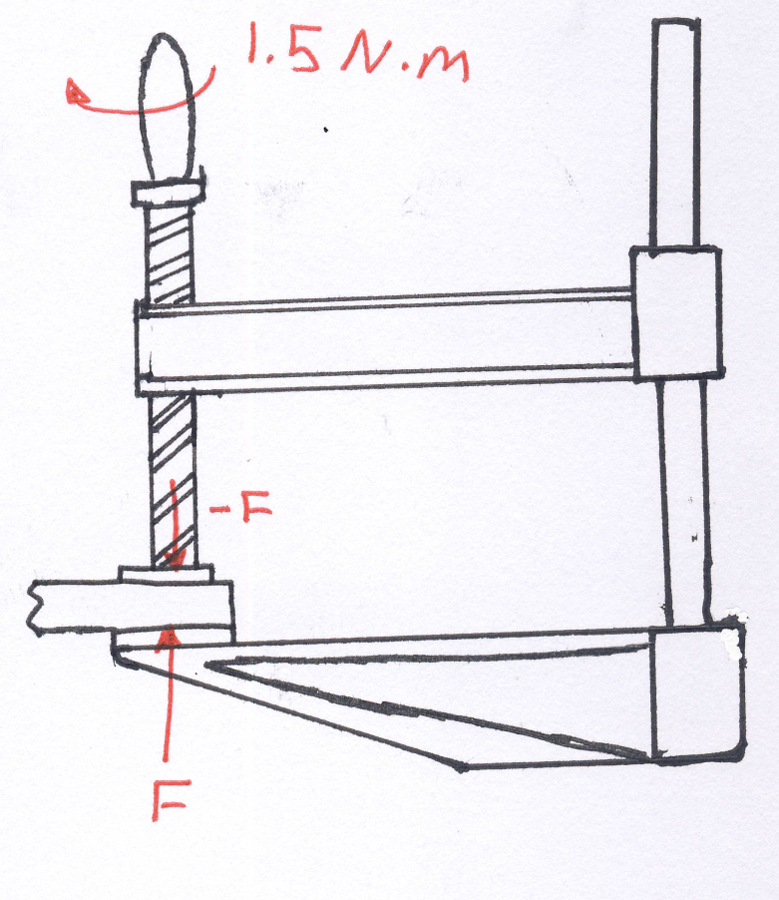
Friction in Screws and Belts
Statics
Example [1] 8-77
The square threaded screw of the clamp has a mean diameter of 14 mm and a lead of 6 mm. If μ_{s}= 0.2 for the threads, and the torque applied to the handle is 1.5 N . m, determine the compressive force F on the block

Slide 7
Friction in Screws and Belts
Statics
Example [1] 8-77
Solution
The angle Ө is found as:
  Ө = tan⁻¹(l/2πr) = tan⁻¹(6/2π(7)) = 7.8º
  W = F and фs =tan⁻¹(μ_{s}) = 11.3º.
  Apply M = r W tan(ф_{s}+Ө) → 1.5 = F(0.007) tan(7.8+11.3)
  → F = 620 N

Slide 8
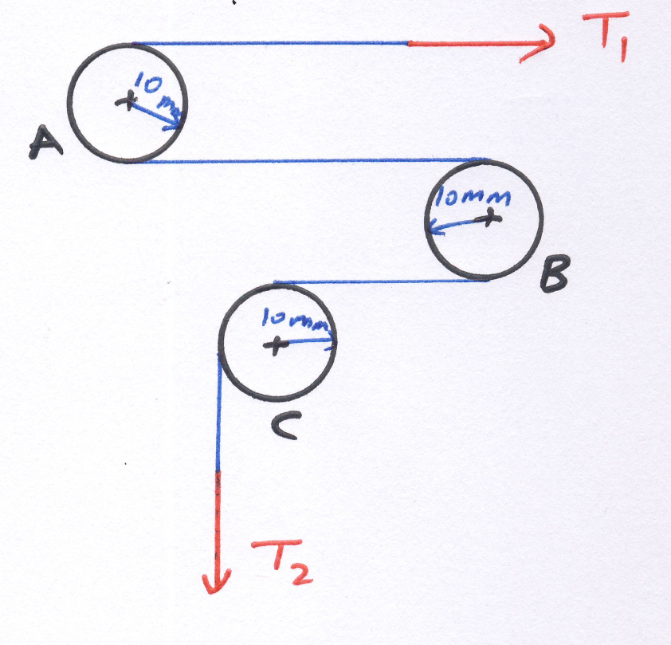
Friction in Screws and Belts
Statics
Example [1] 8-107
The drive pulley B in a video tape recorder is on the verge of slipping when it is subjected to a torque of M = 0.005 N.m . If the coefficient of static friction between the tape and the drive wheel and between the tape and the fixed shafts A and C is μ_{s}= 0.1 , determine the tensions T₁and T₂ developed in the tape for equilibrium.

Slide 9
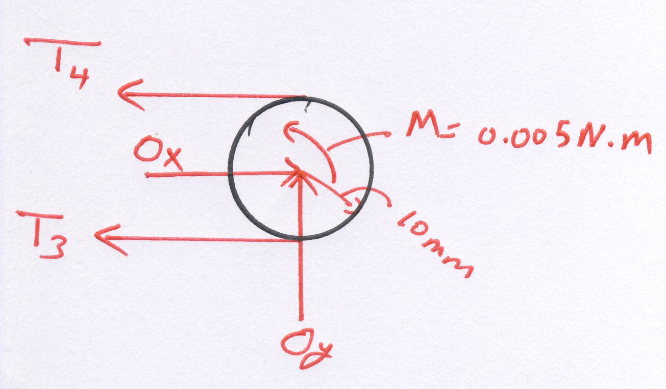
Friction in Screws and Belts
Statics
Example [1] 8-77
Solution
F.B.D

Slide 10
Friction in Screws and Belts
Statics
Example [1] 8-77
Solution
T₃ must overcome T₄ and M. So T₃>T₄
From F.B.D and the equilibrium equations
Solve Eqs 1and 2 to find T₃ and T₄:
T₃ = 1.85N and T₄ = 1.35N
Back to shaft A and C to find T₁ and T₂:

Slide 11
Friction in Screws and Belts
Statics
End of lecture
See you in the next lecture
Don’t forget to answer the quiz
Home
Next
Previous
End

