Slide 1

Statics
Chapter seven
7.3. solved problems
By
Laith Batarseh
Home
Next
Previous
End

Slide 2
solved problems
Statics
In this lecture we will
  Solve some of the textbook problems on dray friction determination

Slide 3
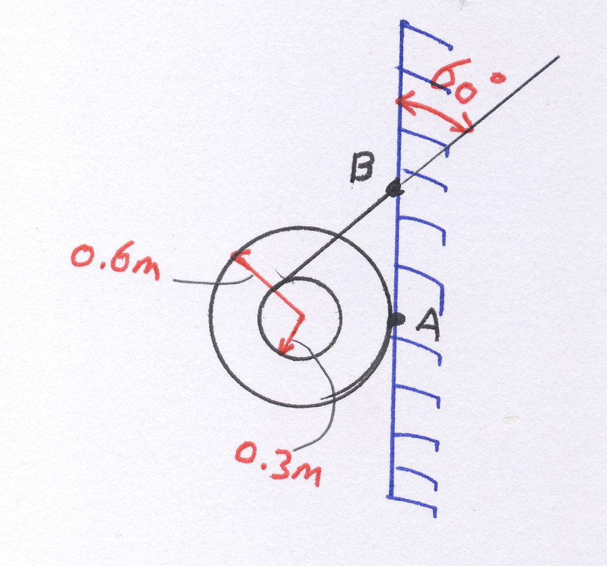
Friction in Screws and Belts
Statics
Example [1] 8-14
Determine the minimum coefficient of static friction between the uniform 50-kg spool and the wall so that the spool does not slip.

Slide 4
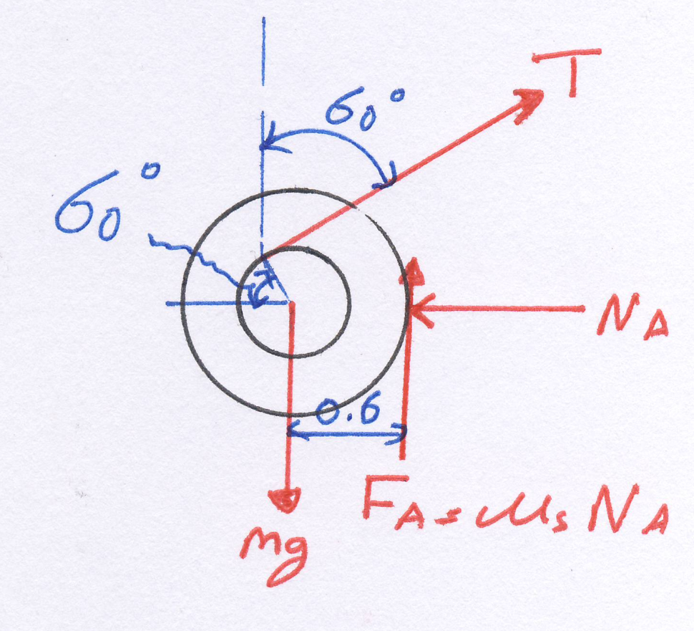
Friction in Screws and Belts
Statics
Example [1] 8-14
Solution
F.B.D

Slide 5
Friction in Screws and Belts
Statics
Example [1] 8-14
Solution
Apply equilibrium moment equation at point A:
Apply equilibrium force equations:

Slide 6
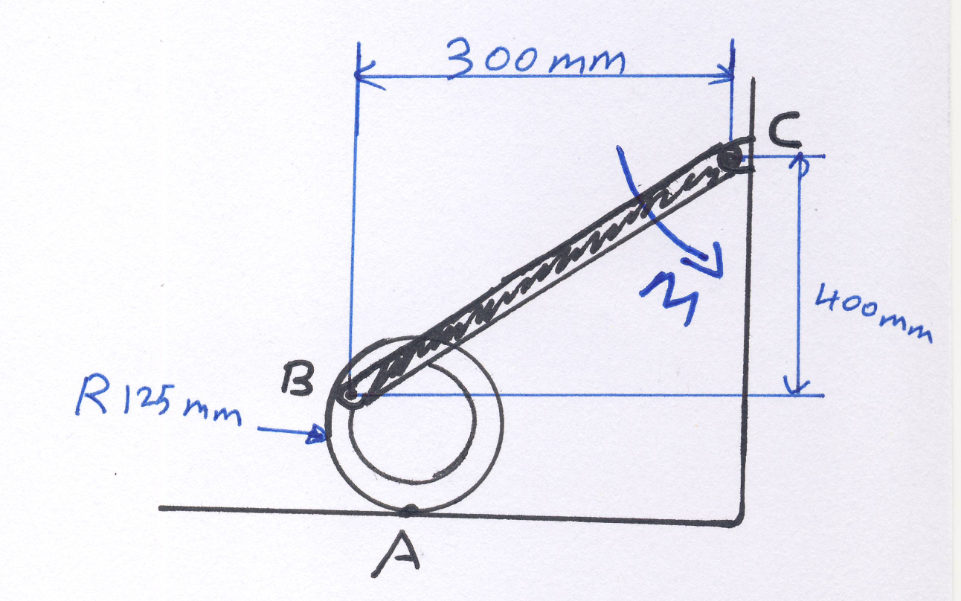
Friction in Screws and Belts
Statics
Example [2] 8-45
The 45-kg disk rests on the surface for which the coefficient of static friction is 0.2 Determine the largest couple moment M that can be applied to the bar without causing motion.

Slide 7
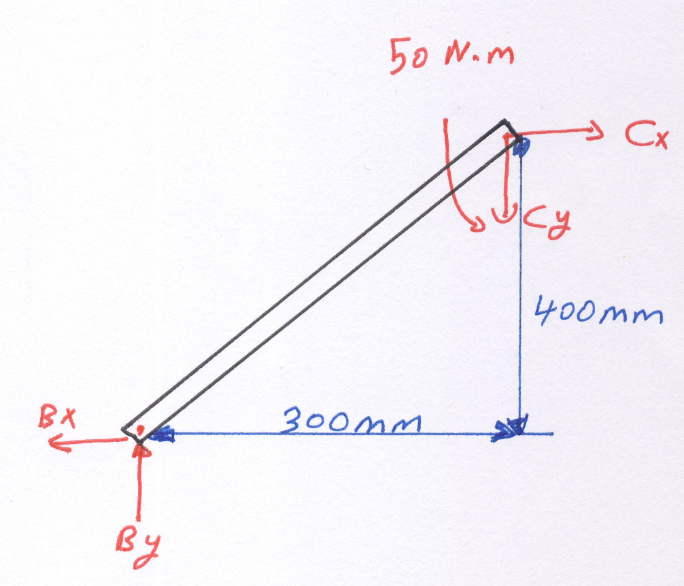
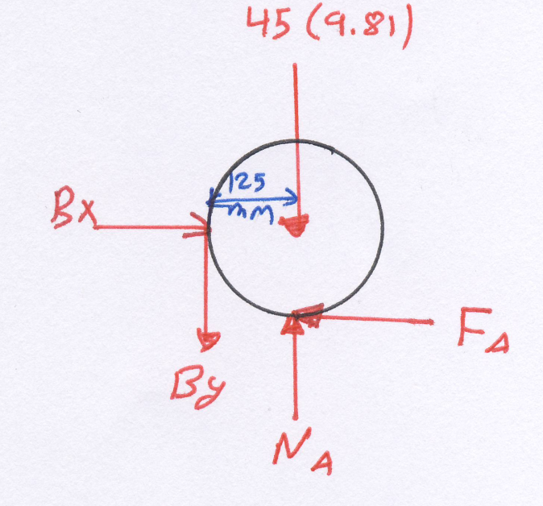


Friction in Screws and Belts
Statics
Example [1] 8-45
Solution
F.B.D

Slide 8
Friction in Screws and Belts
Statics
Example [1] 8-45
Solution
Apply equilibrium moment equation at point O (the center of the disk):
Apply equilibrium force equations:
Solve all these equations to find all the reactions and normal force

Slide 9
Friction in Screws and Belts
Statics
Example [1] 8-45
Solution
Finally, apply equilibrium moment equation at point C:

Slide 10
Friction in Screws and Belts
Statics
End of lecture
See you in the next lecture
Don’t forget to answer the quiz
Home
Next
Previous
End

