Slide 1

Statics
Chapter eight
8.1. Center of Mass and Center of Gravity
By
Laith Batarseh
Home
Next
Previous
End

Slide 2
Center of Mass and Center of Gravity
Statics
In this lecture we will
Define the concepts of center of mass and center of gravity and the centroid
Learn how to locate the center of mass and center of gravity and the centroid

Slide 3
Center of Mass and Center of Gravity
Statics
Center of gravity
z
dw
z
W
CG
y
y
x
x

Slide 4
Center of Mass and Center of Gravity
Statics
Center of gravity
The weight of the body is found by integrating the small portions of dw.
Weight
The weight of a body acts at a point in the body called the center of gravity
The position of the center of gravity is found by applying the equilibrium of moment equations where the summation of moment at C.G equal zero

Slide 5
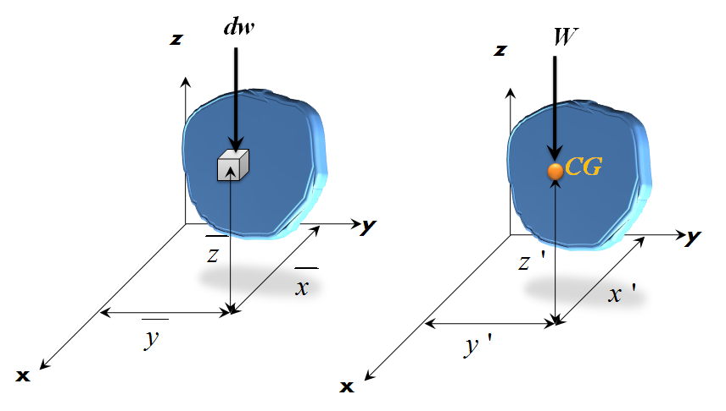
Center of Mass and Center of Gravity
Statics
Center of gravity
The location of C.G of a certain body is found as:

Slide 6
Center of Mass and Center of Gravity
Statics
Center of mass
As in the center of gravity, center of mass represent the point where we can assume that all the mass is concentrated in it. Mathematically, the location of the center of mass can be found by:
dW = g dm

Slide 7
Center of Mass and Center of Gravity
Statics
Center of volume
If the body is made from a constant density material, then the center of volume can be found from the relation between the mass and the density:
dm = ρ dV

Slide 8
Center of Mass and Center of Gravity
Statics
Centroid of an Area
Centroid of an Line

Slide 9
Center of Mass and Center of Gravity
Statics
Analysis procedures
Differential Element
Define the coordinate system.
Chose a suitable differential element for the integration
For line: line segment dL
For area: rectangular element (dA = L dW; L is the length and W is the width)
For volume: circular disk ( dV = πr².dt; r is the radius and t is the thickness)
3. Be sure that the chosen element touch an arbitrary point P(x,y,z) located at the curve that define the boundary of the body

Slide 10
Center of Mass and Center of Gravity
Statics
Analysis procedures
Size and Moment Arms
Express the chosen element in terms of the pre described coordinates
Express the moment arms ( , , ) in terms of the pre described coordinates (x, y, z)
Integration
Substitute the formulas of moment arms and the chosen elements in the appropriate equation.
Rearrange the equation in the integration to be in the same variable
Define the limits of the integration

Slide 11
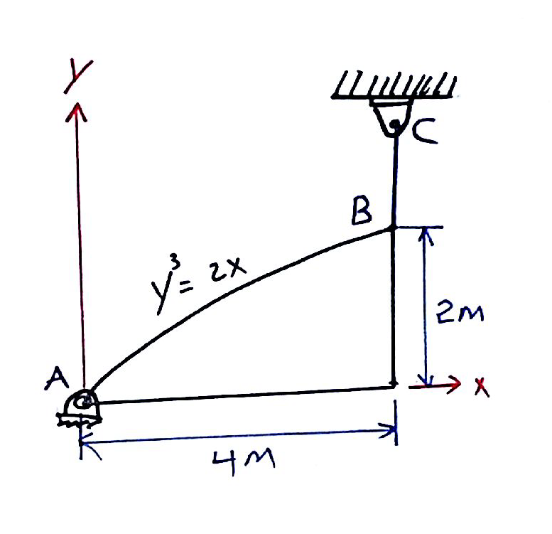
Center of Mass and Center of Gravity
Statics
Example: problem 9-18
The plate is made of steel having a density of 7850 kg/m³. If the thickness of the plate is 10 mm, determine the horizontal and vertical components of reaction at the pin A and the tension in cable BC.

Slide 12
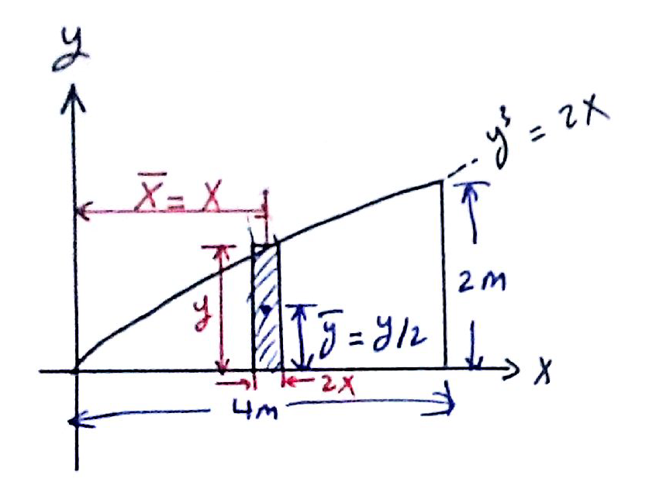
Center of Mass and Center of Gravity
Statics
Example: problem 9-18
Solution
Differential element and coordinate system

Slide 13
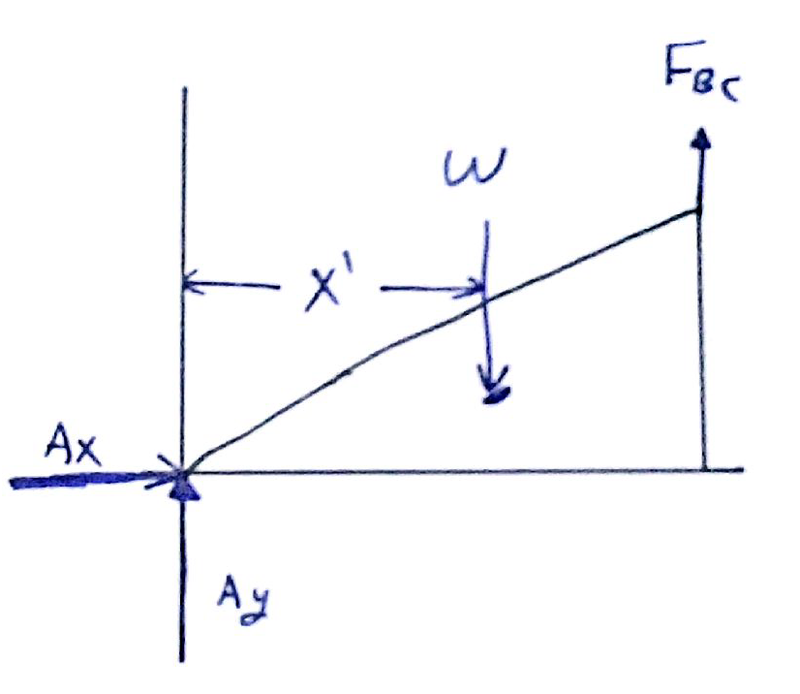
Center of Mass and Center of Gravity
Statics
Example: problem 9-18
Solution
F.B.D

Slide 14
Center of Mass and Center of Gravity
Statics
Example: problem 9-18
Solution
Centroid
Area element
Centroid location
Area
Weight (w)
Centroid location

Slide 15
Center of Mass and Center of Gravity
Statics
Example: problem 9-18
Solution
Equilibrium conditions

Slide 16
Center of Mass and Center of Gravity
Statics
End of lecture
See you in the next lecture
Don’t forget to answer the quiz
Home
Next
Previous
End

