Slide 1

Statics
Chapter eight
8.2. Centroid - 2
By
Laith Batarseh
Home
Next
Previous
End

Slide 2
Centroid
Statics
Centroid of an Area
Centroid of an Line

Slide 3
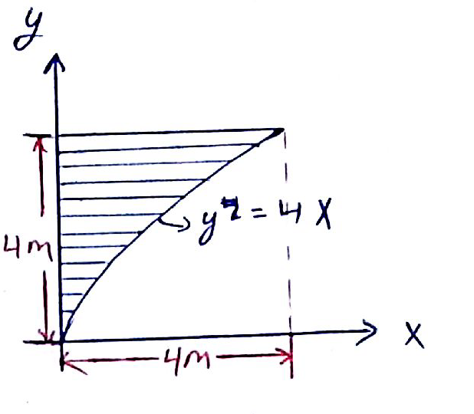
Centroid
Statics
Example: problem 9-8
Determine the area and the centroid of the area.

Slide 4
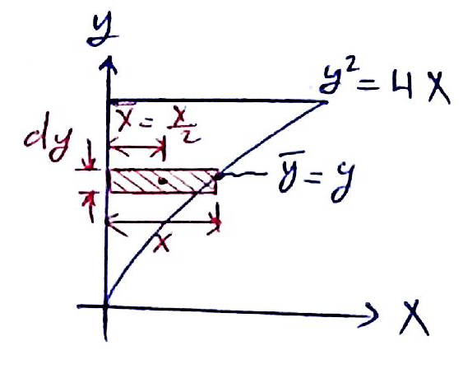
Centroid
Statics
Example: problem 9-18
Solution
Differential element and coordinate system

Slide 5
Centroid
Statics
Example: problem 9-18
Solution
Centroid
Area element
Centroid location
Area
Centroid location

Slide 6
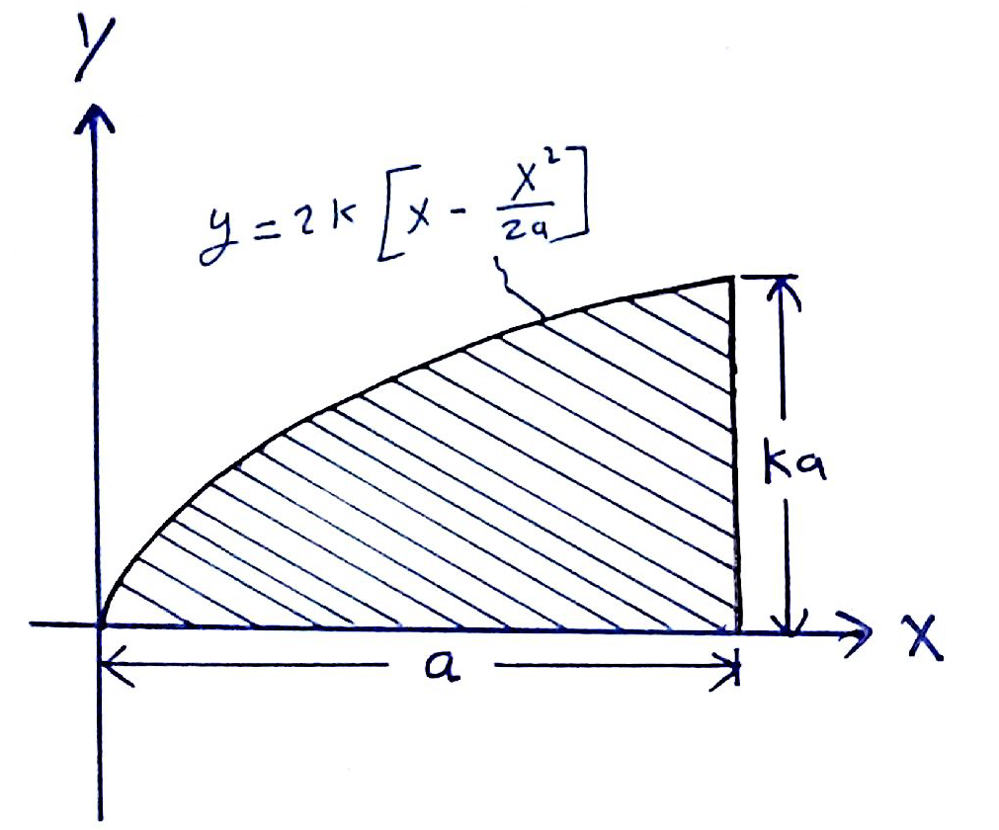
Centroid
Statics
Example: problem 9-21
Determine the area and the centroid of the area from the y-axis.

Slide 7
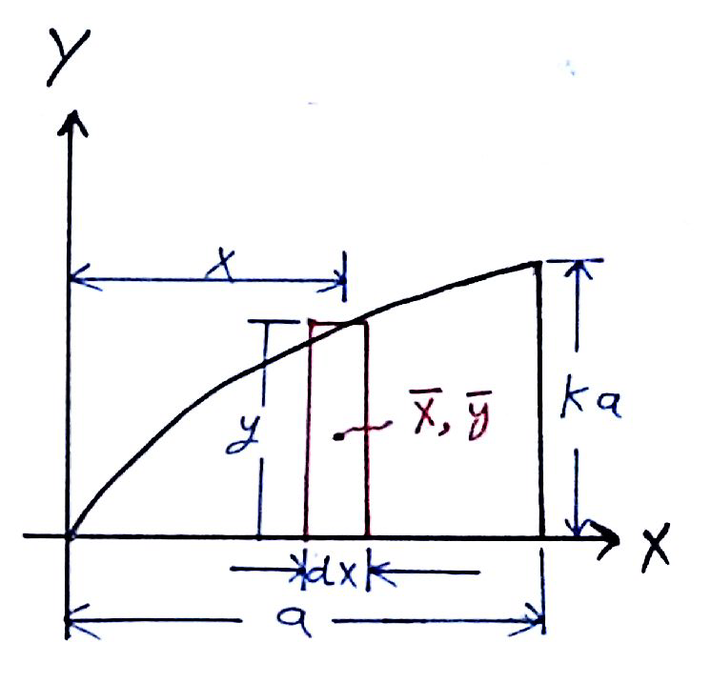
Centroid
Statics
Example: problem 9-18
Solution
Differential element and coordinate system

Slide 8
Centroid
Statics
Example: problem 9-18
Solution
Centroid
Centroid location
Area
Centroid location

Slide 9
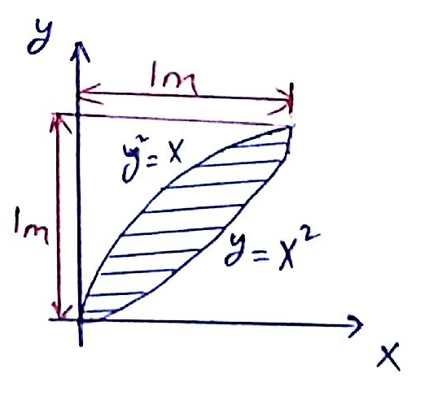
Centroid
Statics
Example: problem 9-26
Determine the area and the centroid of the area from the y-axis.

Slide 10
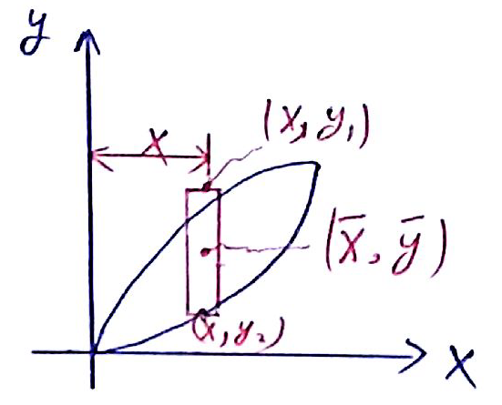
Centroid
Statics
Example: problem 9-18
Solution
Differential element and coordinate system

Slide 11
Centroid
Statics
Example: problem 9-18
Solution
Centroid
Area element
Centroid location
Area
Centroid location

Slide 12
Centroid
Statics
End of lecture
See you in the next lecture
Don’t forget to answer the quiz
Home
Next
Previous
End

