Slide 1

Statics
Chapter eight
8.3. Composite Bodies
By
Laith Batarseh
Home
Next
Previous
End

Slide 2
Composite Bodies
Statics
Basic concept
Composite bodies are a series of simple shaped
The centroid of the composite body is found by finding the centroid for each shape and then apply superposition principle.
Where:
W is the individual weight of each shape
∑W is the total weight of the body

Slide 3
Composite Bodies
Statics
For length
For area

Slide 4
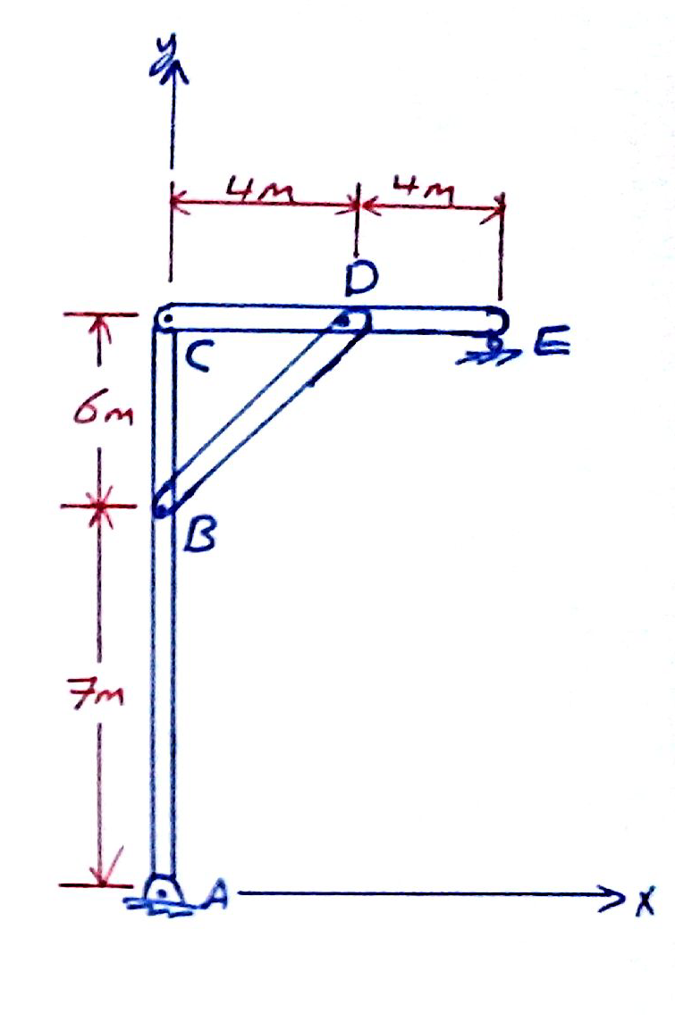
Composite Bodies
Statics
Example: problem 9-50
Each of the three members of the frame has a mass per unit length of 6 kg/m. Locate the position of the center of mass. Neglect the size of the pins at the joints and the thickness of the members. Also, calculate the reactions at the pin A and roller E.

Slide 5
Composite Bodies
Statics
Example: problem 9-50
  Solution
  Centroid location
Seg | L
C-D-E | 8 | 4 | 13 | 32 | 104
B-D | 7.2 | 2 | 10 | 14.4 | 72
A-B-C | 13 | 0 | 6.5 | 0
∑ | 28.21 |  |  | 46.4 | 260.6

Slide 6
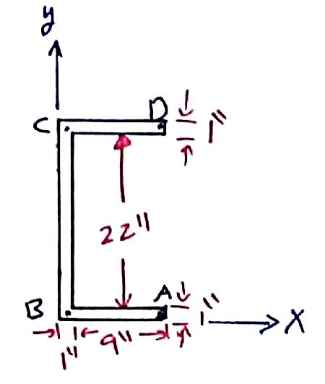
Composite Bodies
Statics
Example: problem 9-51
Locate the centroid of the cross-sectional area of the channel.

Slide 7
Composite Bodies
Statics
Example: problem 9-51
  Solution
  Centroid location
Seg | A
A-B | (9)(1) =9 | 5.5 | 0.5 | 49.5 | 4.5
B-C | (1)(24)=24 | 0.5 | 12 | 12 | 288
C-D | (9)(1) =9 | 5.5 | 23.5 | 49.5 | 211.5
∑ | 42 |  |  | 111 | 504

Slide 8
Centroid
Statics
End of lecture
See you in the next lecture
Don’t forget to answer the quiz
Home
Next
Previous
End

