Slide 1

Statics
Chapter eight
8.3. Composite Bodies-partII
By
Laith Batarseh
Home
Next
Previous
End

Slide 2
Composite Bodies
Statics
In this lecture
we will solve some examples on how to find the centroid of composite bodies

Slide 3
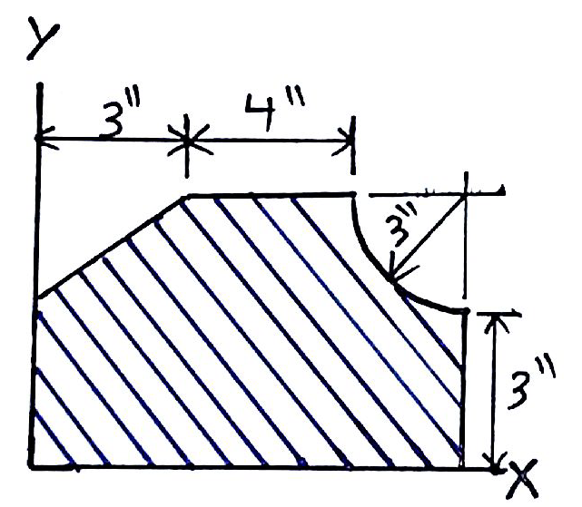
Composite Bodies
Statics
Example: problem 9-59
Locate the centroid of the composite area shown in the Fig

Slide 4
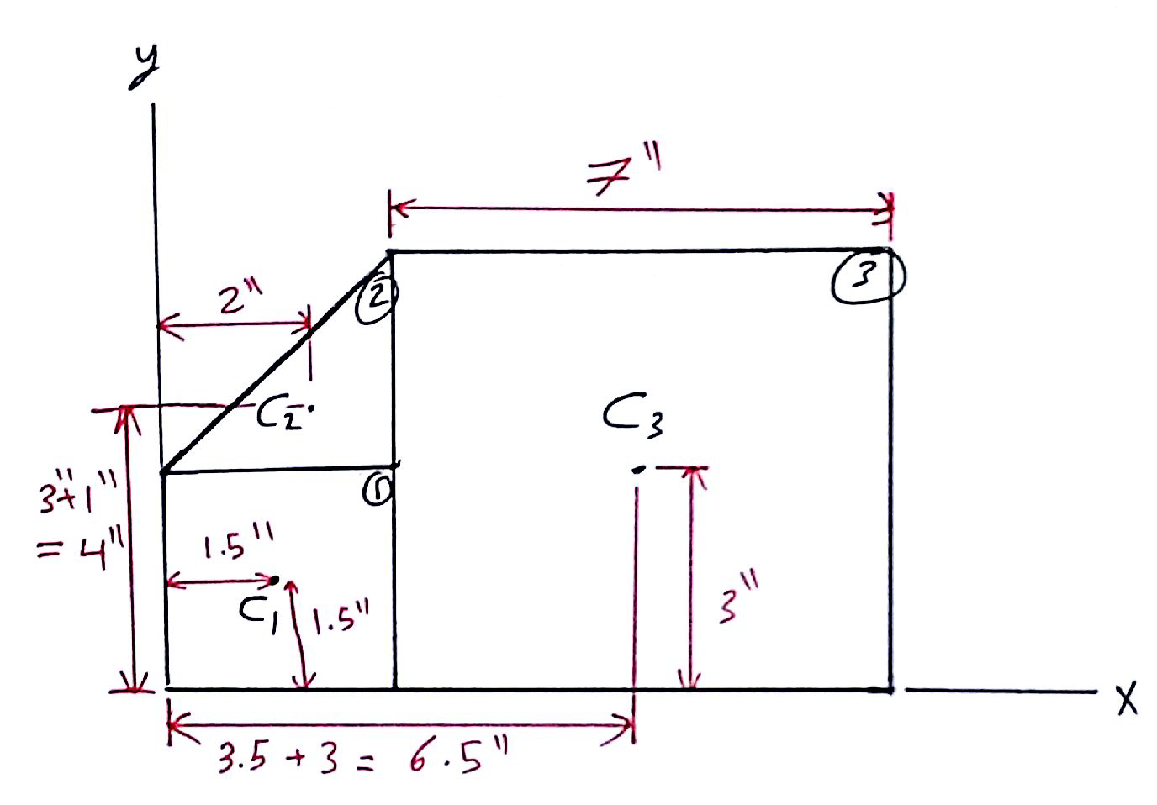
Composite Bodies
Statics
Example: problem 9-59
Solution
Decompose the area

Slide 5
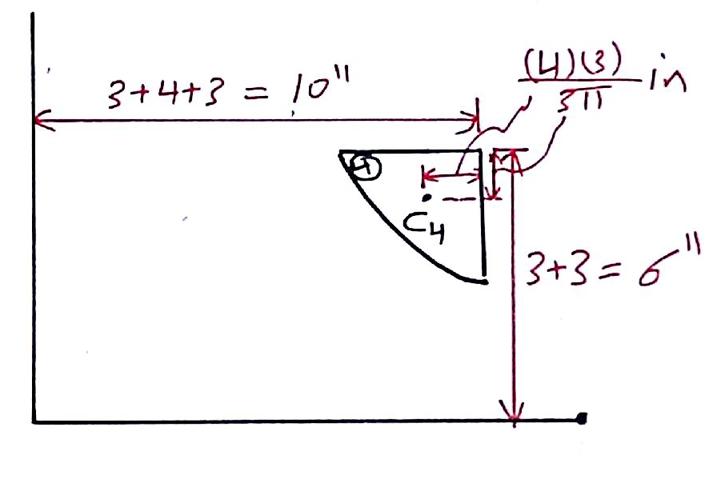
Composite Bodies
Statics
Example: problem 9-59
Solution
Decompose the area

Slide 6
Composite Bodies
Statics
Example: problem 9-50
Solution
Centroid location
Area | A
1 | 9 | 1.5 | 1.5 | 13.5 | 13.5
2 | 4.5 | 2 | 4 | 9 | 18
3 | 42 | 6.5 | 3 | 273 | 126
4 | -(π3²)/4 | 10-(4/π) | 6-(4/π) | -61.7 | -33.4
∑ | 48.4 |  |  | 233.8 | 124.1

Slide 7
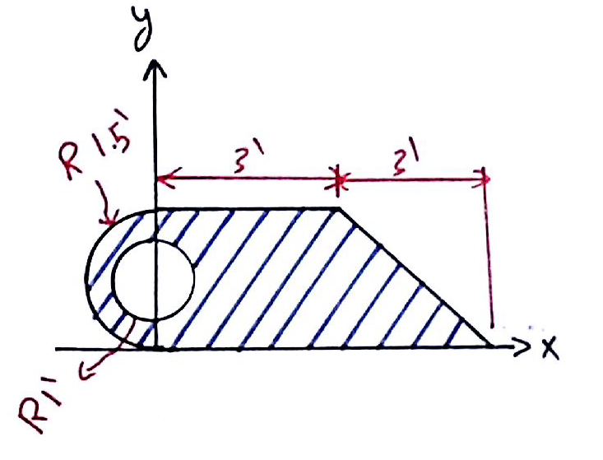
Composite Bodies
Statics
Example: problem 9-60
Locate the centroid of the composite area shown in the Fig

Slide 8
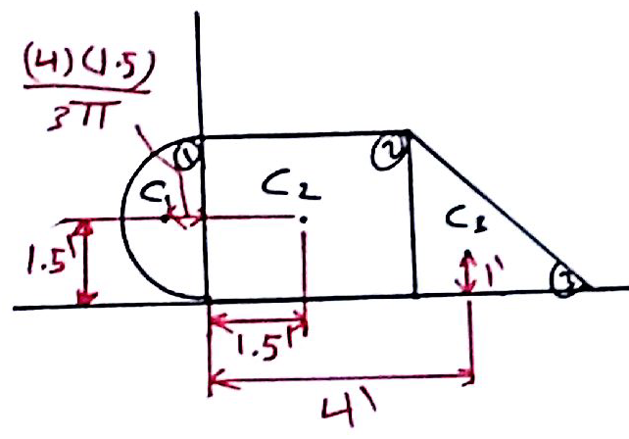
Composite Bodies
Statics
Example: problem 9-60
Solution
Decompose the area

Slide 9
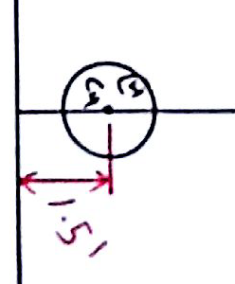
Composite Bodies
Statics
Example: problem 9-60
Solution
Decompose the area

Slide 10
Composite Bodies
Statics
Example: problem 9-51
Solution
Centroid location
Area | A
1 | (9/4)π | (2/π) | 1.5 | 4.5 | (27/8)π
2 | 9 | 1.5 | 1.5 | 13.5 | 13.5
3 | 4.5 | 4 | 1 | 18 | 4.5
4 | -π | 0 | 1.5 | -0 | -1.5π
∑ | 17.43 |  |  | 36 | 23.9

Slide 11
Composite Bodies
Statics
End of lecture
See you in the next lecture
Don’t forget to answer the quiz
Home
Next
Previous
End

