Slide 1

Statics
Chapter eight
8.4. resultant of distributed Loads-I
By
Laith Batarseh
Home
Next
Previous
End

Slide 2
resultant of distributed Loads
Statics
Definition
w
w
dF = dA
dx
w = w(x)
w = w(x)
x
x
x
L
L
Magnitude of resultant force
Location of resultant force
The centroid

Slide 3
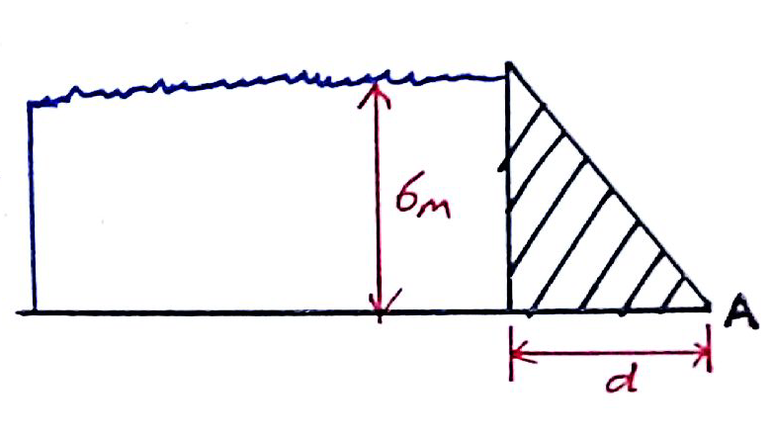
resultant of distributed Loads
Statics
Example[1]: problem 9-105
The concrete “gravity” dam is held in place by its own weight. If the density of concrete is 2.5 Mg/m³, and water has a density of 1 Mg/m³ , determine the smallest dimension d that will prevent the dam from overturning about its end A

Slide 4
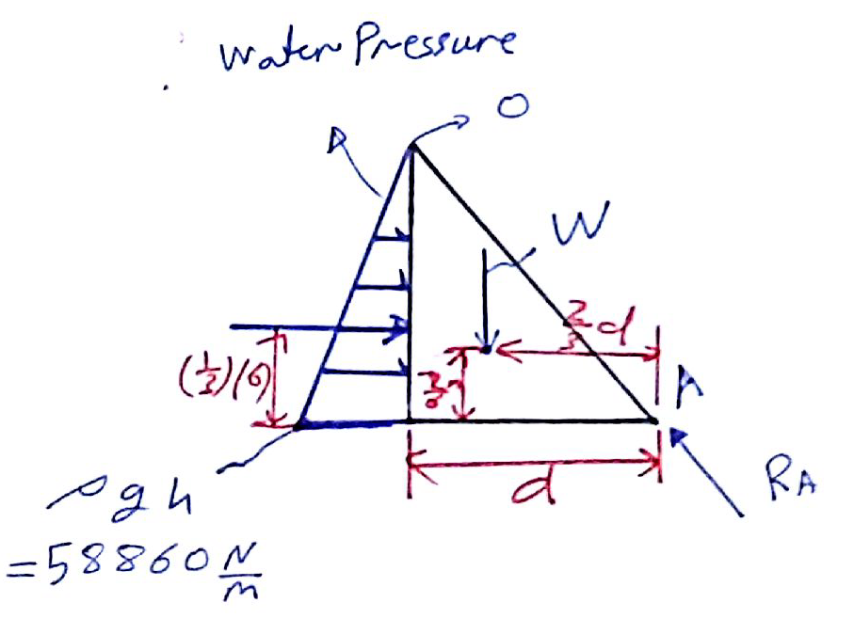
resultant of distributed Loads
Statics
Example[1]: problem 9-105
Solution
F.B.D
F

Slide 5
resultant of distributed Loads
Statics
Example[1]: problem 9-105
Solution
The pressure produced by the water depends on the depth and is related by:
P = ρ g h
Where :
ρ is water density
g is the gravitational acceleration
h is the depth
And so, the pressure will has a maximum value at the base of the dam where h=6m and zero at the surface . Mathematically:
P_{6m} = (1000)(9.81)(6) =58860 N/m

Slide 6
resultant of distributed Loads
Statics
Example[1]: problem 9-105
Solution
Now, let us relate the distributed pressure to force (F_{dis}):
F_{dis} = P*Area
Let the width of the dam equal 1m to have a unity area. So,
F_{dis} = P
Finally, the distributed load is reduced to a single force act at the centroid of loading area:
F = (0.5)(5886)(6) = 176580 N
Then, we can Find that the weight of the dam (w) can be found as:
W= (0.5)(d)(6)(1)(2500)(9.81) = 73575d

Slide 7
resultant of distributed Loads
Statics
Example[1]: problem 9-105
Solution
Apply the moment equilibrium equation at point A :
176580(2) = 73575 (2/3)d
d = 2.68 m (for each 1m depth of the dam)

Slide 8
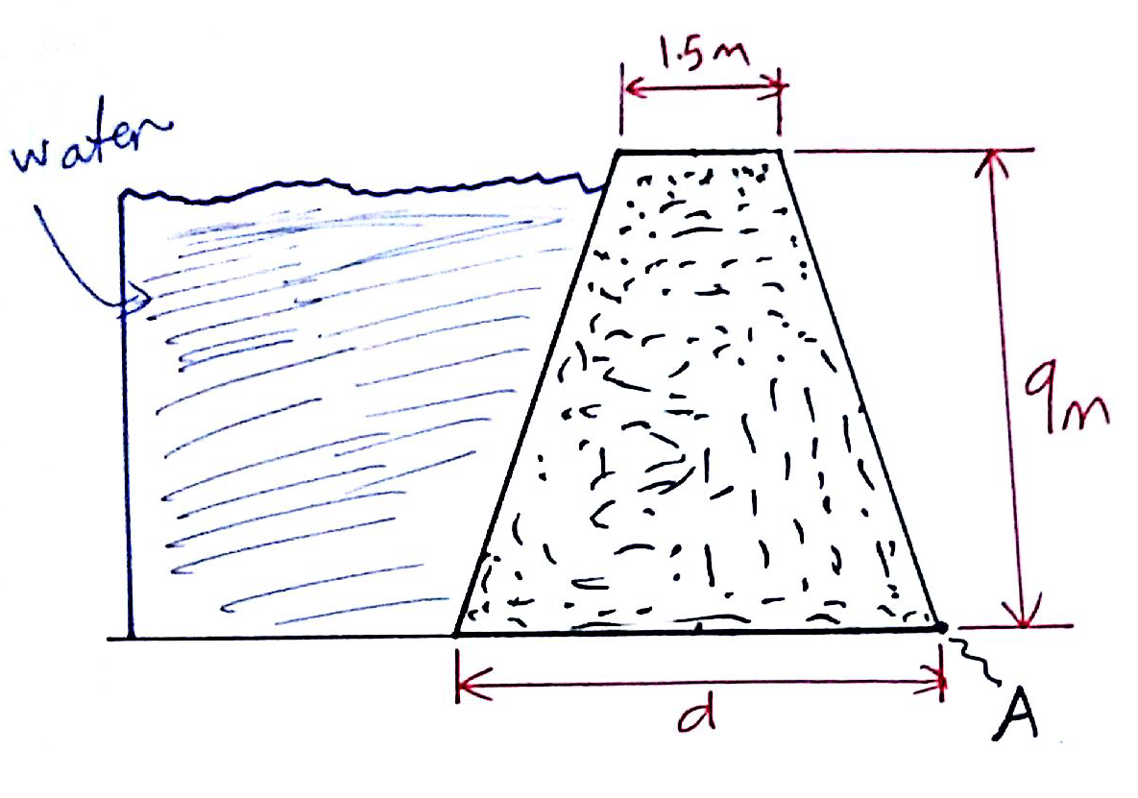
resultant of distributed Loads
Statics
Example[2]: problem 9-106
The symmetric concrete “gravity” dam is held in place by its own weight. If the density of concrete is 2.5 Mg/m³, and water has a density of 1 Mg/m³ , determine the smallest dimension d that will prevent the dam from overturning about its end A. The dam has a width of 8 m

Slide 9
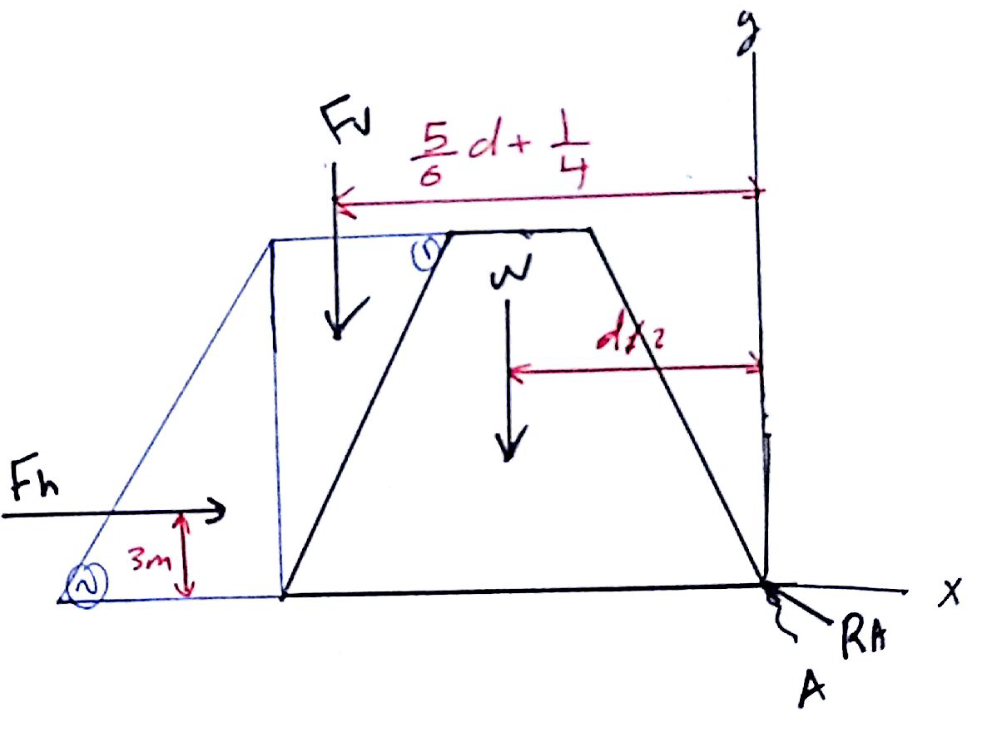
resultant of distributed Loads
Statics
Example[2]: problem 9-106
Solution
F.B.D
As you can see, the area (1) act as a weight at the dam surface and the area (2) apply a pressure at the same surface.

Slide 10
resultant of distributed Loads
Statics
Example[2]: problem 9-106
Solution
Area (1)
Area (2)
Dam weight (W)

Slide 11
resultant of distributed Loads
Statics
Example[2]: problem 9-106
Solution
Moment equation

Slide 12
resultant of distributed Loads
Statics
End of lecture
See you in the next lecture
Don’t forget to answer the quiz
Home
Next
Previous
End

