Slide 1

Statics
Chapter eight
8.4. resultant of distributed Loads-II
By
Laith Batarseh
Home
Next
Previous
End

Slide 2
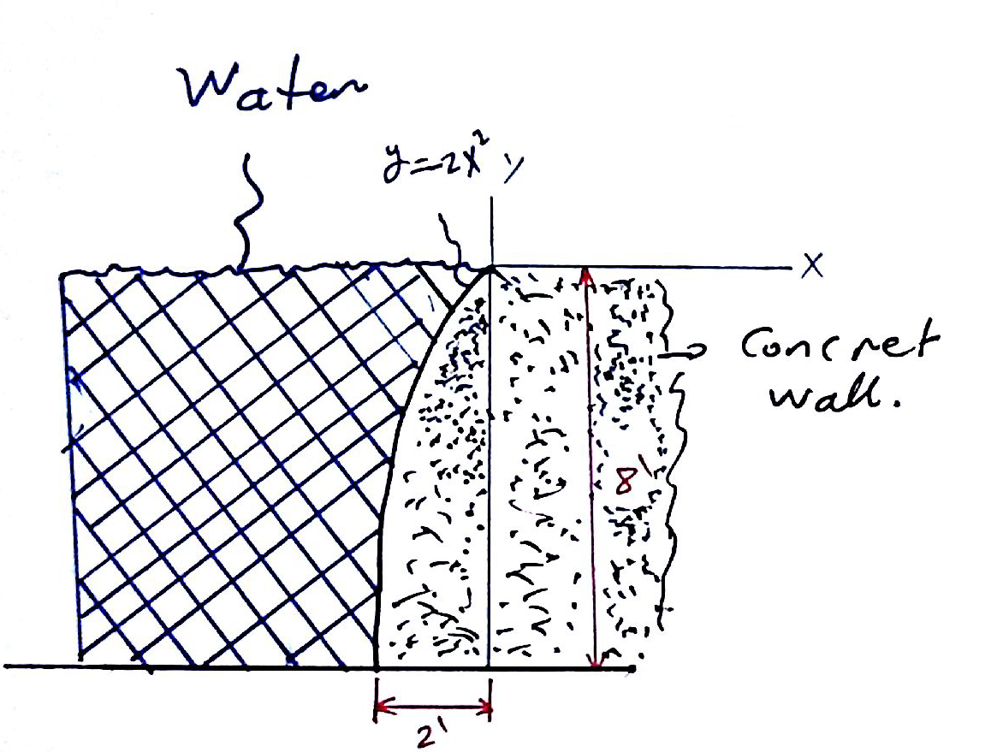
resultant of distributed Loads
Statics
Example[2]: problem 9-112
Determine the magnitude of the hydrostatic force acting per foot of length on the seawall.
γ_{w} = 62.4 lb/ft³.

Slide 3
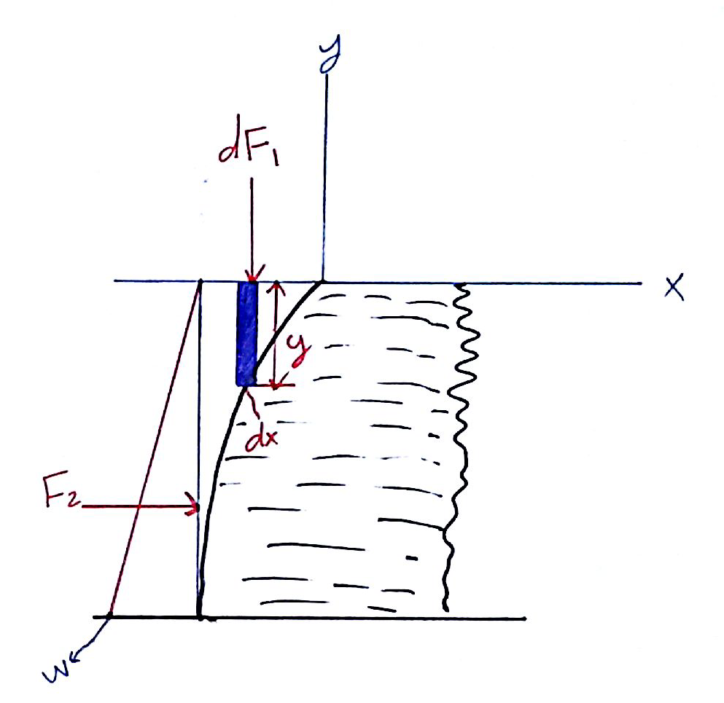
resultant of distributed Loads
Statics
Example[2]: problem 9-112
Solution
F.B.D

Slide 4
resultant of distributed Loads
Statics
Example[2]: problem 9-112
Solution
Area (1)
Area (2)
Resultant

Slide 5
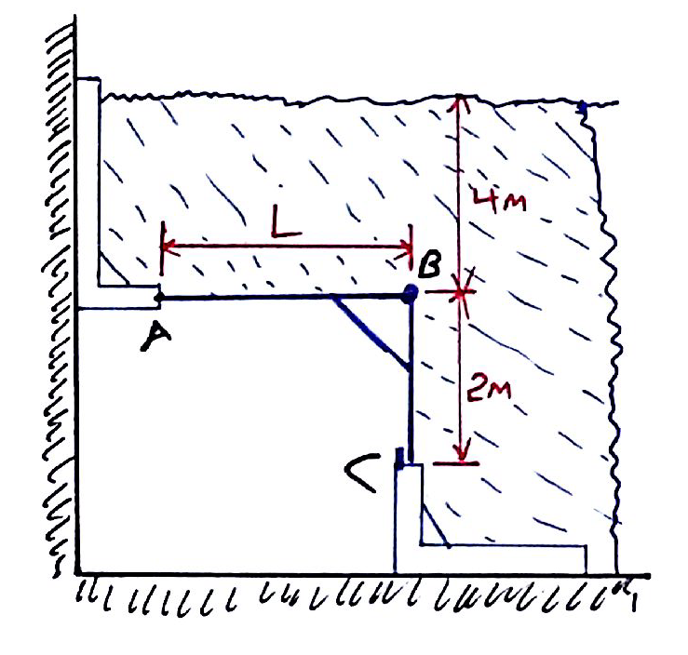
resultant of distributed Loads
Statics
Example[3]: problem 9-113
If segment AB of gate ABC is long enough, the gate will be on the verge of opening. Determine the length L of this segment in order for this to occur. The gate is hinged at B and has a width of 1 m. The density of water is ρ_{w} = 1 Mg/m³

Slide 6
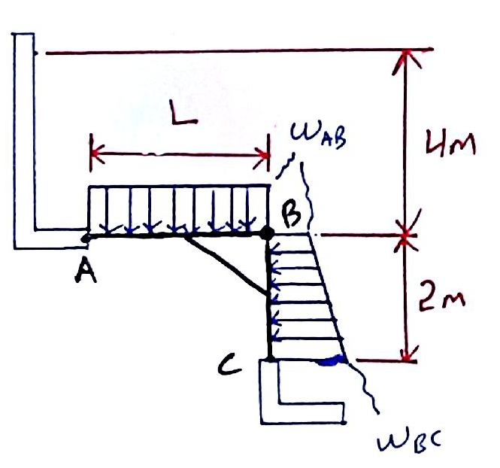
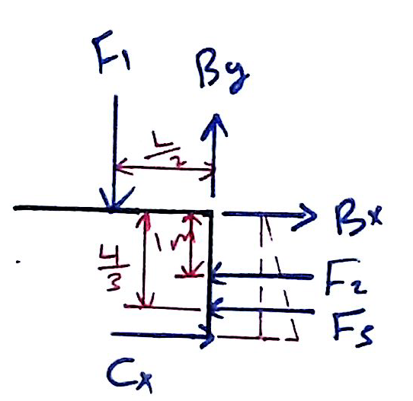
resultant of distributed Loads
Statics
Example[3]: problem 9-113
Solution
F.B.D

Slide 7
resultant of distributed Loads
Statics
Example[2]: problem 9-113
Solution
First, we have to find w_{AB} and w_{BC} from the relation between pressure and the depth:
Now we can find the concentrated loads

Slide 8
resultant of distributed Loads
Statics
Example[2]: problem 9-113
Solution
Moment equation
Finally apply equilibrium equation:
  Since the gate is verge of opening, Cx = 0
  Apply equilibrium moment equation at point B. by this step we eliminate the reactions at point B. assume counter clockwise is the positive direction :

Slide 9
resultant of distributed Loads
Statics
End of chapter
End of lecture
See you in the next lecture
Don’t forget to answer the quiz

