Slide 1

Statics
Chapter nine
9.2. Parallel - Axis Theorem
By
Laith Batarseh
Home
Next
Previous
End

Slide 2
Parallel - Axis Theorem
Statics
Parallel - Axis Theorem
This method is used to find the moment of inertia about an axis not passing in the centroid of the area.
The axis under study is parallel to axis passing through the centroid which the moment of inertia is known.

Slide 3
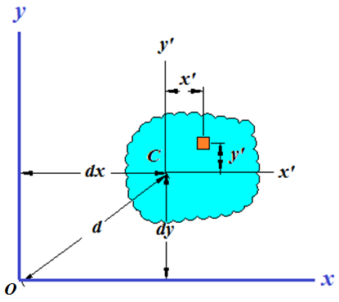
Parallel - Axis Theorem
Statics
Derivation

Slide 4
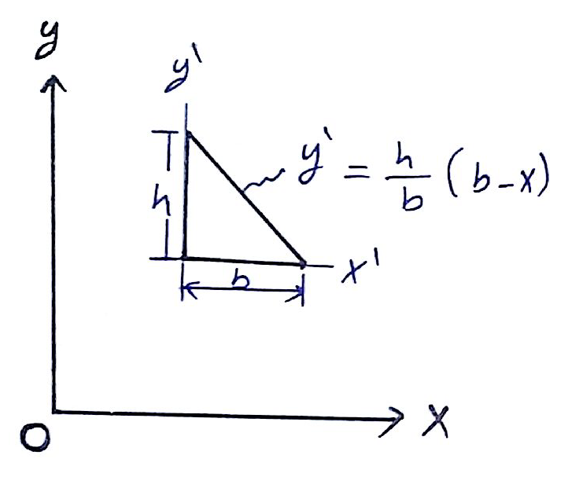
Parallel - Axis Theorem
Statics
Example [1]: Prob. 10-17
Determine the moment of inertia of the triangular area about the x, y, x’ and y’ axes .
β
α

Slide 5
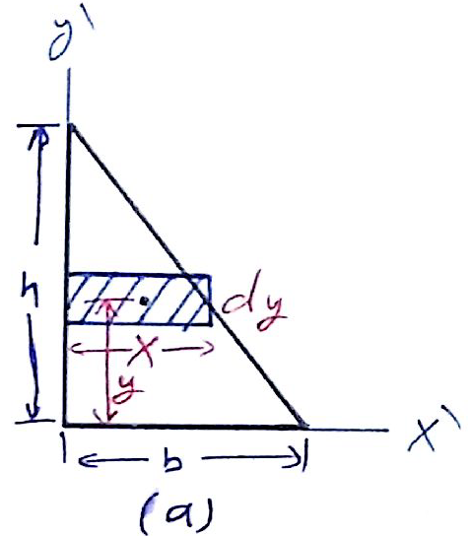
Parallel - Axis Theorem
Statics
Example [1]: Prob. 10-17
Solution
I_{x’}:

Slide 6
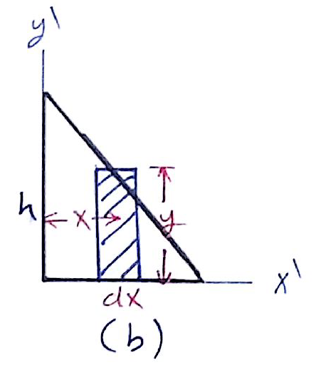
Parallel - Axis Theorem
Statics
Example [1]: Prob. 10-17
Solution
I_{y’}:

Slide 7
Parallel - Axis Theorem
Statics
Example [1]: Prob. 10-17
Solution
Parallel axis theorem

Slide 8
Parallel - Axis Theorem
Statics
Example [1]: Prob. 10-17
If we take the same problem however the distances α and β are from the centroid.

Slide 9
Parallel - Axis Theorem
Statics
End of lecture
See you in the next lecture
Don’t forget to answer the quiz
Home
Next
Previous
End

