Slide 1

Statics
Chapter nine
9.3. Radius of Gyration of an Area
By
Laith Batarseh
Home
Next
Previous
End

Slide 2
Radius of Gyration of an Area
Statics
Main concept
This is a method used to transfer any irregular area into regular one (rectangle or ring) that has no moment of inertia about its centroid and tend to rotate about a certain axis (for rectangular area) or about a point (for the ring area)

Slide 3
Radius of Gyration of an Area
Statics
Main concept
y
y
k_{y}
k_{x}
x
x

Slide 4
Radius of Gyration of an Area
Statics
Main concept
y
k
x
O

Slide 5
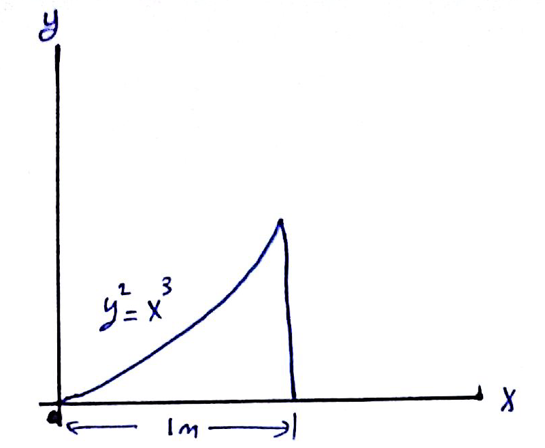
Radius of Gyration of an Area
Statics
Example [1]: Prob. 10-4
Find the radii of gyration : k_{x} and k_{y} for the following area

Slide 6
Radius of Gyration of an Area
Statics
Example [1]: Prob. 10-4
Solution

Slide 7
Radius of Gyration of an Area
Statics
Example [1]: Prob. 10-4
Solution

Slide 8
Radius of Gyration of an Area
Statics
Example [1]: Prob. 10-4
Solution

Slide 9
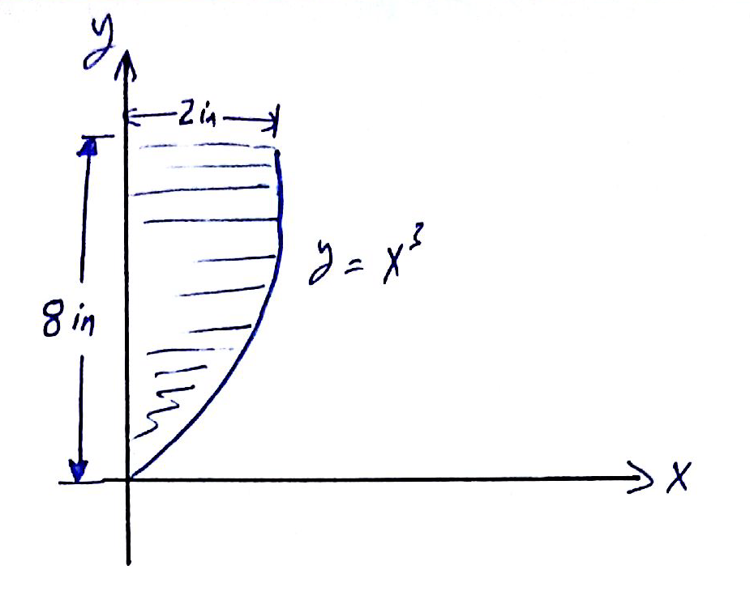
Radius of Gyration of an Area
Statics
Exercise : Prob. 10-11
Find the radii of gyration : k_{y}

Slide 10
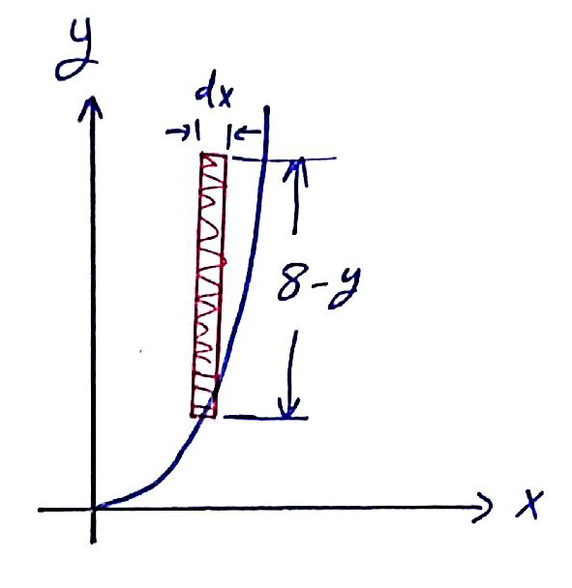
Radius of Gyration of an Area
Statics
Exercise : Prob. 10-11
Hint: the differential element can be drawn as shown below

Slide 11
Radius of Gyration of an Area
Statics
End of lecture
See you in the next lecture
Don’t forget to answer the quiz
Home
Next
Previous
End

