Slide 1

Statics
Chapter nine
9.4. Composite Areas
By
Laith Batarseh
Home
Next
Previous
End

Slide 2
Composite Areas
Statics
Main concept
Basic concept
Composite area are a series of simple shaped areas
The moment of inertia of the composite area is found by finding the moment of inertia for each shape and then sum these moments
to find the total moment of inertia, we chose a certain axis locates at the centroid of one of the simple areas. Then use the parallel axis theorem to find the moment of inertia of other areas about the chosen axis

Slide 3
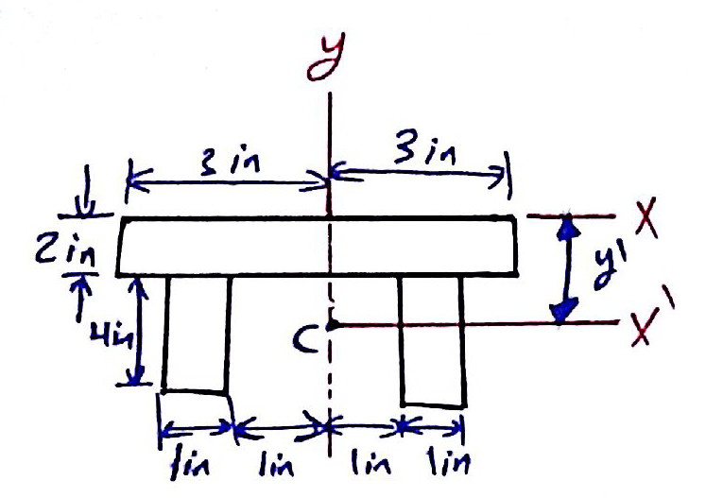
Composite Areas
Statics
Example [1]: Prob. 10-27
Determine the distance y’ to the centroid of the beam’s cross-sectional area; then find the moment of inertia about the x’ axis.

Slide 4
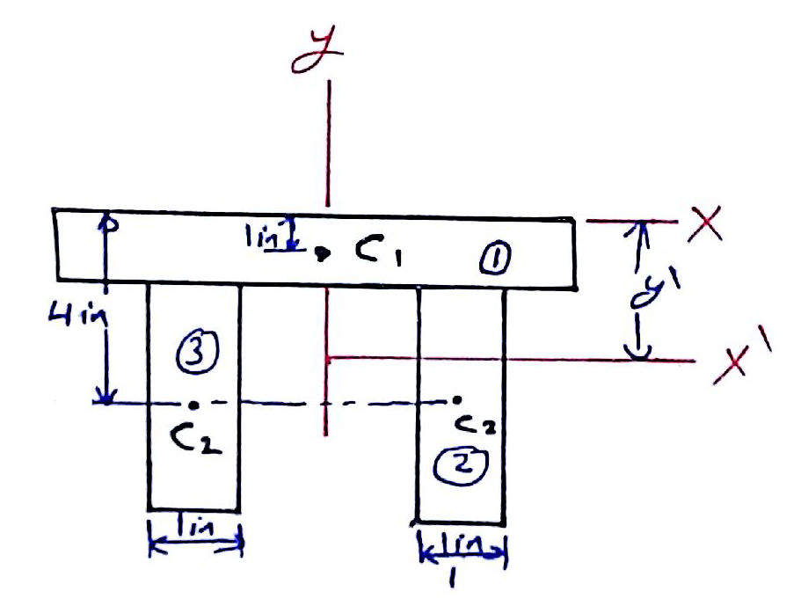
Composite Areas
Statics
Example [1]: Prob. 10-27
Solution

Slide 5
Composite Areas
Statics
Example [1]: Prob. 10-27
Solution
Centroid
Moment of inertia

Slide 6
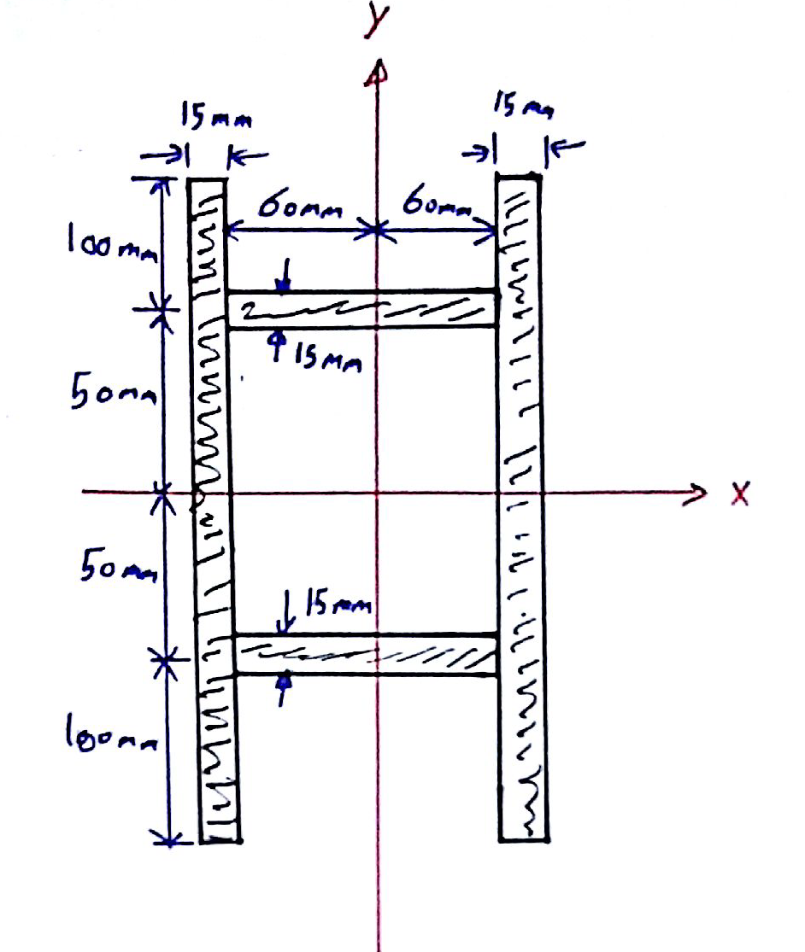
Composite Areas
Statics
Example [2]: Prob. 10-31
Determine the moment of inertia of the beam’s cross-sectional area about the y axis.

Slide 7
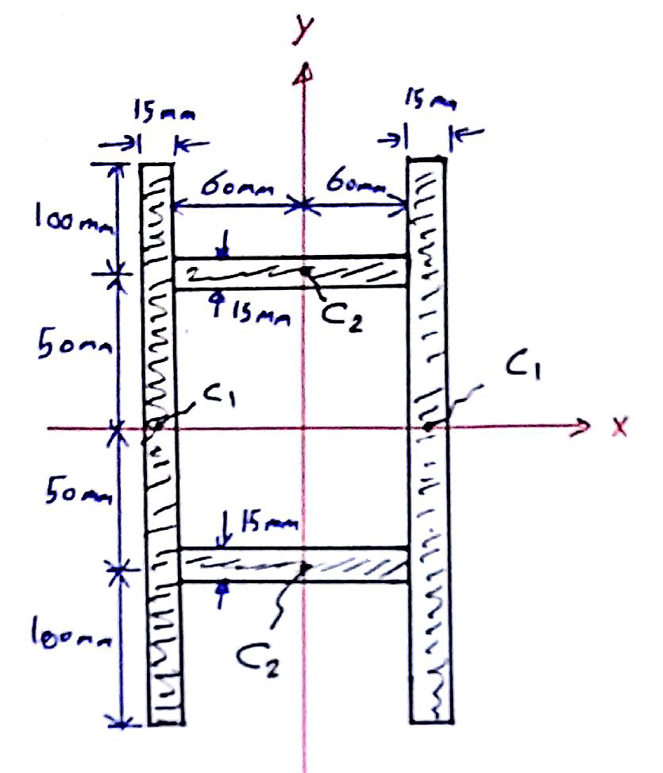
Composite Areas
Statics
Example [2]: Prob. 10-31
Solution

Slide 8
Composite Areas
Statics
Example [2]: Prob. 10-31
Solution
Moment of inertia

Slide 9
Composite Areas
Statics
End of lecture
See you in the next lecture
Don’t forget to answer the quiz
Home
Next
Previous
End

