Slide 1

Statics
Chapter nine
9.4. Composite Areas-II
By
Laith Batarseh

Slide 2
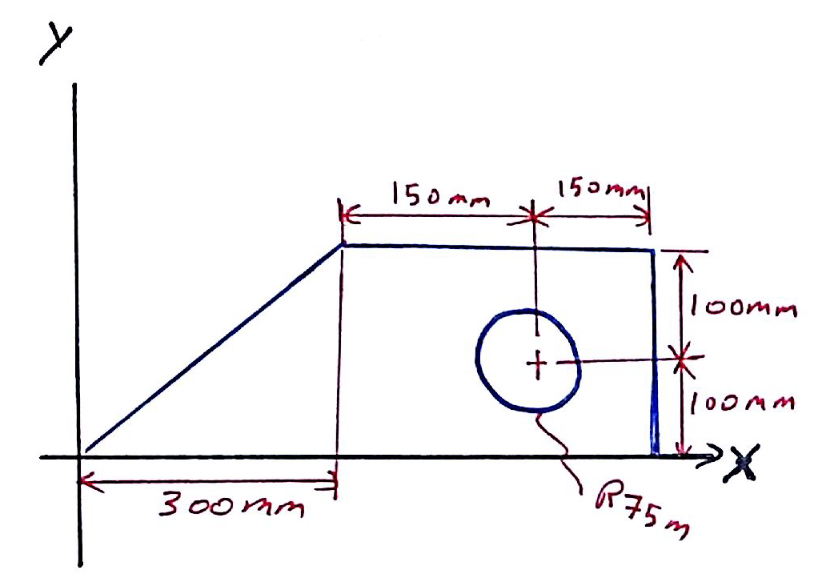
Composite Areas
Statics
Example [1]: Prob. 10-33
Determine the moment of inertia of the beam’s cross-sectional area about the y axis.

Slide 3
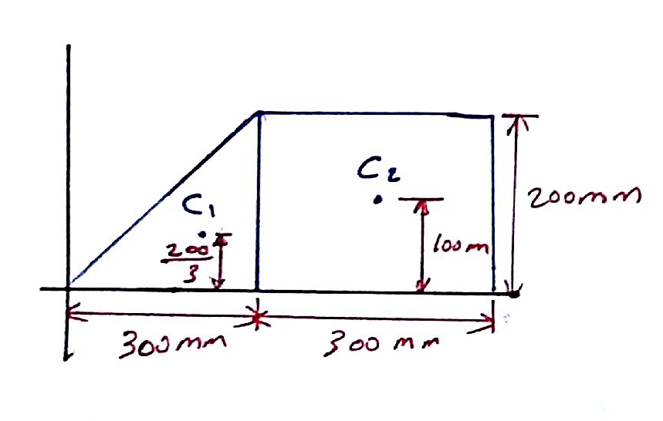
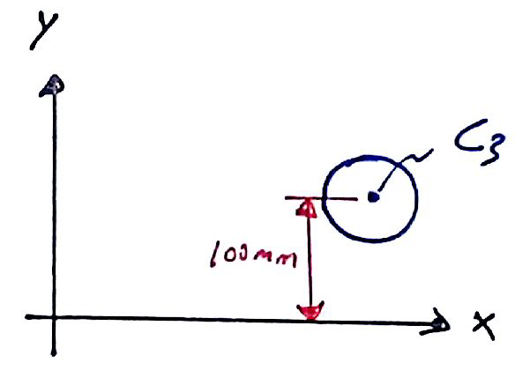
Composite Areas
Statics
Example [1]: Prob. 10-33
Solution
We can start with dividing this area into 3 different areas as shown below

Slide 4

Composite Areas
Statics
Example [1]: Prob. 10-33
Solution
Area (1) and (2)

Slide 5
Composite Areas
Statics
Example [1]: Prob. 10-33
Solution
Area (3)
Total inertia

Slide 6
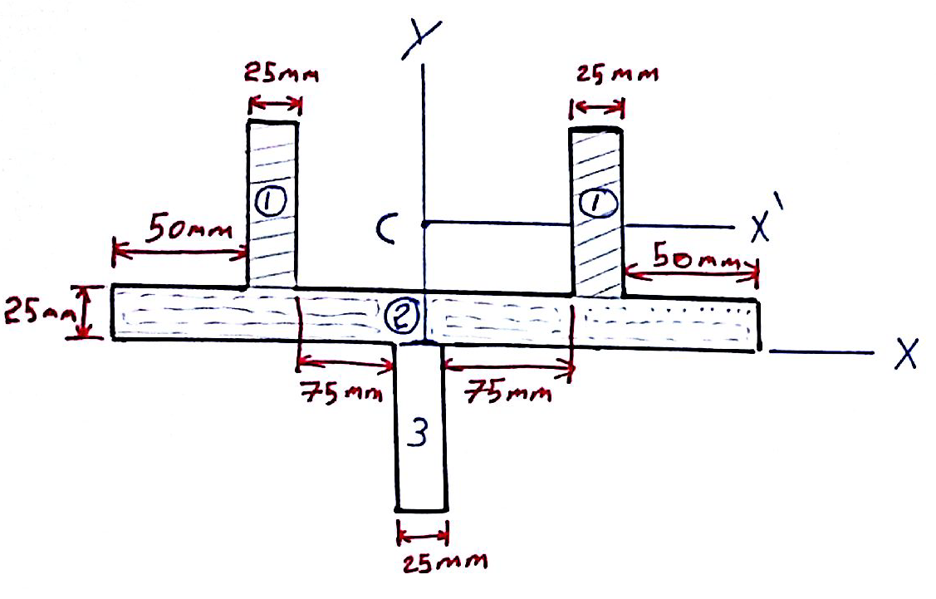
Composite Areas
Statics
Example [2]: Prob. 10-35
Determine the moment of inertia of the beam’s cross-sectional area about the y axis.

Slide 7
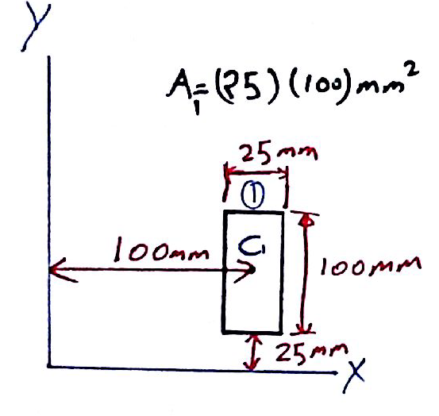
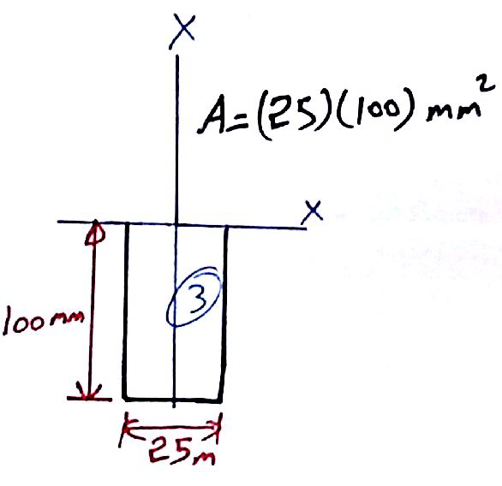
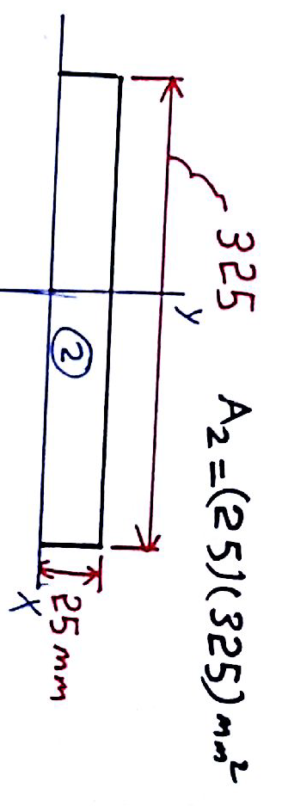
Composite Areas
Statics
Example [2]: Prob. 10-35
Solution
We can start with dividing this area into 3 different areas as shown below

Slide 8
Composite Areas
Statics
Example [2]: Prob. 10-35
Solution
Area (1)
Area (2)

Slide 9
Composite Areas
Statics
Example [2]: Prob. 10-35
Solution
Area (3)
Total inertia

Slide 10
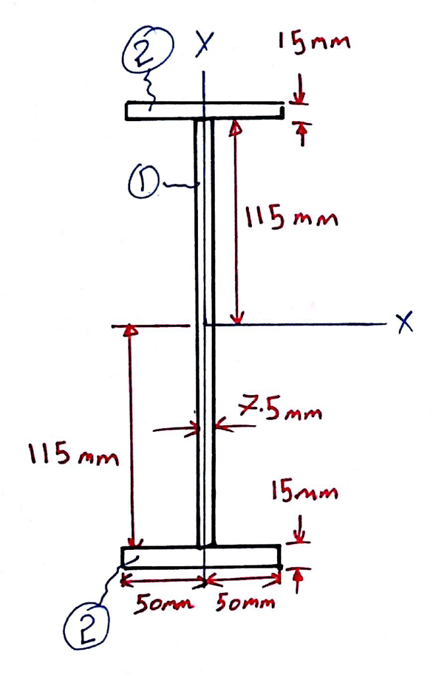
Composite Areas
Statics
Example [3]: Prob. 10-42
Determine the moment of inertia of the beam’s cross-sectional area about the y axis.

Slide 11
Composite Areas
Statics
Example [3]: Prob. 10-42
Solution
Because the y-axis passes through the centroids of all areas, we don’t need the parallel axis theorem and simply I_{y} equal:

Slide 12
Composite Areas
Statics
End of lecture
See you in the next lecture
Don’t forget to answer the quiz

