Slide 1

Statics
Chapter nine
9.5. product of inertia
By
Laith Batarseh

Slide 2
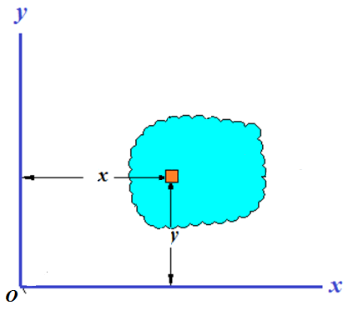
product of inertia
Statics
Product of inertia
Product of inertia (I_{xy}) is given as
Note that if the differential element was chosen in 2D (i.e. dA=dx.dy), then the integration about the area A is a double integral.

Slide 3
product of inertia
Statics
Product of inertia
Product of inertia (I_{xy}) is given as
Note that if the differential element was chosen in 1D, then the integration about the area A is a single integral (i.e.

Slide 4
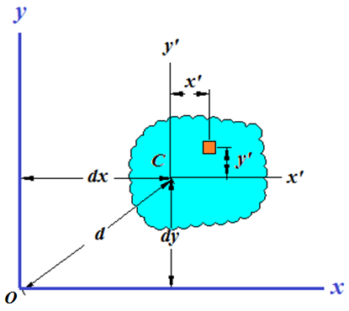
product of inertia
Statics
Parallel axis theorem
Apply the parallel axis theorem

Slide 5
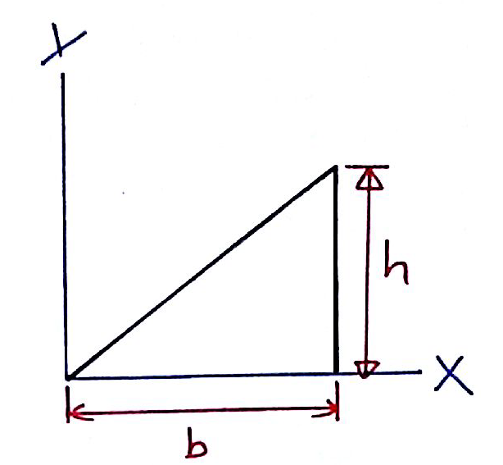
product of inertia
Statics
Example [10.6]
Determine the product of inertia I_{xy} for the given triangle

Slide 6
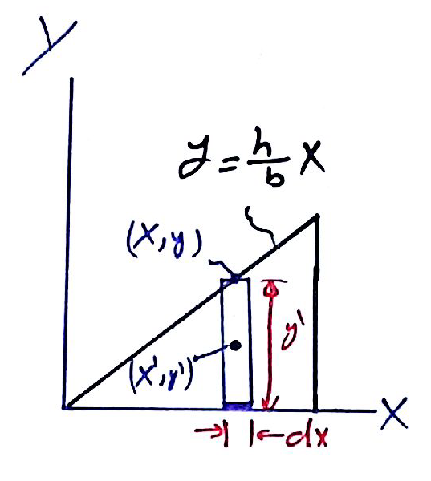
product of inertia
Statics
Example [10.6]
Solution
By taking a vertical differential element as shown
By taking a differential element for dI_{xy}:
The first term equal zero due to the symmetry in the area and the 2nd term can be expressed as:

Slide 7
product of inertia
Statics
Example [10.6]
Solution
Express yin terms of x:
The differential element of product of inertia is expressed as:
Finally, integrate dI_{xy} from 0 to b:

Slide 8
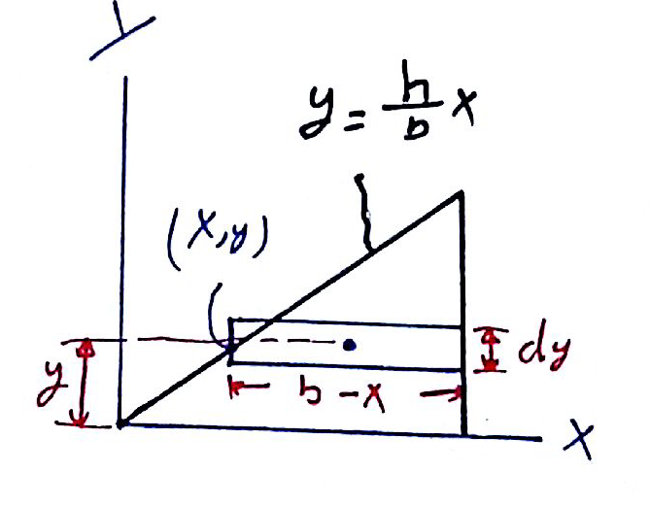
product of inertia
Statics
Example [10.6]
Solution
We can solve the same problem by taking a horizontal element instead of vertical one as shown.

Slide 9
product of inertia
Statics
Example [10.6]
Solution
The term dA(dx)(dy):

Slide 10
product of inertia
Statics
Example [10.6]
Solution
The differential element of product of inertia is expressed as:
Finally, integrate dI_{xy} from 0 to b:

Slide 11
product of inertia
Statics
End of lecture
See you in the next lecture
Don’t forget to answer the quiz

