Slide 1

Statics
Chapter nine
9.6. mass moment of inertia - II
By
Laith Batarseh

Slide 2
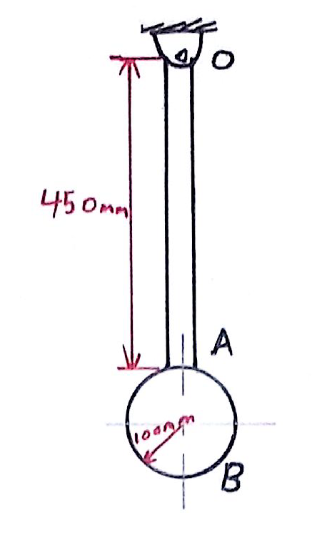
mass moment of inertia
Statics
Example [1]: problem 10-100
Determine the mass moment of inertia of the pendulum about an axis perpendicular to the page and passing through point O. The slender rod has a mass of 10 kg and the sphere has a mass of 15 kg.

Slide 3
mass moment of inertia
Statics
Example [1]: problem 10-100
Solution
This body consisted from to bodies: A (rood) and B(sphere) and the mass moment of inertia about an axis pass through point O. this means applying the parallel axis theorem.
Body A

Slide 4
mass moment of inertia
Statics
Example [1]: problem 10-100
Solution
Body B
Total

Slide 5
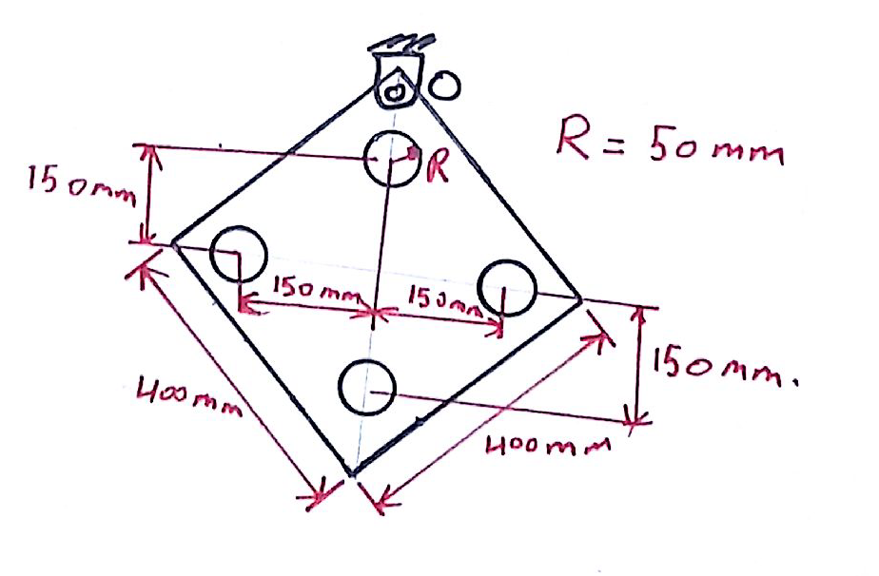
mass moment of inertia
Statics
Example [2]: problem 10-110
Determine the mass moment of inertia of the thin plate about an axis perpendicular to the page and passing through point O. The material has a mass per unit area of 20 kg.m².

Slide 6
mass moment of inertia
Statics
Example [2]: problem 10-110
Solution
This body consisted from to 5 bodies: the plate and 4holes the mass moment of inertia about an axis pass through point O. this means applying the parallel axis theorem.
Mass moment of inertia about the centroid
Solid plate mass:-
Solid plate mass amount of inertia :-

Slide 7
mass moment of inertia
Statics
Example [2]: problem 10-110
Solution
Hole mass:-
Holes mass amount of inertia :-
Total mass moment of inertia about the centroid :-

Slide 8
mass moment of inertia
Statics
Example [2]: problem 10-110
Solution
Total mass moment of inertia about the point O using parallel axis theorem :-
Where d is the distance between the centroid and the rotating point:-
m is the total mass of the system = 3.6 – (4)(0.157) = 2.572 kg

Slide 9
mass moment of inertia
Statics
End of lecture
See you in the next lecture
Don’t forget to answer the quiz

