Slide 1

Sequence 01: Real Numbers
Session one
Pre – calculus preview

Slide 2
Goals of Session One
Success in calculus depends to a large extent on knowledge of the mathematics that precedes calculus: algebra, analytic geometry, functions, and trigonometry.
The following subjects (sequences) are intended to refresh your skills
in these areas.

Slide 3
References of Session One
James Stewart, Calculus: Early Transcendentals, 7th Edition, Brooks/ Cole 2012.
Howard Anton, Irl C. Bivens and Stephen Davis, Calculus: Early Transcendentals, 9th Edition, John Wiley & Sons, Inc. 2010.
Salas, Etgen, and Hille, Calculus: One and Several Variables, 10th Edition, John Wiley &
Sons, Inc. 2007.

Slide 4
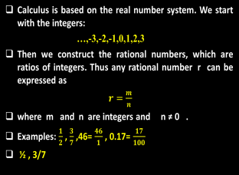

Sequence 01: Real Numbers
Calculus is based on the real number system. We start with the integers:
…,-3,-2,-1,0,1,2,3
Then we construct the rational numbers, which are ratios of integers. Thus any rational number r can be expressed as
$r=\frac{m}{n}$
where m and n are integers and n ≠ 0 .
Examples: $\frac{1}{2}$ , $\frac{3}{7}$ ,46= $\frac{46}{1}$ , 0.17= $\frac{17}{100}$
½ , 3/7

Slide 5

Sequence 01: Real Numbers
Some real numbers, such as $\sqrt{2 }$,can’t be expressed as a ratio of integers and are therefore called irrational numbers.
The following are also irrational numbers:$\sqrt[3]{2}$ , $π,\sin{1}$
The set of all real numbers is usually denoted by the symbol $ℝ$ .
Any real number is either rational number or irrational number but not both.

Slide 6

Sequence 01: Real Numbers
Every number has a decimal representation. If the number is rational, then the corresponding decimal is repeating. For example,
$\frac{1}{2}$ =0.500…= 0.50,$\frac{2}{3}$ =0.666…=0.6,$\frac{9}{7}$ =1.285714
On the other hand, if the number is irrational, the decimal is nonrepeating:
$\sqrt{2}$ =1.414213562373095…
π = 3.141592653589793…

Slide 7
Sequence 01: Real Numbers
The real numbers can be represented by points on a line as in the figure.
The number associated with the point ρ is called the coordinate of ρ and the line is then called a coordinate line, or a real number line, or simply a real line.
The real numbers are ordered.

Slide 8

Sequence 01: Real Numbers
In what follows we need to use set notation.
A set is a collection of objects, and these objects are called the elements of the set.
If S is a set, the notation a$∈S$ means that a is an element of S ,and a$∉S$ means that a is not an element of S .
For example, if $ℤ$ represents the set of integers, then -3$εℤ$ but $π∉ℤ$ .

Slide 9

Sequence 01: Real Numbers
If S and T are sets, then their union is the set S$∪T$ consisting of all elements that are in S or T or in both.
The intersection of S and T is the set S $∩T$ consisting of all elements that are in both S and T .
The empty set, denoted by $∅$ , is the set that contains no element.
Certain sets of real numbers, called intervals, occur frequently in calculus and correspond
geometrically to line segments.

Slide 10



Sequence 01: Real Numbers
For example, if a$<b$, the open interval from a to b consists of all numbers between a and b and is denoted by the symbol $(a,b)$ , and we can write
$(a,b)$= { x : a < x < b }
The closed interval from a to b is the set
[a,b] = { x : $a$ $≤x≤b\}$
It is also possible to include only one endpoint in an interval,
as shown in the following table.

Slide 11
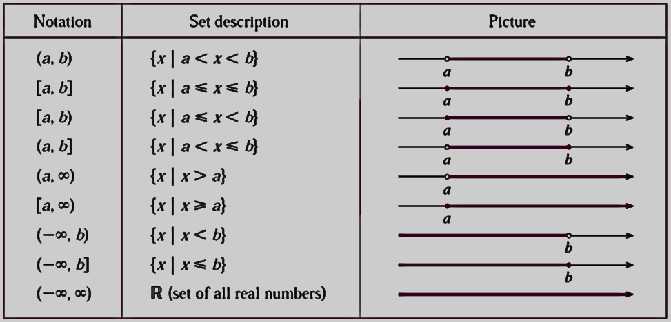
Sequence 01: Real Numbers

Slide 12
Thank you for your Attention

