Slide 1

Session one
Pre – calculus preview
Sequence 03: Absolute Value

Slide 2
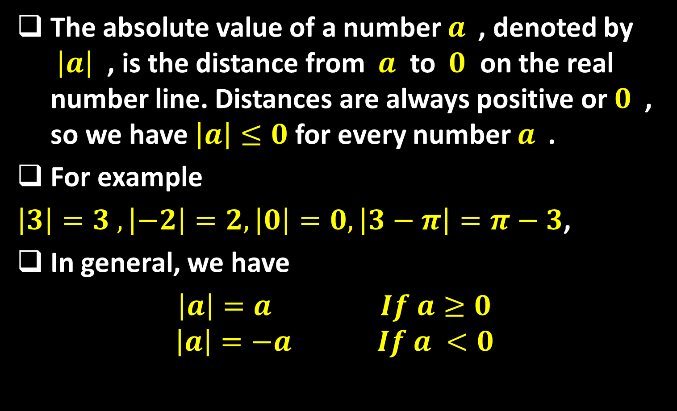
Sequence 03: Absolute Value
The absolute value of a number $a$ , denoted by $\left|a\right|$ , is the distance from $a$ to $0$ on the real number line. Distances are always positive or $0$ , so we have $\left|a\right|≤0$ for every number $a$ .
For example
$\left|3\right|=3 , \left|−2\right|=2, \left|0\right|=0, \left|3−π\right|=π−3$,
In general, we have
$\left|a\right|=a$ $If a≥0$
$$\left|a\right|=−a If a <0$$

Slide 3

Sequence 03: Absolute Value
Example: Express $\left|3x−2\right|$without using the absolute value symbol.
Solution:
$$\left|3x−2\right|= \left\{\begin{aligned}3x−2 if 3x−2≥0 \\ −\left(3x−2\right) if 3x−2<0\end{aligned}\right.$$
= $\left\{\begin{aligned}3x−2 if x≥\frac{2}{3} \\ 2−3x if x<\frac{2}{3}\end{aligned}\right.$

Slide 4
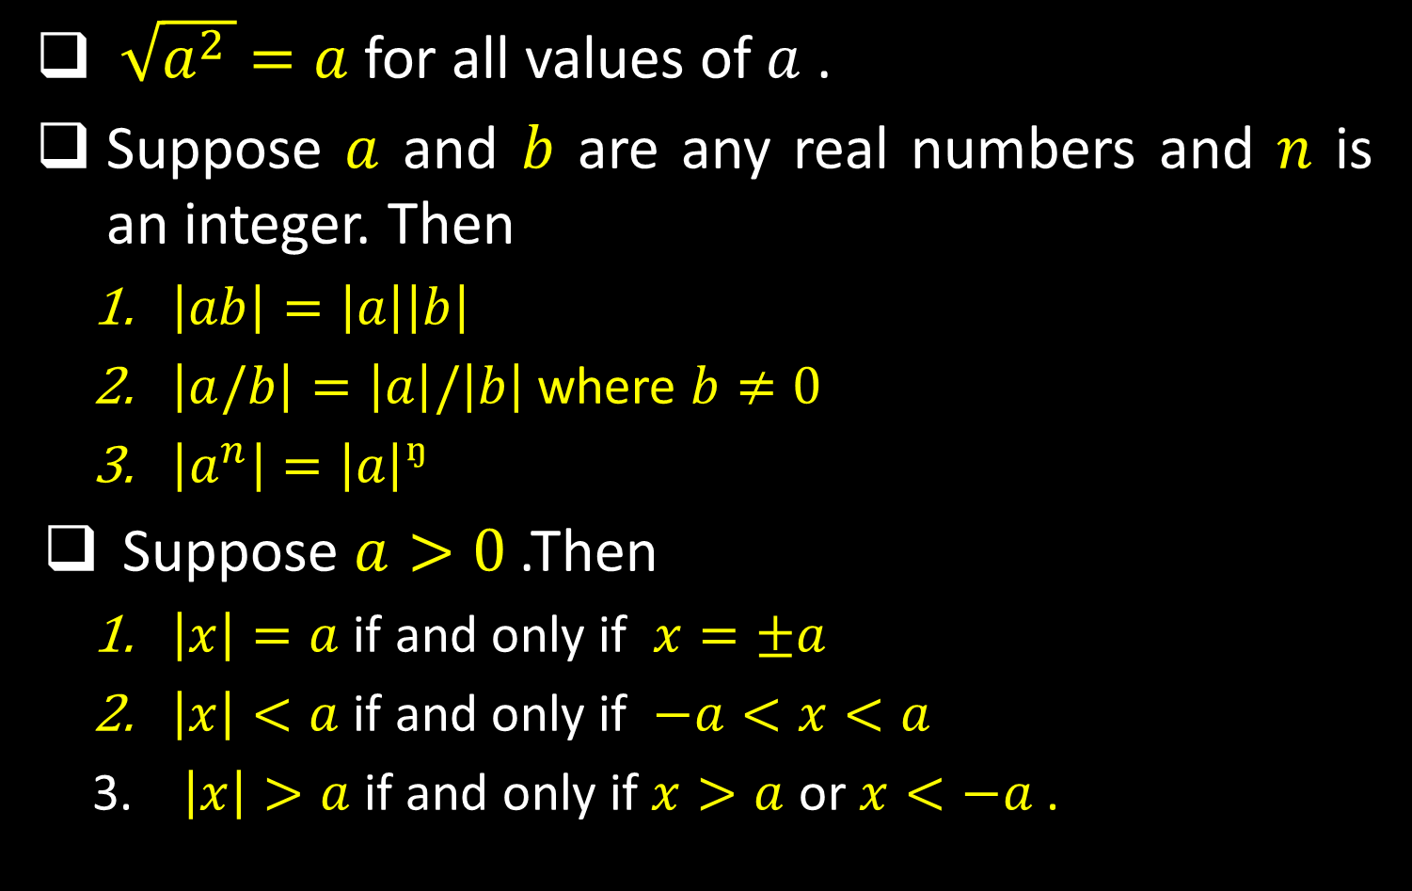
Sequence 03: Absolute Value
$\sqrt{a^{2 }}$ $=a$ for all values of $a$ .
Suppose $a$ and $b$ are any real numbers and $n$ is an integer. Then
  $\left|ab\right|=\left|a\right|\left|b\right|$
  $\left|a/b\right|=\left|a\right|/\left|b\right|$ where $b≠0$
  $\left|a^{n}\right|=\left|a\right|ᵑ$
Suppose $a>0$ .Then
  $\left|x\right|=a$ if and only if $x=±a$
  $\left|x\right|<a$ if and only if $−a<x<a$
  $\left|x\right|>a$ if and only if $x>a$ or $x<−a$ .

Slide 5

Sequence 03: Absolute Value
Example: Solve $\left|2x−5\right|=3$ .
Solution: By property 1 from the third group,
$\left|2x−5\right|=3$
is equivalent to $2x−5=3$ or$2x−5=−3$ .
So $2x=8$ or $2x=2$ . Thus $x=4$ or $x=1$ .

Slide 6

Sequence 03: Absolute Value
Example: Solve $\left|x−5\right|<2$ .
Solution: By property 2 from the third group,
$\left|x−5\right|<2$
is equivalent to
$2<x−5<−2$
Therefore, adding 5 to each side, we have
$3<x<7$
and the solution set is the open interval $(3,7)$ .

Slide 7
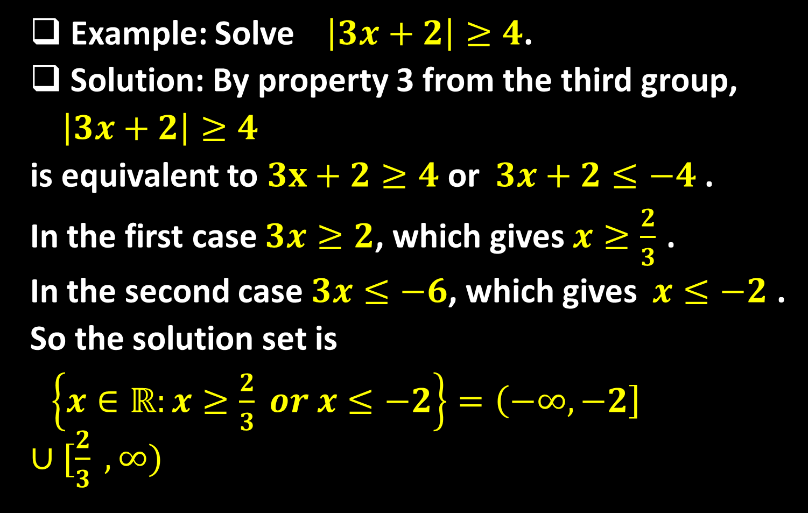
Sequence 03: Absolute Value
Example: Solve $\left|3x+2\right|≥4$.
Solution: By property 3 from the third group,
$\left|3x+2\right|≥4$
is equivalent to $3x+2≥4$ or $3x+2≤−4$ .
In the first case $3x≥2$, which gives $x≥\frac{2}{3}$ .
In the second case $3x≤−6$, which gives $x≤−2$ .
So the solution set is
$\left\{x∈ℝ:x≥\frac{2}{3} or x≤−2\right\}=\left(−∞,−2\right]∪[\frac{2}{3} ,∞)$

Slide 8

Sequence 03: Absolute Value
Another important property of absolute value, called the Triangle Inequality, is used frequently not only in calculus but throughout mathematics in general.
The Triangle Inequality If a and b are any real number , then
$\left|a+b\right|≤\left|a\right|+\left|b\right|$
Observe that if the numbers and are both positive or both negative, then the two sides in the Triangle Inequality are actually equal. But if and have opposite signs , the left side involves a
subtraction and the right side does not.

Slide 9
Thank you for your Attention

