Slide 1

Session one
Pre – calculus preview
Sequence 04: Coordinate Geometry

Slide 2

Sequence 04: Coordinate Geometry
Just as the points on a line can be identified with real numbers by assigning them coordinates, as described in Sequence 01, so the points in a plane can be identified with ordered pairs of real numbers.
We start by drawing two perpendicular coordinate lines that intersect at the origin $Ο$ on each line.
Usually one line is horizontal with positive direction to the right and is called the $x−$axis; the other line is vertical with positive
direction upward and
is called the $y−$axis.

Slide 3
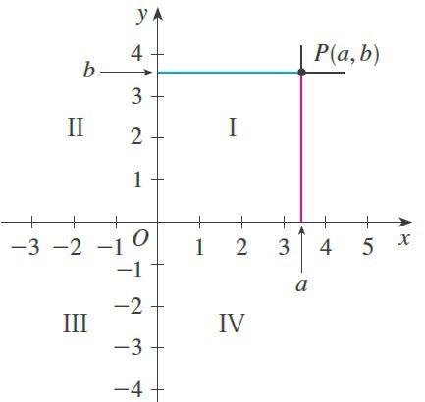
Sequence 04: Coordinate Geometry
Any point in the plane can be located by a unique ordered pair of numbers as follows.
  Draw lines through perpendicular to the and axes.
  These lines intersect the axes in points with coordinates and as shown in the figure below.

Slide 4
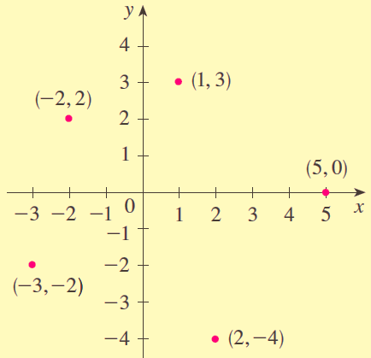

Sequence 04: Coordinate Geometry
  Then the point $P$ is assigned the ordered pair $(a,b)$.
  The first number $a$ is called the $x−$ coordinate of $P$ ; the second number$b$ is called the $y−$coordinate of.
  Several points are labeled with their coordinates in the figure below.

Slide 5

Sequence 04: Coordinate Geometry
This coordinate system is called the rectangular coordinate system or the Cartesian coordinate system.
The plane supplied with this coordinate system is called the coordinate plane or the Cartesian plane and is denoted by $ℝ^{2}$ .
The $x−$ and $y−$ axes are called the coordinate axes and divide the Cartesian plane into four quadrants, which are labeled I, II, III, and IV in the first figure.
Notice that the first quadrant consists of those points whose $x−$ and
$y−$ coordinates are both positive.

Slide 6
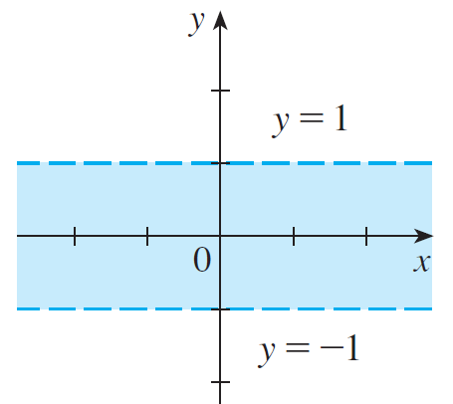

Sequence 04: Coordinate Geometry
Example: Describe and sketch the region given by the set $\left\{\left(x,y\right)∈ℝ^{2}:\left|y\right|<1\right\}$ .
Solution: Recall from Sequence 03 that $\left|y\right|<1$ if and only if $−1<y<1$ . The given region consists of those points in the plane whose $y−$coordinates lie between -1 and 1 . Thus the region consists of all points that lie between (but not on) the horizontal
lines $y=−1$ and $y=1$.

Slide 7
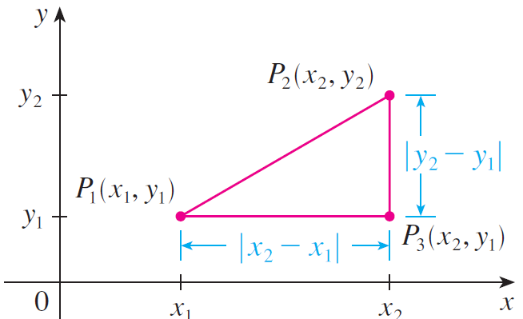

Sequence 04: Coordinate Geometry
The distance formula between the points $P_{1}(x_{1},y_{1})$ and $P_{2}(x_{2},y_{2})$is
Notice from the figure above, the distance between points$P_{1}(x_{1},y_{1})$ and $P_{3}(x_{2},y_{1})$ on a horizontal line must be $\left|x_{2}−x_{1}\right|$ and the distance between $P_{2}(x_{2},y_{2})$ and $P_{3}(x_{2},y_{1})$ on a vertical line must be $\left|y_{2}−y_{1}\right|$.

Slide 8

Sequence 04: Coordinate Geometry
Example: Find the distance between the two points $(1,−2)$ and $(5,3)$ .
Solution: The distance is
$\sqrt{{(5−1)}^{2}−{(3−\left(−2\right))}^{2}} =\sqrt{4^{2}+5^{2}} = \sqrt{41}$

Slide 9
Thank you for your Attention

