Slide 1

Session one
Pre – calculus preview
Sequence 05: Lines

Slide 2

Sequence 05: Lines
We want to find an equation of a given line $L$ .
Such an equation is satisfied by the coordinates of the points on $L$ and by no other point.
To find the equation of $L$ we use its slope, which is a measure of the steepness of the line.
Definition: The slope of a non-vertical line that passes through the points $(x_{1},y_{1})$ and $(x_{2},y_{2})$ is $m=\frac{Δy}{Δx}=\frac{y_{2}−y_{1}}{x_{2}−x_{1}}$ .
The slope of a vertical line is not defined,
and the slope of a horizontal line is $0$ .

Slide 3
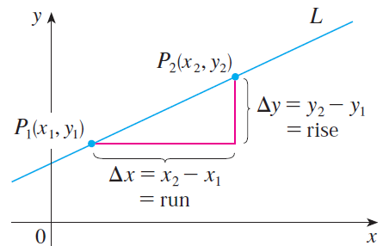
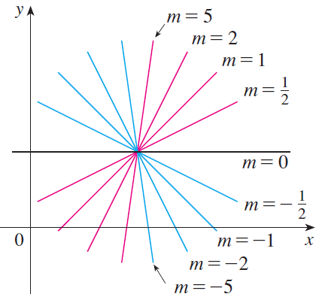

Sequence 05: Lines
Thus the slope of a line is the ratio of the change in$y$ , $∆y$ , to the change in $x$ ,$∆x$ , see the figure below.
The second figure above shows several lines labeled with their slopes. Notice that lines with positive slope slant upward to the right, whereas lines with negative slope slant downward to the right.

Slide 4

Sequence 05: Lines
Now let’s find an equation of the line that passes through a given point $P_{1}(x_{1},y_{1})$ and has slope $m$.
Point-Slope Form of the Equation of a Line: An equation of the line passing through the point $P_{1}(x_{1},y_{1})$ and having slope $m$ is
$$y−y_{1}=m(x−x_{1})$$

Slide 5

Sequence 05: Lines
Example: Find an equation of the line through $(1,−7)$ with slope $−\frac{1}{2}$ .
Solution: Using the point-slope form with
$m=−\frac{1}{2}$ , $x=1$, and $y_{1}=−7$ .
we obtain an equation of the line as
$y+7=−\frac{1}{2}(x−1)$
which we can rewrite as
$x+2y+13=0$

Slide 6

Sequence 05: Lines
Example: Find an equation of the line through the points $(−1,2)$ and $(3,−4)$ .
Solution: By the definition of the slope, the slope of the line is
$m=\frac{−4−2}{3−(−1)}=−\frac{3}{2}$
Using the point-slope form with and , we obtain
$y−2=−\frac{3}{2}(x−\left(−1\right))$
which simplifies to
$3x+2y=1$

Slide 7

Sequence 05: Lines
Parallel and Perpendicular Lines:
  Two non-vertical lines are parallel if and only if they have the same slope.
  Two lines with slopes $m_{1}$ and $m_{2}$ are perpendicular if and only if $m_{1}$ $m_{2}=−1$ ; that is, their slopes are negative reciprocals:
$m_{2}=−\frac{1}{m_{1}}$

Slide 8
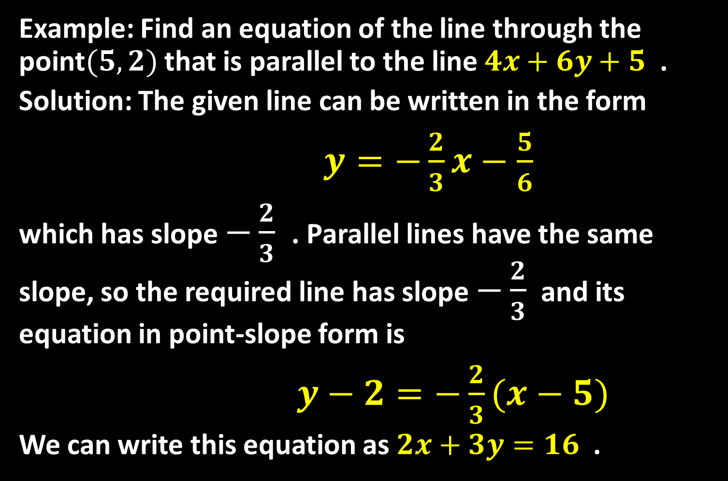
Sequence 05: Lines
Example: Find an equation of the line through the point$(5,2)$ that is parallel to the line $4x+6y+5$ .
Solution: The given line can be written in the form
$y=−\frac{2}{3}x−\frac{5}{6}$
which has slope $−\frac{2}{3}$ . Parallel lines have the same slope, so the required line has slope $−\frac{2}{3}$ and its equation in point-slope form is
$y−2=−\frac{2}{3}(x−5)$
We can write this equation as $2x+3y=16$ .

Slide 9

Sequence 05: Lines
Example: Show that the lines $6x−4y−1=0$ and $2x+3y=1$ are perpendicular.
Solution: The equations can be written as
$y=−\frac{2}{3}x+\frac{1}{3}$ and $y=\frac{3}{2}x−\frac{1}{4}$
from which we see that the slopes are
$m_{1}=−\frac{2}{3}$ and $m_{2}=\frac{3}{2}$
Since $m_{1} ×m_{2}=−1$
the lines are perpendicular.

Slide 10
Thank you for your Attention

