Slide 1

Session one
Pre – calculus preview
Sequence 06: Trigonometry (Part 1)

Slide 2
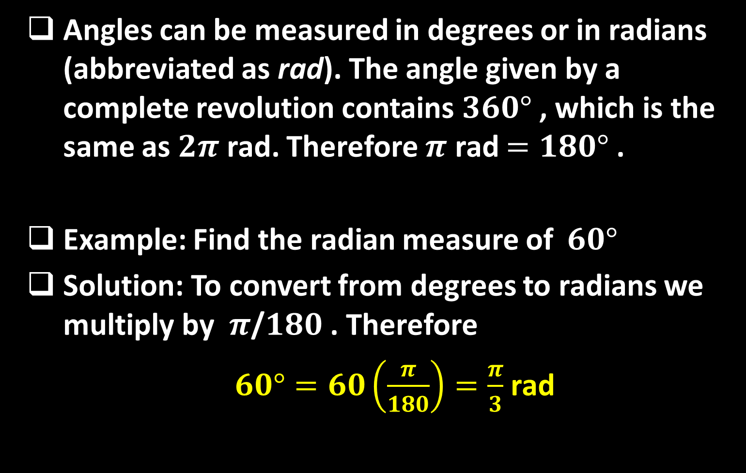
Sequence 06: Trigonometry (Part 1)
Angles can be measured in degrees or in radians (abbreviated as rad). The angle given by a complete revolution contains $360°$ , which is the same as $2π$ rad. Therefore $π$ rad $=180°$ .
Example: Find the radian measure of $60°$
Solution: To convert from degrees to radians we multiply by $π$/$180$ . Therefore
$60°=60\left(\frac{π}{180}\right)=\frac{π}{3}$rad

Slide 3
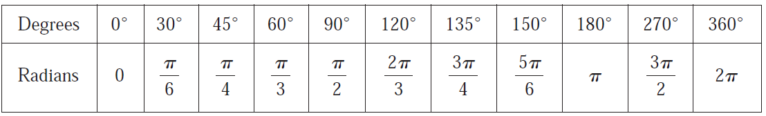

Sequence 06: Trigonometry (Part 1)
Example: Express $5π/4$ rad in degrees.
Solution: To convert from radians to degrees we multiply by $180/π$ . Thus
$\frac{5π}{4}$ rad $=\frac{5π}{4}\left(\frac{180}{π}\right)=225°$
The following table gives the correspondence between degree and radian measures of some common angles.

Slide 4
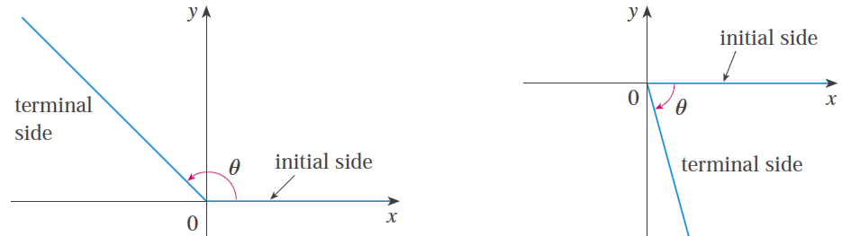

Sequence 06: Trigonometry (Part 1)
The standard position of an angle occurs when we place its vertex at the origin of a coordinate system and its initial side on the positive $x−$ axis as in the figure below.
A positive angle is obtained by rotating the initial side counterclockwise until it coincides with the terminal side. Likewise, negative angles are obtained by clockwise rotation as in the figure below.

Slide 5
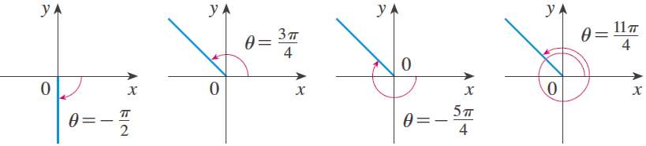

Sequence 06: Trigonometry (Part 1)
The following figure shows several examples of angles in standard position. Notice that different angles can have the same terminal side. For instance, the angles $3π/4$,$−5π/4$, and $11π/4$ have the same initial and terminal sides because
$\frac{3π}{4}−2π$ and $\frac{3π}{4}+2π=\frac{11π}{4}$
and $2π$ rad represents a complete revolution.

Slide 6
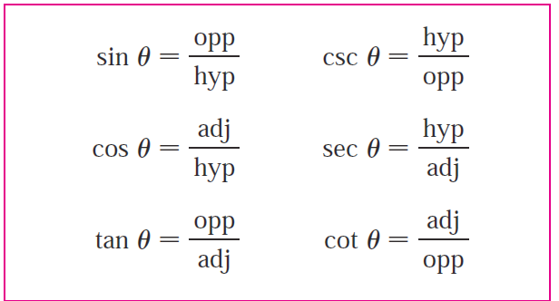
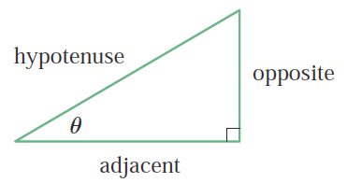
Sequence 06: Trigonometry (Part 1)
The Trigonometric Functions: For an acute angle the six trigonometric functions are defined as ratios of lengths of sides of a right triangle as follows.

Slide 7
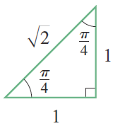
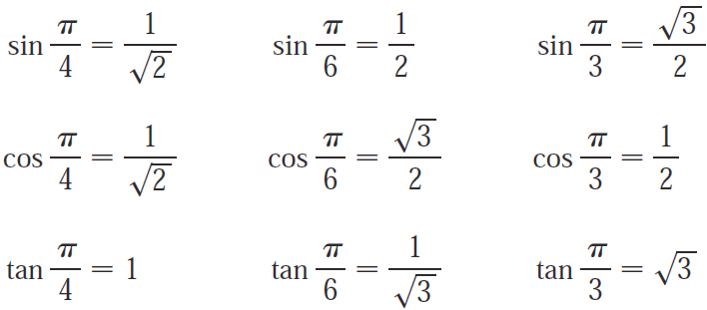
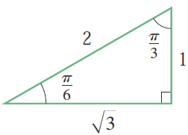
Sequence 06: Trigonometry (Part 1)
Example: The exact trigonometric ratios for certain angles can be read from the triangles in the figure below. For instance,

Slide 8
Thank you for your Attention

