Slide 1

Session one
Pre – calculus preview
Sequence 07: Trigonometry (Part 2)

Slide 2
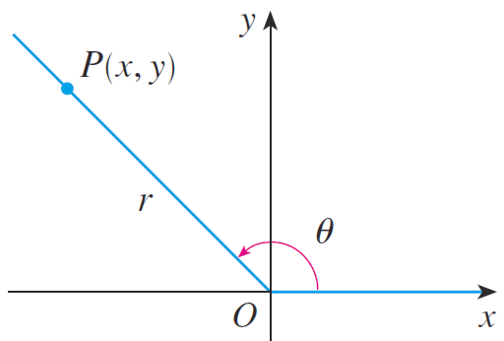

Sequence 07: Trigonometry (Part 2)
The definition of trigonometric functions in the last of the previous sequence doesn’t apply to obtuse
or negative angles, so for a general angle $θ$ in standard position we let $P(x,y)$ be any point on the terminal side of $θ$and we let $r$ be the distance
$\left|OP\right|$ as in the figure. Then we define $cosθ=\frac{x}{r} secθ=\frac{r}{x}$
$\sin{θ=\frac{y}{r} \csc{θ=\frac{r}{y}}}$
$tanθ=\frac{y}{x} cotθ=\frac{x}{y}$

Slide 3
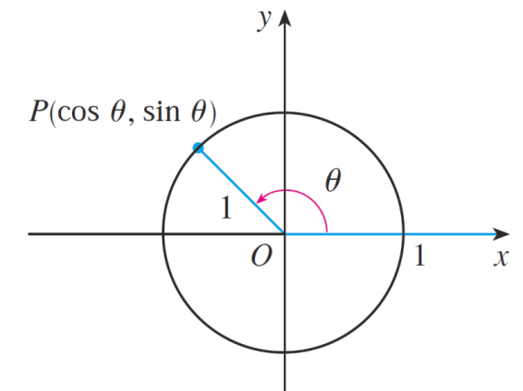

Sequence 07: Trigonometry (Part 2)
Notice that the previous definitions are consistent when $θ$ is an acute angle.
Since division by $O$ is not defined, $tan$ and $sec$ are undefined when $x=0$ and $cos$ and $cot$ are undefined when $y=0$ .
If we put $r=1$ in the previous definition and draw a unit circle with center the origin and label as in the figure, then the coordinates of $y$ are $P\left(\cos{θ},\sin{θ}\right)$ .

Slide 4
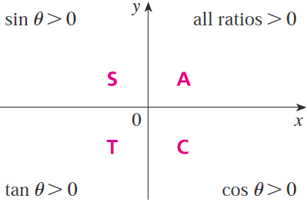
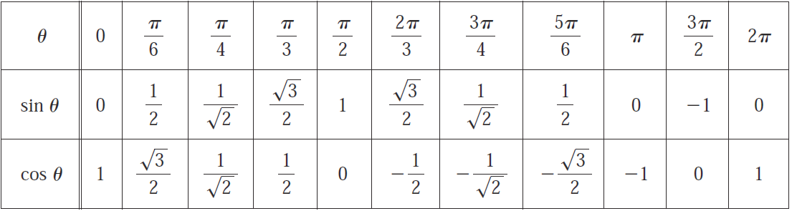

Sequence 07: Trigonometry (Part 2)
The signs of the trigonometric functions for angles in each of the four quadrants can be remembered by means of the rule “All Students Take Calculus” as shown below.
The following table gives some values of cos$θ sinθ$

Slide 5
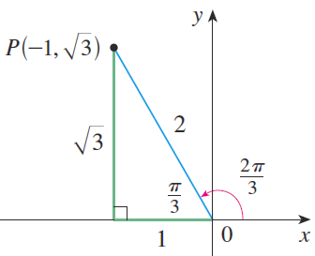

Sequence 07: Trigonometry (Part 2)
Example: Find the exact trigonometric ratios for $θ=\frac{2π}{3}$.
Solution: From the figure below we see that a point on the terminal line for $θ=\frac{2π}{3}$ is $(−1,\sqrt{3})$. Therefore, taking $x=−1 , y=\sqrt{3 } , r=2$ in the definitions of the trigonometric ratios, we have
$\csc{\frac{2π}{3}}=\frac{2}{\sqrt{3}} \sec{\frac{2π}{3}=−2}$ $\cot{\frac{2π}{3}=−\frac{1}{\sqrt{3}}}$ $\sin{\frac{2π}{3}=\frac{\sqrt{3}}{2} } \cos{\frac{2π}{3}=−\frac{1}{2} \tan{\frac{2π}{3}=−\sqrt{3 }}}$

Slide 6
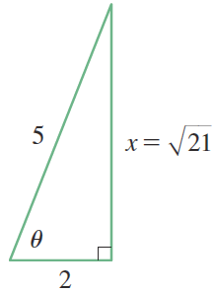
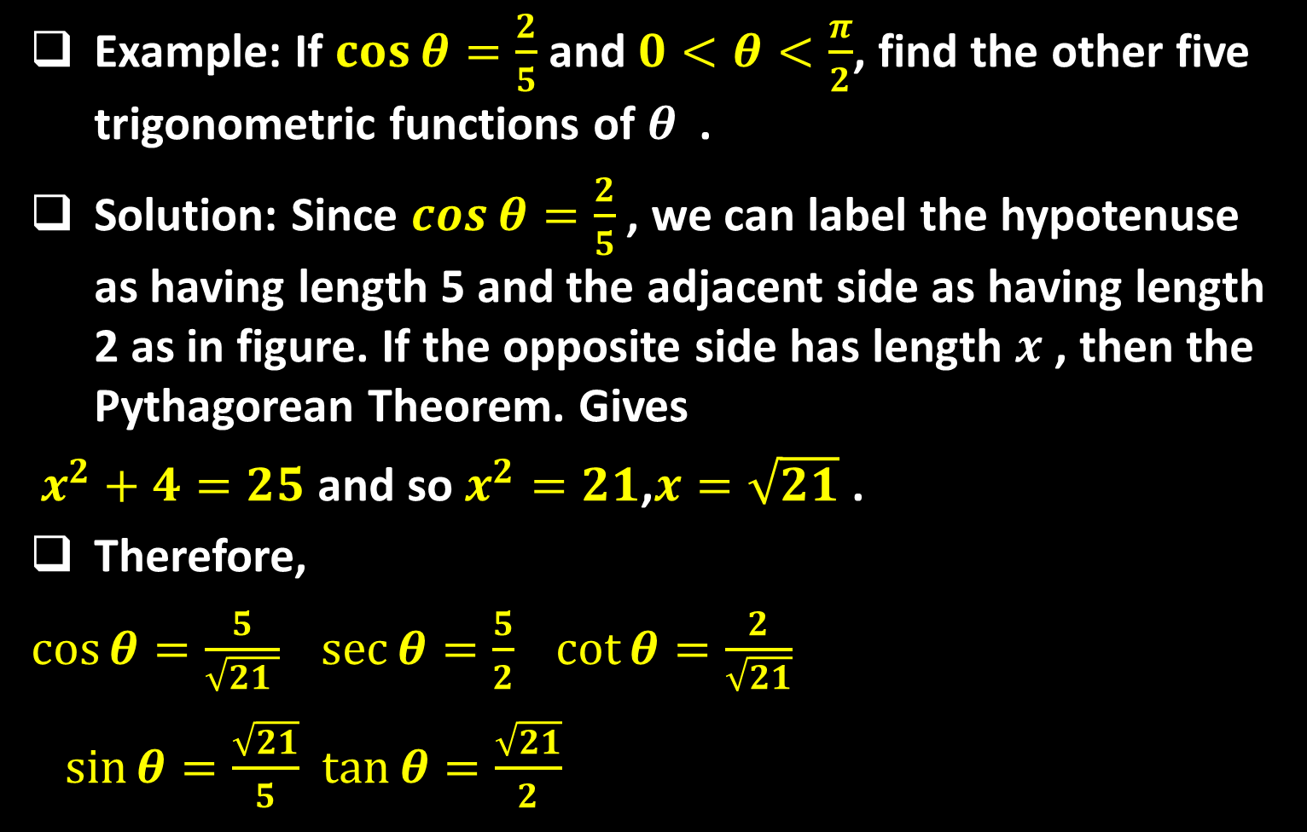
Sequence 07: Trigonometry (Part 2)
Example: If $\cos{θ}=\frac{2}{5}$ and $0<θ<\frac{π}{2}$, find the other five trigonometric functions of $θ$ .
Solution: Since $\cos{θ}=\frac{2}{5}$, we can label the hypotenuse as having length 5 and the adjacent side as having length 2 as in figure. If the opposite side has length $x$ , then the Pythagorean Theorem. Gives
$x^{2}+4=25$ and so $x^{2}=21$,$x=\sqrt{21}$ .
Therefore,
$\cos{θ}=\frac{5}{\sqrt{21 }} \sec{θ}=\frac{5}{2} \cot{θ}=\frac{2}{\sqrt{21}}$
$\sin{θ}=\frac{\sqrt{21}}{5}$ $\tan{θ}=\frac{\sqrt{21}}{2}$

Slide 7

Sequence 07: Trigonometry (Part 2)
Trigonometric Identities: A trigonometric identity is a relationship among the trigonometric functions.
  The most elementary are the following, which are immediate consequences of the definitions of the trigonometric functions.
  $$\csc{θ}=\frac{1}{\sin{θ}} \sec{\frac{1}{\cos{θ}} }\cot{θ}=\frac{1}{\tan{θ}}$$
  $$\tan{θ}=\frac{\sin{θ}}{\cos{θ}} \cot{θ}=\frac{\cos{θ}}{\sin{θ}}$$
  We have the most useful of all trigonometric identities: $sin²{θ}+ cos²{θ}=1$
  $tan²{θ}+1=sec²{θ}$
  $1+cot²{θ}=csc²{θ}$

Slide 8
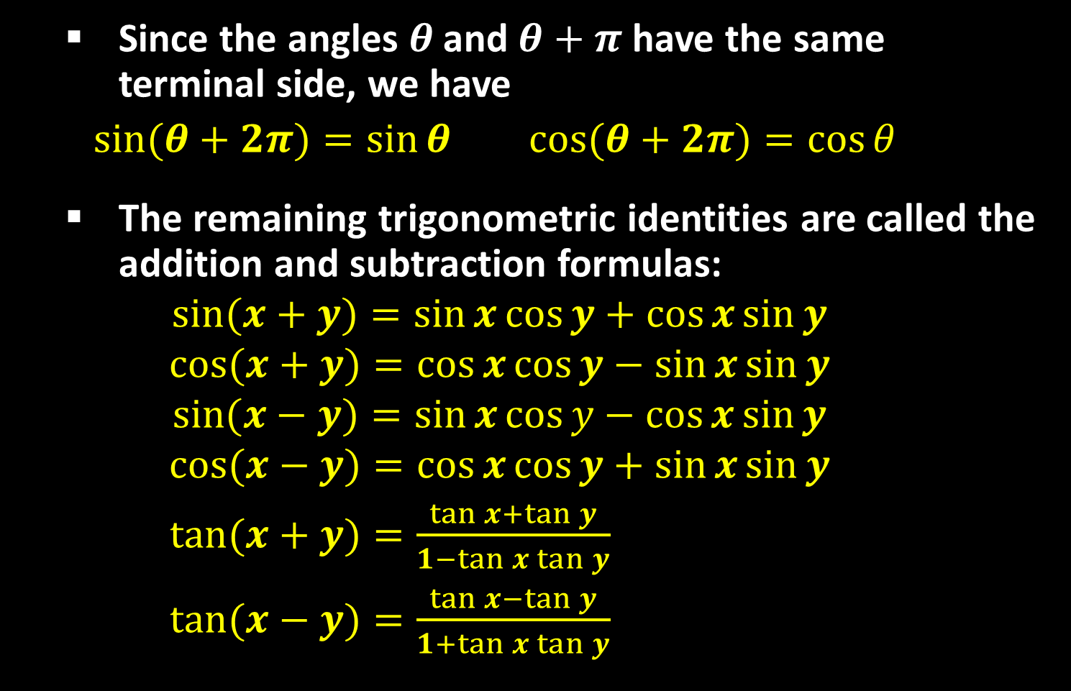
Sequence 07: Trigonometry (Part 2)
  Since the angles $θ$ and $θ+π$ have the same terminal side, we have
  $\sin{(θ+2π)}=\sin{θ}$ $\cos{(θ+2π)}=\cos{θ}$
  The remaining trigonometric identities are called the addition and subtraction formulas:
  $$\sin{(x+y)}=\sin{x}\cos{y}+\cos{x}\sin{y}$$
  $$\cos{(x+y)}=\cos{x}\cos{y}−\sin{x}\sin{y}$$
  $$\sin{(x−y)}=\sin{x}\cos{y}−\cos{x}\sin{y}$$
  $$\cos{(x−y)}=\cos{x}\cos{y}+\sin{x}\sin{y}$$
  $\tan{(x+y)}=\frac{\tan{x}+\tan{y}}{1−\tan{x}\tan{y}}$
  $\tan{(x−y)}=\frac{\tan{x}−\tan{y}}{1+\tan{x}\tan{y}}$

Slide 9
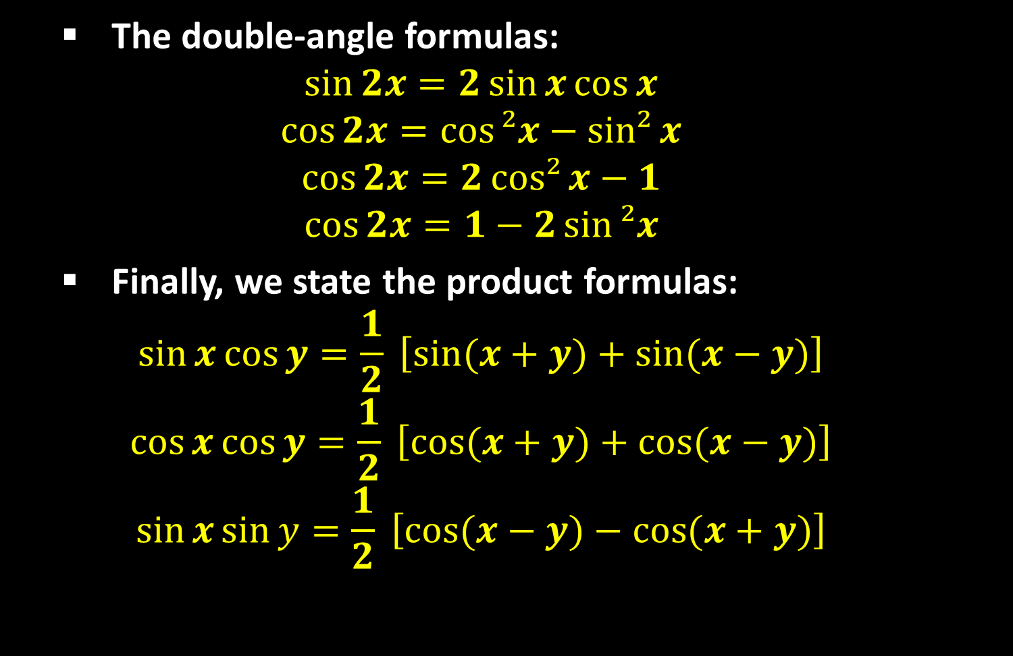
Sequence 07: Trigonometry (Part 2)
  The double-angle formulas:
  $$\sin{2x}=2\sin{x}\cos{x}$$
  $$\cos{2x}=\cos{²x}−sin²{x}$$
  $$\cos{2x}=2cos²{x}−1$$
  $$\cos{2x}=1−2\sin{²x}$$
  Finally, we state the product formulas:
  $$\sin{x}\cos{y}=\frac{1}{2} \left[\sin{(x+y)}+\sin{(x−y)}\right]$$
  $$\cos{x}\cos{y}=\frac{1}{2} \left[\cos{(x+y)}+\cos{(x−y)}\right]$$
  $$\sin{x}\sin{y}=\frac{1}{2} \left[\cos{(x−y)}−\cos{(x+y)}\right]$$

Slide 10
Thank you for your Attention

