Slide 1

Session Two
Functions
Sequence 08: Introduction (Part 1)

Slide 2
Sequence 08: Introduction (Part 1)
The fundamental objects that we deal with in calculus are functions. This session prepares the way for calculus by discussing the basic ideas concerning functions, their graphs, and ways of transforming and combining them.
We look at the main types of functions that occur in calculus.

Slide 3
Sequence 08: Introduction (Part 1)
James Stewart, Calculus: Early Transcendentals, 7th Edition, Brooks/ Cole 2012.
Howard Anton, Irl C. Bivens and Stephen Davis, Calculus: Early Transcendentals, 9th Edition, John Wiley & Sons, Inc. 2010.
Salas, Etgen, and Hille, Calculus: One and Several Variables, 10th Edition, John Wiley & Sons, Inc. 2007.

Slide 4

Sequence 08: Introduction (Part 1)
Functions arise whenever one quantity depends on another.
Definition: A function $f$ is a rule that assigns to each element $x$ in a set $D$ exactly one element called $f(x)$ in a set $E$ .
  We usually consider functions for which the sets $D$ and $E$ are sets of real numbers.
  The set $D$is called the domain of the function.
  The number $f(x)$ is the value of $f$at $x$and is read of .
  The range of $f$is the set of all possible values of $f(x)$ as $x$ varies throughout the domain.

Slide 5
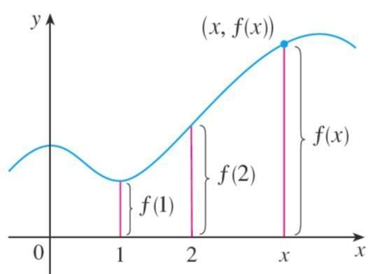

Sequence 08: Introduction (Part 1)
  A symbol that represents an arbitrary number in the domain of a function $f$ is called an independent variable.
  A symbol that represents a number in the range of $f$ is called a dependent variable.
Since the $y−$coordinate of any point $(x,y)$ on the graph is $y=f(x)$ , we can read the value of $f(x)$ from the graph as being the height of the graph above the point $x$ .

Slide 6
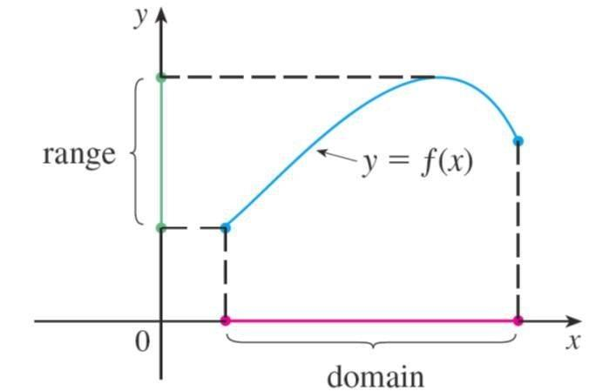

Sequence 08: Introduction (Part 1)
The graph of $f$ also allows us to picture the domain of $f$ on the $x−$axis and its range on the $y−$axis.
Example: The graph of a function $f$ is shown in the figure (in the next slide).
  Find the values of $f(1)$ and $f(7)$ .
  What are the domain and range of $f$?

Slide 7
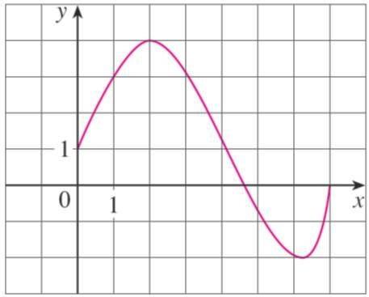
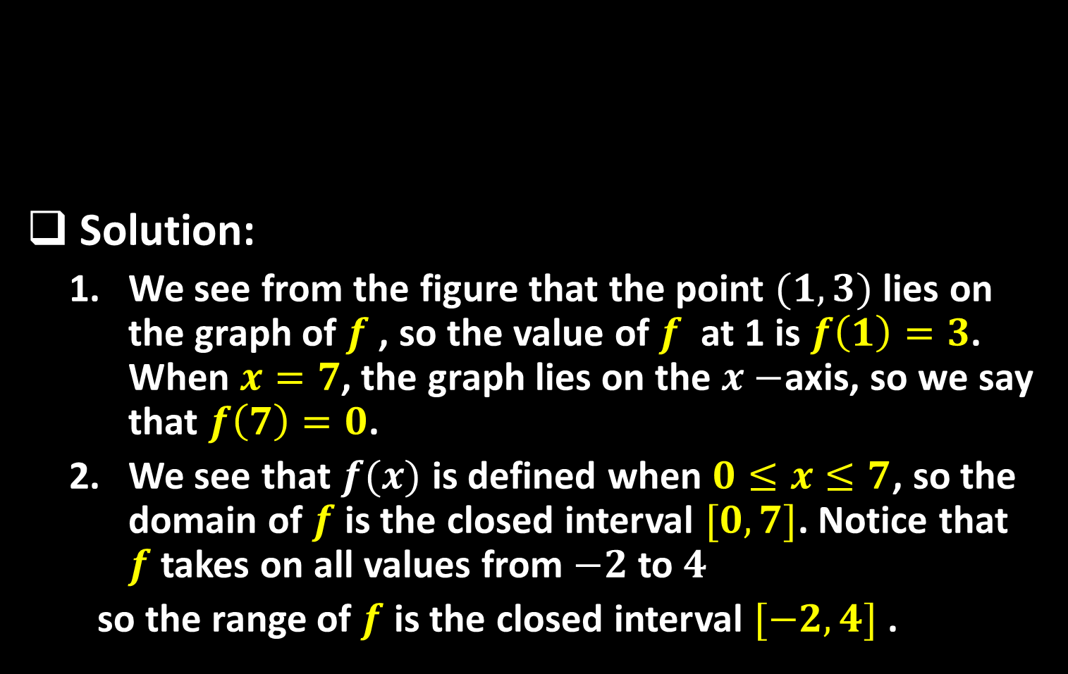
Sequence 08: Introduction (Part 1)
Solution:
  We see from the figure that the point $(1,3)$ lies on the graph of $f$ , so the value of $f$ at 1 is $f\left(1\right)=3$. When $x=7$, the graph lies on the $x−$axis, so we say that $f\left(7\right)=0$.
  We see that $f(x)$ is defined when $0≤x≤7$, so the domain of $f$is the closed interval $[0,7]$. Notice that $f$takes on all values from $−2$ to $4$
  so the range of $f$ is the closed interval $[−2,4]$ .

Slide 8
Thank you for your Attention

