Slide 1

Session Two
Functions
Sequence 17: Exponential and Logarithmic Functions (Part I)

Slide 2

Sequence 17: Exponential and Logarithmic Functions (Part I)
In this part you will study two types of non-algebraic functions: exponential functions and logarithmic functions. These functions are examples of transcendental functions.
Definition: The exponential function $f$ with base $a$is denoted by $f\left(x\right)=a^{x}$ where $a>0$,$a≠1$ , and $x$is any real number. The domain of the exponential function $f\left(x\right)=a^{g(x)}$is the same as the domain of $g(x)$.

Slide 3
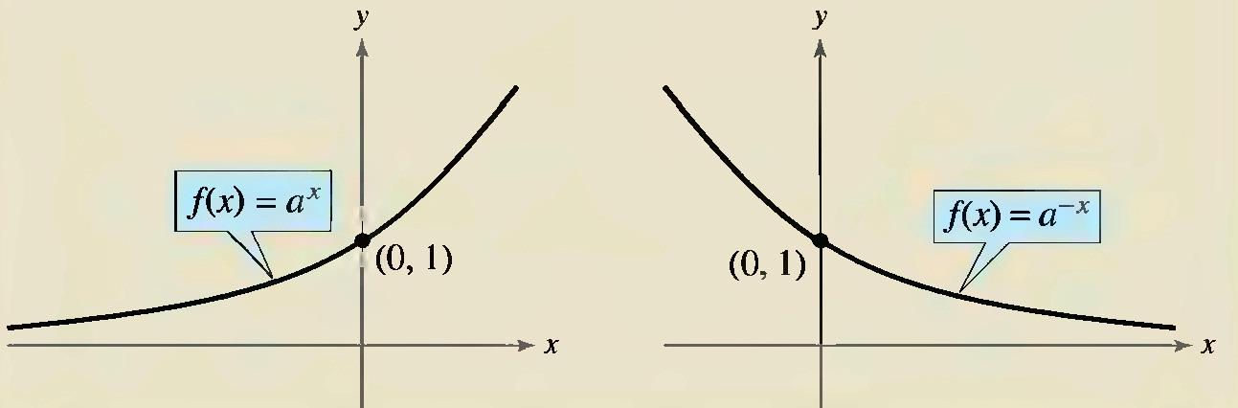

Sequence 17: Exponential and Logarithmic Functions (Part I)
You already know how to evaluate $a^{x}$ for integer and rational values of $x$. For example, you know that $4^{3}=64$ and $4^{1/2}=\sqrt{4}=2$ .
A distinguishing characteristic of an exponential function is its rapid increase as increases (for $a>1$ ). Many real-life phenomena with patterns of rapid growth (or decline) can be modeled by exponential functions.

Slide 4

Sequence 17: Exponential and Logarithmic Functions (Part I)
The properties of exponents can also be applied to real-number exponents. For review, these properties are listed below.
$a^{x}a^{y}=a^{x+y}$ $a^{0}=1$ ${(a}^{x})ʸ=a^{xy}$
$\frac{a^{x}}{a^{y}}=a^{x−y}$ $\sqrt[n]{a^{m}}=a^{m/n}$ ${\frac{a}{b}}^{x}=\frac{a^{x}}{b^{x}}$
$a^{−x}=\frac{1}{a^{x}}=({\frac{1}{a})}^{x}$ (${ab)}^{x}=a^{x}b^{x}$ $\left|a²\right|={\left|a\right|}^{2}=a^{2}$
Example: Find the exact value of ${(−8)}^{2/3}$
Solution: ${(−8)}^{2/3}=\sqrt[3]{{−8}^{2}}={\left(\sqrt[3]{−8}\right)}^{2}={\left(−2\right)}^{2}=4$ .

Slide 5
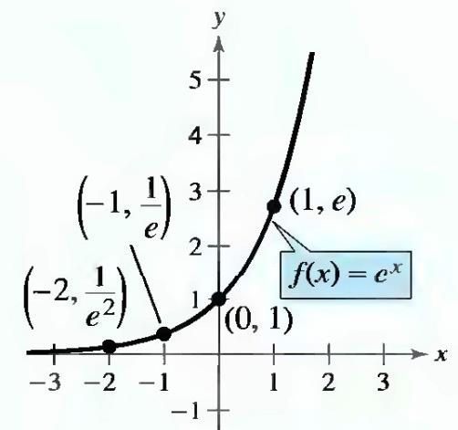

Sequence 17: Exponential and Logarithmic Functions (Part I)
The Natural Base $e$ : For many applications, the convenient choice for a base is the irrational number $e≈2.7\overline{182}$. This number is called the natural base. The function $f\left(x\right)=e^{x}$ is called the natural exponential function and its graph is shown.
The number $e$can be approximated by the expression ${(1+\frac{1}{x})}^{x} for large value of x$

Slide 6

Sequence 17: Exponential and Logarithmic Functions (Part I)
We learned that if a function is one-to-one-that is, if the function has the property such that no horizontal line intersects its graph more than once-the function must have an inverse function. By looking back at the graphs of the exponential functions, you will see that every function of the form $f\left(x\right)=a^{x}$ ,$a>0$ , $a≠1$ passes the Horizontal Line Test and therefore must have an inverse function. This inverse function is called the logarithmic function with base $a$ .

Slide 7

Sequence 17: Exponential and Logarithmic Functions (Part I)
Definition: For $x>0$,$a>0$ , and $a≠1$ ,$y=\log_{a}{x}$ if and only if $x=y^{a}$ . The function given by
$f\left(x\right)=\log_{a}{x}$ (read as log base $a$ of $x$) is called the logarithmic function with base . The domain of the this function is $\left\{x∈ℝ:g\left(x\right)>0\right\}∩the domain of g(x)$
Example: Use the definition of logarithmic function to evaluate each logarithm at the indicated value of .
  $f\left(x\right)=\log_{2}{x}$ , at $x=32$ 2. $f\left(x\right)=\log_{4}{x}$ , at $x=2$
Solution:
  $f\left(32\right)=\log_{2}{32}=5$ because $2^{5}=32$
  $f\left(2\right)=\log_{4}{2}=1/2$ because $4^{1/2}=\sqrt{4}=2$

Slide 8
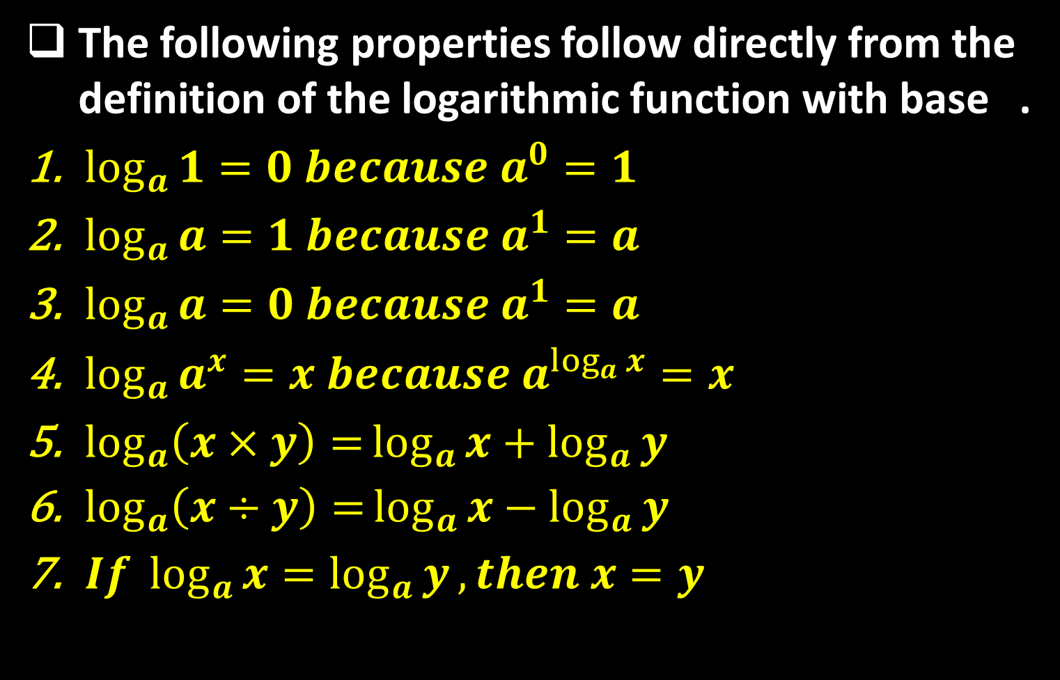
Sequence 17: Exponential and Logarithmic Functions (Part I)
The following properties follow directly from the definition of the logarithmic function with base .
$\log_{a}{1}=0 because a^{0}=1$
$\log_{a}{a}=1 because a^{1}=a$
$\log_{a}{a}=0 because a^{1}=a$
$\log_{a}{a^{x}}=x because a^{\log_{a}{x}}=x$
$\log_{a}\left(x×y\right)=\log_{a}{x}+\log_{a}{y}$
$\log_{a}\left(x÷y\right)=\log_{a}{x}−\log_{a}{y}$
$If \log_{a}{x}=\log_{a}{y},then x=y$

Slide 9
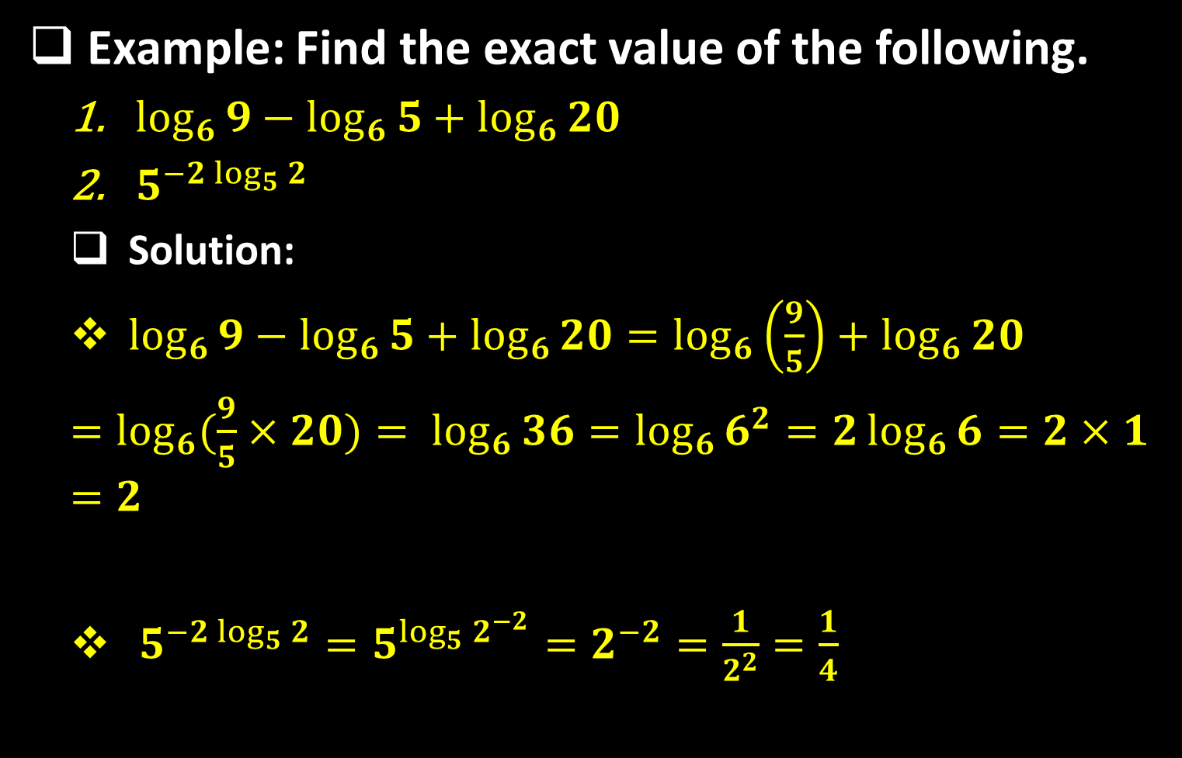
Sequence 17: Exponential and Logarithmic Functions (Part I)
Example: Find the exact value of the following.
  $\log_{6}{9}−\log_{6}{5}+\log_{6}{20}$
  $5^{−2\log_{5}{2}}$
  Solution:
  $\log_{6}{9}−\log_{6}{5}+\log_{6}{20}=\log_{6}\left(\frac{9}{5}\right)+\log_{6}{20}$
  $=\log_{6}{(\frac{9}{5}×20)}= \log_{6}{36}=\log_{6}{6^{2}}=2\log_{6}{6}=2×1=2$
  $5^{−2\log_{5}{2}}=5^{\log_{5}{2^{−2}}}=2^{−2}=\frac{1}{2^{2}}=\frac{1}{4}$

Slide 10
Thank you for your Attention

