Slide 1

Session Two
Functions
Sequence 18: Exponential and Logarithmic Functions (Part 2)

Slide 2

Sequence 18: Exponential and Logarithmic Functions (Part 2)
The Natural logarithmic Function: By looking back to the natural exponential function $f\left(x\right)=e^{x}$,you will see it is one-to-one and so has an inverse function. This inverse function is called the natural logarithmic function and is denoted by the special symbol $\ln{x}$ , read as: the natural log of $x$ .
Definition: For $x>0$,$y=\ln{x}$ if and only if $x=e^{y}$. The function given by $f\left(x\right)=\log_{e}{x}=\ln{x}$ is called the natural logarithmic function. The domain of the natural logarithmic function $f\left(x\right)=\ln{g(x)}$ is
$\left\{x∈ℝ:g\left(x\right)>0\right\}∩the domain of g(x)$

Slide 3

Sequence 18: Exponential and Logarithmic Functions (Part 2)
From the previous definition, you can see that every logarithmic equation can be written in an equivalent exponential form and every exponential equation can be written in logarithmic form.
The properties of logarithms previously listed are also valid for natural logarithms.
$\ln{1}=0 becouse e^{0}=1$ $5.\ln{x×y}=\ln{x}+\ln{y}$
$\ln{e}=1 becouse e^{1}=e$ $6.\ln{x÷y}=\ln{x}−\ln{y}$
$\ln{a^{x}=x\ln{a}}$ $7.If \ln{x}=\ln{y} then x=y$
$\ln{e^{x}}=x and e^{\ln{x}}=x$ $8.\log_{a}{b}=\ln{b}/\ln{a}$

Slide 4

Sequence 18: Exponential and Logarithmic Functions (Part 2)
Now, you will study procedures for solving equations involving exponential and logarithmic functions.
There are two basic strategies for solving exponential or logarithmic equations. The first is based on the One-to-One Properties and the second is based on the Inverse Properties.
  One-to-One Properties:$a^{x}=a^{y}$ if and only if $x=y$ , and $\log_{a}{x}=\log_{a}{y}$ if and only if $x=y$ .
  Inverse Properties:$a^{\log_{a}{x}}=x$ and $\log_{a}{a^{x}}=x$ .

Slide 5

Sequence 18: Exponential and Logarithmic Functions (Part 2)
Example: Solve the following equations.
  $2^{x}=32$
  $\ln{x}=−3$
Solution:
  $2^{x}=32⇒2^{x}=2^{5}⇒x=5$ by one-to-one property.
  $\ln{x}=−3⇒e^{\ln{x}}=e^{−3}⇒x=e^{−3}$ by inverse property.
Example: Solve the equation $e^{x}−2xe^{x}=0$.
Solution: $e^{x}−2xe^{x}=0 ⇒e^{x}\left(1−2x\right)=0$
$$1−2x=0⇒\frac{x1}{2} ⇒e^{x}≠0$$

Slide 6
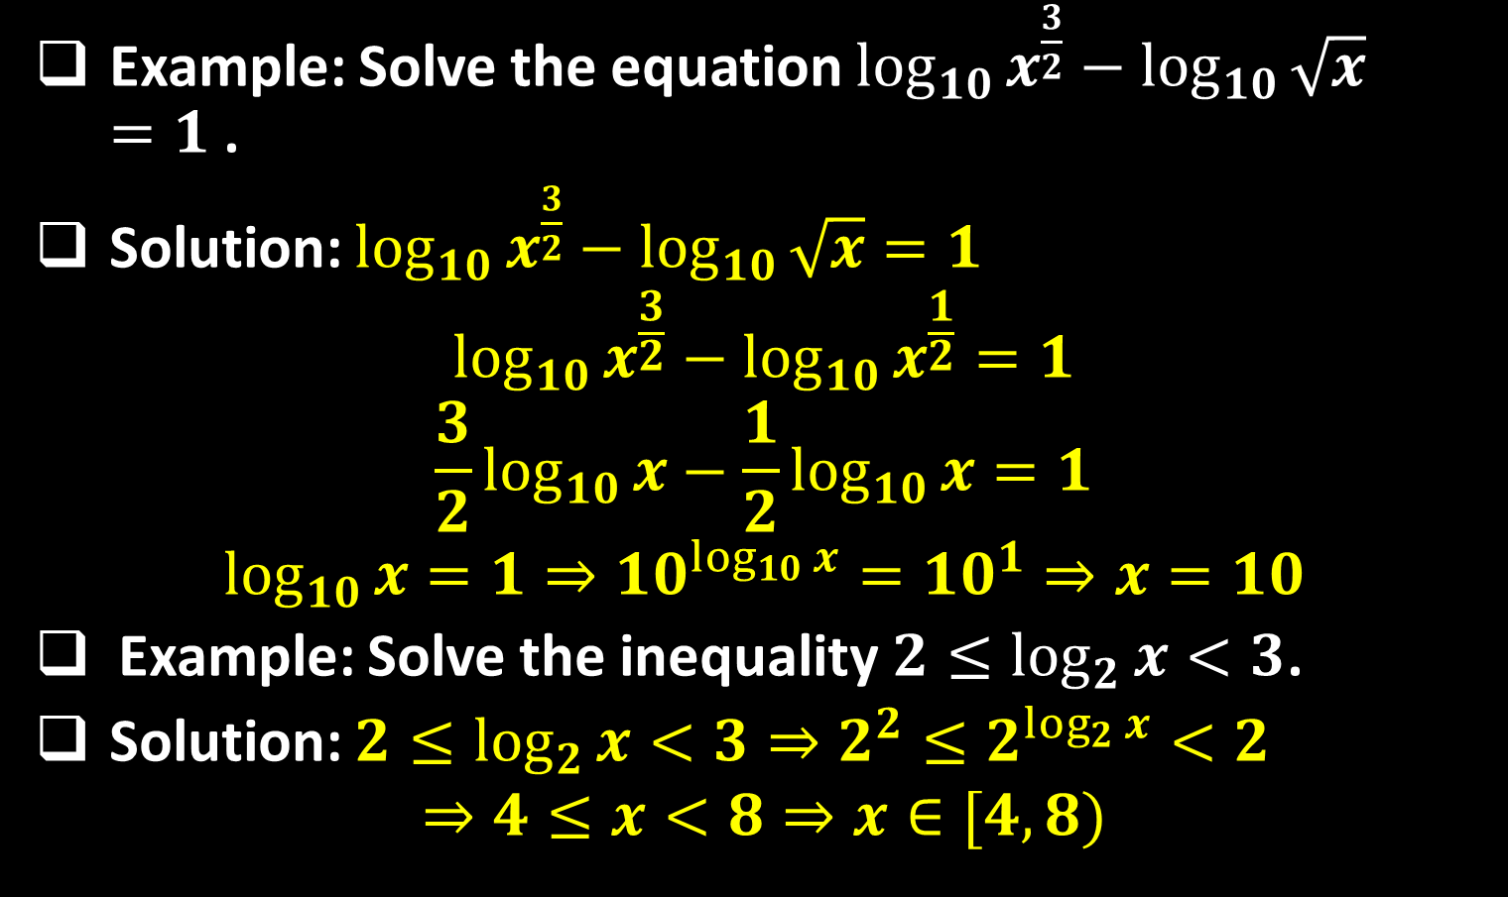
Sequence 18: Exponential and Logarithmic Functions (Part 2)
Example: Solve the equation $\log_{10}{x^{\frac{3}{2}}}−\log_{10}{\sqrt{x}}=1$ .
Solution: $\log_{10}{x^{\frac{3}{2}}}−\log_{10}{\sqrt{x}}=1$
$$\log_{10}{x^{\frac{3}{2}}}−\log_{10}{x^{\frac{1}{2}}}=1$$
$$\frac{3}{2}\log_{10}{x}−\frac{1}{2}\log_{10}{x}=1$$
$$\log_{10}{x}=1⇒{10}^{\log_{10}{x}}={10}^{1}⇒x=10$$
Example: Solve the inequality $2≤\log_{2}{x}<3$.
Solution: $2≤\log_{2}{x}<3⇒2^{2}≤2^{\log_{2}{x}}<2$
$$⇒4≤x<8⇒x∈[4,8)$$

Slide 7

Sequence 18: Exponential and Logarithmic Functions (Part 2)
Example: Solve the equation $\ln{x−2}+\ln{2x−3}=2\ln{x}$
Solution: $\ln{x−2}+\ln{2x−3}=2\ln{x}$
$\ln\left[\left(x−2\right)\left(2x−3\right)\right]=\ln{x^{2}}$
$\left(x−2\right)\left(2x−3\right)=x^{2}$
$2x^{2}−7x+6=x^{2}$
$x^{2}−7x+6=0⇒\left(x−1\right)\left(x−6\right)=0$
$x−1=0⇒x=1$
$$x−6=0⇒x=6$$
You can conclude that $x=1$ is not valid. This is because when $x=1$, $\ln{(x−2)}+\ln{(2x−3}=\ln{(−1)}+\ln{(−1)}$ , which is invalid because $−1$ is not in the domain of the natural logarithmic function. So, the only solution is $x=6$ .

Slide 8
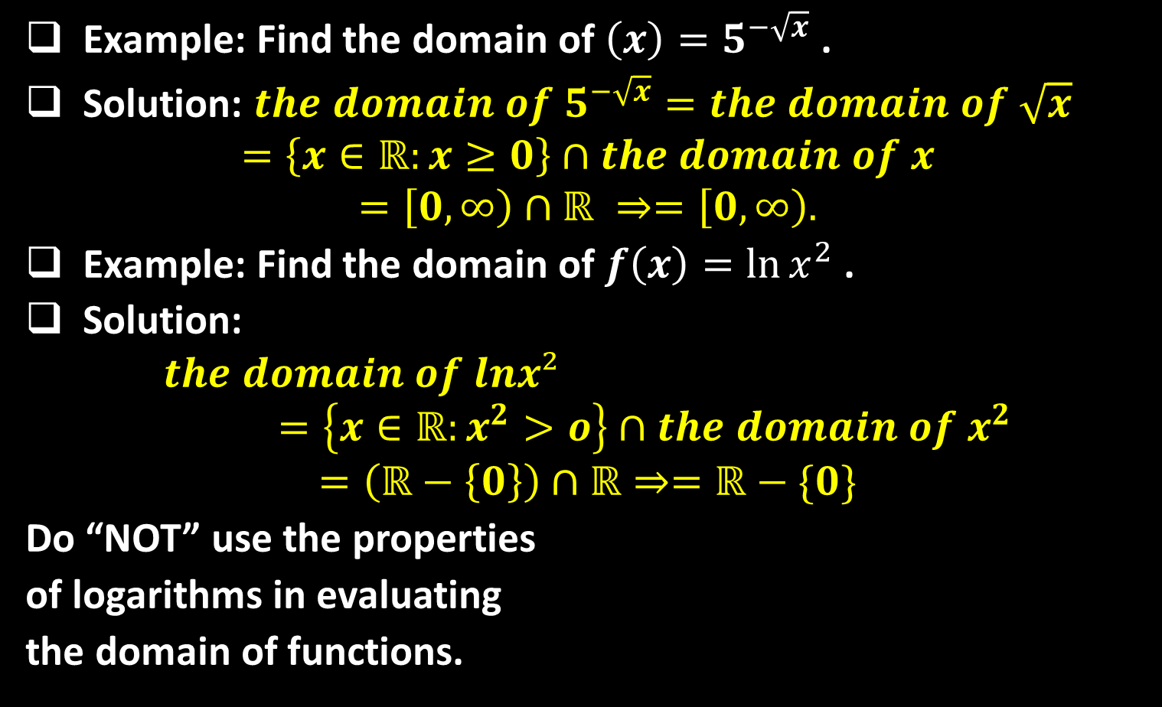
Sequence 18: Exponential and Logarithmic Functions (Part 2)
Example: Find the domain of $\left(x\right)=5^{−\sqrt{x}}$ .
Solution: $the domain of 5^{−\sqrt{x}}=the domain of \sqrt{x}$
$$=\left\{x∈ℝ:x≥0\right\}∩the domain of x$$
$$=\left[0,∞\right)∩ℝ ⇒=\left[0,∞\right).$$
Example: Find the domain of $f\left(x\right)=\ln{x^{2}}$ .
Solution:
$$the domain of lnx² =\left\{x∈ℝ:x^{2}>o\right\}∩the domain of x^{2}$$
$$=\left(ℝ−\left\{0\right\}\right)∩ℝ⇒=ℝ−\{0\}$$
Do “NOT” use the properties
of logarithms in evaluating
the domain of functions.

Slide 9

Sequence 18: Exponential and Logarithmic Functions (Part 2)
Example: Find a formula for the inverse of the function $f\left(x\right)=e^{2x−1}$.
Solution: First, let $y=e^{2x−1}$ . By inverse property we have $\ln{y}=\ln{e^{2x−1}}$ and then $\ln{y}=e^{2x−1}$ . So, $x=(1+\ln{y)/2}$. Hence,$f^{−1}\left(x\right)=(1+\ln{x})/2$ .
Example: Find a formula for the inverse of the function $f\left(x\right)=\ln{(x+3)}$.
Solution: Let $y=\ln{(x+3)}$ . By inverse property we have $e^{y}=e^{\ln{(x+3)}}$ and then
$e^{y}=x+3$ . So, $x=e^{y}−3$.
Hence, $f^{−1}\left(x\right)=(e^{x}−3)$

Slide 10
Thank you for your Attention

