Slide 1

Session Two
Functions
Sequence 19: Hyperbolic Functions

Slide 2

Sequence 19: Hyperbolic Functions
Certain even and odd combinations of the exponential functions $e^{x}$ and $e^{−x}$ arise so frequently in mathematics and its applications that they deserve to be given special names.
In many ways they are analogous to the trigonometric functions, and they have the same relationship to the hyperbola that the trigonometric functions have to the circle.
For this reason they are collectively called hyperbolic functions and individually called hyperbolic sine, hyperbolic cosine,
and so on.

Slide 3
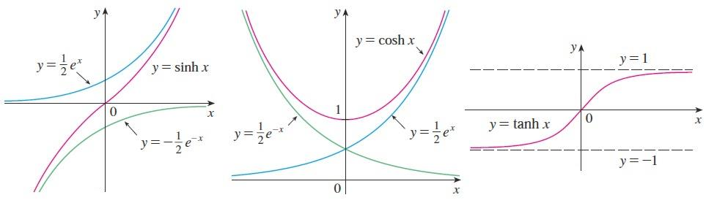

Sequence 19: Hyperbolic Functions
Definition of the Hyperbolic Functions:
$\sinh^{−1}{x}=\frac{e^{x}−e^{−x}}{2}$ $\operatorname{sech}{x}=\frac{1}{\cosh{x}}=\frac{2}{e^{x}+e^{−x}}$
$\cosh{x}=\frac{e^{x}+e^{−x}}{2}$ $\operatorname{csch}{x}=\frac{1}{\sinh{x}}=\frac{2}{e^{x}−e^{−x}}$
$\tanh{x}=\frac{\sinh{x}}{\cosh{x}}=\frac{e^{x}−e^{−x}}{e^{x}+e^{−x}}$
$\coth{x}=\frac{1}{\tanh{x}}=\frac{e^{x}+e^{−x}}{e^{x}−e^{−x} }$
The graphs of hyperbolic sine, cosine, and tangent can be sketched using graphical addition as in the figures.

Slide 4

Sequence 19: Hyperbolic Functions
Note that $\sinh{x}$ has domain $ℝ$ and range $ℝ$ , while $\cosh{x}$ has domain $ℝ$ and range $[1,∞)$ . The graph of $\tanh{x}$ has the horizontal asymptotes $y=±1$ .
Example: Find the numerical value of each expression.
  $\sinh{0}$
  $\cosh{\ln{(3)}}$
Solution:
  $\sinh{0}=\frac{e^{0}−e^{0}}{2}=0$
  $\cosh{\ln{(3)}}=\frac{e^{\ln{3}}+e^{−ln{3}}}{2}=\frac{\left(3+\frac{1}{3}\right)}{2}=\frac{5}{3}$

Slide 5

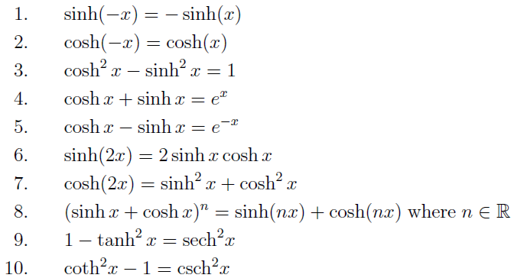
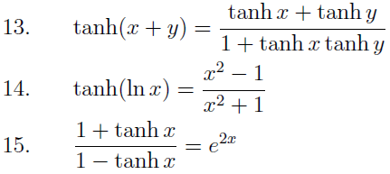
Sequence 19: Hyperbolic Functions
Hyperbolic Identities: The hyperbolic functions satisfy a number of identities that are similar to well-known trigonometric identities. We list some of them here.

Slide 6
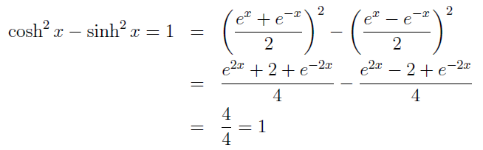

Sequence 19: Hyperbolic Functions
Example: Prove the identity $cosh²{x}−\sinh^{2}{x}=1$.
Solution:
Inverse Hyperbolic Functions: You can see from the figure in the 3rd slide that $\sinh{x }$and $\tanh{x}$ are one-to-one functions and so they have inverse functions denoted by $\sinh^{−1}{x}$and $\tanh^{−1}{x}$.

Slide 7
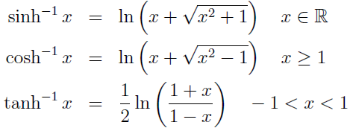
Sequence 19: Hyperbolic Functions
Also, in the same figure shows that is not one-to-one, but when restricted to the domain it becomes one-to-one. The inverse hyperbolic cosine function is defined as the inverse of this restricted function.
Since the hyperbolic functions are defined in terms of exponential functions, it’s not surprising to learn that the inverse hyperbolic functions can be expressed in terms of logarithms. In particular, we have:

Slide 8

Sequence 19: Hyperbolic Functions
Example: Find the numerical value of each expression.
  $\cosh^{−1}{1}$
  $\sinh^{−1}{1}$
Solution:
  $\cosh^{−1}{1}=\ln{(1+\sqrt{1^{2}−1})}=\ln{1}=0$
  $\sinh^{−1}{1}=\ln{(1+\sqrt{1^{2}+1})}=\ln{(1+}\sqrt{2}$

Slide 9
Thank you for your Attention

