Slide 1

Session Two
Functions
Sequence 09: Introduction (Part 2)

Slide 2

Sequence 09: Introduction (Part 2)
Representations of Functions
  verbally (by a description in words)
  numerically (by a table of values)
  visually (by a graph)
  algebraically (by an explicit formula)
The graph of a function is a curve in the$xy−$plane. But the question arises: Which curves in the $xy−$plane are graphs of functions? This is answered by the Vertical Line Test.

Slide 3
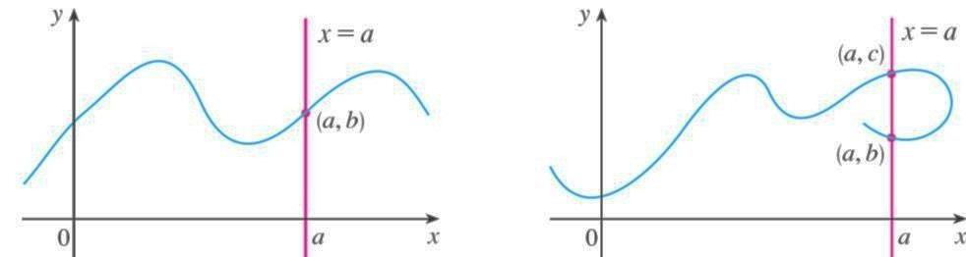

Sequence 09: Introduction (Part 2)
Vertical Line Test : A curve in the $xy−$plane is the graph of a function of $x$ if and only if no vertical line intersects the curve more than once.

Slide 4

Sequence 09: Introduction (Part 2)
If each vertical line $x=a$ intersects a curve only once, at $(a,b)$ , then exactly one functional value is defined by $f\left(a\right)=b$ .
But if a line $x=a$ intersects the curve twice, at $(a,b)$and $(a,c)$, then the curve can't represent a function because a function can't assign two different values to $a$.

Slide 5
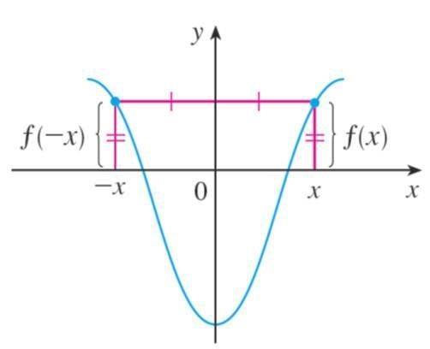

Sequence 09: Introduction (Part 2)
Symmetry.
  If a function $f$ satisfies $f\left(−x\right)=f(x)$
  for every number $x$ in its domain, then $f$ is called an even function.
  For instance, the function $f\left(x\right)=x^{2}$ is even because
  $f\left(−x\right)=(−x)²=x^{2}=f\left(x\right).$

Slide 6
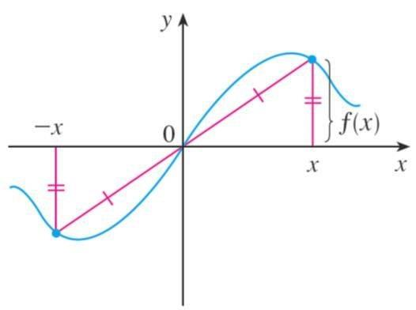

Sequence 09: Introduction (Part 2)
  If $f$ satisfies $f\left(−x\right)=−f(x)$ for every number $x$in its domain, then $f$ is called an odd function.
  For example, the function$f\left(x\right)=x^{3}$is odd because
  $f\left(−x\right)=(−x^{3})=−x^{3}=−f\left(x\right).$

Slide 7

Sequence 09: Introduction (Part 2)
The geometric significance of an even function is that its graph is symmetric with respect to the $y−$axis, while the graph of an odd function is symmetric about the origin.
Note that the function may be neither even nor odd, for example, $h\left(x\right)=2x−x^{2}$ is neither even nor odd because $h\left(−x\right)=2\left(−x\right)−{\left(−x\right)}^{2}=−2x−x^{2}$ and $h(−x)≠h(x)$ or $h\left(−x\right)≠−h(x)$

Slide 8
Thank you for your Attention

