Slide 1

Session Two
Functions
Sequence 10: Essential Functions (Part 1)

Slide 2

Sequence 10: Essential Functions (Part 1)
There are many different types of functions that can be used to model relationships observed in the real world. In what follows, we discuss the behavior and graphs of these functions and give examples of situations appropriately modeled by such functions.
Linear Function: When we say that $y$ is a linear function of $x$ , we mean that the graph of the function is a line, so we can use the slope-intercept form of the equation of a line (see sequence 5) to write a formula for the function as $y=f\left(x\right)=mx+b$ where $m$ is the slope of the line and $b$
is the $y−$intercept.

Slide 3

Sequence 10: Essential Functions (Part 1)
Example: As dry air moves upward, it expands and cools. If the ground temperature is $20℃$ and the temperature at a height of 1 km is $10℃$ .
  Express the temperature $T$ (in$℃$) as a function of the height $h$ (in kilometers), assuming that a linear model is appropriate.
  Draw the graph of the function in the first part. What does the slope represent?
  What is the temperature at a height of 2.5 km?

Slide 4

Sequence 10: Essential Functions (Part 1)
Solution:
  Because we are assuming that $T$is a linear function of $h$, we can write $T=mh+b$. We are given that $T=20$ when $h=0$ , so
  $20=m×0+b=b$
  In other words, the $y−$intercept is $b=20$ . We are also given that $T=10$ when $h=1$ , so
  $10=m×1+20$
  The slope of the line is therefore $m=10−20=−10$ and the required linear function is
  $$T=−10h+20.$$

Slide 5
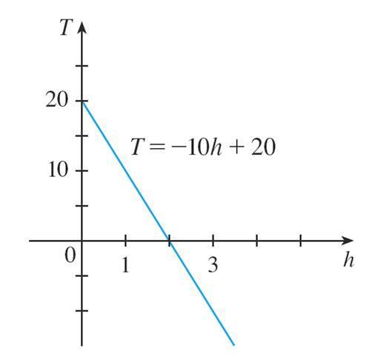

Sequence 10: Essential Functions (Part 1)
  At a height of $h=2.5$ km, the temperature is
  $T=−10\left(2.5\right)+20=−5℃$

Slide 6

Sequence 10: Essential Functions (Part 1)
Polynomials: A function $P$ is called a polynomial if
$p\left(x\right)=a_{n}x^{n}+a_{n−1}x^{n−1}+…+a_{2}x^{2}+a_{1}x+a_{0}$
where is a nonnegative integer and the numbers
$a_{0},a_{1},a_{2},…,a_{n}$
are constants called the coefficients of the polynomial.
  The domain of any polynomial is $ℝ=(−∞,∞)$ .
  If the leading coefficient $a_{n}≠0$ ,
  then the degree of the polynomial is $n$.
  For example,

Slide 7

Sequence 10: Essential Functions (Part 1)
  A polynomial of degree is of the form
  $p\left(x\right)=mx+b$
  and so it is a linear function.
  A polynomial of degree $2$ is of the form
  $p\left(x\right)=ax^{2}+bx+c$
  and is called a quadratic function.
  A polynomial of degree $3$ is of the form
  $p\left(x\right)=ax^{3}+bx²+cx+d$
  and is called a cubic function.

Slide 8

Sequence 10: Essential Functions (Part 1)
Piecewise Defined Functions:
  Example: A function $f$ is defined by
  $f\left(x\right)=\left\{\begin{aligned}1−x : x≤−1 \\ x^{2} : x>−1\end{aligned}\right.$
  Evaluate $f(−2)$ ,$f(−1)$, and $f(0)$ and sketch the graph.
  Solution: Remember that a function is a rule. For this particular function the rule is the following: First look at the value of the input $x$. If it happens that $x≤−1$, then the value of $f\left(x\right)$ is $1−x$
  On the other hand, if $x>−1$,
  then the value of $f\left(x\right)$is $x^{2}$

Slide 9
Thank you for your Attention

Slide 10
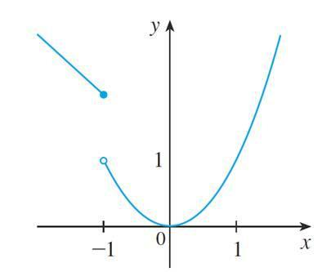

Sequence 10: Essential Functions (Part 1)
  Since $−2≤−1$ , we have $f\left(−2\right)=1−\left(−2\right)=3$ .
  Since $−1≤−1$ , we have $f\left(−1\right)=1\left(−1\right)=2$ .
  Since $0>1$ , we have $f\left(0\right)=0^{2}=0$ .
The absolute value (see sequence 3) is an example of a piecewise defined function.

