Slide 1

Session Two
Functions
Sequence 11: Essential Functions (Part 2)

Slide 2

Sequence 11: Essential Functions (Part 2)
Trigonometric Functions: We have provided the almost of this topic earlier in sequences 6 and 7. Now, we will introduce some other important points.
  The values of trigonometric functions of angles greater than $90°=π/2$ or less than $0°$ can be determined from their values at corresponding acute angles called reference angles.
  Definition: Let $θ$ be an angle in standard position. Its reference angle is the
  acute angle $θ`$ formed by
  the terminal side of $θ$ and the $x−$axis.

Slide 3
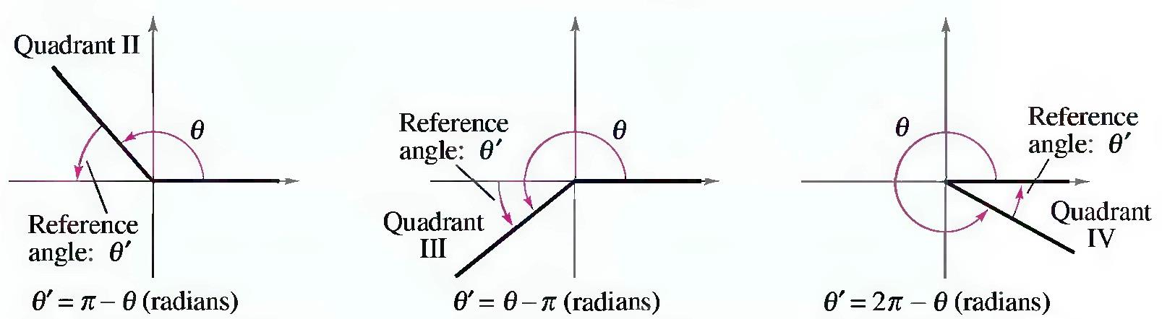

Sequence 11: Essential Functions (Part 2)
  Example: Find the reference angle of $θ=5π/3$.
  Solution: Because $\frac{5π}{3}=300°$lies in quadrant 4, the angle it makes with the $x−$axis is
  $θ`=2π−\frac{5π}{3}=\frac{π}{3}=60°$

Slide 4

Sequence 11: Essential Functions (Part 2)
  Example: Find the reference angle of $θ=−3π/4$ .
  Solution: First, note that $−\frac{3π}{4}=−135°$ is conterminal with $\frac{5π}{4}=225°$
  which lies in quadrant 3. So, the reference angle is
  $θ`=\frac{5π}{4}−π=\frac{π}{4}=45°$
  Example: Evaluate $\cos{(\frac{4π}{3})}$.
  Solution: Because $θ=\frac{4π}{3}=240°$ lies in quadrant 3, the reference angle is $θ`=\frac{4π}{3}−π=\frac{π}{3}$ . Moreover, the cosine is negative in quadrant 3, so
  $\cos{(\frac{4π}{3})}\text{=(−)}\cos{(\frac{π}{3})}−\frac{1}{2}.$

Slide 5

Sequence 11: Essential Functions (Part 2)
The graph of the function $f\left(x\right)=\sin{x}$, shown in Figure (b), is obtained by plotting points for $0≤x≤2π$ and then using the periodic nature of the function to complete the graph. Notice that the zeros of the sine function occur at the integer multiples of $π$, that is,
$$\sin{x}=0 wheneverx=nπ$$
$n=0,±1,±2,±3,…$
The graph of cosine is obtained by shifting the graph of sine by an amount $π/2$ to the left [see Figure (a)]. Therefore, the zeros of the cosine function occur at the integer multiples of $π$ plus $π/2$ , that is,
$\cos{x}=0 wheneverx=\frac{π}{2}+nπ$
$n=0,±1,±2,±3,…$

Slide 6
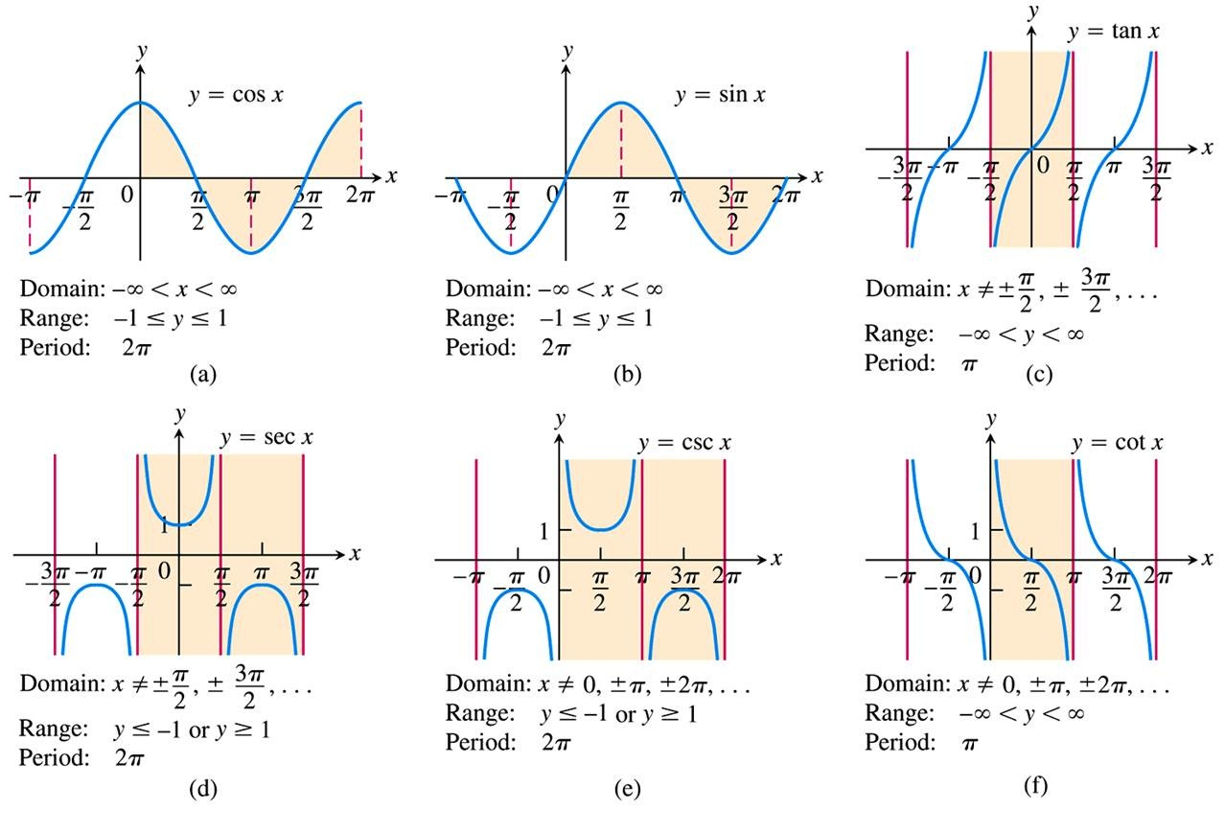
Sequence 11: Essential Functions (Part 2)

Slide 7

Sequence 11: Essential Functions (Part 2)
Note that for both the sine and cosine functions the domain is $ℝ=(−∞,∞)$ and the range is the closed interval $[−1,1]$ .
The tangent and cotangent have range
$ℝ=(−∞,∞)$, whereas cosecant and secant have range $\left(−∞,−1\right]∪[1,∞)$.
The zeros of the tangent function is the same as of the sine function, and the zeros of the cotangent function is the same as of the cosine function, while the secant and
cosecant functions have no zeros.

Slide 8

Sequence 11: Essential Functions (Part 2)
Example: Solve the equation $\sin{x}=1$.
Solution: $\sin{x}$ equals $1$ when $x=\frac{π}{2}$ plus multiples of $2π$ . So $\sin{x}=1$, whenever
$x=\frac{π}{2}+2nπ$ where $n=0,±1,±2,±3,…$
Example: Solve the equation $\cos{x}=−1$.
Solution: $\cos{x}$ equals $−1$when $x=π$ plus multiples of $2π$ So, $\cos{x}=−1$whenever
$x=π+2nπ$ where $n=0,±1,±2,±3,…$

Slide 9
Thank you for your Attention

