Slide 1

Session Two
Functions
Sequence 12: Essential Functions (Part 3)

Slide 2
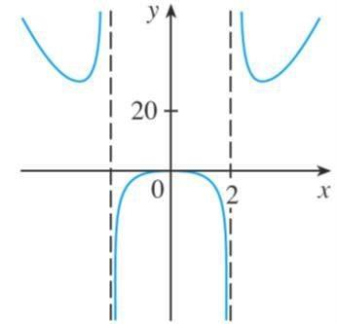
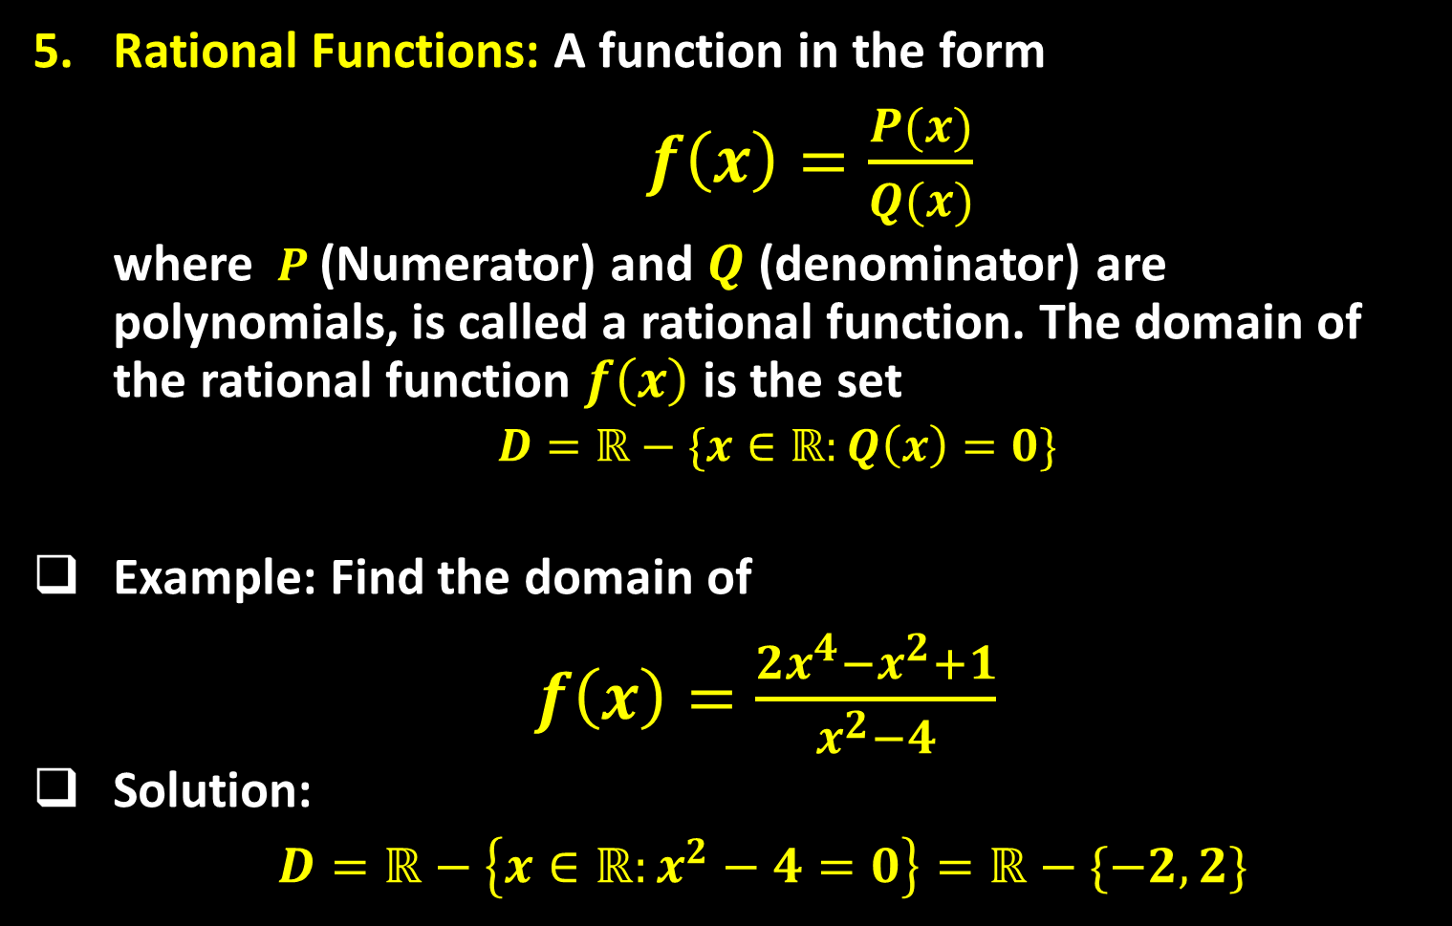
Sequence 12: Essential Functions (Part 3)
Rational Functions: A function in the form
$f\left(x\right)=\frac{P(x)}{Q(x)}$
where $P$(Numerator) and $Q$ (denominator) are polynomials, is called a rational function. The domain of the rational function $f\left(x\right)$ is the set
$D=ℝ−\{x∈ℝ:Q\left(x\right)=0\}$
Example: Find the domain of
$f\left(x\right)=\frac{2x^{4}−x^{2}+1}{x^{2}−4}$
Solution:
$D=ℝ−\left\{x∈ℝ:x^{2}−4=0\right\}=ℝ−\{−2,2\}$

Slide 3
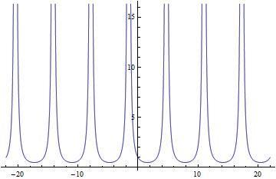

Sequence 12: Essential Functions (Part 3)
Example: Find the domain of
$f\left(x\right)=\frac{1}{1+\sin{x}}$
Solution: The domain of f is
$D=ℝ−\{x∈ℝ:1+\sin{x}=0\}$
$=ℝ−\{x∈ℝ:\sin{x}=−1\}$
$=ℝ−\{x=\frac{3π}{2}+2nπ\}$

Slide 4

Sequence 12: Essential Functions (Part 3)
Root Function: For any integer $n≥2$ ,
$f\left(x\right)=\sqrt[n]{g(x)}$
is the $n^{th}$ root function of $g(x)$.
The domain of the root function depends on the value of if it is even or odd.
  $n$ is odd: The domain of $f\left(x\right)$in this case is the same as the domain of $g(x)$. The range of $f\left(x\right)$ will be .
  $n$ is even: In this case, the domain of $f\left(x\right)$is the set
  $D=ℝ−\left\{x∈ℝ:g\left(x\right)≥0\right\}∩\{g\left(x\right)domain\}$
The range of $f$ is $[0,∞)$ .

Slide 5
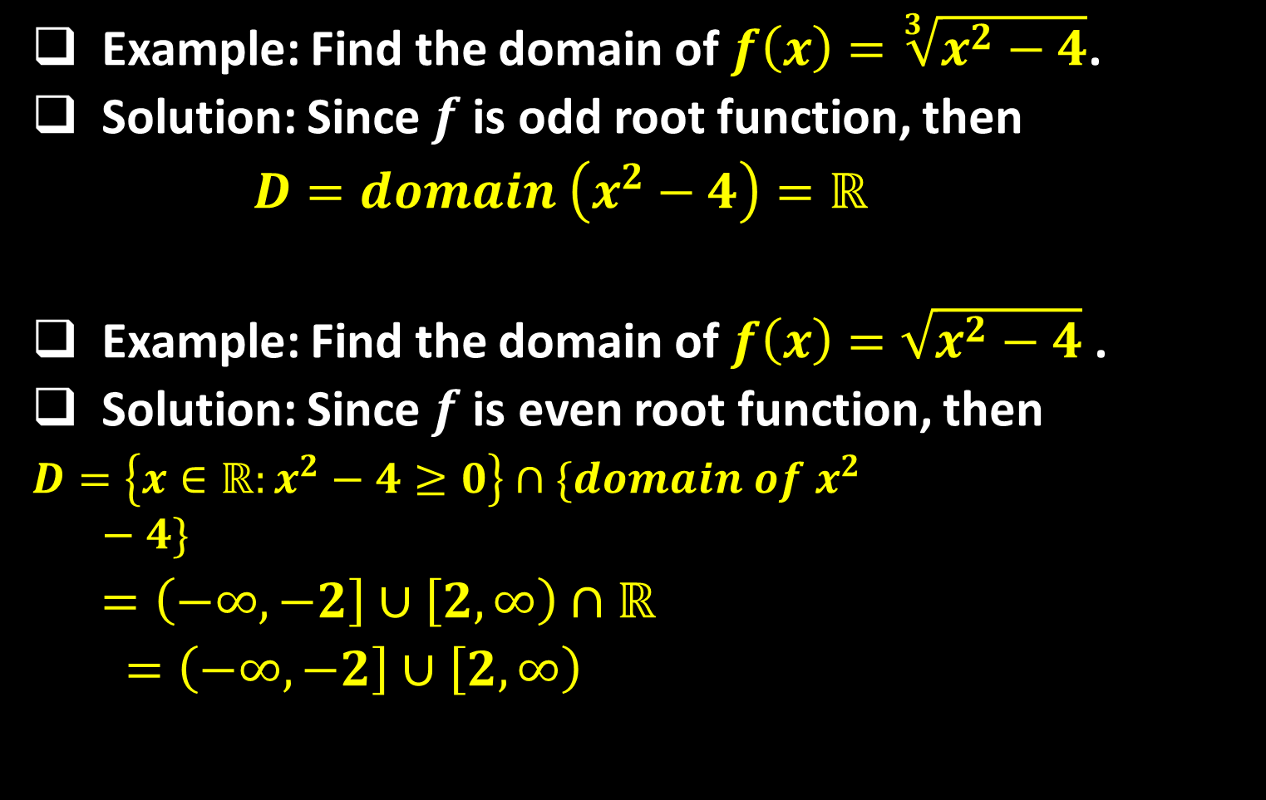
Sequence 12: Essential Functions (Part 3)
Example: Find the domain of $f\left(x\right)=\sqrt[3]{x^{2}−4}$.
Solution: Since $f$ is odd root function, then
$D=domain \left(x^{2}−4\right)=ℝ$
Example: Find the domain of $f\left(x\right)=\sqrt{x^{2}−4}$ .
Solution: Since $f$is even root function, then
$D=\left\{x∈ℝ:x^{2}−4≥0\right\}∩\{domain of x^{2}−4\}$
$=\left(−∞,−2\right]∪\left[2,∞\right)∩ℝ$
$=\left(−∞,−2\right]∪\left[2,∞\right)$

Slide 6

Sequence 12: Essential Functions (Part 3)
Example: Find the domain of $f\left(x\right)=\frac{1}{\sqrt{9−x^{2}}}$ .
Solution: This function is rational and its denominator is even root. The root's domain is the dominant here. The domain of $f$ is
$D=\left\{domain of \sqrt{9−x^{2}}\right\}−\{xεℝ:\sqrt{9−x^{2}}$=0}
$=\left\{x∈ℝ:9−x^{2}>0\right\}∩\left\{domain of 9−x^{2}\right\}$
$=\{x∈ℝ:x^{2}<9\}∩$ $ℝ$
$=\{x∈ℝ:\left|x\right|<3\}∩$ $ℝ$
$=(−3,3)∩$ $ℝ$
$=(−3,3)$

Slide 7

Sequence 12: Essential Functions (Part 3)
Example: Find the domain of $f\left(x\right)=\frac{1}{1−\sqrt{x}}$.
Solution: This example is quite different from the previous example. The function $f$ here is rational but its denominator contains an even root. The root's domain is also the dominant here. So, the domain of $f$ is
$D=\left\{domain of\sqrt{x} \right\}−\{xεℝ:1−\sqrt{x}$=0}
$=\left\{x∈ℝ:x>0\right\}∩\left\{domain of x\right\}−\{1\}$
$=[0,∞)∩$ $ℝ −\{1\}$
$=[0,∞) −\{1\}$
$=[0,1)∪(1,∞)$

Slide 8

Sequence 12: Essential Functions (Part 3)
Example: Find the domain of $f\left(x\right)=\sqrt{\sin{x}}$.
Solution: The domain of $f$ will be
$\{x∈ℝ:\sin{x≥0\}∩\{domain \sin{x}}\}$
  Note that $sinx≥0$ in quadrants I and II, when $x∈[0,π]$ .
  Since $sinx$ is periodic with period $2π$ , then it is greater than or equals to $0$ when
  $x∈[0+2nπ,π+2nπ]$ where $n=0,±1,±2,±3,…$ .
  Hence, the domain of $f$ is
  $$D=[0+2nπ,π+2nπ]∩ℝ$$
  $$=[0+2nπ,π+2nπ]$$
  $=[2nπ,(1+2n)π]$

Slide 9
Thank you for your Attention

