Slide 1

Session Two
Functions
Sequence 13: Combinations of Functions (Part 1)

Slide 2

Sequence 13: Combinations of Functions (Part 1)
Just as two real numbers can be combined by the operations of addition, subtraction, multiplication, and division to form other real numbers, two functions can be combined to create new functions.
Definition: Let $f$ and $g$ be two functions with overlapping domains. Then, for all $x$ common to both domains, the sum, difference, product, and quotient of $f$ and $g$ are defined as follows.

Slide 3
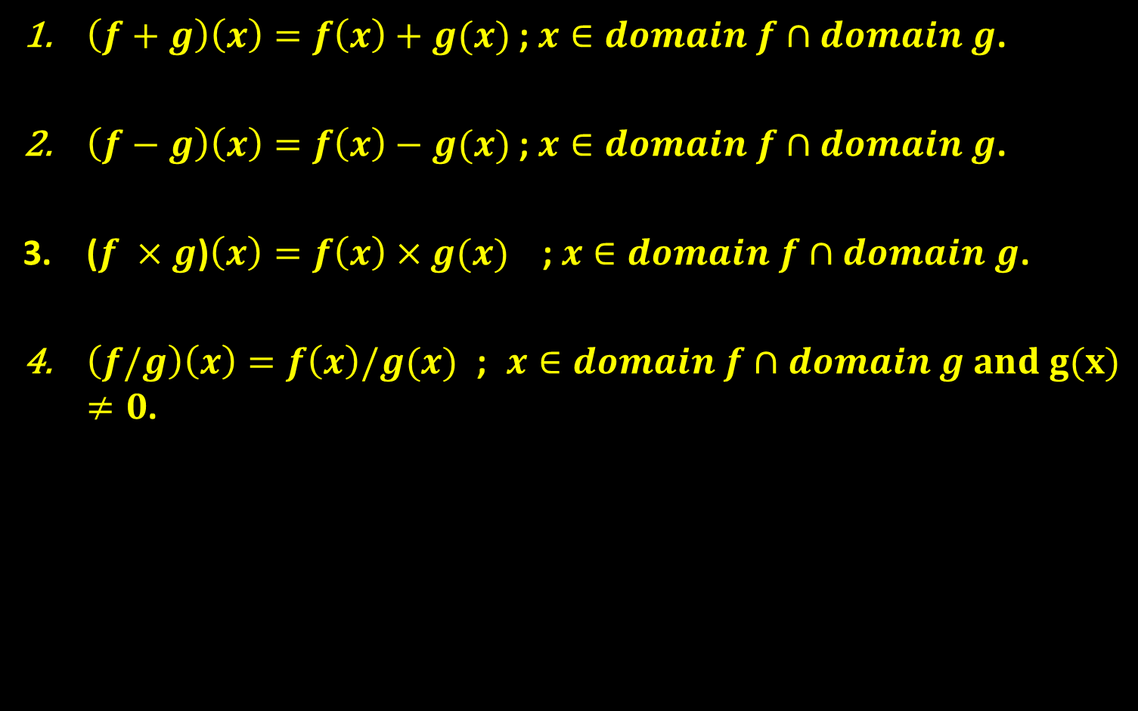
Sequence 13: Combinations of Functions (Part 1)
$\left(f+g\right)\left(x\right)=f\left(x\right)+g(x)$ ; $x∈domain f∩domain g$.
$\left(f−g\right)\left(x\right)=f\left(x\right)−g(x)$ ; $x∈domain f∩domain g$.
($f ×g$)$\left(x\right)=f\left(x\right)×g(x)$ ; $x∈domain f∩domain g$.
$\left(f/g\right)\left(x\right)=f\left(x\right)/g(x)$;$x∈domain f∩domain g and g(x)≠0$.

Slide 4

Sequence 13: Combinations of Functions (Part 1)
Example: Find $\left(f/g\right)\left(x\right)$ and $\left(g/f\right)\left(x\right)$ for the functions given by $f\left(x\right)=\sqrt{x}$ and $g\left(x\right)=\sqrt{4−x^{2}}$. Then find the domains of $f/g$ and $g/f$.
Solution: The quotient of $f$ and $g$ is
$\left(\frac{f}{g}\right)\left(x\right)=\frac{f\left(x\right)}{g\left(x\right)}=\frac{\sqrt{x}}{\sqrt{4−x^{2}}}$
The quotient of $g$ and $f$ is
$$\left(\frac{g}{f}\right)\left(x\right)=\frac{g\left(x\right)}{f\left(x\right)}=\frac{\sqrt{4−x^{2}}}{\sqrt{x}}$$

Slide 5

Sequence 13: Combinations of Functions (Part 1)
Continue: The domain of $f$is $[0,∞)$ and the domain of $g$ is $[−2,2]$ . The intersection of these domains is $[0,2]$ . So, the domains for $f/g$ and $g/f$ are as follows.
  Domain of $(f/g)$is $[0,2)$ .
  Domain of $(g/f)$ is $[0,2)$.

Slide 6

Sequence 13: Combinations of Functions (Part 1)
Example: Given $f\left(x\right)=2x+1$ and $g\left(x\right)=\frac{1}{x}+2x−1$ .
  Find $(f−g)(x)$ and its domain.
  Evaluate the difference when $x=2$ .
Solution: The difference of $f$ and $g$ is
$(f−g)(x)$ $=2x+1−(\frac{1}{x}+2x−1)$
$=2x+1−\frac{1}{x}−2x+1$
$=2−\frac{1}{x}$

Slide 7

Sequence 13: Combinations of Functions (Part 1)
Continue: Note that the domain of $f$ is $ℝ$ and the domain of g is $ℝ−\{0\}$ . Then, the intersection of these domains is $ℝ−\{0\}$. So, the domain of $(f−g)(x)$ is $ℝ−\{0\}$.

Slide 8
Thank you for your Attention

