Slide 1

Session Two
Functions
Sequence 15: Inverse Functions

Slide 2
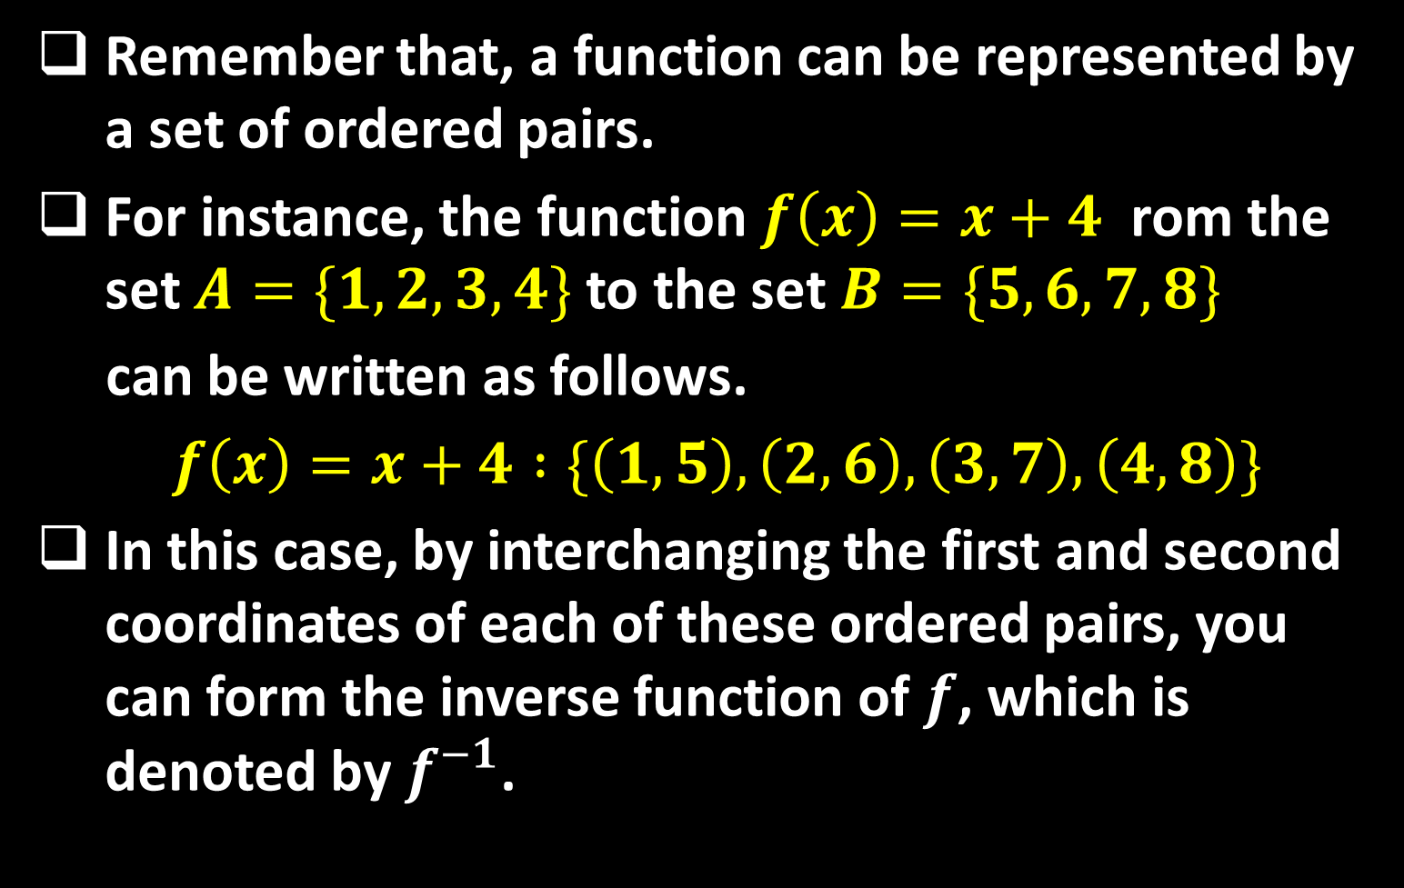
Sequence 15: Inverse Functions
Remember that, a function can be represented by a set of ordered pairs.
For instance, the function $f\left(x\right)=x+4$ rom the set $A=\{1,2,3,4\}$ to the set $B=\{5,6,7,8\}$
can be written as follows.
$f\left(x\right)=x+4 :\{\left(1,5\right), \left(2,6\right), \left(3,7\right), \left(4,8\right)\}$
In this case, by interchanging the first and second coordinates of each of these ordered pairs, you can form the inverse function of $f$, which is denoted by $f^{−1}$.

Slide 3

Sequence 15: Inverse Functions
$f^{−1}$ is a function from the set $B$ to the set $A$ , and can be written as follows.
$f^{−1}\left(x\right)=x+4 :\{\left(5,1\right), \left(6,2\right), \left(7,3\right), \left(8,4\right)\}$
Note that the domain of $f$ is equal to the range of $f^{−1}$, and vice versa.
Also note that the functions $f$ and $f^{−1}$ have the effect of "undoing" each other. In other words, when you form the composition of $f$ with $f^{−1}$ or the composition of $f$ with $f^{−1}$, you obtain the identity function $x$.
$f\left(f^{−1}\left(x\right)\right)=f\left(x−4\right)=\left(x−4\right)+4=x$
$f^{−1}\left(f\left(x\right)\right)=f^{−1}\left(x−4\right)=\left(x+4\right)−4=x$

Slide 4

Sequence 15: Inverse Functions
Definition: A function is called a one-to-one function if it never takes on the same value twice; that is, $f(x_{1})≠f(x_{2})$ whenever $x_{1}≠x_{2}$ .
We have the following geometric method for determining whether a function is one-to-one.
Horizontal Line Test: A function is one-to-one if and only if no horizontal line intersects its graph more than once.

Slide 5
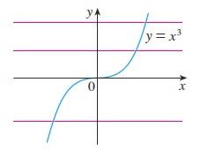

Sequence 15: Inverse Functions
Example: Is the function $f\left(x\right)=x^{3}$ one-to-one?
Solution: If $x_{1}≠x_{2}$ , then $x_{1}^{3}≠x_{2}^{3}$ (two different numbers can’t have the same cube). Therefore, $f\left(x\right)=x^{3}$ is one-to-one. From the figure below we see that no horizontal line intersects the graph of $f\left(x\right)=x^{3}$ more than once. Therefore, by the Horizontal Line Test, $f$ is one-to-one.

Slide 6
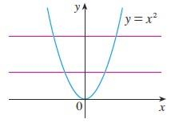

Sequence 15: Inverse Functions
Example: Is the function $g\left(x\right)=x^{2}$ one-to-one?
Solution: This function is not one-to-one because, for instance,
$g\left(1\right)=1=g(−1)$
and so $1$ and $−1$ have the same output. From the figure below we see that there are horizontal lines that intersect the graph of $g$ more than once. Therefore, by the Horizontal Line Test, $g$ is not one-to-one.

Slide 7

Sequence 15: Inverse Functions
Not all functions possess inverses. Only function that has the one-to-one property has inverse function according to the following definition.
Definition: Let $f$ be a one-to-one function with domain $A$ and range $B$ . Then its inverse function $f^{−1}$ has domain $B$ and range $A$ and is defined by $f^{−1}\left(y\right)=x⇔f\left(x\right)=y$ for any $y∈B$.
By this definition we get the following cancelation equations:
$f^{−1}\left(f\left(x\right)\right)=x$ for every $x∈A$
$f\left(f^{−1}\left(x\right)\right)=x$ for every $x∈B$ .

Slide 8

Sequence 15: Inverse Functions
How To Find The Inverse Function Of A One-To-One Function $f$:
  Write $y=f(x)$ .
  Solve this equation for $x$ in terms of $y$ (if possible).
  To express $f^{−1}$ as a function of $x$ , interchange $x$ and $y$ . The resulting equation is $y=f^{−1}(x)$ .

Slide 9

Sequence 15: Inverse Functions
Example: Find the inverse function of
$$f\left(x\right)=x^{3}+2$$
Solution: Note that $f\left(x\right)=x^{3}+2$ is one-to-one function. According to the previous algorithm, first we write $y=x^{3}+2$ . Then we solve this equation for $x$ :
$x^{3}=y−2$
$x=\sqrt[3]{y−2}$
Finally, we interchange $x$ and $y$
$y=\sqrt[3]{x−2}=f^{−1}(x)$

Slide 10
Thank you for your Attention

