Slide 1

Session Two
Functions
Sequence 16: Inverse Trigonometric Functions

Slide 2
Sequence 16: Inverse Trigonometric Functions
When we try to find the inverse trigonometric functions, we have a slight difficulty: Because the trigonometric functions are not one-to-one, they do not have inverse functions.
The difficulty is overcome by restricting the domains of these functions so that they become one-to-one.

Slide 3
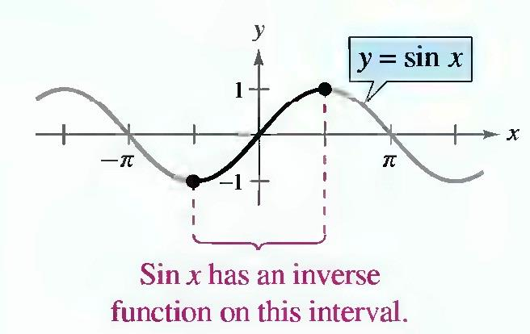
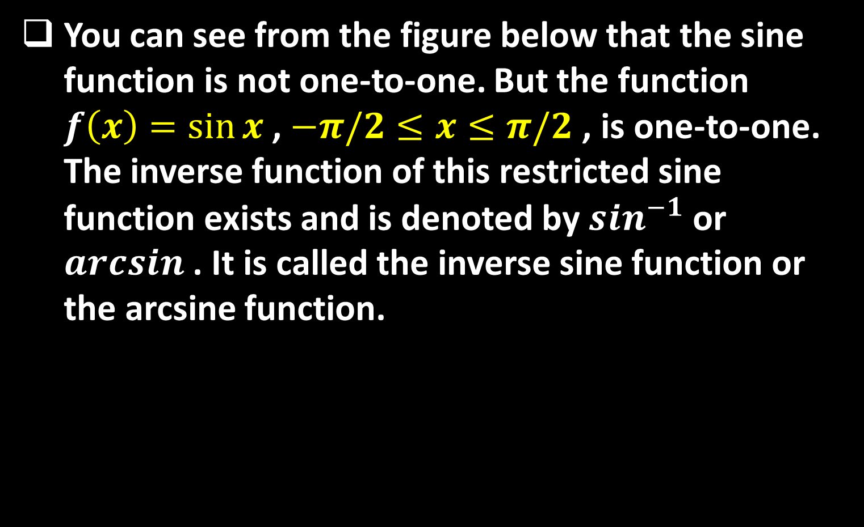
Sequence 16: Inverse Trigonometric Functions
You can see from the figure below that the sine function is not one-to-one. But the function $f\left(x\right)=\sin{x}$ , $−π/2≤x≤π/2$ , is one-to-one. The inverse function of this restricted sine function exists and is denoted by $\sin^{−1}$ or $arcsin$ . It is called the inverse sine function or the arcsine function.

Slide 4
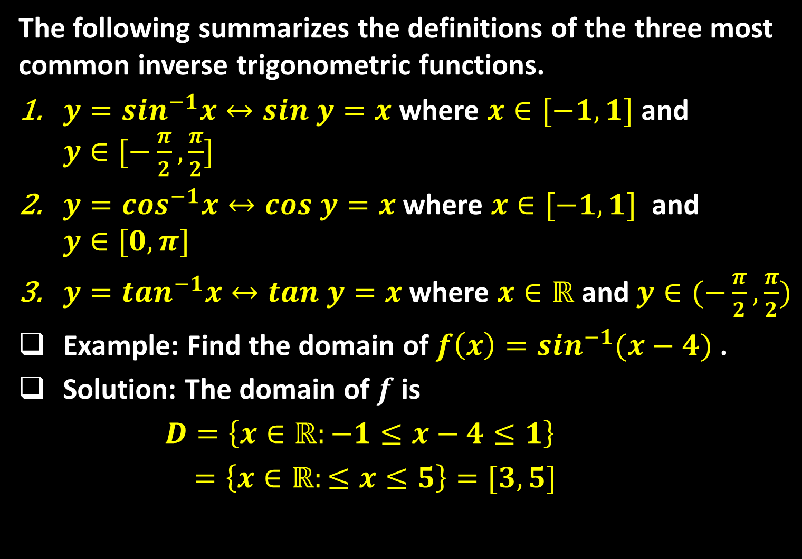
Sequence 16: Inverse Trigonometric Functions
The following summarizes the definitions of the three most common inverse trigonometric functions.
$y=\sin^{−1}x↔sin y=x$ where $x∈[−1,1]$ and $y∈[−\frac{π}{2},\frac{π}{2}]$
$y=\cos^{−1}x↔cos y=x$ where $x∈[−1,1]$ and $y∈[0,π]$
$y=\tan^{−1}x↔tan y=x$ where $x∈ℝ$ and $y∈(−\frac{π}{2},\frac{π}{2})$
Example: Find the domain of $f\left(x\right)=\sin^{−1}(x−4)$ .
Solution: The domain of $f$ is
$D=\left\{x∈ℝ:−1≤x−4≤1\right\}$
$=\left\{x∈ℝ:≤x≤5\right\}=[3,5]$

Slide 5

Sequence 16: Inverse Trigonometric Functions
Example: If possible, find the exact value of
  $\sin^{−1}(\frac{\sqrt{3}}{2})$
  $\cos^{−1}(\frac{\sqrt{2}}{2})$
Solution:
  Because$sin({π/3)}=\sqrt{3}/2$and$π/3∈[−π/2,π/2]$it
  Follows $\sin^{−1}\left(\frac{\sqrt{3}}{2}\right)=π/3$
  Because $cos\left(\frac{π}{4}\right)=\sqrt{2}/2$ and $\frac{π}{4}∈[0,π]$, it
  Follows $\cos^{−1}\left(\frac{\sqrt{2}}{2}\right)=π/4$

Slide 6

Sequence 16: Inverse Trigonometric Functions
The following are some important identities of inverse trigonometric functions.
  $\sin^{−1}\left(−x\right)=−\sin^{−1}(x)$ for all $x∈[−1,1]$.
  $\tan^{−1}\left(−x\right)=−\tan^{−1}(x)$ for all $x∈ℝ$.
  $\cos^{−1}\left(−x\right)=π−\cos^{−1}(x)$ for all $x∈[−1,1]$.
  $\sin\left(\sin^{−1}\left(x\right)\right)=x$ for all $x∈[−1,1]$ and $\sin^{−1}\left(sinx\right)=x$ for all $x∈[−\frac{π}{2},\frac{π}{2}]$.
  $\cos\left(\cos^{−1}\left(x\right)\right)=x$ for all $x∈[−1,1]$ , and $\cos^{−1}\left(cosx\right)=x$ for all $x∈[0,π]$ .
  $\tan\left(\tan^{−1}\left(x\right)\right)=x$ for all $x∈ℝ$, and $\tan^{−1}\left(tanx\right)=x$ for all $x∈[−\frac{π}{2},\frac{π}{2}]$.

Slide 7
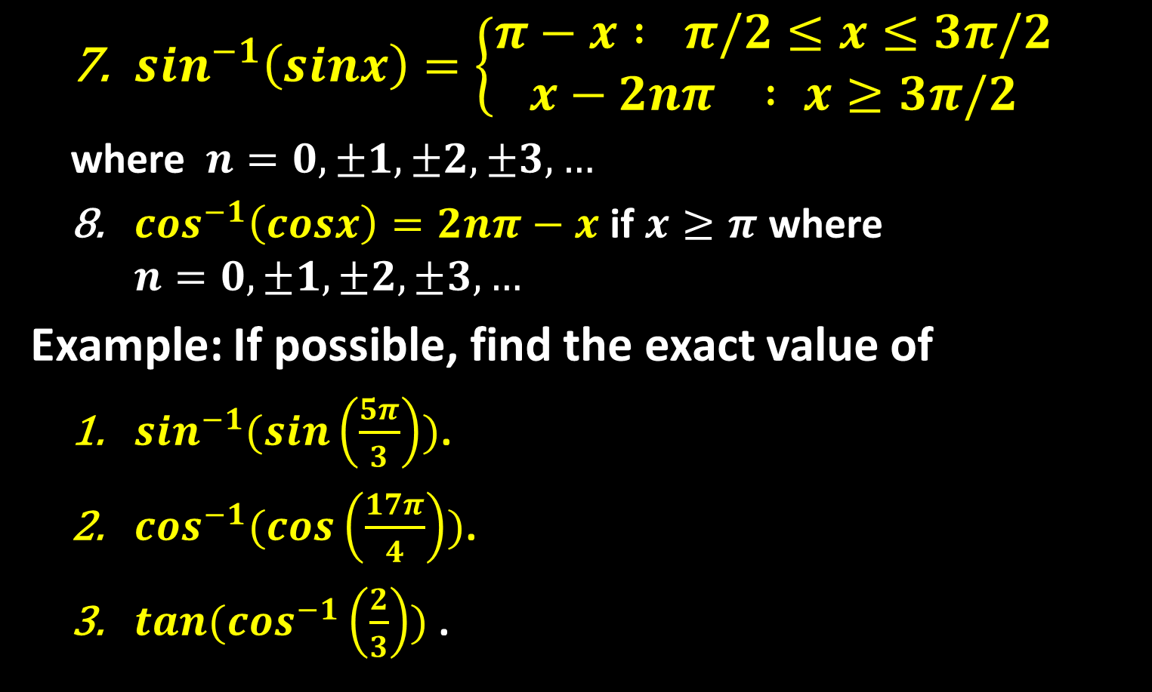
Sequence 16: Inverse Trigonometric Functions
  $\sin^{−1}\left(sinx\right)=\left\{\begin{aligned}π−x : π/2≤x≤3π/2 \\ x−2nπ : x≥3π/2\end{aligned}\right.$
  where $n=0,±1,±2,±3,…$
  $\cos^{−1}\left(cosx\right)=2nπ−x$ if $x≥π$ where $n=0,±1,±2,±3,…$
Example: If possible, find the exact value of
  $\sin^{−1}(sin\left(\frac{5π}{3}\right))$.
  $\cos^{−1}(cos\left(\frac{17π}{4}\right))$.
  $tan(\cos^{−1}\left(\frac{2}{3}\right))$ .

Slide 8

Sequence 16: Inverse Trigonometric Functions
Solution:
  In this case, $5π/3$ does not lie within the range of the arcsine function $[−\frac{π}{2},\frac{π}{2}]$. However, $5π/3$ is conterminal with $\frac{5π}{2}−2π=−\frac{π}{3}∈[−\frac{π}{2},\frac{π}{2}]$, and you have
  $$\sin^{−1}\left(sin\left(\frac{5π}{3}\right)\right)=\sin^{−1}\left(sin\left(−\frac{π}{3}\right)\right)=−\frac{π}{3}$$
  In this case, $17π/4$ does not lie within the range of the cosine function $[0,π]$ . However, $17π/4$ is conterminal with $2\left(2\right)π−\frac{17π}{4}=−π/4$, and you have
  $\cos^{−1}\left(cos\left(\frac{17π}{4}\right)\right)=\cos^{−1}\left(cos\left(−\frac{π}{4}\right)\right)$
  $=\cos^{−1}\left(cos\left(\frac{π}{4}\right)\right)=\frac{π}{4}$

Slide 9

Sequence 16: Inverse Trigonometric Functions
  If you let $u=\cos^{−1}(\frac{2}{3})$ then $cos u=2/3$ . Because $cos u$ is positive, $u$ is a first-quadrant angle. You can sketch and label angle $u$ as shown in the figure below. Consequently
  $tan\left(\cos^{−1}\left(\frac{2}{3}\right)\right)=tan u=\frac{opp}{adj} =\frac{\sqrt{5}}{2}$

Slide 10
Thank you for your Attention

