Slide 1

Session Three
Limits and Continuity
An Introduction to Limits
Calculating Limits using the Limit Laws

Slide 2
An Introduction to Limits
We could begin by saying that limits are important in calculus, but that would be a major understatement. Without limits, calculus would not exist. Every single notion of calculus is a limit in one sense or another.
For example: What is the slope of a curve? It is the limit of slopes of secant lines. What is the length of a curve? It is the limit of the lengths of polygonal paths inscribed in the curve. What is the area of a region bounded by a curve? It is the limit of the sum of areas of approximating rectangles.

Slide 3
An Introduction to Limits
James Stewart, Calculus: Early Transcendentals, 7th Edition, Brooks/ Cole 2012.
Howard Anton, Irl C. Bivens and Stephen Davis, Calculus: Early Transcendentals, 9th Edition, John Wiley & Sons, Inc. 2010.
Salas, Etgen, and Hille, Calculus: One and Several Variables, 10th Edition, John Wiley & Sons, Inc. 2007.

Slide 4
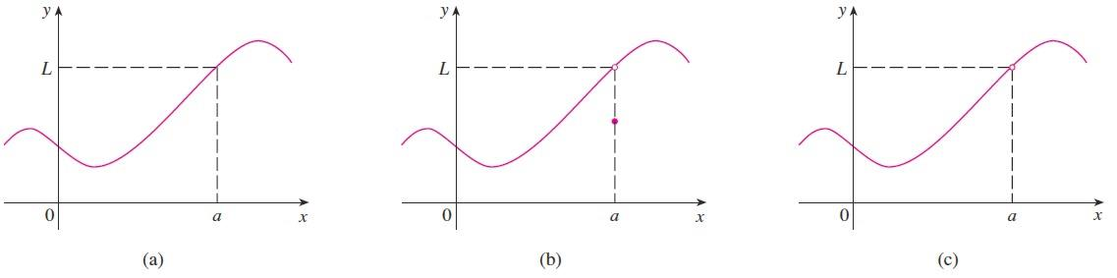

An Introduction to Limits
The informal description of a limit is as follows: If $f(x)$ becomes arbitrarily close to a single number $L$ as $x$ approaches $a$ from either side, the limit of $f(x)$, as $x$ approaches $a$ ,is $L$.
The existence or nonexistence of $f(x)$ at $x=a$ has no bearing on the existence of the limit of $f(x)$ as $x$ approaches $a$ .

Slide 5

An Introduction to Limits
The notation for a limit is $\lim_{x→a}{f\left(x\right)=L}$ which is
read as the limit of $f(x)$ as $x$ approaches $a$ is $L$ .
Example: Guess the value of $\lim_{x→1}{\frac{x−1}{x^{2}−1}}$ .
Solution: Notice that the function $\lim_{x→1}{\frac{x−1}{x^{2}−1}}$ is not
defined when $x=1$, but that does not matter
because the definition of $\lim_{x→a}{f(x)}$ says that we consider values of $x$
that are close to $a$ but not equal to $a$ .

Slide 6
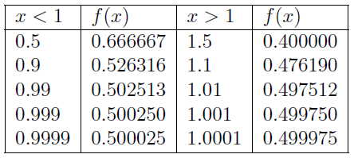

An Introduction to Limits
Continue: The table below gives values of (correct to six decimal places) for values of that approach (but are not equal to ).
On the basis of the values in the table, we make the guess that
$\lim_{x→1}{\frac{x−1}{x^{2}−1}}=\frac{1}{2}$

Slide 7
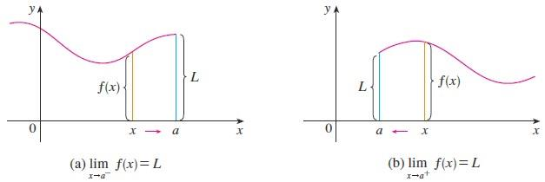

An Introduction to Limits
Definition: We write $\lim_{x→a^{−}}{f(x)}=L$ and say the left-hand limit of $f(x)$ as $x$ approaches $a$ is equal to $L$ if we can make the values of $f(x)$ arbitrarily close to $L$ by taking $x$ to be sufficiently close to $a$ and $x$ less than $a$ . Similarly, if we require that $x$ be greater than $a$ , we get the right-hand limit of $f(x)$ as $x$ approaches $a$ is equal to $L$ , and we write $\lim_{x→a^{+}}{f(x)}=L$ .

Slide 8

An Introduction to Limits
Thus the symbol $x→a^{−}$ means that we consider only $x<a$ , and the symbol $x→a^{+}$ means that we consider only $x>a$ .
The relationship between ordinary (two-sided) limits and one-sided limits can be stated as follows.
Theorem: Let $L∈ℝ$ . We say $\lim_{x→a}{f(x)}$ exists and equals to $L$ if and only if
$\lim_{x→a^{−}}{f(x)}=\lim_{x→a^{+}}{f(x)}=L$

Slide 9

An Introduction to Limits
Limits That Fail to Exist:
  If a function $f(x)$ approaches a different number from the right side of $x=c$ than it approaches from the left side, then the limit of $f(x)$ as $x$ approaches $a$ does not exist.
  $\lim_{ x→a^{−}}{f(x)}≠\lim_{x→a^{+}}{f(x)}$
  If $f(x)$ is not approaching a real number $L−$ that is, if $f(x)$ increases or decreases without bound $−$ as $x$ approaches $a$ , you can conclude that the limit does not exist.
  $\lim_{x→a}{f(x)}=±∞$
  The limit of $f(x)$ as $x$ approaches $a$
  does not exist if $f(x)$ oscillates
  between two fixed values as $x$ approaches $a$ .

Slide 10
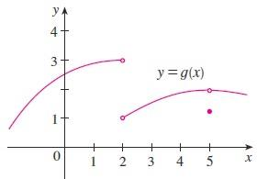

An Introduction to Limits
Example: The graph of a function $g$ is shown in the figure. Use it to state the value (if it exists) of $\lim_{x→2}{g(x)}$ .
Solution: From the graph we see that the values of $g\left(x\right)$approach $3$ as $x$ approaches $2$ from the left, but they approach $1$ as $x$ approaches $2$ from the right. Therefore $\lim_{x→2^{−}}{g(x)}=3$ and $\lim_{x→2^{+}}{g(x)}=1$ . Since the left and right limits are different,
we conclude that $\lim_{x→2}{g(x)}$ does not exist.

Slide 11
Calculating Limits using the Limit Laws
In this section we use the following properties of limits, called the Limit Laws, to calculate limits.
Theorem: Suppose that $c$ is a constant and the limits $\lim_{x→a}{f(x)}$ and $\lim_{x→a}{g(x)}$ exist. Then
$$1. \lim_{x→a}{[f\left(x\right)+g\left(x\right)]}=\lim_{x→a}{f(x)}+\lim_{x→a}{g(x)}.$$
$$2. \lim_{x→a}{[f\left(x\right)−g\left(x\right)]}=\lim_{x→a}{f(x)}−\lim_{x→a}{g\left(x\right)}.$$
$3. \lim_{x→a}{[cf\left(x\right)]}=c\lim_{x→a}{f(x)}.$
$$4.\lim_{x→a}{[f\left(x\right)×g\left(x\right)]}=\lim_{x→a}{f(x)}×\lim_{x→a}{g(x)}.$$
$5.\lim_{x→a}\left[\frac{f\left(x\right)}{g\left(x\right)}\right]=\frac{\lim_{x→a}{f\left(x\right)}}{\lim_{x→a}{g\left(x\right)}} if\lim_{x→a}{g(x)}≠0$.

Slide 12

Calculating Limits using the
$$6.\lim_{x→a}{{[f\left(x\right)]}^{n}}={[\lim_{x→a}{f(x)}]}^{n} where n is a positive integer$$
$7.\lim_{x→a}{c}=c$
$8. \lim_{x→a}{x}=a$
$9.\lim_{x→a}{x^{n}}=a^{n} where n is a positive integer$
$10. \lim_{x→a}{\sqrt[n]{x}=\sqrt[n]{a} }where n is a positive integer,$
$and if n is even, we assume that a$
$$11. \lim_{x→a}{\sqrt[n]{f(x)}= \sqrt[n]{\lim_{a→x}{f(x)}}}where n is a positive integer$$
$, and if n is even, we assume that \lim_{x→a}{f(x)}>0$

Slide 13
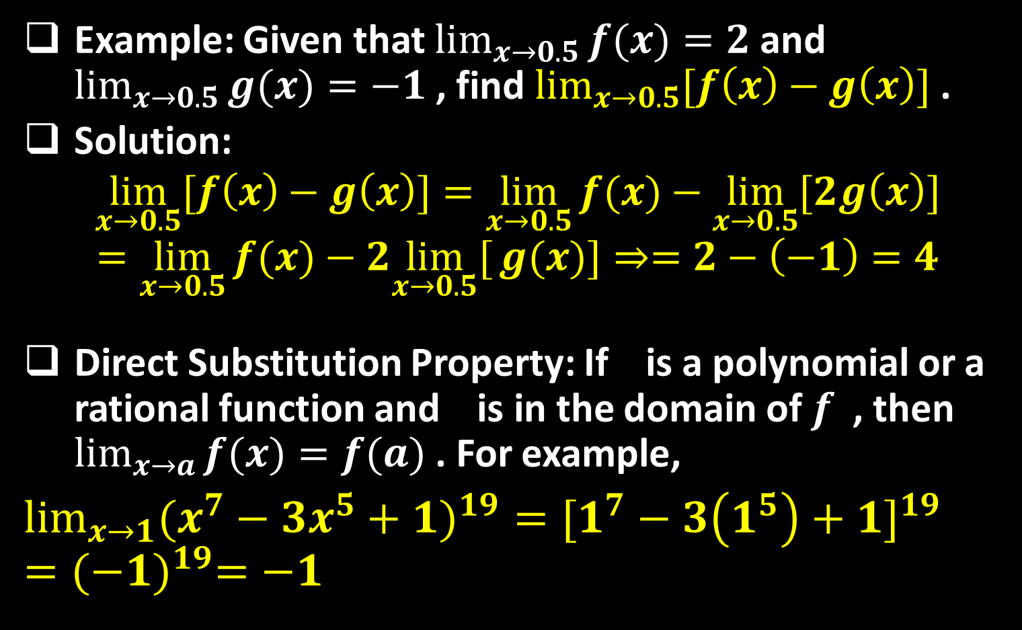
Example: Given that $\lim_{x→0.5}{f(x)}=2$ and $\lim_{x→0.5}{g(x)}=−1$ , find $\lim_{x→0.5}{[f\left(x\right)−g\left(x\right)]}$ .
Solution:
$$\lim_{x→0.5}{[f\left(x\right)−g\left(x\right)]}=\lim_{x→0.5}{f(x)}−\lim_{x→0.5}{[2g\left(x\right)]}$$
$$=\lim_{x→0.5}{f(x)}−2\lim_{x→0.5}[{g(x)]}⇒=2−\left(−1\right)=4$$
Direct Substitution Property: If is a polynomial or a rational function and is in the domain of $f$ , then $\lim_{x→a}{f(x)}=f(a)$ . For example,
$\lim_{x→1}{({x^{7}−3x^{5}+1)}^{19}}={[1^{7}−3\left(1^{5}\right)+1]}^{19}={(−1)}^{19}=−1$

Slide 14

The next examples show various ways algebraic manipulations can be used to evaluate $\lim_{x→a}{f(x)}$ in situations where $f(a)$ is undefined. This usually happens when $f(x)$ is a fraction with denominator equal to $0$ at $x=a$ .
Example: Evaluate $\lim_{x→3}{\frac{x^{2}−9}{x−3}}$
Solution: We factor the numerator as a difference of squares:$\frac{(x+3)(x−3)}{x−3}$ . The numerator and denominator have a common factor of $x−3$ . Therefore,
$$\lim_{x→3}{\frac{x^{2}−9}{x−3}}=\lim_{x→3}{\text{:}\frac{(x+3)(x−3)}{x−3}}= \lim_{x→3}{x+3}$$
$=6$

Slide 15
Example: Find $\lim_{t→0}{\frac{\sqrt{t^{2}−9}−3}{t^{2}}}$
Solution: Here the preliminary algebra consists of rationalizing the numerator:
$$\lim_{t→0}{\frac{\sqrt{t^{2}−9}−3}{t^{2}}}=\lim_{t→0}{\frac{\sqrt{t^{2}−9}−3}{t^{2}}}.\frac{\sqrt{t^{2}+9}+3}{\sqrt{t^{2}+9}+3}$$
$$=\lim_{t→0}{\frac{\left(t^{2}+9\right)−9}{t^{2}(\sqrt{t^{2}+9}+3)}}=\lim_{t→0}{\frac{t^{2}}{t^{2}(\sqrt{t^{2}+9}+3)}}$$
$$=\lim_{t→0}{\frac{1}{\sqrt{t^{2}+9}+3}}=\frac{1}{6}$$

Slide 16
Example: Find $\lim_{x→1}{\frac{\sqrt{x}−1}{\sqrt[3]{x}−1}}$
Solution: Here the preliminary algebra consists of rationalizing both the numerator and the denominator by multiplying $\frac{\sqrt{x}−1}{\sqrt[3]{x}−1}−\frac{\sqrt[3]{x^{2}}+\sqrt[3]{x}+1}{\sqrt[3]{x^{2}}+\sqrt[3]{x}+1}$ which takes long time in calculations.
The Substitution method is much better in this example. The idea is: write the problem using other variable $y$ so that the problem will transform to nice form that can easily solve.
So, let $x=y^{6}$ where $6=LCM\left(2,3\right).$

Slide 17
Continue: Also, as $x→1$ we have $y→\sqrt[6]{1}=1$ . Hence,
$$\lim_{x→1}{\frac{\sqrt{x}−1}{\sqrt[3]{x}−1}}=\lim_{y→1}{\frac{\sqrt{y^{6}}−1}{\sqrt[3]{y^{6}}−1}}=\lim_{y→1}{\frac{y^{3}−1}{y^{2}−1}}$$
$$=\lim_{y→1}{\frac{(y−1)(y^{2}+y+1)}{(y−1)(y+1)}}$$
$$=\lim_{y→1}{\frac{y^{2}+y+1}{y+1}}=\frac{3}{2}$$

Slide 18
Thank you for your Attention

