Slide 1

Limits and Continuity
Calculating Limits using the Limit Laws
Limits at Infinity

Slide 2

Example: Find $\lim_{x→−4}{\frac{\frac{1}{4}+\frac{1}{x}}{x+4}}$
Solution: Here the preliminary algebra consists of simplifying the numerator:
$\lim_{x→−4}{\frac{\frac{1}{4}+\frac{1}{x}}{x+4}}=\lim_{x→−4}{(\frac{1}{4}+\frac{1}{x})}÷\left(x+4\right)$
$=\lim_{x→−4}{\frac{x+4}{4x}}.\frac{1}{x+4}=\lim_{x→−4}{\frac{1}{4x}}=−\frac{1}{16}$

Slide 3

A function may be defined on both sides of $x=a$ but still not have a limit at $x=a$ .
Example: Find $\lim_{x→1}{g(x)}$ where
$$g\left(x\right)=\left\{\begin{aligned}x+1 if x≠1 \\ π if x=1 \end{aligned}\right.$$
Solution: Here $g$ is defined at $x=1$ and $g\left(1\right)=π$ , but the value of a limit as approaches $1$ does not depend on the value of the function at $1$, Since $g\left(1\right)=π$ for $x≠1$ , we have
$\lim_{x→1}{g(x)}=\lim_{x→1}{(x+1)}=2$

Slide 4

Some limits are best calculated by first finding the left- and right-hand limits
Example: If $f\left(x\right)=\left\{\begin{aligned}\sqrt{x−4} if x>4 \\ 8−2x if x<4\end{aligned}\right.$, determine whether $\lim_{x→4}{f(x)}$ exists.
Solution: Since $\sqrt{x−4}$ for $x>4$ , we have
$\lim_{x→4^{+}}{f(x)}=\lim_{x→4^{+}}{\sqrt{x−4}}=\sqrt{4−4}=0$
Since $f\left(x\right)=8−2x$ for $x>4$, we have
$$\lim_{x→4^{−}}{f(x)}=\lim_{x→4^{−}}{8−2x}=8−2×4=0$$
The right- and left-hand limits are equal.
Thus the limit exists and $\lim_{x→4}{f\left(x\right)=0}$

Slide 5

Example: If $f\left(x\right)=\frac{\left|x−2\right|}{x^{2}+x−6}$ , find $\lim_{x→2}{f(x)}$ .
Solution: Observe that $\left|x−2\right|=\left\{\begin{aligned}x−2 if x≥2 \\ −\left(x−2\right)if x<2\end{aligned}\right.$ . Therefore,
$\lim_{x→2^{+}}{\frac{\left|x−2\right|}{x^{2}+x−6}} =\lim_{x→2^{+}}{\frac{x−2}{(x−2)(x+3)}=} \lim_{x→2^{+}}{\frac{1}{x+3}}=\frac{1}{5}$

Slide 6

$$\lim_{x→2^{−}}{\frac{\left|x−2\right|}{x^{2}+x−6}}=\lim_{x→2^{−}}{\frac{−(x−2)}{(x−2)(x+3)}=}\lim_{x→2^{−}}{\frac{−1}{x+3}}=−\frac{1}{5}$$
Since $\lim_{x→2^{+}}{f(x)}≠\lim_{x→2^{−}}{f(x)}$, then the limit $\lim_{x→2}{f(x)}$ does not exist.

Slide 7

Example: Let $g\left(x\right)=\sqrt{1−x^{2}}$ find $\lim_{x→1}{g(x)}$.
Solution: The domain of $g$ is $[−1,1]$ , so $g(x)$ is defined only to the right of $x=−1$ and to the left of $x=1$ . So, $\lim_{x→1^{−}}{g(x)}=0$ and $\lim_{x→1^{+}}{g(x)}$ does not exist. Therefore, $\lim_{x→1}{g(x)}$ does not exist.
Squeeze Theorem: If $f(x)≤g(x)≤h(x)$ when $x$ is near $a$ (except possibly at $a$ ) and $\lim_{x→a}{f(x)}=\lim_{x→a}{h(x)}=L$ Then $\lim_{x→a}{g(x)}=L$

Slide 8
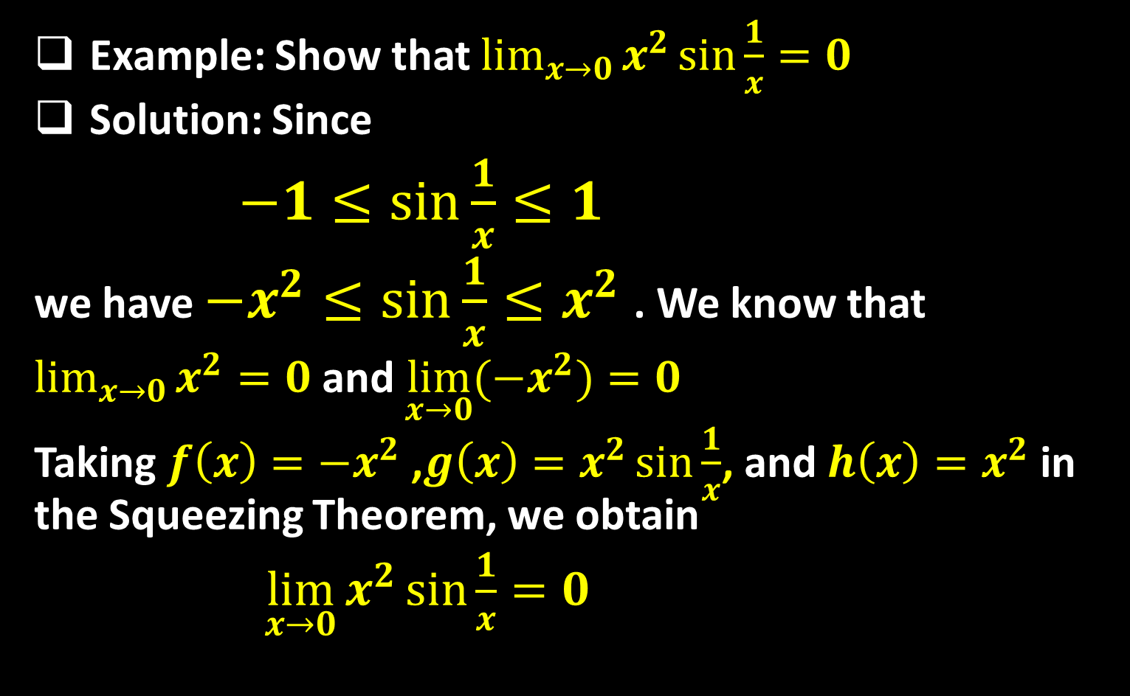
Example: Show that $\lim_{x→0}{x^{2}\sin{\frac{1}{x}}}=0$
Solution: Since
$−1≤\sin{\frac{1}{x}}≤1$
we have $−x^{2}≤\sin{\frac{1}{x}}≤x^{2}$ . We know that
$\lim_{x→0}{x^{2}}=0$ and $\lim_{x→0}{(−x^{2})}=0$
Taking $f\left(x\right)=−x^{2}$ ,$g\left(x\right)=x^{2}\sin{\frac{1}{x}}$, and $h\left(x\right)=x^{2}$ in the Squeezing Theorem, we obtain
$\lim_{x→0}{x^{2}\sin{\frac{1}{x}}}=0$

Slide 9

Limits at Infinity
In this section we will extend the concept of limit to allow for limits at infinity, where $x$ becomes arbitrarily large, positive or negative.
Definition:
  If the function $f$ is defined on an interval $(a,∞)$ and if we can ensure that $f(x)$ is as close as we want to the number $L$ by taking $x$ large enough, then we say that $f(x)$ approaches the limit $L$ as $x$ approaches infinity, and we write
  $\lim_{x→∞}{f(x)}=L$

Slide 10
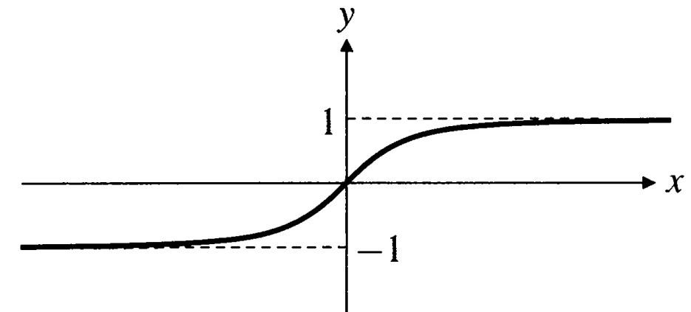
  If the function $f$ is defined on an interval $(−∞,b)$ and if we can ensure that $f(x)$ is as close as we want to the number $M$ by taking $x$ negative and large enough, then we say that $f(x)$ approaches the limit $M$ as $x$ approaches negative infinity, and we write
  $\lim_{x→−∞}{f(x)}=M$
Example: Consider the function $f\left(x\right)=\frac{x}{\sqrt{x^{2}+1}}$ whose graph is shown below.

Slide 11
The values of $f(x)$ seem to approach $1$ as $x$ takes on larger and larger positive values, and $−1$ as $x$ takes on negative values that get smaller and smaller. We express this behavior by writing and $\lim_{x→∞}{f(x)}=1 and\lim_{x→−∞}{f(x)}=−1$
The graph of $f$ conveys this limiting behavior by approaching the horizontal lines $y=1$ as $x$ moves far to the right and $y=−1$ as $x$ moves far to the left. These lines are called horizontal asymptotes of the graph.

Slide 12
Definition: A line $y=b$ is a horizontal asymptote of the graph of a function $f(x)$ if either $\lim_{x→∞}{f(x)}=b$ or $\lim_{x→−∞}{f(x)}=b$ .
Example: (Polynomial behavior at infinity) Find
$$\lim_{x→∞}{(3x^{3}−x^{2}+2)}$$
Solution: The highest-degree term of a polynomial dominates the other terms as $\left|x\right|$ grows large, so the limits of this term at $∞$ and $−∞$ determine the limits of the whole polynomial. So,
$\lim_{x→∞}{(3x^{3}−x^{2}+2)}$
$=\lim_{x→∞}{(3x^{3})}=3×∞^{3}=∞$

Slide 13
Example: Find $\lim_{x→−∞}{(x^{4}−{5x}^{3}−x)}$
Solution:
$$\lim_{x→−∞}{(x^{4}−{5x}^{3}−x)}=\lim_{x→−∞}{{(x}^{4})}={(−∞)}^{4}=∞$$
The situation is more interesting for rational functions. The way to render such a function in a form where its limits at $∞$ and $−∞$ (if they exist) are apparent is: to divide the numerator and denominator by the highest power of $x$ appearing in the denominator, then use the following theorem.

Slide 14

Theorem: If $r>0$ is a rational number such that is defined for all $x$, then $\lim_{x→±∞}{\frac{1}{x^{r}}}=0$ .
Remark: The limits of a rational function at infinity and negative infinity either both fail to exist or both exist and are equal.
Example: Evaluate $\lim_{x→±∞}{\frac{2x^{2}−x+3}{3x^{2}+5}}$.
Solution: Divide the numerator and the denominator by
$$\lim_{x→±∞}{\frac{2x^{2}−x+3}{3x^{2}+5}}=\lim_{x→±∞}{\frac{2−\left(\frac{1}{x}\right)+(\frac{3}{x^{2}})}{3+(\frac{5}{x^{2}})}}=\lim_{x→±∞}{\frac{2−0+0}{3+0}}=\frac{2}{3}$$

Slide 15
Note that, in the previous example, $y=\frac{2}{3}$ is horizontal asymptote of $\frac{2x^{2}−x+3}{3x^{2}+5}$ .
Example: Evaluate $\lim_{x→∞}{\frac{x^{3}+1}{x^{2}+1}}$.
Solution: Divide the numerator and the denominator by $x^{2}$,
$\lim_{x→∞}{\frac{x^{3}+1}{x^{2}+1}}=\lim_{x→∞}{\frac{x+(\frac{1}{x^{2}})}{1+(\frac{1}{x^{2}})}}=\lim_{x→∞}{\frac{∞+0}{1+0}}=∞$
Also $\lim_{x→−∞}{\frac{x^{3}+1}{x^{2}+1}}=−∞$

Slide 16

Therefore the limits are not exist, and the function $\frac{x^{3}+1}{x^{2}+1}$ has no horizontal asymptotes.
Summary of limits at $±∞$ for rational functions: Let $P_{m}\left(x\right)=a_{m}x^{m}+…+a_{0}$ and $Q_{n}\left(x\right)=b_{n}x^{n}+…+b_{0}$ be polynomials of degree $m$ and $n$ ,rspectively, so that $a_{m}≠0$ and $b_{n}≠0$ . Then $\lim_{x→±∞}{\frac{P_{m}\left(x\right)}{Q_{n}\left(x\right)}}$
  equals $0$ if $m<n$,
  equals $\frac{a_{m}}{b_{n}}$ if $m=n$ ,
  does not exist if $m>n$ .

Slide 17
Thank you for your Attention

