Slide 1

Infinite Limits
Limits Involving

Slide 2

In this section we will extend the concept of limit to allow for infinite limits, which are not really limits at all but provide useful symbolism for describing the behavior of functions whose values become arbitrarily large, positive or negative.
Infinite limits provide useful symbols and language for describing the behavior of functions whose values become arbitrarily large, positive or negative. We continue our analysis of graphs of rational functions using vertical asymptotes
and dominant terms for numerically large values of $x$ .

Slide 3
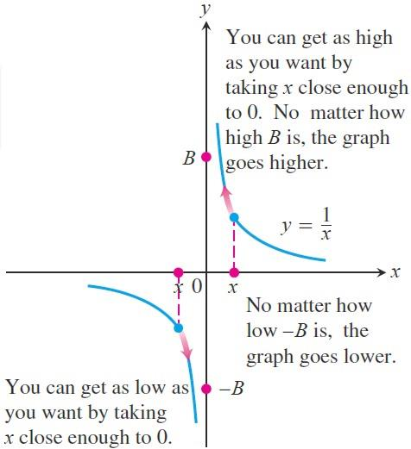

Example: Let us look again at the function $f\left(x\right)=\frac{1}{x}$.

Slide 4

  We write $\lim_{x→∞^{+}}{f(x)}=\lim_{x→∞^{+}}{\frac{1}{x}}=∞$ . In writing this, we are not saying that the limit exists. Nor are we saying that there is a real number $∞$, for there is no such number. Rather, we are saying that $\lim_{x→∞^{+}}{\frac{1}{x}}$ does not exist because $\frac{1}{x}$ becomes arbitrarily large and positive as $x→∞^{+}$.
  We write $\lim_{x→∞^{−}}{f(x)}=\lim_{x→∞^{−}}{\frac{1}{x}}=−∞$. Again, we are not saying that the limit exists and equals the number $−∞$. There is no real number $−∞$. We are describing the behavior of a function whose limit as $x→∞^{−}$ does not exist because its values become
  arbitrarily large and negative.

Slide 5
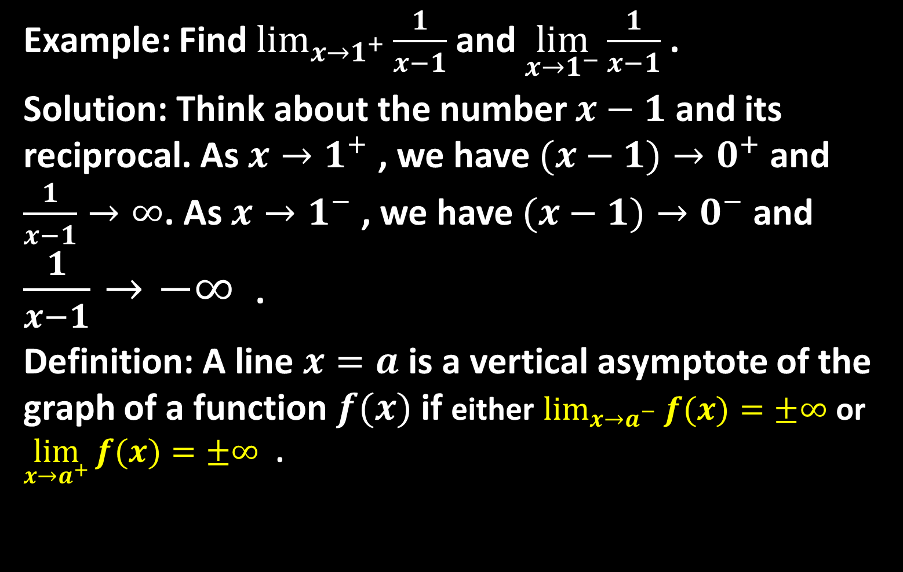
Example: Find $\lim_{x→1^{+}}{\frac{1}{x−1}}$ and $\lim_{x→1^{−}}{\frac{1}{x−1}}$ .
Solution: Think about the number $x−1$ and its reciprocal. As $x→1^{+}$ , we have $(x−1)→0^{+}$ and $\frac{1}{x−1}→∞$. As $x→1^{−}$ , we have $(x−1)→0^{−}$ and $\frac{1}{x−1}→−∞$ .
Definition: A line $x=a$ is a vertical asymptote of the graph of a function $f(x)$ if either $\lim_{x→a^{−}}{f(x)}=±∞$ or $\lim_{x→a^{+}}{f(x)}=±∞$ .

Slide 6

Example: Find the horizontal and vertical asymptotes of the curve $f\left(x\right)=\frac{x+3}{x+2}$.
Solution: We are interested in the behavior as $x→±∞$ and as $x→−2$ where the denominator is zero. Since
$\lim_{x→±∞}{\frac{x+3}{x+2}}=\lim_{x→±∞}{\frac{1+(\frac{3}{x})}{1+\left(\frac{2}{x}\right)}}=1$
and
$\lim_{x→{−2}^{+}}{\frac{x+3}{x+2}}=∞$ and $\lim_{x→{−2}^{+}}{\frac{x+3}{x+2}}=−∞$
then: the horizontal asymptote is $y=1$
and the vertical asymptote is $x=−2$.

Slide 7

Example: Find the horizontal and vertical asymptotes of the curve $g\left(x\right)=\frac{−8}{x^{2}−4}$
Solution: We are interested in the behavior as $x→±∞$ and as $x→±2$ where the denominator is zero. Since
$\lim_{x→±∞}{\frac{−8}{x^{2}−4}}$
the line $y=0$ is a horizontal asymptote of the graph of $g$ . Since
$\lim_{x→2^{+}}{\frac{−8}{x^{2}−4}}=−∞$ and $\lim_{x→2^{−}}{\frac{−8}{x^{2}−4}}=∞$
and
$\lim_{x→2^{+}}{\frac{−8}{x^{2}−4}}=∞$ and $\lim_{x→2^{−}}{\frac{−8}{x^{2}−4}}=−∞$
then the lines $x=−2$ and $x=2$
are vertical asymptotes of the graph of $g$ .

Slide 8
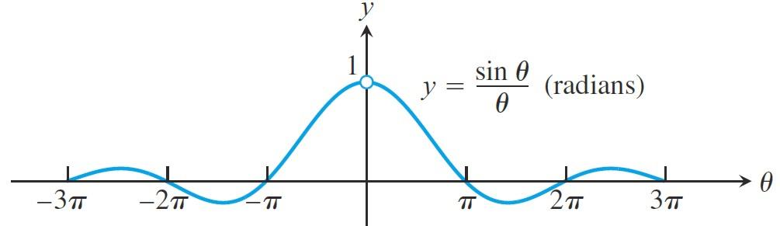
Limits Involving
A central fact about $(\sin{θ)}/θ$ is that in radian measure its limit as $θ→a$ is $1$ . We can see this in the figure below and confirm it algebraically using the Squeezing Theorem.
Theorem:$\lim_{θ→}0{\frac{\sin{θ}}{θ}}=1$ where $θ$ in radians.
Corollary: $\lim_{θ→}0{\frac{\tan{θ}}{θ}}=1$ where $θ$
in radians.

Slide 9
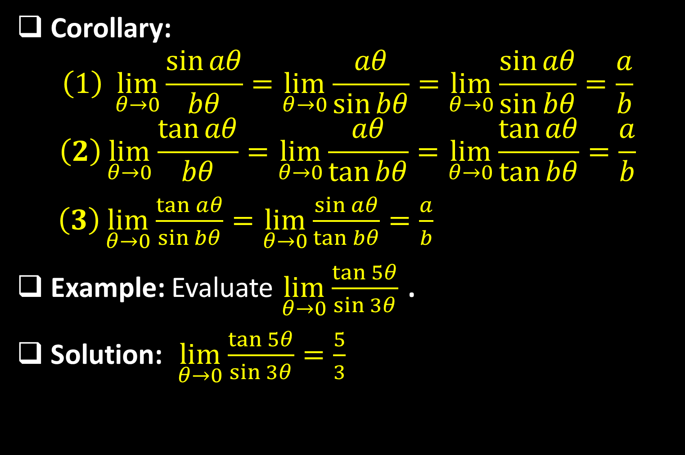
Corollary:
$$\left(1\right) \lim_{θ→0}{\frac{\sin{aθ}}{bθ}}=\lim_{θ→0}{\frac{aθ}{\sin{bθ}}}=\lim_{θ→0}{\frac{\sin{aθ}}{\sin{bθ}}}=\frac{a}{b}$$
$$\left(2\right)\lim_{θ→0}{\frac{\tan{aθ}}{bθ}}=\lim_{θ→0}{\frac{aθ}{\tan{bθ}}}=\lim_{θ→0}{\frac{\tan{aθ}}{\tan{bθ}}}=\frac{a}{b}$$
$\left(3\right)\lim_{θ→0}{\frac{\tan{aθ}}{\sin{bθ}}}=\lim_{θ→0}{\frac{\sin{aθ}}{\tan{bθ}}}=\frac{a}{b}$
Example: Evaluate $\lim_{θ→0}{\frac{\tan{5θ}}{\sin{3θ}}}$ .
Solution: $\lim_{θ→0}{\frac{\tan{5θ}}{\sin{3θ}}}=\frac{5}{3}$

Slide 10
Example: Show that $\lim_{x→0}{\frac{1−\cos{x}}{x}}=0$.
Solution: Using the half-angle formula
$cosx=1−2\sin{²(\frac{x}{2})}$
we calculate
$$\lim_{x→0}{\frac{1−\cos{x}}{x}}=\lim_{x→0}{\frac{1−[1−2\sin{²(\frac{x}{2})}]}{x}}$$
$=\lim_{x→0}{[\frac{2\sin{(x/2)}}{x}}\sin{(x/2)}]$
$=2×\lim_{x→0}{\frac{(\frac{x}{2})}{x}}×\lim_{x→0}{\sin{(\frac{x}{2})}}=2×\frac{1/2}{1}×0=0$

Slide 11
Example: Evaluate $\lim_{x→0}{\frac{5\sin{3x}+\tan{7x}}{3x+x^{2}}}$.
Solution:
$$\lim_{x→0}{\frac{5\sin{3x}+\tan{7x}}{3x+x^{2}}}\text{=}\lim_{x→0}{\frac{5\left(\frac{\sin{3x}}{x}\right)+\frac{\tan{7x}}{x}}{\frac{3x}{x}+\frac{x^{2}}{x}}}$$
$$=\lim_{x→0}{\frac{5\left(\frac{\sin{3x}}{x}\right)+\frac{\tan{7x}}{x}}{3+x}}$$
$$=\frac{5×\frac{3}{1}+\frac{7}{1}}{3+0}=\frac{22}{3}$$

Slide 12
Example: Evaluate $\lim_{t→0}{\frac{\sin{t^{2}}}{t}}$.
Solution:
$$\lim_{t→0}{\frac{\sin{t^{2}}}{t}}=\underset{t→0}{lim[}{\frac{\sin{t^{2}}}{t²}}×t]=\lim_{t→0}{\frac{\sin{t^{2}}}{t²}}×\lim_{t→0}{t}$$
$$1×0=0$$
Example: Evaluate $\lim_{t→0}{\frac{\sin{²t}}{3t²}}$.
Solution:
$\lim_{t→0}{\frac{\sin{²t}}{3t²}}=\frac{1}{3}\lim_{t→0}{[\frac{\sin{t}}{3t}}]²=\frac{1}{3}{\left[\lim_{t→0}{\frac{\sin{t}}{3t}}\right]}^{2}$
$$=\frac{1}{3}×{\left(1\right)}^{2}=\frac{1}{3}$$

Slide 13
Example: Evaluate $\lim_{t→5}{\frac{\tan{(t−5)}}{t^{2}−25}}$.
Solution:
$$\lim_{t→5}{\frac{\tan{(t−5)}}{t^{2}−25}}=\lim_{t→5}{\frac{\tan{(t−5)}}{(t−5)(t+5)}}$$
$$=\lim_{t→5}{\frac{\tan{(t−5)}}{t−5}}×\lim_{t→5}{\frac{1}{t+5}}$$
$$=1×\frac{1}{5+5}=\frac{1}{10}$$

Slide 14
Thank you for your Attention

