Slide 1

Continuous Functions

Slide 2

We noticed in sequence 21 that the limit of a function as $x$ approaches $a$ can often be found simply by calculating the value of the function at $a$. Functions with this property are called continuous at $a$ .
We will see that the mathematical definition of continuity corresponds closely with the meaning of the word continuity in everyday language. (A continuous process is one that takes place gradually, without interruption or abrupt change.)

Slide 3

Definition: A function $f$ is continuous at a number $a$ if $\lim_{x→a}{f(x)}=f(a)$ .
Notice that the previous definition implicitly requires three things if $f$ is continuous at $a$ :
  $f(a)$ is defined (that is, $a$ is in the domain of $f$ ),
  $\lim_{x→a}{f(x)}$ exists,
  $\lim_{x→a}{f(x)}=f(a)$ .
We say that $f$ is discontinuous at $a$ (or has a discontinuity at $a$) if $f$ is not continuous at $a$ .

Slide 4
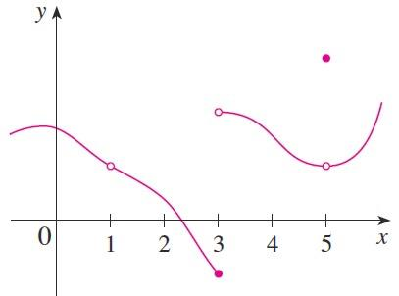

Example: The figure below shows the graph of a function $f$. At which numbers is $f$ discontinuous? Why?
Solution:
  It looks as if there is a discontinuity when $a=1$ because the graph has a break there. The official reason that $f$ is discontinuous
  at $1$ is that $f(1)$ is not defined.

Slide 5

  The graph also has a break when $a=3$, but the reason for the discontinuity is different. Here, $f(3)$ is defined, but $\lim_{x→3}{f(x)}$ does not exist (because the left and right limits are different). So $f$ is discontinuous at $3$ .
  What about $a=5$ ? Here, $f(5)$ is defined and $\lim_{x→5}{f(x)}$ exists (because the left and right limits are the same). But $\lim_{x→5}{f(x)}≠f(5)$ . So $5$ is discontinuous at $5$ .
Definition: A function $f$ is continuous from the right at a number $a$ if $\lim_{x→a^{+}}{f(x)}=f(a)$ and $f$ is continuous from the left at if $\lim_{x→a^{−}}{f(x)}=f(a)$ .

Slide 6

Definition: A function $f$ is continuous on an interval if it is continuous at every number in the interval. (If $f$ is defined only on one side of an endpoint of the interval, we understand continuous at the endpoint to mean continuous from the right or continuous from the left.)
Theorem: All functions, except possibly piecewise functions, are continuous on its domain.
Theorem: If $f$ and $g$ are continuous at $a$ and $c$ is a constant, then the following functions are also continuous at :
$1. f+g 2. f−g 3.cf$
$4.f×g 5.\frac{f}{g} if g(a)≠0$

Slide 7

Example: Find the points of discontinuity.
  $f\left(x\right)=2\ln{\sqrt{1−x}}$
  $f\left(x\right)=\left\{\begin{aligned}2x−3 if x≤4 \\ 1+\frac{16}{x} if x>4 \end{aligned}\right.$
Solution:
  Since the domain of $f\left(x\right)=2\ln{\sqrt{1−x}}$ is $(−∞,1)$ then $f$ is continuous on $(−∞,1)$ and discontinuous on $ℝ−\left(−∞,1\right)=[1,∞)$
  $f$ is piecewise function. Since $f\left(x\right)=2x−3$ when $x<4$ then it is continuous because $2x−3$ is a polynomial continuous everywhere and has no discontinuity point. When $x>4$ , $f\left(x\right)=1+\frac{16}{x}$ also continuous,
  although it is discontinuous at $x=0$ but $0≯4$ .

Slide 8

  So, the only possible discontinuity points of $f(x)$ is $x=4$ . However, $f(x)$ is continuous at $x=4$ because:
  $f\left(4\right)=2×4−3$ is defined,
  Since
  $\lim_{x→4^{+}}{f(x)}=\lim_{x→4^{+}}{(1+\frac{16}{x})}=5$
  $\lim_{x→4^{−}}{f(x)}=\lim_{x→4^{−}}{(2x−3)}=5$
  then $\lim_{x→4}{f(x)}$ exists and equals $5$ .
  $f\left(4\right)=\lim_{x→4}{f(x)}=5$ .
Hence,$f(x)$ is continuous on $ℝ$ and has no discontinuity point.

Slide 9

Another way of combining continuous functions $f$and $g$ to get a new continuous function is to form the composite function $f∘g$ . This fact is a consequence of the following theorem.
Theorem: If $g$ is continuous at $a$ and $f$ is continuous at $g(a)$ , then the composite function $\left(f∘g\right)\left(x\right)=f(g\left(x\right))$ is continuous at $a$ .
Theorem: If $f$ is continuous at $a$ and $\lim_{x→a}{g(x)}=b$ then $\lim_{x→a}{f (g(x))}=f(b)$
In other words, $\lim_{x→a}{f\left(g\left(x\right)\right)=f(\lim_{x→a}{g(x))}}$.

Slide 10
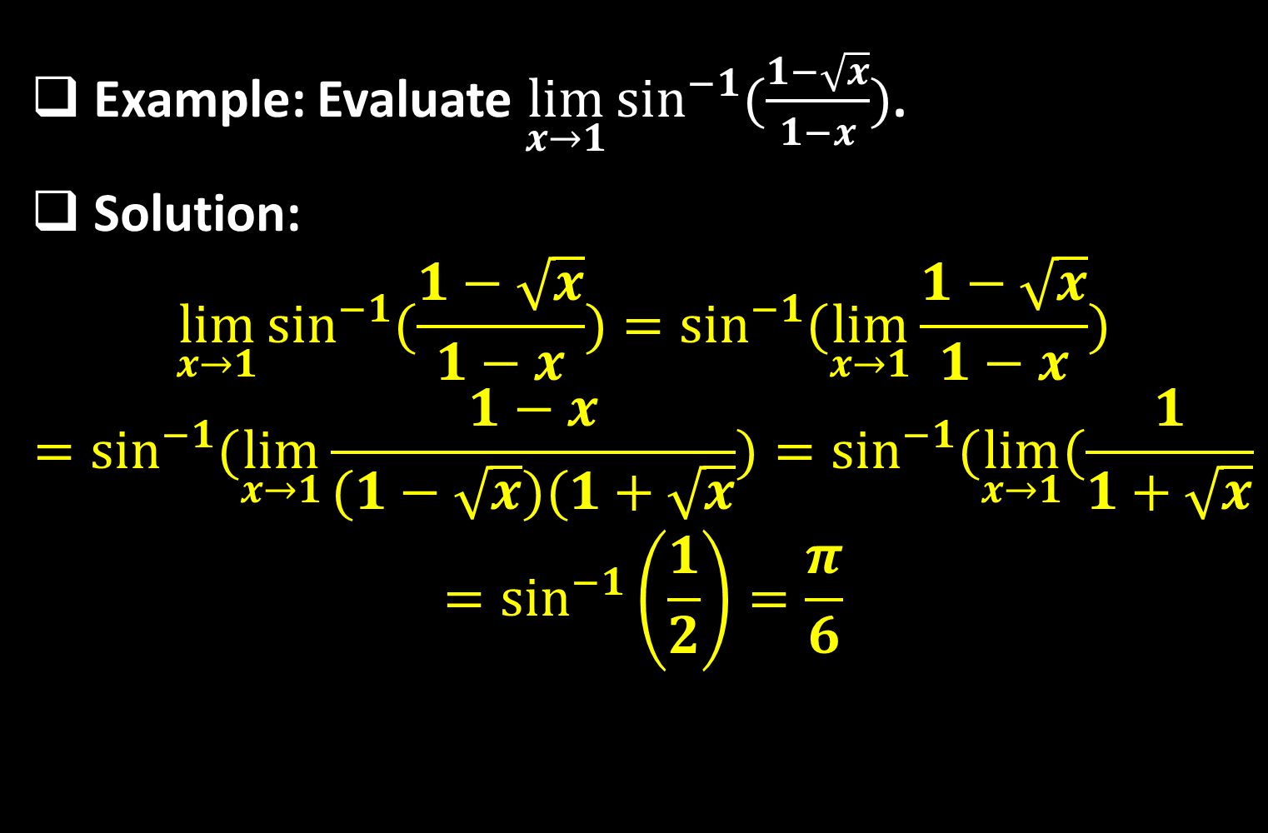
Example: Evaluate $\lim_{x→1}{\sin^{−1}{(\frac{1−\sqrt{x}}{1−x})}}$.
Solution:
$$\lim_{x→1}{\sin^{−1}{(\frac{1−\sqrt{x}}{1−x})}}=\sin^{−1}{(\lim_{x→1}{\frac{1−\sqrt{x}}{1−x}}})$$
$$=\sin^{−1}{(\lim_{x→1}{\frac{1−x}{(1−\sqrt{x})(1+\sqrt{x}}}})=\sin^{−1}{(\lim_{x→1}{(\frac{1}{1+\sqrt{x}}}}$$
$$=\sin^{−1}\left(\frac{1}{2}\right)=\frac{π}{6}$$

Slide 11
Thank you for your Attention

