Slide 1

The Derivative as a Function

Slide 2
The derivative is a limit measures the rate at which a function changes and is one of the most important ideas in calculus.
Derivatives are used widely in science, economics, medicine, and computer science to calculate velocity and acceleration, to explain the behavior of machinery, to estimate the drop in water levels as water is pumped out of a tank, and to predict the consequences of making errors in measurements.
Finding derivatives by evaluating limits can be lengthy and difficult. We develop techniques to make calculating derivatives easier.

Slide 3
James Stewart, Calculus: Early Transcendentals, 7th Edition, Brooks/ Cole 2012.
Howard Anton, Irl C. Bivens and Stephen Davis, Calculus: Early Transcendentals, 9th Edition, John Wiley & Sons, Inc. 2010.
Salas, Etgen, and Hille, Calculus: One and Several Variables, 10th Edition, John Wiley & Sons, Inc. 2007.

Slide 4
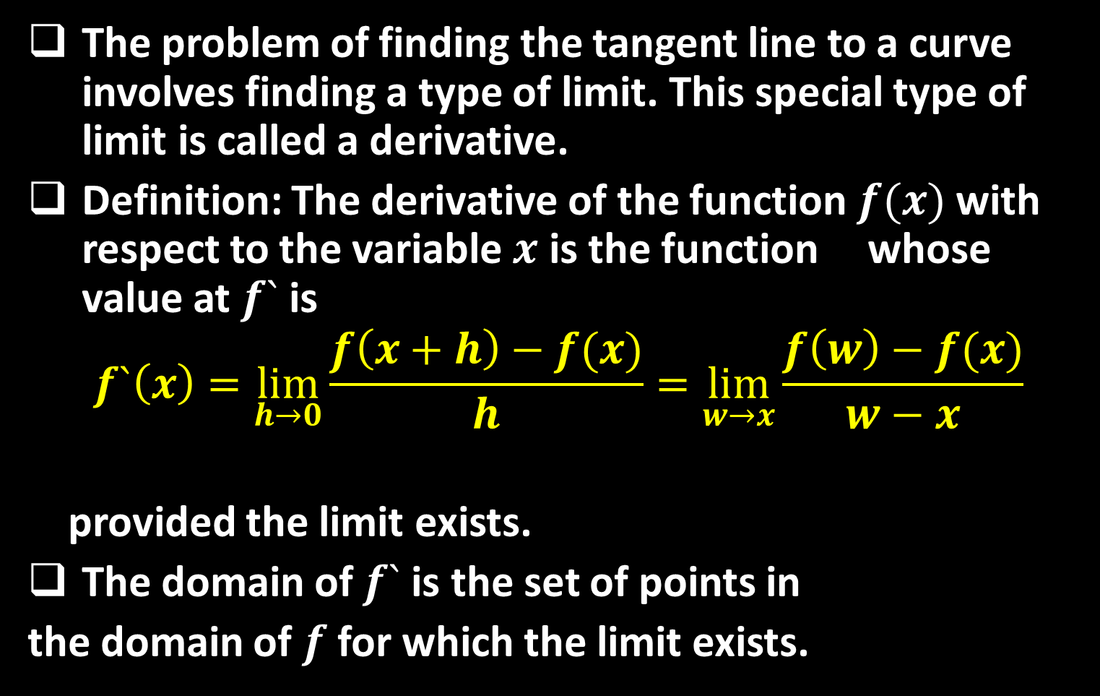
The problem of finding the tangent line to a curve involves finding a type of limit. This special type of limit is called a derivative.
Definition: The derivative of the function $f(x)$ with respect to the variable $x$ is the function whose value at $f`$ is
$$f`\left(x\right)=\lim_{h→0}{\frac{f\left(x+h\right)−f(x)}{h}}=\lim_{w→x}{\frac{f\left(w\right)−f(x)}{w−x}}$$
provided the limit exists.
The domain of $f`$ is the set of points in
the domain of $f$ for which the limit exists.

Slide 5

If $f`$ exists at a particular $x$, we say that $f$ is differentiable (has a derivative) at $x$. If $f`$ exists at every point in the domain of $f$ , we call $f$ differentiable.
Notations: There are many ways to denote the derivative of a function $y=f(x)$ where the independent variable is $x$ and the dependent variable is $y$ . Some common alternative notations for the derivative are
$$f`\left(x\right)=y`= \frac{ⅆy}{ⅆx}=\frac{df}{dx}=\frac{d}{dx}f\left(x\right)=D\left(f\right)\left(x\right)=D_{x}f(x)$$

Slide 6

To indicate the value of a derivative at a specified number $x=a$ , we use the notation
$$f`\left(a\right)={\left.\frac{dy}{dx}\right|}_{x=a}={\left.\frac{df}{dx}\right|}_{x=a}={\left.\frac{d}{dx}f(x)\right|}_{x=a}$$
The process of calculating a derivative is called differentiation.
To emphasize the idea that differentiation is an operation performed on a function $y=f(x)$ we use the notation $\frac{d}{dx}f(x)$ as another way
to denote the derivative $f`(x)$ .

Slide 7
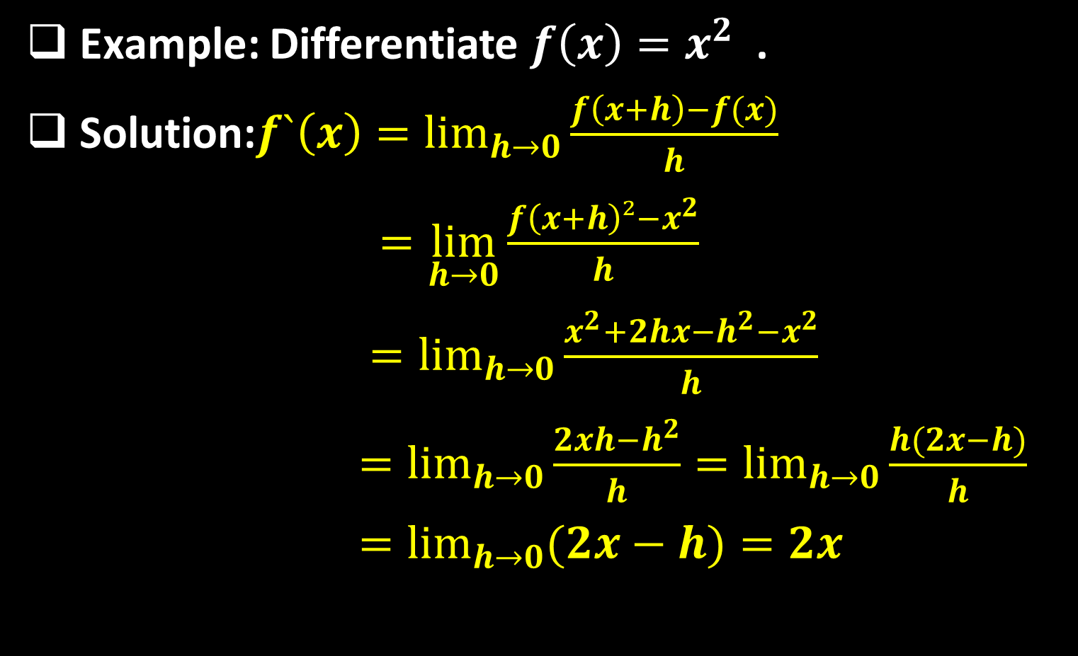
Example: Differentiate $f\left(x\right)=x^{2}$ .
Solution:$f`\left(x\right)=\lim_{h→0}{\frac{f\left(x+h\right)−f(x)}{h}}$
$=\lim_{h→0}{\frac{f\left(x+h\right)²−x^{2}}{h}}$
$=\lim_{h→0}{\frac{x^{2}+2hx−h^{2}−x^{2}}{h}}$
$=\lim_{h→0}{\frac{2xh−h^{2}}{h}}=\lim_{h→0}{\frac{h(2x−h)}{h}}$
$=\lim_{h→0}{(2x−h)}=2x$

Slide 8
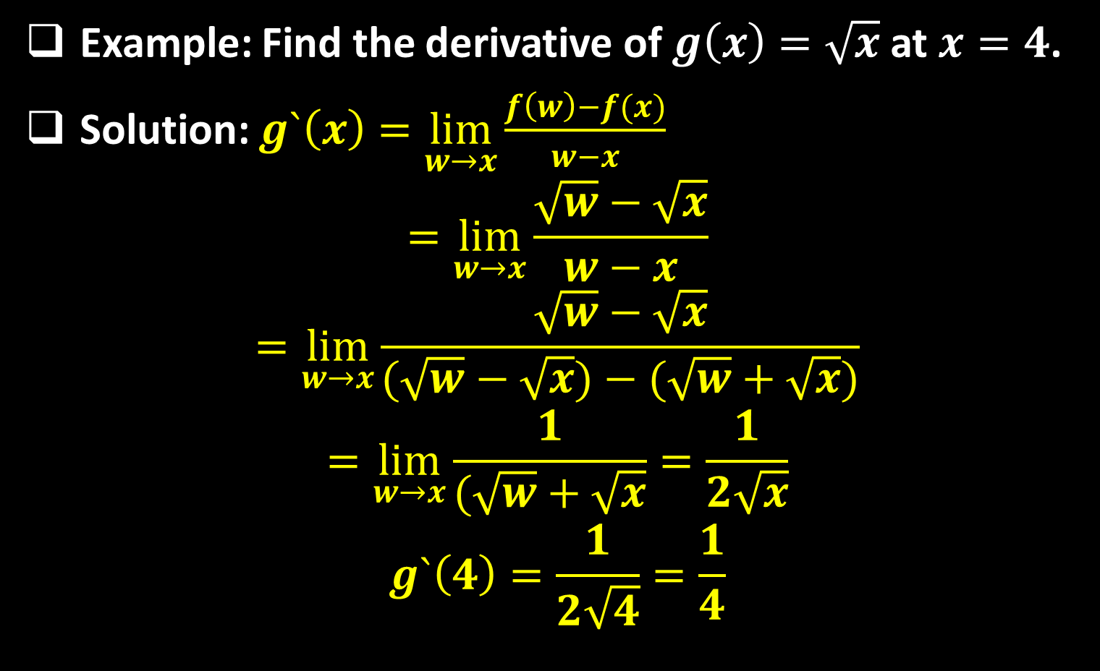
Example: Find the derivative of $g\left(x\right)=\sqrt{x}$ at $x=4$.
Solution: $g`\left(x\right)=\lim_{w→x}{\frac{f\left(w\right)−f(x)}{w−x}}$
$$=\lim_{w→x}{\frac{\sqrt{w}−\sqrt{x}}{w−x}}$$
$$=\lim_{w→x}{\frac{\sqrt{w}−\sqrt{x}}{(\sqrt{w}−\sqrt{x})−(\sqrt{w}+\sqrt{x})}}$$
$$=\lim_{w→x}{\frac{1}{(\sqrt{w}+\sqrt{x}}}=\frac{1}{2\sqrt{x}}$$
$$g`\left(4\right)=\frac{1}{2\sqrt{4}}=\frac{1}{4}$$

Slide 9

Differentiable on an Interval; One-Sided Derivatives: A function $y=f(x)$ is differentiable on an open interval (finite or infinite) if it has a derivative at each point of the interval. It is differentiable on a closed interval $[a,b]$ if it is differentiable on the interior $(a,b)$ and if the limits.
$${f`}_{+}\left(a\right)=\lim_{h→a^{+}}{\frac{f\left(a+h\right)−f(a)}{h}} Right−hand derivative at a$$
$${f`}_{−}\left(b\right)=\lim_{h→a^{−}}{\frac{f\left(b+h\right)−f(b)}{h}} left−hand derivative at b$$
exist at the endpoints.

Slide 10
A function has a derivative at a point if and only if it has left-hand and right-hand derivatives there, and these one-sided derivatives are equal.
$$f`\left(x_{0}\right) exists ⇔ {f`}_{+}\left(x_{0}\right)={f`}_{−}\left(x_{0}\right) and both are exist$$
Example: Show that the function $g\left(x\right)=\left|x\right|$ is not differentiable at $x=0$.
Solution: There can be no derivative at the origin because the one-sided derivatives differ there:
$${g`}_{+}\left(0\right)=\lim_{h→0^{+}}{\frac{g\left(0+h\right)−g(0)}{h}}=\lim_{h→0^{+}}{\frac{\left|0+h\right|−\left|0\right|}{h}}$$
$$=\lim_{h→0^{+}}{\frac{\left|h\right|}{h}}=\lim_{h→0^{+}}{\frac{h}{h}}=\lim_{h→0^{+}}{1}=1$$

Slide 11
$${g`}_{−}\left(0\right)=\lim_{h→0^{−}}{\frac{g\left(0+h\right)−g(0)}{h}}=\lim_{h→0^{−}}{\frac{\left|0+h\right|−\left|0\right|}{h}}$$
$$=\lim_{h→0^{−}}{\frac{\left|h\right|}{h}}=\lim_{h→0^{−}}{\frac{−h}{h}}=\lim_{h→0^{−}}{−1}=−1$$
Question: When Does a Function Not Have a Derivative at a Point?
Answer: Differentiability is a smoothness condition on the graph of $f$ . A function whose graph is otherwise smooth will fail to have a derivative at a point for several reasons,
such as at points where the graph has:

Slide 12
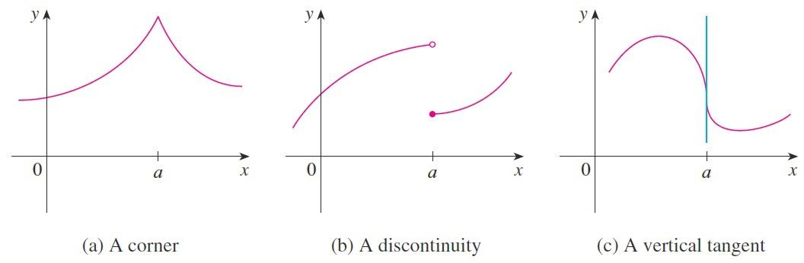
  a corner, where the one-sided derivatives differ.
  a cusp, where the derivative approaches $∞$ from one side and $−∞$ from the other.
  a vertical tangent, where the derivative approaches $∞$ from both sides or $−∞$ from both sides.
  a discontinuity.

Slide 13

Theorem: If $f$ has a derivative at $x=c$ , then $f$ is continuous at $x=c$.
Corollary: If $f$ is discontinuous at $x=c$ , then $f$ is not differentiable at $x=c$ .
Note that a function need not have a derivative at a point where it is continuous. Also, a function that is not differentiable at a point need not be discontinuous at that point. For example,$\left|x\right|$ is continuous at $x=0$ but it is not differentiable at $x=0$.

Slide 14
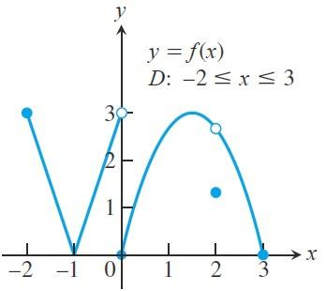

Example: The figure below shows the graph of a function over a closed interval $D$ . At what domain points does the function appear to be
  differentiable?
  continuous but not differentiable?
  neither continuous nor differentiable?

Slide 15

Solution:
  $f$ is differentiable on $\left[−2,3\right]−\{−1,0,2\}$ .
  $f$ is continuous but not differentiable at $x=1$ because
  $f\left(−1\right)=\lim_{x→−1}{f\left(x\right)}=0$
  but there is a corner at $x=1$ .
  $f$ is neither continuous nor differentiable at $x=0$ because
  $\lim_{x→0}{f(x)}$ does not exist,
  and $x=2$ because $f(2)≠\lim_{x→2}{f(x)}$

Slide 16
Thank you for your Attention

