Slide 1

Differentiation Rules

Slide 2

Differentiation Rules
This section introduces rules that allow us to differentiate a great variety of functions. By these rules, we can differentiate functions without having to apply the definition of the derivative each time.
Rule 1: If $f$ has the constant value $f\left(x\right)=c$ then
$\frac{ⅆf}{ⅆx}=\frac{d}{dx}\left(c\right)=0$
The first rule of differentiation is that the derivative of every constant function is zero. For example,$\frac{d}{dx}\left(8\right)=0$, $\frac{d}{dx}\left(π\right)=0$, and $\frac{d}{dx}\left(\sqrt{e}\right)=0$.

Slide 3

Rule 2: If $n$ is a real number, then $\frac{d}{dx}x^{n}=nx^{n−1}$ . The second rule tells how to differentiate $x^{n}$ if $n$ is a real number. For example,
$\left(1\right) \frac{d}{dx}\left(x\right)=1$
$\left(2\right)\frac{d}{dx}\left(x^{2}\right)=2x$
$\left(3\right)\frac{d}{dx}\left(x^{3}\right)=3x^{2}$
$\left(4\right)\frac{d}{dx}\left(x^{4}\right)=4x^{3}$
$\left(5\right)\frac{d}{dx}\left(\frac{1}{x^{2}}\right)=\frac{d}{dx}\left(x^{−2}\right)=2x^{−3}=−\frac{2}{x^{3}}$
$\left(6\right)\frac{d}{dx}$($\sqrt[3]{x^{4}}$)$=\frac{d}{dx}\left(x^{4/3}\right)=\frac{4}{3}x^{1/3}=\frac{4}{3}\sqrt[3]{x}$

Slide 4

Rule 3: If $u$ is a differentiable function of $x$, and $c$ is a constant, then $\frac{d}{du}\left(cu\right)=c\frac{du}{dx}$. The third rule says that when a differentiable function is multiplied by a constant, its derivative is multiplied by the same constant. For example,
$$\frac{d}{dx}\left(3x^{2}\right)=3\frac{d}{dx}\left(x^{2}\right)=3×\left(2x\right)=6x$$
Rule 4: If $u$ and $v$ are differentiable functions of , then their sum (or difference) $u±v$ is differentiable at every point where $u$ and $v$ are both differentiable. At such points, $\frac{d}{dx}\left(u±v\right)=\frac{du}{dx}±\frac{dv}{dx}$

Slide 5
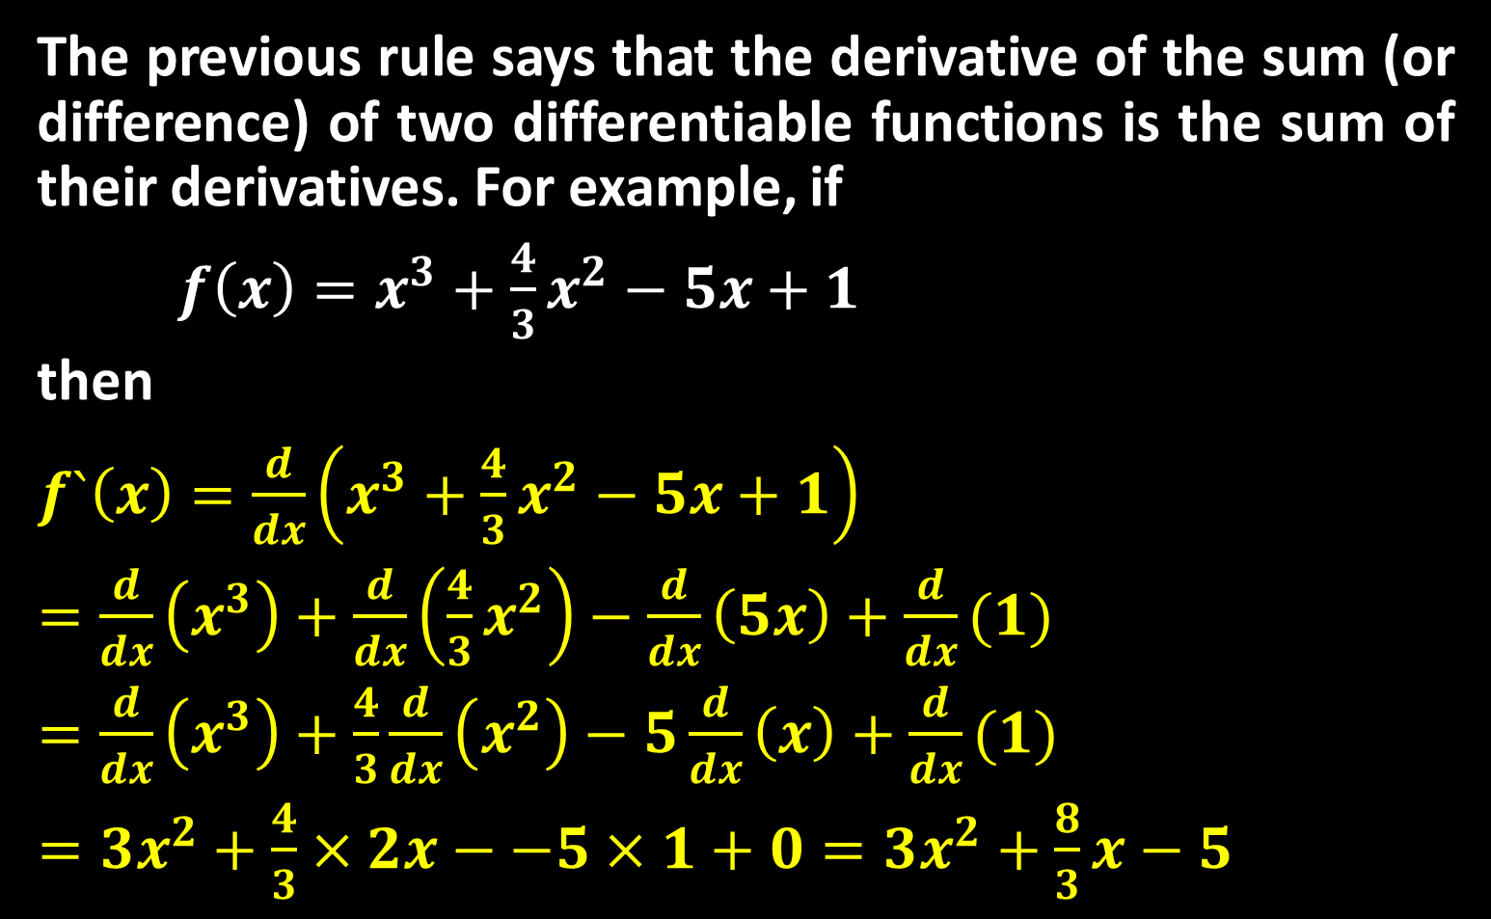
The previous rule says that the derivative of the sum (or difference) of two differentiable functions is the sum of their derivatives. For example, if
$f\left(x\right)=x^{3}+\frac{4}{3}x^{2}−5x+1$
then
$f`\left(x\right)=\frac{d}{dx}\left(x^{3}+\frac{4}{3}x^{2}−5x+1\right)$
$=\frac{d}{dx}\left(x^{3}\right)+\frac{d}{dx}\left(\frac{4}{3}x^{2}\right)−\frac{d}{dx}\left(5x\right)+\frac{d}{dx}(1)$
$=\frac{d}{dx}\left(x^{3}\right)+\frac{4}{3}\frac{d}{dx}\left(x^{2}\right)−5\frac{d}{dx}\left(x\right)+\frac{d}{dx}(1)$
$=3x^{2}+\frac{4}{3}×2x−−5×1+0=3x^{2}+\frac{8}{3}x−5$

Slide 6

Rule 5: If $u$ and $v$ are differentiable at $x$ , then so is their product $uv$ , and $\frac{d}{dx}\left(uv\right)=u\frac{d}{dx}+v\frac{d}{dx}$ . For example,
$$\frac{d}{dx}\left[x\left(1−x^{2}\right)\right]=x\frac{d}{dx}\left(1−x^{2}\right)+\left(1−x^{2}\right)\frac{d}{dx}(x)$$
$$=x\left(−2x\right)+\left(1−x^{2}\right)\left(1\right)=−2x^{2}+1−x^{2}$$
$$=1−3x^{2}$$
Rule 6: If $u$ and $v$ are differentiable at $x$ and if $v(x)≠0$ then the quotient $u/v$ is differentiable at $x$, and
$\frac{d}{dx}\left(\frac{u}{v}\right)=\frac{v\frac{du}{dx}−u\frac{dv}{dx}}{v^{2}}$

Slide 7
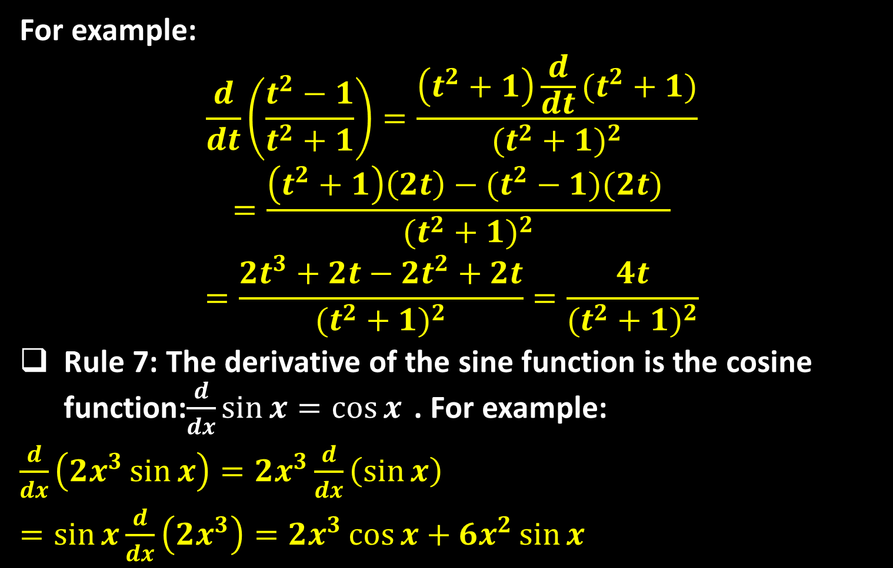
For example:
$$\frac{d}{dt}\left(\frac{t^{2}−1}{t^{2}+1}\right)=\frac{\left(t^{2}+1\right)\frac{d}{dt}(t^{2}+1)}{{(t^{2}+1)}^{2}}$$
$$=\frac{\left(t^{2}+1\right)\left(2t\right)−(t^{2}−1)(2t) }{{(t^{2}+1)}^{2}}$$
$$=\frac{2t^{3}+2t−2t^{2}+2t}{{(t^{2}+1)}^{2}}=\frac{4t}{{(t^{2}+1)}^{2}}$$
Rule 7: The derivative of the sine function is the cosine function:$\frac{d}{dx}\sin{x}=\cos{x}$ . For example:
$\frac{d}{dx}\left(2x^{3}\sin{x}\right)=2x^{3}\frac{d}{dx}\left(\sin{x}\right)$
$=\sin{x}\frac{d}{dx}\left(2x^{3}\right)=2x^{3}\cos{x}+6x^{2}\sin{x}$

Slide 8
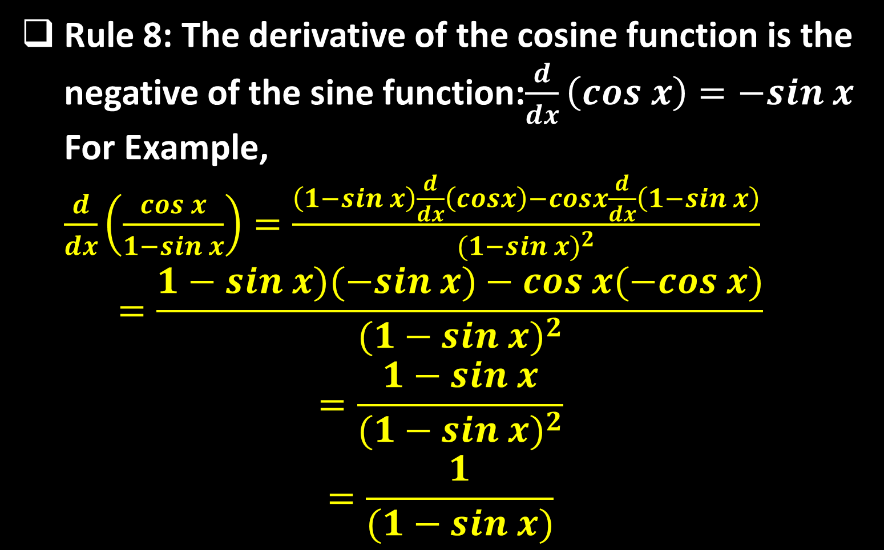
Rule 8: The derivative of the cosine function is the negative of the sine function:$\frac{d}{dx}\left(cos x\right)=−sin x$ For Example, $\frac{d}{dx}\left(\frac{cos x}{1−sin x}\right)=\frac{\left(1−sin x\right)\frac{d}{dx}\left(cosx\right)−cosx\frac{d}{dx}\left(1−sin x\right)}{{(1−sin x)}^{2}}$
$$=\frac{1−sin x)(−sin x)−cos x(−cos x)}{{(1−sin x)}^{2}}$$
$$=\frac{1−sin x}{{(1−sin x)}^{2}}$$
$$=\frac{1}{(1−sin x)}$$

Slide 9

Rule 9: The other related trigonometric functions are differentiable and their derivatives are:
$\frac{d}{dx}\left(tan x\right)= \sec^{2}x$
$\frac{d}{dx}\left(cot x\right)=−csc^{2}x$
$\frac{d}{dx}\left(sec x\right)=sec x tan x$
$\frac{d}{dx}\left(csc x\right)=−csc x cot x$

Slide 10
Rule 10: The Derivative Rule for Inverses: If $f$ has an interval $I$ as domain and $f´(x)$ exists and is never zero on $I$, then $f^{−1}$ is differentiable at every point in its domain. The value of $(f^{−1})$´ at a point $b$ in the domain of $f^{−1}$is: $\left(f^{−1}\right)´\left(b\right)=\frac{1}{f´\left(f^{−1}\left(b\right)\right)}$.
Example: Let $f\left(x\right)=x^{3}−2$. Find the value of $df^{−1}/dx$ at $x=6=f(2)$ without finding a formula for $f^{−1}(x)$
Solution:
$\left(f^{−1}\right)´\left(6\right)=\frac{1}{f´\left(f^{−1}\left(6\right)\right)}=\frac{1}{f´(2)}=\frac{1}{3×2^{2}}=\frac{1}{12}$

Slide 11

Rule 11: For every positive value of $x$, we have $\frac{d}{dx}\left(\ln{x}\right)=\frac{1}{x}$, and in general $\frac{d}{dx}\left(\log_{a}{x}\right)=\frac{1}{x\ln{a}}$
For example,
$$\frac{d}{dt}(t \ln{t)}=t\frac{d}{dt}\left(\ln{t}\right)+\ln{t\frac{d}{dt}\left(t\right)}=t×\frac{1}{t}+\ln{t}=1+\ln{t}$$
$$\frac{d}{dt}\left(2\log_{10}{t}\right)=2\frac{d}{dt}\left(\log_{10}{t}\right)=2×\frac{1}{t\ln{10}}=\frac{2}{t\ln{10}}$$
Rule 12: The exponential function is differentiable and we have $\frac{d}{dx}\left(e^{x}\right)=e^{x}$, and in general $\frac{d}{dx}a^{x}=a^{x}\ln{a}$. For example,

Slide 12
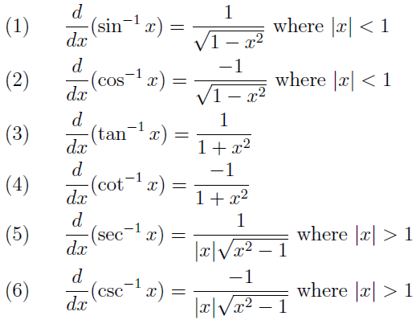
$\frac{d}{dt}\left(\frac{\tan{t}}{{10}^{t}}\right)=\frac{{10}^{t}\frac{d}{dt}\left(\tan{t}\right)−\tan{t}\frac{d}{dt}({10}^{t})}{{(10}^{t})²}$
$=\frac{{10}^{t}\sec^{2}t−{10}^{t}(\ln{10)\tan{t}}}{{(10}^{2t}) }=\frac{sec²t−(\ln{10})\tan{t}}{{10}^{t}}$
Rule 13: The derivatives of the inverse trigonometric functions are summarized as follows.

Slide 13
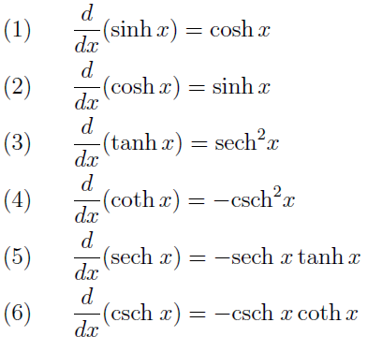
Rule 14: Derivatives of Hyperbolic Functions.

Slide 14
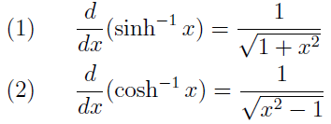
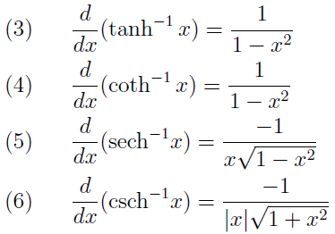
Rule 15: Derivatives of Inverse Hyperbolic Functions.

Slide 15
Example: If $f\left(x\right)=\sqrt{x}g(x)$ where $g\left(4\right)=2$ and $g´\left(4\right)=3$ , find $f´(4)$.
Solution:
$$f´\left(x\right)=\frac{d}{dx}\left[\sqrt{x}g\left(x\right)\right]=\sqrt{x}g´\left(x\right)+g\left(x\right)×\frac{1}{2\sqrt{x}}$$
$$f´\left(4\right)=\sqrt{4}g´\left(4\right)+g\left(4\right)×\frac{1}{2\sqrt{4}}$$
$$=2×3+2×\frac{1}{4}=\frac{13}{2}$$
Example: For what values of $a$ and $b$ such that
$f\left(x\right)=\left\{\begin{aligned}x^{2}+a if x≤1 \\ bx if x>1 \end{aligned}\right.$
is differentiable at $x=1$.

Slide 16
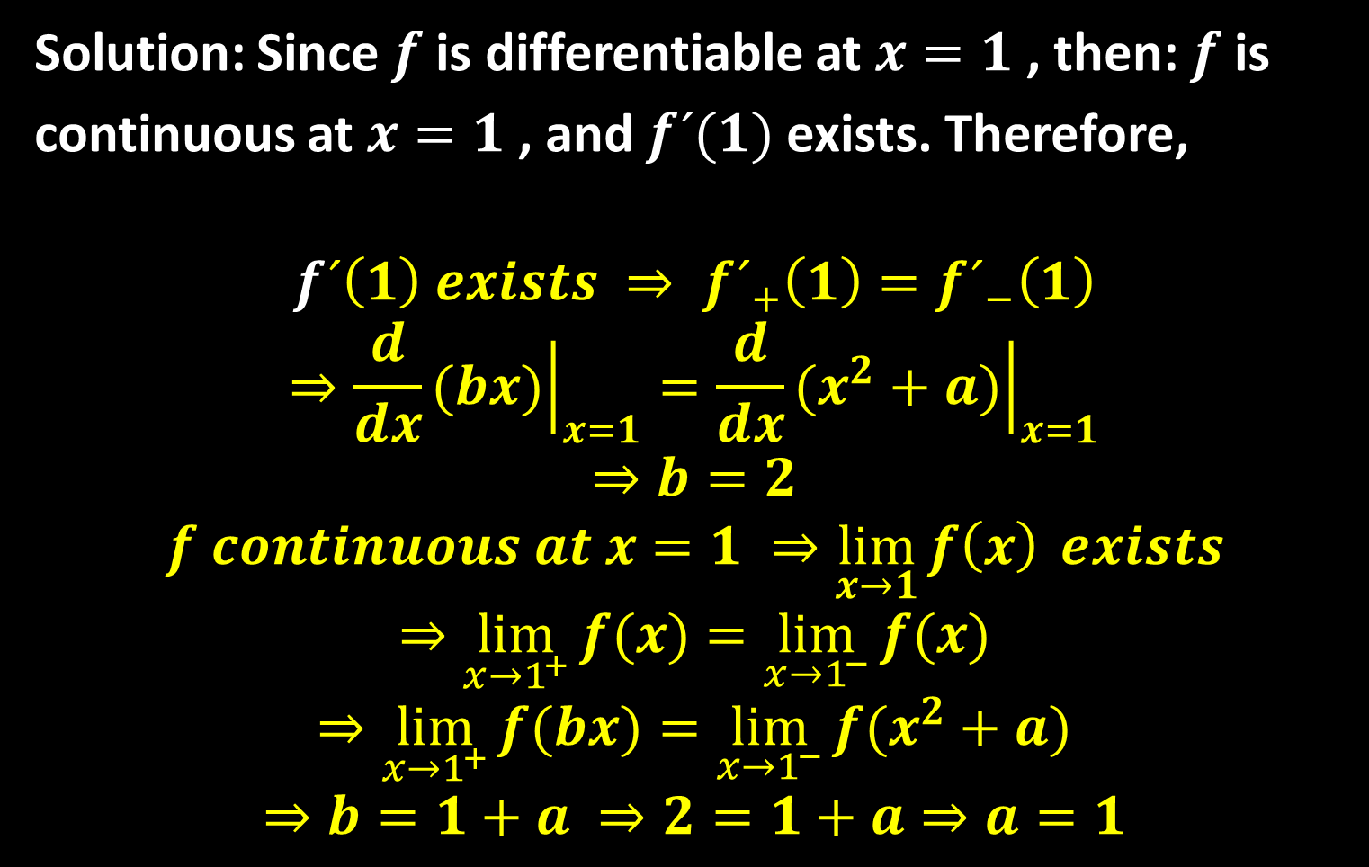
Solution: Since $f$ is differentiable at $x=1$ , then: $f$ is
continuous at $x=1$ , and $f´(1)$ exists. Therefore,
$$f´\left(1\right) exists ⇒ {f´}_{+}\left(1\right)={f´}_{−}\left(1\right)$$
$$⇒\frac{d}{dx}{\left.(bx)\right|}_{x=1}=\frac{d}{dx}{\left.(x^{2}+a)\right|}_{x=1}$$
$$⇒b=2$$
$$f continuous at x=1 ⇒\lim_{x→1}{f\left(x\right)} exists$$
$$⇒\lim_{{x→1}^{+}}{f(x)}=\lim_{{x→1}^{−}}{f(x)}$$
$$⇒\lim_{{x→1}^{+}}{f(bx)}=\lim_{{x→1}^{−}}{f(x^{2}+a)}$$
$$⇒b=1+a ⇒2=1+a⇒a=1$$

Slide 17
Thank you for your Attention

