Slide 1

Sequence 31: Higher Derivatives

Slide 2

If $f(x)$ is a differentiable function, then its derivative $f´(x)$ is also a function.
If $f´$ is also differentiable, then we can differentiate to get a new function of $x$ denoted by $f´´$. So $f´´=(f´)´$.
The function $f´´$ is called the second derivative of because it is the derivative of the first derivative.
Notationally,
$f´´\left(x\right)=\frac{d^{2}}{dx^{2}}f\left(x\right)=\frac{d}{dx}\left[\frac{d}{dx}f\left(x\right)\right]$.

Slide 3

If $f´´$ is differentiable, its derivative
$f´´´\left(x\right)=\frac{d^{3}}{dx^{3}}f\left(x\right)=\frac{d}{dx}\left[\frac{d²}{dx²}f\left(x\right)\right]$
is the third derivative of $f$ with respect to $x$ .
The names continue as you imagine, with
$f^{n}\left(x\right)=\frac{d^{n}}{dx^{n}}f\left(x\right)=\frac{d}{dx}\left[\frac{d^{n−1}}{{dx}^{n−1}}f\left(x\right)\right]$
denoting the $n^{th}$ derivative of $f$ with
respect to $x$ for any positive integer $n$.

Slide 4
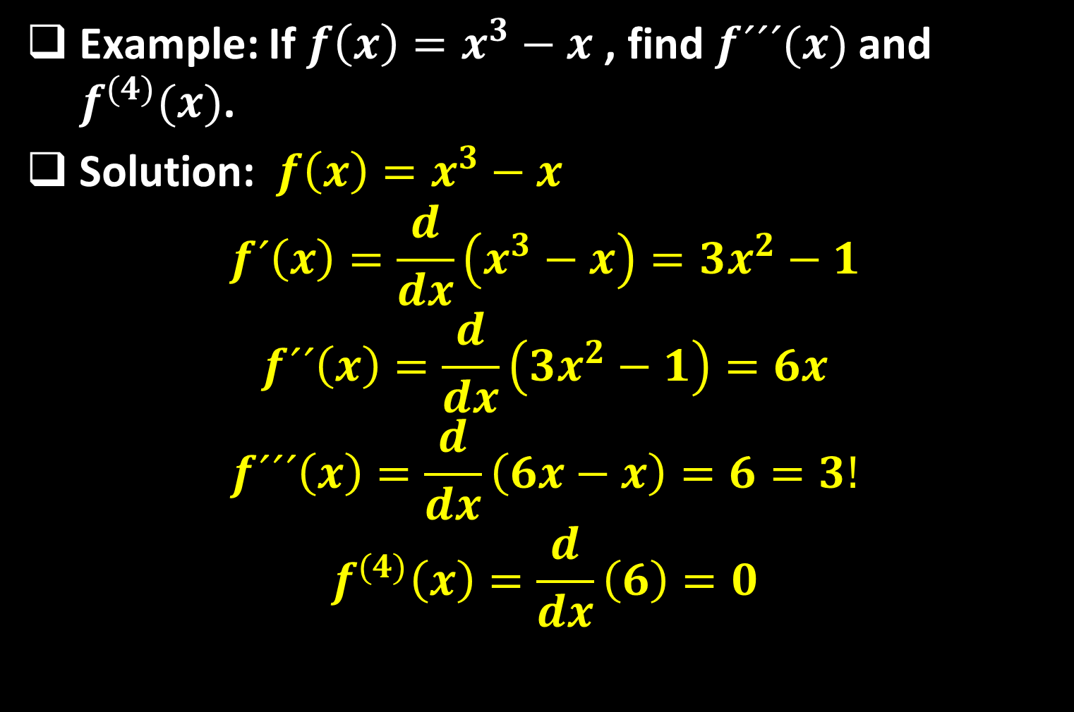
Example: If $f\left(x\right)=x^{3}−x$ , find $f´´´(x)$ and $f^{(4)}(x)$.
Solution: $f\left(x\right)=x^{3}−x$
$$f´\left(x\right)=\frac{d}{dx}\left(x^{3}−x\right)=3x^{2}−1$$
$$f´´\left(x\right)=\frac{d}{dx}\left(3x^{2}−1\right)=6x$$
$$f´´´\left(x\right)=\frac{d}{dx}\left(6x−x\right)=6=3!$$
$$f^{(4)}\left(x\right)=\frac{d}{dx}\left(6\right)=0$$

Slide 5

Example: Find the $27$th derivative of $\cos{x}$.
Solution: The first few derivatives of $f\left(x\right)=\cos{x}$ are as follows:$f´\left(x\right)=−\sin{x}$
$$f´´\left(x\right)=−\cos{x}$$
$$f´´´\left(x\right)=\sin{x}$$
$$f^{(4)}\left(x\right)=\cos{x}$$
$$f^{(5)}\left(x\right)=−\sin{x}$$
We see that the successive derivatives occur in a cycle of length $4$ and, in particular,
$f^{n}\left(x\right)=\cos{x}$
whenever $n$ is a multiple of $4$.

Slide 6

Therefore $f^{(24)}\left(x\right)=\cos{x}$ and, differentiating three more times, we have $f^{(27)}\left(x\right)=\sin{x}$ .
Example: Find a formula of the general $n$th derivative of $g\left(x\right)=xe^{x}$.
Solution:
$g´\left(x\right)=x\frac{d}{dx}\left(e^{x}\right)+ e^{x}\frac{d}{dx}\left(x\right)=xe^{x}+e^{x}=(x+1)e^{x}$
$g´´\left(x\right)=(x+1)\frac{d}{dx}\left(e^{x}\right)+ e^{x}\frac{d}{dx}\left(x+1\right)=(x+1)e^{x}+e^{x}=(x+2)e^{x}$
$g´´´\left(x\right)=(x+2)\frac{d}{dx}\left(e^{x}\right)+ e^{x}\frac{d}{dx}\left(x+2\right)=(x+2)e^{x}+e^{x}=(x+3)e^{x}$
$g^{(4)}\left(x\right)=(x+3)\frac{d}{dx}\left(e^{x}\right)+ e^{x}\frac{d}{dx}\left(x+3\right)=(x+3)e^{x}+e^{x}=(x+4)e^{x}$
.
.
$$g^{n}\left(x\right)=(x+n)e^{x}$$

Slide 7
Thank you for your Attention

