Slide 1

The Chain Rule

Slide 2

It would be useful to have a rule that tells us how to find the derivative of $F=f∘g$ in terms of the derivatives of $f$ and $g$.
The Chain Rule: If $g$ is differentiable at $x$ and $f$ is differentiable at $g(x)$, then the composite function $F=f∘g$ defined by $F\left(x\right)=f\left(g\left(x\right)\right)$ is differentiable at $x$ and $F´$ is given by the product
$F´\left(x\right)=f´\left(g\left(x\right)\right) . g´(x)$
In Leibniz notation, if $y=f(u)$ and $u=g(x)$ are both differentiable functions, then
$\frac{dy}{dx}=\frac{dy}{du}\frac{du}{dx}$

Slide 3

Example: Let $y=5−e^{t}$ and $t=2t^{2}−3$. Find $dy/dt$ at $x=1$ .
Solution: Here, $y$ is a function of $t$ and $t$ is a function of $x$, so $y$ is a function of $x$. Note that when $x=1$ we have $t=2×{(1)}^{2}−3=−1$. Hence,
$$\frac{dy}{dx}=\frac{dy}{dt} .\frac{dt}{dx}=({−e}^{t})×(4x)$$
and
$${\left.\frac{dy}{dx}\right|}_{\begin{aligned}x=1 \\ t=−1\end{aligned}}=\left(−e^{−t}\right)×\left(4\right)=−\frac{4}{e}$$

Slide 4

Example: Given that $g\left(2\right)=1/2$,$g´\left(2\right)=−1/4$ , and $f´\left(\frac{1}{2}\right)=1$, find $(f∘g)´(2)$.
Solution:
$$\left(f∘g\right)´\left(2\right)=f´\left(g\left(2\right)\right) . g\left(2\right)=f´\left(\frac{1}{2}\right)×−\frac{1}{4}=1×−\frac{1}{4}=−\frac{1}{4}$$
When applying the Chain Rule, it is helpful to think of the composite function $f∘g$ as having two parts, an inner part and an outer part. The Chain Rule tells you that the derivative of $y=f(u)$ is the derivative of the outer function (at the inner function $u$)
times the derivative of the inner function. That is,
$y =f´\left(u\right). u$´.

Slide 5
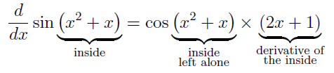

Example: Differentiate $\sin{(x^{2}+x)}$ with respect to $x$.
Solution:
Example: Differentiate $\sqrt{x^{2}+1}$ with respect to .
Solution:
$$\frac{d}{dx}\sqrt{x}=\frac{1}{2\sqrt{x}} and \frac{d}{dx}\left(x^{2}+1\right)=2x$$
then
$\frac{d}{dx}\sqrt{x^{2}+1}=\frac{1}{2\sqrt{x^{2}+1}} ×2x=\frac{x}{\sqrt{x^{2}+1}}$

Slide 6

Example: Differentiate ${(x^{3}−1)}^{100}$ with respect to $x$ .
Solution: Since
$$\frac{d}{dx}x^{100}=100x^{99} and\frac{d}{dx}\left(x^{3}−1\right)=3x^{2}$$
then
$$\frac{d}{dx}{(x^{3}−1)}^{100}=100{(x^{3}−1)}^{99}×3x^{2}=300x^{2}(x^{3}−1)$$

Slide 7

Example: Differentiate $\sin^{3}x$ with respect to .
Solution: Note that ${\left(\sin{x}\right)}^{3}$ . So, since
$$\frac{d}{dx}x^{3}=3x^{2} and \frac{d}{dx}\sin{x}=\cos{x}$$
then
$$\frac{d}{dx}\sin^{3}x=\frac{d}{dx}{\left(\sin{x}\right)}^{3}=3{\left(\sin{x}\right)}^{2}×cos x=3\sin^{2}x cos x$$

Slide 8
Example: Differentiate $2^{x\cos{x}}$ with respect to $x$.
Solution: Since
$\frac{d}{dx}2^{x}=2^{x}\ln{2} and \frac{d}{dx}\left(x\cos{x}\right)=\cos{x}−x\sin{x}$
then
$$\frac{d}{dx}2^{x\cos{x}}=2^{x\cos{x}}\ln{2}×(\cos{x}−x\sin{x})$$

Slide 9
Example: Differentiate $\ln{(\cos{(5x^{2}))}}$ with respect to $x$ .
Solution: Since
$$\frac{d}{dx}\ln{x}=\frac{1}{x} , \frac{d}{dx}\cos{x}=−\sin{x} , \frac{d}{dx}5x^{2}=10x$$
then
$$\frac{d}{dx}\ln{(\cos{(5x^{2}))}}=\frac{1}{\cos\left(5x^{2}\right)} ×−\sin\left(5x^{2}\right)×10x$$
$$=−\frac{10x\sin\left(5x^{2}\right)}{\cos\left(5x^{2}\right)} =−10x \tan{(5x^{2})}$$

Slide 10
Example: Differentiate $\ln\left(\frac{t^{2}\sin{t}}{\sqrt{t+1}}\right)$with respect to $t$.
Solution: First simplify the expression as follows, then differentiate with respect to $t$ .
$$\ln\left(\frac{t^{2}\sin{t}}{\sqrt{t+1}}\right)=\ln{t^{2}}+\ln{\sin{t}}−\ln{\sqrt{t+1}}$$
$$=2\ln{t}+\ln{\sin{t}}−\ln{{\left(t+1\right)}^{\frac{1}{2}}}$$
$$=2\ln{t}+\ln{\sin{t}}−\frac{1}{2}\ln{(t+1)}$$
$$⇒$$

Slide 11
Solution
$$\frac{d}{dt}\left[\ln{\frac{t^{2}\sin{t}}{\sqrt{t+1}} }\right]=2\frac{d}{dt}\left(\ln{t}\right)+\frac{d}{dt}\left[\ln{(\sin{t)}}\right]−\frac{1}{2}\frac{d}{dt}\left[\ln\left(t+1\right)\right]$$
$$=\frac{2}{t}+\frac{\cos{t}}{\sin{t}} −\frac{1}{2} \frac{1}{t+1}$$
$$=\cot{t}+4+\frac{3t}{2t\left(1+t\right)}$$

Slide 12
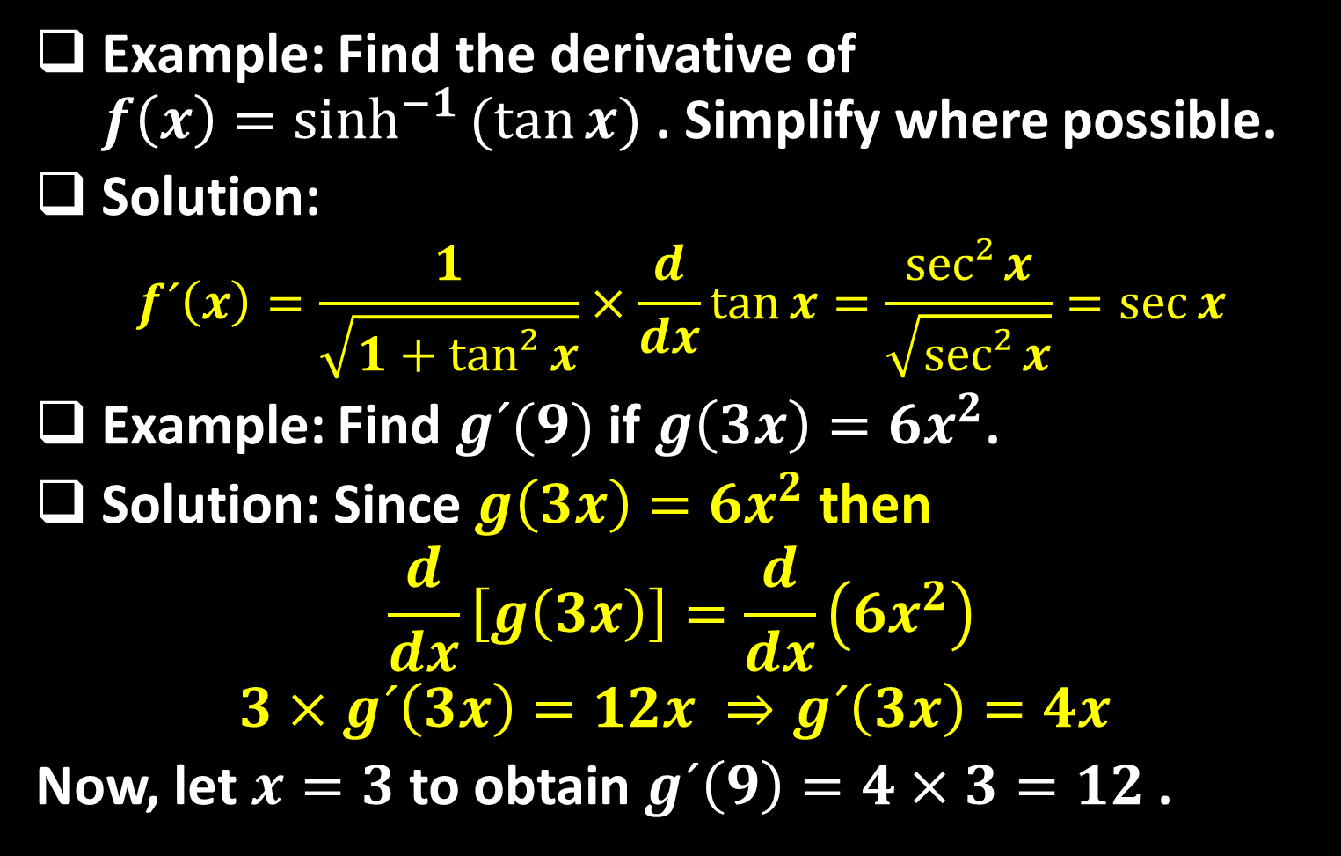
Example: Find the derivative of $f\left(x\right)=\sinh^{−1}{(tan{x})}$ . Simplify where possible.
Solution:
$$f´\left(x\right)=\frac{1}{\sqrt{1+tan²{x}}}×\frac{d}{dx}\tan{x}=\frac{sec²{x}}{\sqrt{sec²{x}}}=\sec{x}$$
Example: Find $g´(9)$ if $g\left(3x\right)=6x^{2}$.
Solution: Since $g\left(3x\right)=6x^{2}$ then
$$\frac{d}{dx}\left[g\left(3x\right)\right]=\frac{d}{dx}\left(6x^{2}\right)$$
$$3×g´\left(3x\right)=12x ⇒g´\left(3x\right)=4x$$
Now, let $x=3$ to obtain $g´\left(9\right)=4×3=12$ .

Slide 13
Example: Let $\frac{d}{dx}\left[f\left(x^{2}\right)\right]=x^{2}$ . Find $f´(x^{2})$.
Solution:
$$\frac{d}{dx}\left[f\left(x^{2}\right)\right]=x^{2}$$
$$2xf´\left(x^{2}\right)= x^{2}$$
$$f´\left(x^{2}\right)=\frac{x^{2}}{2x}=\frac{1}{2}x where x≠0$$

Slide 14
Thank you for your Attention

