Slide 1

Implicit Differentiation
Tangent Line

Slide 2

Implicit Differentiation
Most of the functions we have dealt with so far have been described by an equation of the form that expresses $y=f(x)$ explicitly in terms of the variable $x$.
Another situation occurs when we encounter equations like $x^{2}+y^{2}=25$ or $y^{2}−x=0$. These equations define an implicit relation between the variables $x$ and $y$.
When we cannot put an equation $F(x,y)=0$ in the form $y=f(x)$ to differentiate it in the usual way,
we may still be able to find $\frac{dy}{dx}$ by implicit differentiation.

Slide 3

This consists of differentiating both sides of the equation with respect to $x$ and then solving the resulting equation for $y´$.
Implicit Differentiation Technique:
  Differentiate both sides of the equation with respect to $x$, treating $y$ as a differentiable function of $x$.
  Collect the terms with $dy/dx$ on one side of the equation.
  Solve for $dy/dx$.

Slide 4

Example: Find $dy/dx$ if $y^{2}=x$.
Solution: To find $dy/dx$, we simply differentiate both sides of the equation $y^{2}=x$ with respect to $x$, treating $y=f(x)$ as a differentiable function of $x$:
$$y^{2}=x$$
$$\frac{d}{dx}\left(y^{2}\right)=\frac{d}{dx}\left(x\right)$$
$$2y\frac{dy}{dx}=1$$
$$\frac{dy}{dx}=\frac{1}{2y}$$

Slide 5

Example: Find $dy/dx$ of circle $x^{2}+y^{2}=25$ at the point $(3,4)$.
Solution: We can solve the problem more easily by differentiating the given equation of the circle implicitly with respect to $x$:
$$x^{2}+y^{2}=25$$
$$\frac{d}{dx}\left(x^{2}+y^{2}\right)=\frac{d}{dx}\left(25\right)$$
$$2x+2y\frac{dy}{dx}=0$$
$2y\frac{dy}{dx}=−2x ⇒\frac{dy}{dx}=−\frac{x}{y} ⇒{\left.\frac{dy}{dx}\right|}_{\left(3,4\right)}=−\frac{3}{4}$

Slide 6

Implicit differentiation can also be used to find higher derivatives. Here is an example.
Example: Find $d²y/dx²$ if $2x^{3}−3y^{2}=8$.
Solution: To start, we differentiate both sides of the equation with respect to $x$ in order to find $y´=\frac{dy}{dx}$.
$$\frac{d}{dx}\left(2x^{3}−3y^{2}\right)=\frac{d}{dx}\left(8\right)$$
$$6x^{2}−6yy´=0$$
$−6yy´=−6x^{2} ⇒y´=\frac{x^{2}}{y} where y≠0$

Slide 7

We now apply the Quotient Rule to find $y´´$.
$y´´=\frac{d}{dx}\left(\frac{dy}{dx}\right)=\frac{d}{dx}\left(\frac{x^{2}}{y}\right)=\frac{2xy−x^{2}y´}{y^{2}}=\frac{2x}{y}−\frac{x^{2}}{y^{2}}.y´$
Finally, we substitute $y´=x^{2}/y$ to express $y´´$ in terms of $x$ and $y$.
$$y´´=\frac{2x}{y}−\frac{x^{2}}{y^{2}}\frac{x^{2}}{y^{2}}=\frac{2x}{y} −\frac{x^{4}}{y^{3}} when y≠0$$

Slide 8

The method used in the following example is called logarithmic differentiation.
Example: Differentiate $y=x^{\sqrt{x}}$.
Solution: Using logarithmic differentiation, we have
$$\ln{y}=\ln{x^{\sqrt{x}}}=\sqrt{x}\ln{x}$$
$$\frac{d}{dx}\left(\ln{y}\right)=\frac{d}{dx}\left(\sqrt{x}\ln{x}\right)$$
$$\frac{y´}{y}=y\left(\frac{1}{\sqrt{x}}+\frac{\ln{x}}{2\sqrt{x}}\right)= x^{\sqrt{x}} \left(\frac{2+\ln{x}}{2\sqrt{x}}\right)$$

Slide 9
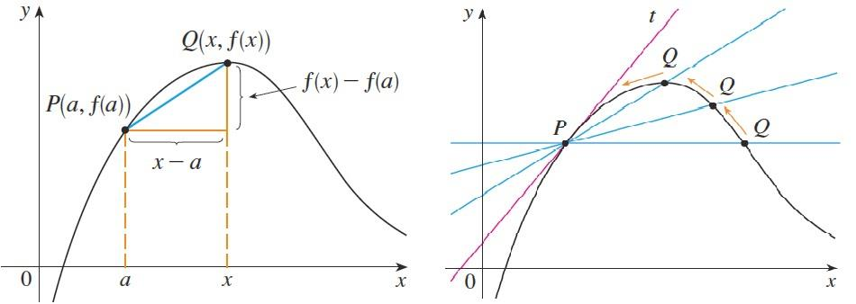

Tangent Line
The problem of finding the tangent line to a curve involve calculating a derivative.
Definition: The tangent line to the curve $y=f(x)$ at the point $\left(a,f\left(a\right)\right)$ is the line through the point with slope $m=\lim_{x→a}{\frac{f\left(x\right)−f(a)}{x−a}}=f´(a)$
provided that this limit exists.

Slide 10
Example: Find an equation of the tangent line to the parabola $f\left(x\right)=x^{2}$ at the point with coordinate is $x=1$.
Solution: Here, the tangent point is
$\left(1,f\left(1\right)\right)=\left(1,1^{2}\right)=\left(1,1\right)$.
Since $f´\left(x\right)=2x$ then the slope is $m=f´\left(1\right)=2×1=2$.
Using the point-slope form of the equation of a line, we find the equation of the tangent line at $P(1,1)$ as follows.$y−y_{0}=m\left(x−x_{0}\right)$
$$y−1=2\left(x−1\right)⇒y=2x−1$$

Slide 11
Example: Find an equation of the tangent line to the hyperbola $g\left(x\right)=3/x$ at the point $(3,1)$.
Solution: Since $f´\left(x\right)=−3/x^{2}$, then the slope of the tangent at $(3,1)$ is
$m=f\left(3\right)=−\frac{3}{9}=−\frac{1}{3}$
Therefore an equation of the tangent at the point $(3,1)$is
$$y−y_{0}=m\left(x−x_{0}\right)$$
$$y−1=−\frac{1}{3}(x−3)$$
$$y=−\frac{1}{3}x+2$$

Slide 12
Example: Find equations of the tangent line to the curve $f\left(x\right)=\sin{(\sin{x})}$ at the point with $x−$coordinate is $x=π$ .
Solution: Here, the tangent point is
$\left(π,f\left(π\right)\right)=\left(π,\sin{\sin{π}}\right)=(π,\sin{0)}=\left(π,0\right)$
Since $f´\left(x\right)=\cos{(\sin{x})}\cos{x}$ (by using Chain Rule), then the slope is
$m=f´\left(π\right)=\cos{(\sin{π})}\cos{π}=\cos{0}×−1=1×−1=−1$
Using the point-slope form of the equation of a line, we find the equation of the tangent line at $P(π,0)$
as follows.

Slide 13
$$y−y_{0}=m\left(x−x_{0}\right)$$
$$y−1=−1 (x−π)$$
$$y=−x+π$$
Example: Find the tangent to $x^{3}+y^{3}=6xy$ at the point $(3,3)$.
Solution : Differentiating both sides of $x^{3}+y^{3}=6xy$ with respect to $x$, regarding $y$ as a function of $x$, and using the Chain Rule on the
term $y^{3}$ and the Product Rule on the term $6xy$ ,
we get

Slide 14
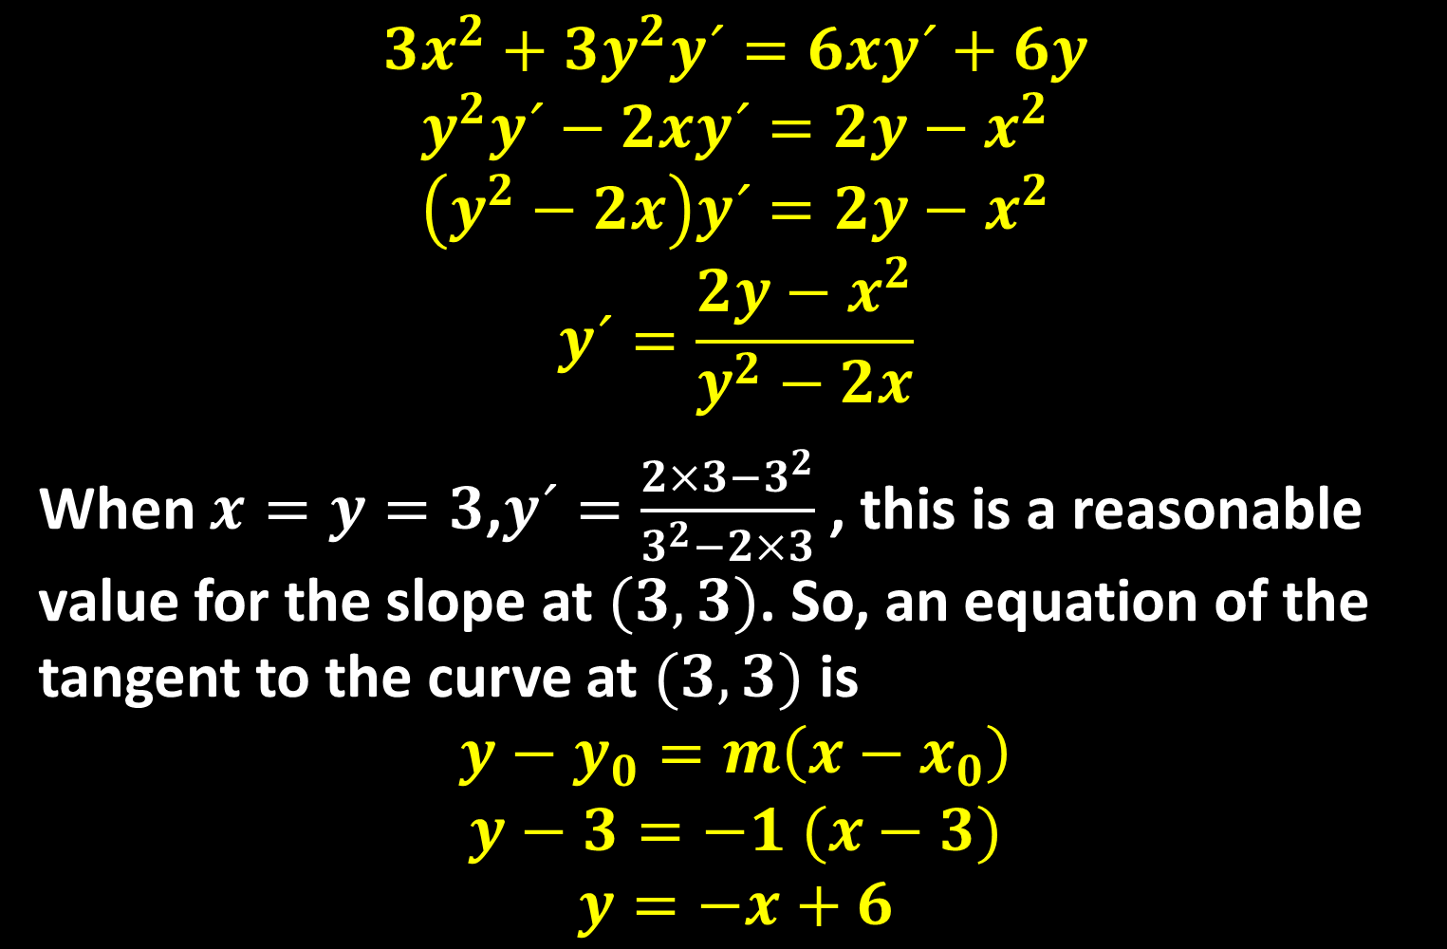
$$3x^{2}+3y^{2}y´=6xy´+6y$$
$$y^{2}y´−2xy´=2y−x^{2}$$
$$\left(y^{2}−2x\right)y´=2y−x^{2}$$
$$y´=\frac{2y−x^{2}}{y^{2}−2x}$$
When $x=y=3$,$y´=\frac{2×3−3^{2}}{3^{2}−2×3}$ , this is a reasonable value for the slope at $(3,3)$. So, an equation of the tangent to the curve at $(3,3)$ is
$$y−y_{0}=m\left(x−x_{0}\right)$$
$$y−3=−1 (x−3)$$
$$y=−x+6$$

Slide 15
Thank you for your Attention

