Slide 1

Indeterminate Forms and L'Hospital's Rule

Slide 2
This chapter studies some of the important applications of derivatives.
We learn how derivatives are used to find extreme values of functions, to determine and analyze the shapes of graphs, to calculate limits of fractions whose numerators and denominators both approach zero or infinity, and to find numerically where a function equals zero.

Slide 3
James Stewart, Calculus: Early Transcendentals, 7th Edition, Brooks/ Cole 2012.
Howard Anton, Irl C. Bivens and Stephen Davis, Calculus: Early Transcendentals, 9th Edition, John Wiley & Sons, Inc. 2010.
Salas, Etgen, and Hille, Calculus: One and Several Variables, 10th Edition, John Wiley & Sons,
Inc. 2007.

Slide 4
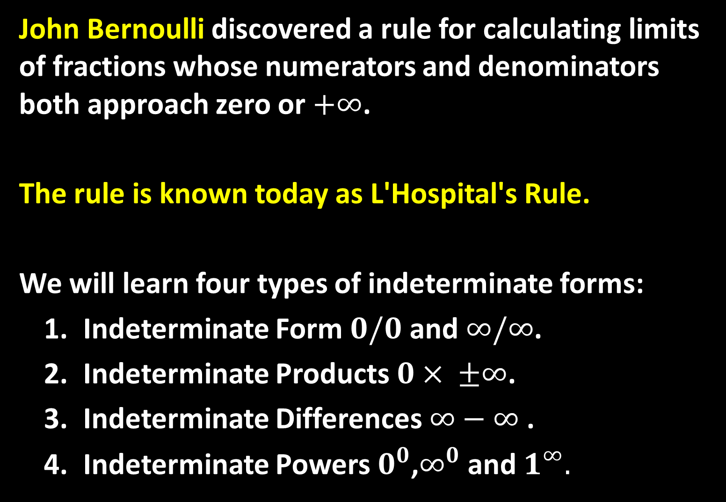
John Bernoulli discovered a rule for calculating limits of fractions whose numerators and denominators both approach zero or $+∞$.
The rule is known today as L'Hospital's Rule.
We will learn four types of indeterminate forms:
  Indeterminate Form $0/0$ and $∞/∞$.
  Indeterminate Products $0× ±∞$.
  Indeterminate Differences $∞−∞$ .
  Indeterminate Powers $0^{0}$,$∞^{0}$ and $1^{∞}.$

Slide 5

Type 1: Indeterminate Form $0/0$ and $∞/∞$:
Theorem: Suppose $f$ and $g$ are differentiable and $g´(x)≠0$ on an open interval $I$ that contains $a$ (except possibly at $a$). Suppose that
$\lim_{x→a}{\frac{f\left(x\right)}{g\left(x\right)}}=\frac{0}{0}$ or $\frac{±∞}{±∞}$
then
$\lim_{x→a}{\frac{f\left(x\right)}{g\left(x\right)}}=\lim_{x→a}{\frac{f´\left(x\right)}{g´\left(x\right)}}$
if the limit on the right side exists or $±∞$.

Slide 6
L'Hospital's Rule says that the limit of a quotient of functions is equal to the limit of the quotient of their derivatives, provided that the given conditions are satisfied. It is especially important to verify the conditions regarding the limits of and before using L'Hospital's Rule.
L'Hospital's Rule is also valid for one-sided limits and for limits at infinity or negative infinity.

Slide 7

Example: Find $\lim_{x→1}{\frac{\ln{x}}{x−1}}$.
Solution: Since $\lim_{x→1}{\ln{x}}=0$ and$\lim_{x→1}\left(x−1\right)=0$, then we can apply L'Hospital's Rule:
$$\lim_{x→1}{\frac{\ln{x}}{x−1}}=\lim_{x→1}{\frac{\frac{d}{dx}(\ln{x})}{\frac{d}{dx}(x−1)}}=\lim_{x→1}{\frac{1/x}{1}}=\lim_{x→1}{\frac{1}{x}=1}$$
Example: Calculate $\lim_{x→∞}{\frac{e^{x}}{x^{2}}} .$
Solution: We have $\lim_{x→∞}{e^{x}}=∞$ and $\lim_{x→∞}{x^{2}}=∞$ , so L'Hospital's Rule gives: $\lim_{x→∞}{\frac{e^{x}}{x^{2}}}=\lim_{x→1}{\frac{\frac{d}{dx}(e^{x})}{\frac{d}{dx}(x^{2})}}=\lim_{x→1}{\frac{e^{x}}{2x}}$

Slide 8

Since $e^{x}→∞$ and $2x→∞$ as $x→∞$ , the limit on the right side is also indeterminate, but a second application of L'Hospital's Rule gives:
$$\lim_{x→∞}{\frac{e^{x}}{x^{2}}}=\lim_{x→∞}{\frac{e^{x}}{2x}}=\lim_{x→∞}{\frac{e^{x}}{2}}=∞$$
Example: Calculate $\lim_{x→∞}{\frac{\ln{x}}{\sqrt[3]{x}}}$.
Solution: Since $\lim_{x→∞}{\ln{x}}=∞$ and $\lim_{x→∞}{\sqrt[3]{x}}=∞$ as $x→∞$, L'Hospital's Rule applies:
$$\lim_{x→∞}{\frac{\ln{x}}{\sqrt[3]{x}}}=\lim_{x→∞}{\frac{1/x}{\frac{1}{3}x^{−2/3}}}$$

Slide 9

Notice that the limit on the right side is now indeterminate of type $\frac{0}{0}$. But instead of applying L'Hospital's Rule a second time as we did in the previous example, we simplify the expression and see that a second application is unnecessary:
$$\lim_{x→∞}{\frac{\ln{x}}{\sqrt[3]{x}}}=\lim_{x→∞}{\frac{1/x}{\frac{1}{3}x^{−2/3}}}=\lim_{x→∞}{\frac{3}{\sqrt[3]{x}}}=0$$

Slide 10

Type 2: Indeterminate Products $0× ±∞$:
We can deal with it by writing the product as a quotient:
$fg=\frac{f}{1/g}$ or $fg=\frac{g}{1/f}$
This converts the given limit into an indeterminate form of type $0/0$ or $∞/∞$ so that we can use L'Hospital's Rule.
Example: Evaluate $\lim_{x→0^{+}}{x\ln{x}}$.
Solution: The given limit is indeterminate because, as $x→0^{+}$, the first factor $x$ approaches $0$ while the second factor $\ln{x}$ approaches $−∞$.

Slide 11

Writing $x$ as $\frac{1}{1/x}$ we have $1/x→∞$ as $x→0^{+}$, so L'Hospital's Rule gives:
$$\lim_{x→0^{+}}{x\ln{x}}=\lim_{x→0^{+}}{\frac{\ln{x}}{1/x}}=\lim_{x→0^{+}}{\frac{1/x}{−1/x^{2}}}=\lim_{x→0^{+}}{(−x)}=0$$
Type 3: Indeterminate Differences $∞−∞$:
If $\lim_{x→a}{f\left(x\right)}=∞$ and $\lim_{x→a}{g\left(x\right)}=∞$ , then the limit
$$\lim_{x→a}{[f\left(x\right)−g\left(x\right)]}$$
is called an indeterminate form of type $∞−∞$.

Slide 12

To find out the limit, we try to convert the difference into a quotient by using a common denominator, or rationalization, or factoring out a common factor so that we have an indeterminate form of type $0/0$ or $∞/∞$.
Example: Evaluate $\lim_{x→{(\frac{π}{2})}^{−}}{(\sec{x}−\tan{x})}$.
Solution: First notice that $\sec{x}→∞$ and $\tan{x}→∞$ as , so the limit is indeterminate.
Here we use a common denominator:

Slide 13

$$\lim_{x→{(\frac{π}{2})}^{−}}{(\sec{x}−\tan{x})}= \lim_{x→{(\frac{π}{2})}^{−}}\left(\frac{1}{\cos{x}}−\frac{\sin{x}}{\cos{x}}\right)$$
$=\lim_{x→{(\frac{π}{2})}^{−}}{\frac{1−\sin{x}}{\cos{x}}} ⇒ =\lim_{x→{(\frac{π}{2})}^{−}}{\frac{−\cos{x}}{−\sin{x}}}=0$
Example: Calculate $\lim_{t→∞}{(te^{1/2}−t)}$.
Solution: Notice that $te^{1/2}→∞$ and $t→∞$ as $t→∞$, so the limit is indeterminate. Here we use a common factor:

Slide 14

$\lim_{t→∞}{(te^{1/2}−t)}=\lim_{t→∞}{t(e^{1/2}−t)}=∞×0$
which is indeterminate form of type 2. Writing $t$ as $1/t$ we have $1/t→0$ as $t→∞$, so L'Hospital's Rule gives:
$\lim_{t→∞}{(te^{1/2}−t)}=\lim_{t→∞}{t(e^{1/2}−t)}= \lim_{t→∞}{\frac{e^{1/t}−1}{1/t}}$
$=\lim_{t→∞}{\frac{−\frac{1}{t^{2}}e^{1/t}}{−\frac{1}{t^{2}}}}=\lim_{t→∞}{e^{1/t}}=1$

Slide 15

Type 4: Indeterminate Powers $0^{0}$, $∞^{0}$ and $1^{∞}$:
These several indeterminate forms arise from the limit
$\lim_{x→a}{{\left[f\left(x\right)\right]}^{g(x)}}$
Each of these three cases can be treated by writing the function as an exponential:
${\left[f\left(x\right)\right]}^{g(x)}=e^{g(x)\ln{f(x)}}$
and then
$\lim_{x→a}{{\left[f\left(x\right)\right]}^{g(x)}}=e^{\lim_{x→a}{g(x)\ln{f(x)}}}$
where the indeterminate product
$g(x)\ln{f(x)}$ is of type $0×∞$.

Slide 16

Example: Find $\lim_{x→0^{+}}{x^{x}}$.
Solution: Notice that this limit is indeterminate since $0^{x}=0$ for any $x>0$ but $x^{0}=1$ for any . We could proceed by writing the function as an exponential $x^{x}=e^{x\ln{x}}$ and then
$$\lim_{x→0^{+}}{x^{x}}=e^{\lim_{x→0^{+}}{x\ln{x}}}=e^{0}=1$$

Slide 17
Thank you for your Attention

