Slide 1

The Mean Value Theorem

Slide 2
We know that constant functions have zero derivatives, but could there be a complicated function, with many terms, the derivatives of which all cancel to give zero?
What is the relationship between two functions that have identical derivatives over an interval?
What we are really asking here is what functions can have a particular kind of derivative.
These and many other questions we study in this session are answered by applying the Mean Value Theorem.
To arrive at this theorem we first need Rolle's Theorem.

Slide 3
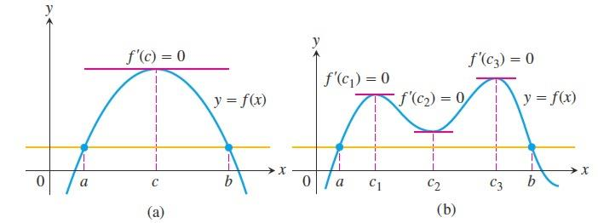

Rolle's Theorem: Drawing the graph of a function gives strong geometric evidence that between any two points where a differentiable function crosses a horizontal line there is at least one point on the curve where the tangent is horizontal.

Slide 4

Theorem: Suppose that $f$ is continuous at every point of the closed interval $[a,b]$ and differentiable at every point of its interior $(a,b)$. If $f\left(a\right)=f(b)$ , then there is at least one number $c∈(a,b)$ at which $f´\left(c\right)=0$.
Example: Verify that the function $f\left(x\right)=\frac{x^{3}}{3}−3x$ satisfies the three hypotheses of Rolle's Theorem on the interval $[−3,3]$. Then find all numbers $c$ that satisfy the conclusion of Rolle's Theorem.
Solution: First, you can see that $f\left(−3\right)=0=f(3)$. Since is a polynomial, it is differentiable on $(−3,3)$ and continuous on $[−3,3]$ .

Slide 5

Thus, by Rolle's Theorem, there is a number $c∈(−3,3)$ such that
$$f´\left(c\right)=0$$
$$c^{2}−3=0$$
$$c^{2}=3$$
$$c=±\sqrt{3}∈(−3,3)$$
Mean Value Theorem: The Mean Value Theorem, which was first stated by Joseph Louis Lagrange, is a slanted version of Rolle's Theorem. There is a point where the tangent is parallel to chord $AB$.

Slide 6
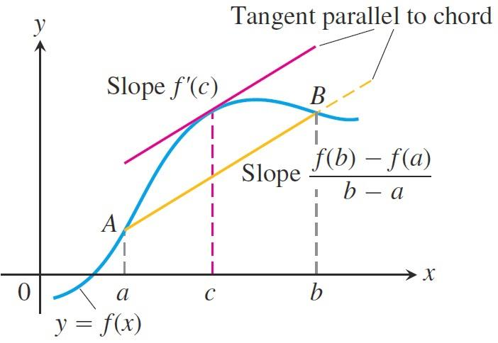
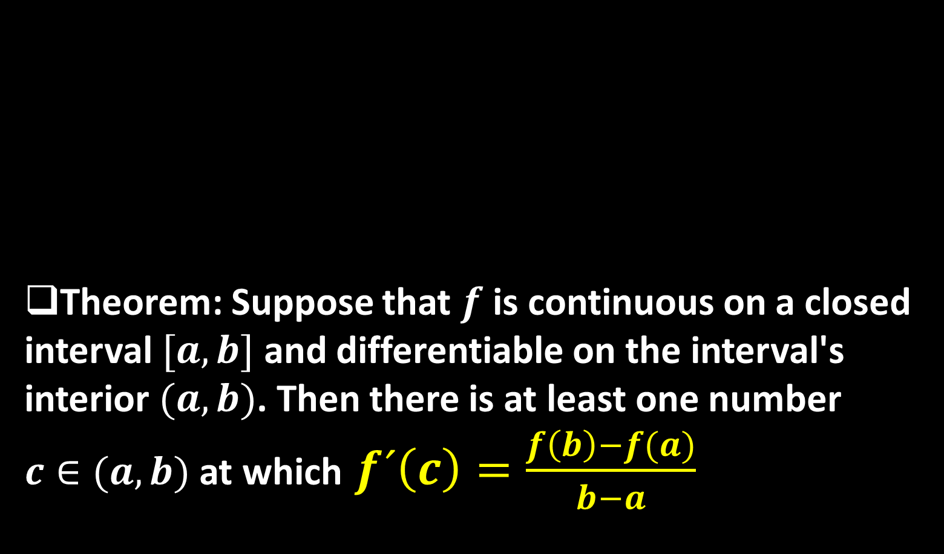
Theorem: Suppose that $f$ is continuous on a closed interval $[a,b]$ and differentiable on the interval's interior $(a,b)$. Then there is at least one number $c∈(a,b)$ at which $f´\left(c\right)=\frac{f\left(b\right)−f(a)}{b−a}$

Slide 7
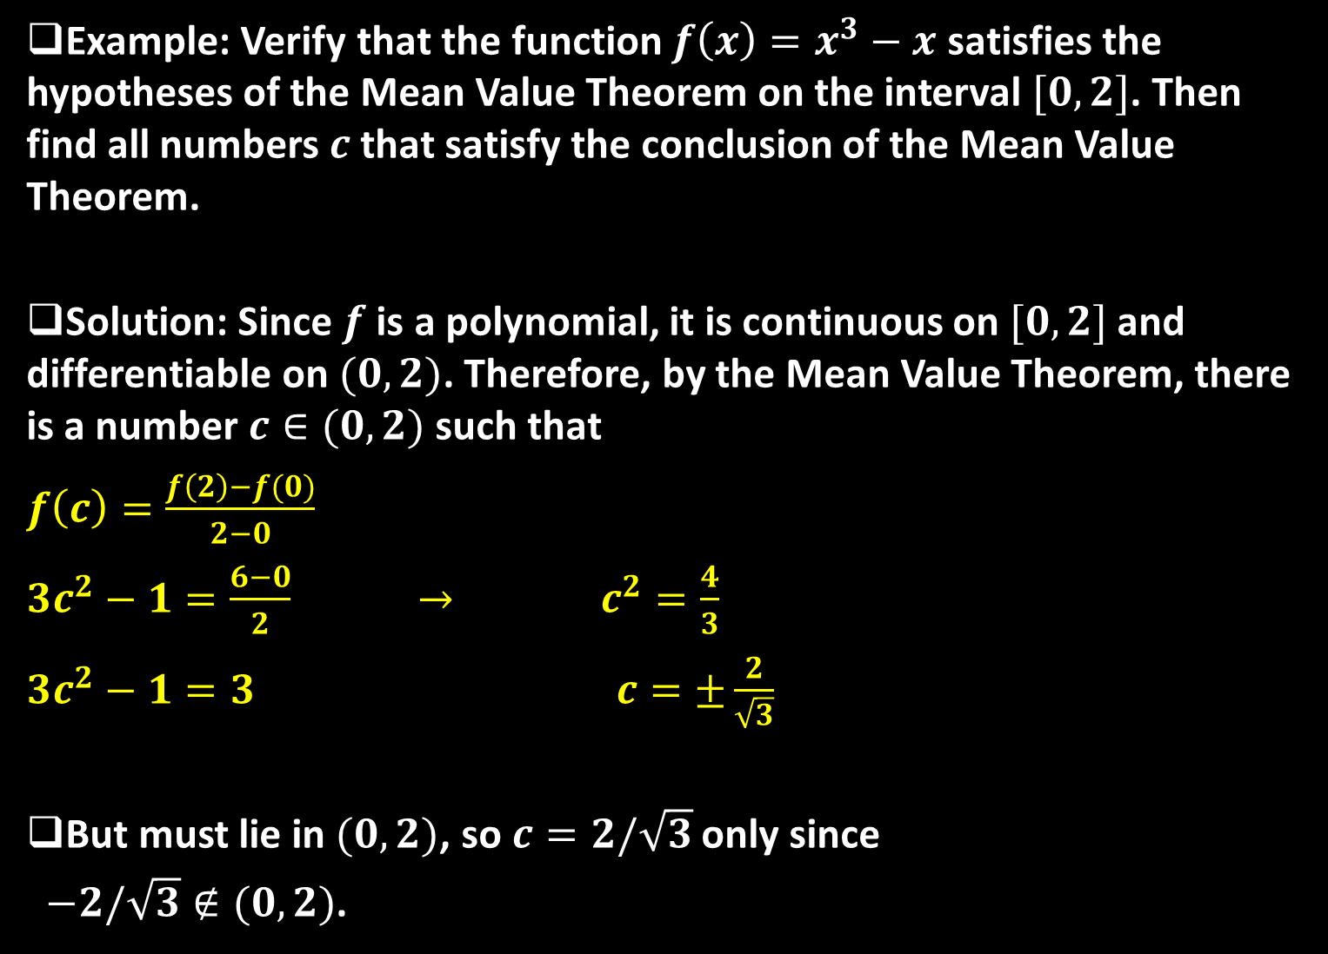
Example: Verify that the function $f\left(x\right)=x^{3}−x$ satisfies the hypotheses of the Mean Value Theorem on the interval $[0,2]$. Then find all numbers $c$ that satisfy the conclusion of the Mean Value Theorem.
Solution: Since $f$ is a polynomial, it is continuous on $[0,2]$ and differentiable on $(0,2)$. Therefore, by the Mean Value Theorem, there is a number $c∈(0,2)$ such that
$f\left(c\right)=\frac{f\left(2\right)−f(0)}{2−0}$
$3c^{2}−1=\frac{6−0}{2}$ $→$ $c^{2}=\frac{4}{3}$
$3c^{2}−1=3$ $c=±\frac{2}{\sqrt{3}}$
But must lie in $(0,2)$, so $c=2/\sqrt{3}$ only since
$−2/\sqrt{3}∉(0,2)$.

Slide 8

Example: Suppose that $f\left(0\right)=−3$ and $f´(x)≤0$ for all values of $0$.How large can $f(2)$ possibly be?
Solution: We are given that $f$ is differentiable (and therefore continuous) everywhere. In particular, we can apply the Mean Value Theorem on the interval $[0,2]$. There exists a number $c∈(0,2)$ such that
$$f´\left(c\right)=\frac{f\left(2\right)−f(0)}{2−0}$$
$$2f´\left(c\right)=f\left(2\right)−\left(−3\right)$$
$$2f´\left(c\right)−3=f(2)$$

Slide 9

We are given that $f´\left(x\right)≤5$ for all $x$, so in particular we know that $f´\left(c\right)≤5$ . Multiplying both sides of this inequality by $2$, we have $2f´\left(c\right)≤10$ , so
$f\left(2\right)=2f´\left(c\right)−3≤10−3=7$
Thus, the largest possible value for $f(2)$ is $7$.
Mathematical Consequences: At the beginning of the last sequence, we asked what kind of function has a zero derivative over an interval. The first corollary of the Mean Value Theorem provides the answer.

Slide 10

Corollary: If $f´\left(x\right)=0$ at each point $x$ of an open interval $(a,b)$, then $f\left(x\right)=C$ for all $x∈(a,b)$, where $C$ is a constant.
Example: Prove the identity $\tan^{−1}{x}+\cot^{−1}{x}=π/2$.
Solution: Although calculus is not needed to prove this identity, the proof using calculus is quite simple. If $f\left(x\right)=\tan^{−1}{x}+\cot^{−1}{x}$, then
$f´\left(x\right)=\frac{1}{1+x^{2}}−\frac{1}{1+x^{2}}=0$
for all values of $x$.

Slide 11

Therefore $f\left(x\right)=C$, a constant. To determine the value of $C$, we put $x=1$ because we can evaluate exactly. Then
$c=f\left(1\right)=\tan^{−1}{1}+\cot^{−1}{1}=\frac{π}{4}+\frac{π}{4} =\frac{π}{2}$
Thus $\tan^{−1}{x}+\cot^{−1}{x}=π/2$.
At the beginning of the last sequence, we also asked about the relationship between two functions that have identical derivatives over an interval. The next corollary tells us that their values
on the interval have a constant difference.

Slide 12

Corollary:
If $f´\left(x\right)=g´(x)$ at each point $x$ in an open interval $(a,b)$, then there exists a constant $C$ such that $f\left(x\right)=g\left(x\right)+C$ for all $x∈(a,b)$. That is,$f−g$ is a constant on $(a,b)$.
Example: Prove the identity
$2\sin^{−1}{x}=\cos^{−1}{(1−2x^{2})}$ for $x≥0$.
Solution: If
$f\left(x\right)=2\sin^{−1}{x}−\cos^{−1}\left(1−2x^{2}\right)$
then

Slide 13

$$f´\left(x\right)=\frac{2}{\sqrt{1−x^{2}}}−\frac{2x}{\sqrt{1−x^{2}}}$$
$$=\frac{2}{\sqrt{1−x^{2}}}−\frac{2x}{\sqrt{x^{2}}\sqrt{1−x^{2}}}$$
$$=\frac{2}{\sqrt{1−x^{2}}}−\frac{2x}{x\sqrt{1−x^{2}}}$$
$$=\frac{2}{\sqrt{1−x^{2}}}−\frac{2}{\sqrt{1−x^{2}}}=0$$
for all values of $x$. Therefore $f\left(x\right)=C$, a constant. To determine the value of $C$, we put $x=1$ because we can evaluate exactly. Then
$c=f\left(1\right)=2\sin^{−1}{1}−\cos^{−1}{−1}=2×\frac{π}{2}−π=0$
Thus $2\sin^{−1}{x}=\cos^{−1}\left(1+{2x}^{2}\right)$.

Slide 14
Thank you for your Attention

