Slide 1

Extreme Values of Functions

Slide 2

This section shows how to locate and identify extreme values of a continuous function from its derivative.
Once we can do this, we can solve a variety of optimization problems in which we find the optimal (best) way to do something in a given situation.
Definition: Let $f$ be a function with domain $D$. Then $f$ has an absolute maximum value on $D$ at a point $c$ if $f(x)≤f(c)$ for all $x∈D$ and an absolute minimum value on $D$ at $c$ if $f(x)≥f(c)$ for all $x∈D$.

Slide 3
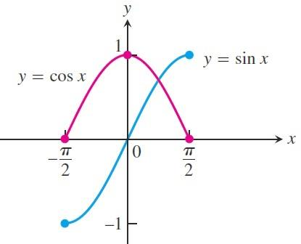

Example: On the closed interval $\left[−\frac{π}{2},\frac{π}{2}\right]$ the function $f\left(x\right)=\cos{x}$takes on an absolute maximum value of $1$ (once) and an absolute minimum value of $0$(twice). On the same interval, the function $g\left(x\right)=\sin{x}$ takes on a maximum value of $1$ and a minimum value of $−1$.

Slide 4
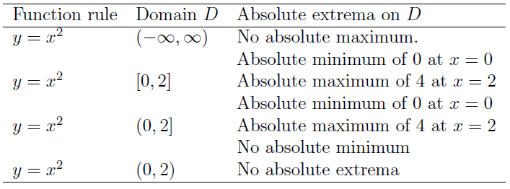

Example: The absolute extrema of the following functions on their domains can be seen in the figure in the next slide.
Each function:has the same defining equation $y=x^{2}$, but the domains vary. Notice that a function might not have a maximum or minimum if the domain is unbounded or fails to contain an endpoint.

Slide 5
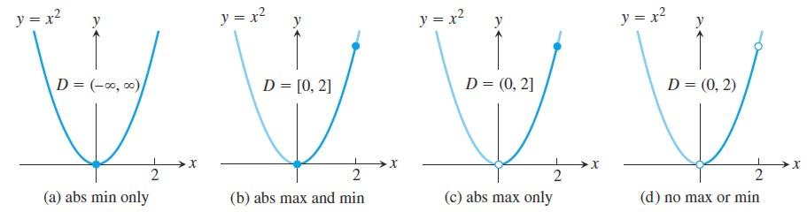
Note: Absolute maximum and minimum values are called absolute extrema.
Absolute extrema are also called global extrema, to distinguish them from local extrema defined later in this section.

Slide 6

The following theorem asserts that a function which is continuous at every point of a closed interval $[a,b]$ has an absolute maximum and an absolute minimum value on the interval. We always look for these values when we graph a function.
Theorem: If $f$ is continuous on a closed interval $[a,b]$, then $f$ attains both an absolute maximum value $M$ and an absolute minimum value $m$ in $[a,b]$. That is, there are numbers $x_{1}$ and $x_{2}$ in $[a,b]$ with $f\left(x_{1}\right)=m$ , $f\left(x_{2}\right)=M$ and $m≤f(x)≤M$
for every other $x$ in $[a,b]$.

Slide 7
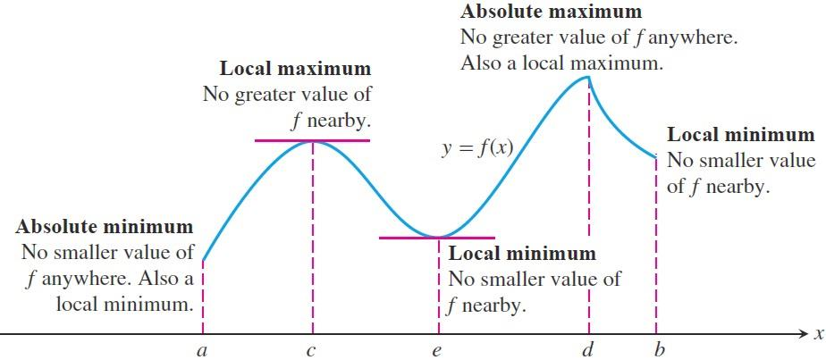

Local (Relative) Extreme Values: The figure shows a graph with five points where a function has extreme values on its domain $[a,b]$.
The function's absolute minimum occurs at $a$ even though at $e$ the function's value is smaller than at any other point nearby. The curve rises to the left and falls to the right around $c$,
making $f(c)$ a maximum locally.
The function attains its absolute maximum at $d$.

Slide 8

Definition: A function $f$ has a local maximum value at an interior point $c$ of its domain if
$f(x)≤f(c)$ for all $x$ in some open interval containing $c$.
A function $f$ has a local minimum value at an interior point $c$ of its domain if
$f(x)≥f(c)$ for all $x$ in some open interval containing $c$.

Slide 9
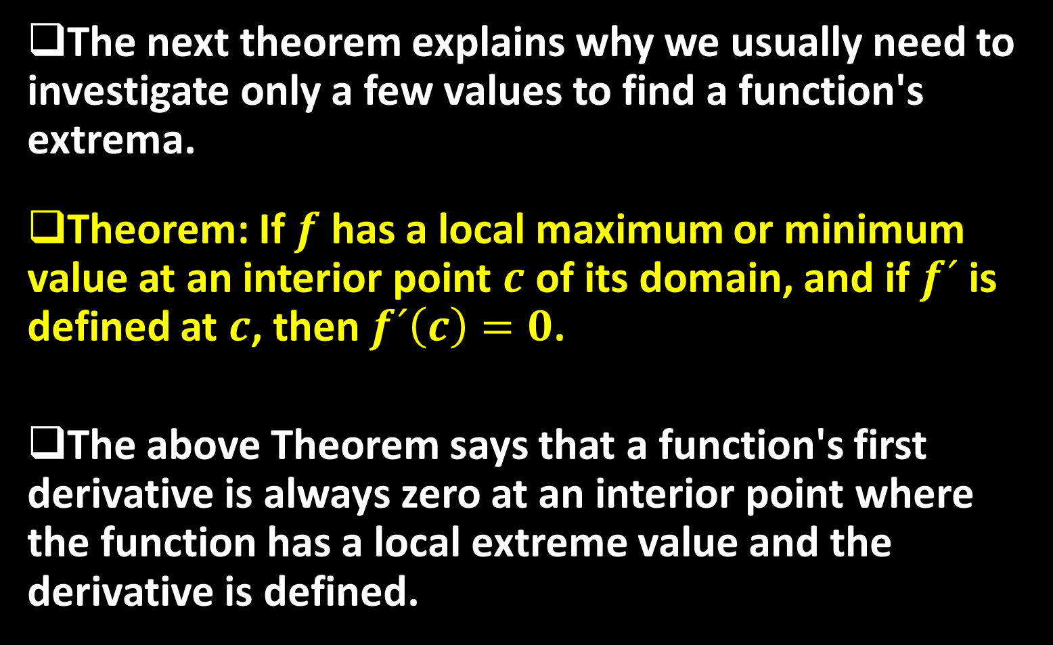
The next theorem explains why we usually need to investigate only a few values to find a function's extrema.
Theorem: If $f$ has a local maximum or minimum value at an interior point $c$ of its domain, and if $f´$ is defined at $c$, then $f´\left(c\right)=0$.
The above Theorem says that a function's first derivative is always zero at an interior point where the function has a local extreme value and the derivative is defined.

Slide 10

Hence the only places where a function $f$ can possibly have an extreme value (local or global) are:
  interior points where $f´=0$ ,
  interior points where $f´$ is undefined,
  endpoints of the domain of $f$ .
Definition: An interior point of the domain of a function $f$where $f´$ is zero or undefined is a critical point of $f$.
Thus the only domain points where a function can assume extreme values are critical points and endpoints.

Slide 11
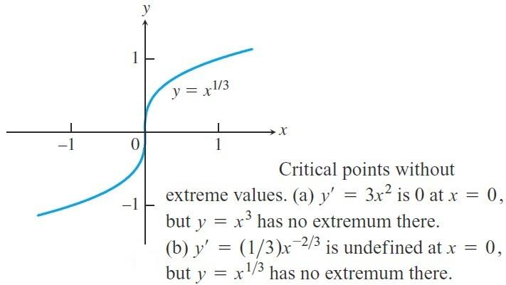

A differentiable function may have a critical point at $x=c$ without having a local extreme value there. For instance, the function $f\left(x\right)=x^{3}$ has a critical point at the origin and zero value there, but is positive to the right of the origin and negative to the left.
So it cannot have a local extreme value at the origin.

Slide 12

The question is: How to find the absolute extrema of a continuous function $f$ on a finite closed interval?
  Evaluate $f$ at all critical points and endpoints.
  Take the largest and smallest of these values.
Example: Find the absolute maximum and minimum values of $f\left(x\right)=10x(2−\ln{x})$ on the interval $\left[1,e^{2}\right]$.
Solution: We evaluate the function at the critical points and endpoints and take the largest and smallest of the resulting values. The first derivative is
$f´\left(x\right)=10\left(2−\ln{x}\right)−10x\left(\frac{1}{x}\right)=10(1−\ln{x})$

Slide 13
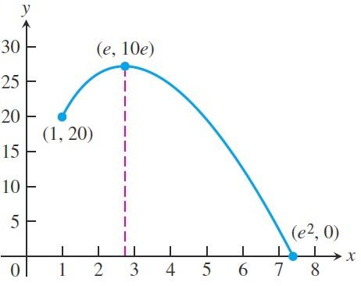

The only critical point in the domain $\left[1,e^{2}\right]$ is the point $x=e$ , where $f´\left(x\right)=0$.
The values of $f$ at this one critical point and at the endpoints are: $f\left(e\right)=10e$,$f\left(1\right)=20$, and $f\left(e^{2}\right)=0$
We can see from this list that the function's absolute maximum value is $10e$ it occurs at the critical interior point $x=e$. The absolute minimum value is $0$ and occurs at the right endpoint $x=e^{2}$.

Slide 14

Example: Find the absolute maximum and minimum values of $f\left(x\right)=x^{2/3}$ on the interval $\left[−2,3\right]$.
Solution: We evaluate the function at the critical points and endpoints and take the largest and smallest of the resulting values. The first derivative
$$f´\left(x\right)=\frac{2}{3}x^{−1/3}=\frac{2}{3\sqrt[3]{x}}$$
has no zeros but is undefined at the interior point $x=0$. The values of $f$ at this one critical point and at the endpoints are
$f\left(0\right)=0 , f\left(−2\right)=\sqrt[3]{4} , f\left(3\right)=\sqrt[3]{9}$

Slide 15
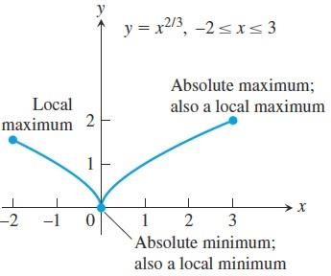

We can see from this list that the function's absolute maximum value is $\sqrt[3]{9}$ and it occurs at the right endpoint $x=3$ . The absolute minimum value is $0$, and it occurs at the interior point $x=0$ where the graph has a cusp.

Slide 16
Thank you for your Attention

