Slide 1

Monotonic Functions

Slide 2
In sketching the graph of a differentiable function, it is useful to know where it increases (rises from left to right) and where it decreases (falls from left to right) over an interval.
This sequence gives a test to determine where it increases and where it decreases.
We also show how to test the critical points of a function to identify whether
local extreme values are present.

Slide 3

Increasing Functions and Decreasing Functions: If the graph of a function climbs or rises as you move from left to right, we say that the function is increasing. If the graph descends or falls as you move from left to right, the function is decreasing.
Definition: Let $f$ be a function defined on an interval $I$ and let $x_{1}$ and $x_{2}$ be any two points in $I$.
  If $f\left(x_{2}\right)>f(x_{1})$ whenever $x_{1}<x_{2}$ then $f$ is said to be increasing on $I$.
  If $f\left(x_{2}\right)<f(x_{1})$ whenever $x_{1}<x_{2}$ then $f$ is said to be decreasing on $I$.

Slide 4

As another corollary to the Mean Value Theorem, functions with positive derivatives are increasing functions and functions with negative derivatives are decreasing functions.
A function that is increasing or decreasing on an interval is said to be monotonic on the interval.
Corollary: Suppose that $f$ is continuous on $[a,b]$ and differentiable on (a,b).
  If $f´\left(x\right)>0$ at each point $x∈(a,b)$ , then $f$ is increasing on $[a,b]$.
  If $f´\left(x\right)<0$ at each point $x∈(a,b)$ ,
  then $f$is decreasing on $[a,b]$.

Slide 5

Example: Find the critical points of
$f\left(x\right)=x^{3}−12x−5$
and identify the intervals on which $f$ is increasing and on which $f$ is decreasing.
Solution: The function $f$ is everywhere continuous and differentiable. The first derivative
$$f´\left(x\right)=3x^{2}−12=3\left(x^{2}−4\right)$$
$=3(x−2)(x+2)$
is zero at $x=−2$ and $x=2$.

Slide 6
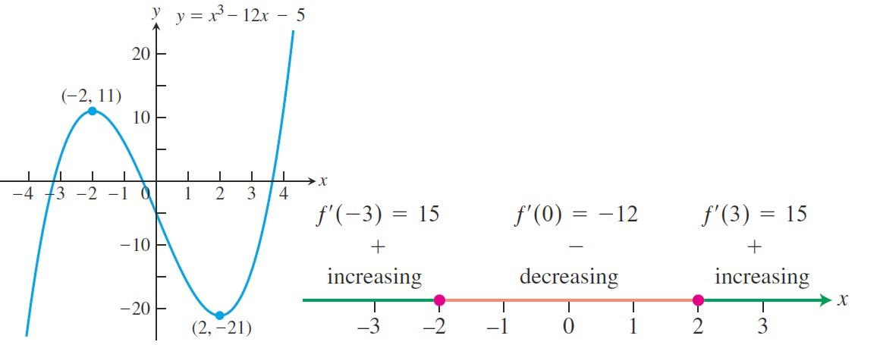

These critical points subdivide the domain of to create non-overlapping open interval $(∞,−2)$ ,$(−2,2)$ , and $(2,∞)$, on which $f´$ is either positive or negative.
We determine the sign of $f´$ by evaluating $f´$ at a convenient point in each subinterval. The behavior of $f$ is determined then by applying the last corollary to each subinterval.

Slide 7
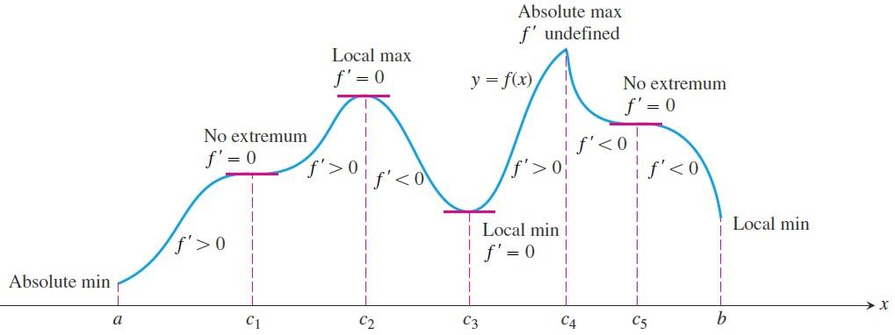

First Derivative Test for Local Extrema: In the figure, at the points where $f$ has a minimum value, $f´<0$ immediately to the left and $f´>0$ immediately to the right. (If the point is an endpoint, there is only one side to consider.) Thus, the function is decreasing on the left of the minimum value and it is increasing on its right.

Slide 8

Similarly, at the points where $f$ has a maximum value, $f´>0$ immediately to the left and $f´<0$ immediately to the right. Thus, the function is increasing on the left of the maximum value and decreasing on its right.
In summary, at a local extreme point, the sign of $f´(x)$ changes.
These observations lead to a test for the presence and nature of local extreme values of differentiable functions.

Slide 9

First Derivative Test for Local Extrema:
Suppose that $c$ is a critical point of a continuous function $f$, and that $f$ is differentiable at every point in some interval containing $c$ except possibly at $c$ itself. Moving across this interval from left to right,
  if $f´$ changes from negative to positive at $c$, then $f$ has a local minimum at $c$;
  if $f´$ changes from positive to negative at $c$, then $f$ has a local maximum at $c$;
  if $f´$ does not change sign at $c$ (that is, is positive on both sides of $c$ or negative on both sides), then $f$ has no local extremum at $c$.

Slide 10

Example: Find the critical points of
$f\left(x\right)=x^{1/3}\left(x−4\right)=x^{4/3}$ $−4x^{1/3}$
Identify the intervals on which $f$ is increasing and decreasing. Find the function's local and absolute extreme values.
Solution: The function $f$ is continuous at all since it is the product of two continuous functions. The first derivative $f\left(x\right)=\frac{d}{dx}\left(x^{4/3}−4x^{1/3}\right)⇒=\frac{4}{3}x^{1/3}−\frac{4}{3}x^{−\frac{2}{3}}$
$$=\frac{4}{3}x^{−2/3}\left(x−1\right)=\frac{4(x−1)}{3x^{2/3}}$$

Slide 11
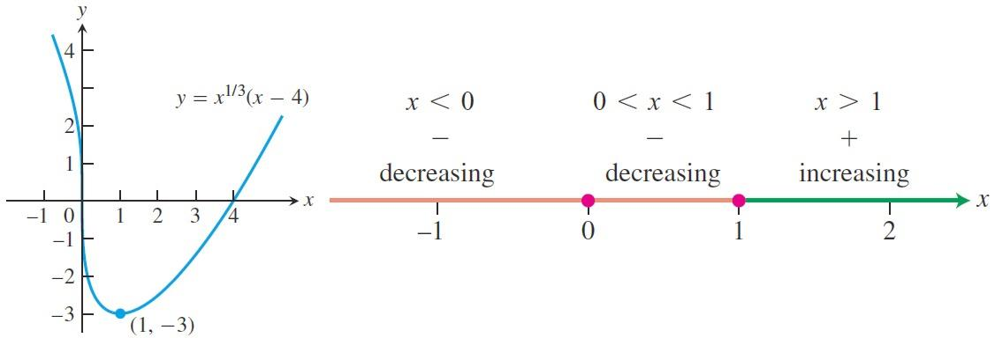

is zero at $x=1$ and undefined at $x=0$. There are no endpoints in the domain, so the critical points $x=0$ and $x=1$ are the only places where $f$ might have an extreme value. The critical points partition the $x−$axis into intervals on which $f´$ is either positive or negative. The sign pattern of $f´$ reveals the behavior of $f$ between and at the critical points, as summarized in the following figure.

Slide 12

Thus,
  $f$ decreases on $(−∞,1]$ and increases on [1,$∞]$.
  The First Derivative Test for Local Extrema tells us that $f$ does not have an extreme value at $x=0(f´$ does not change sign) and that $f$ has a local minimum at $x=1(f´$ changes from negative to positive).
  The value of the local minimum is $f\left(1\right)=1^{1/3}\left(1−4\right)=−3$. This is also an absolute minimum since $f$ is decreasing on $(−∞,1]$ and increases on $[1,∞)$. The previous figure shows this value in relation to the function's graph.
  Note that $\lim_{x→0}{f´\left(x\right)}=∞$
  so the graph of $f$ has a vertical tangent at the origin.

Slide 13
Thank you for your Attention

