Slide 1

Concavity and Curve Sketching

Slide 2
We have seen how the first derivative tells us where a function is increasing, where it is decreasing, and whether a local maximum or local minimum occurs at a critical point.
In this sequence we see that the second derivative gives us information about how the graph of a differentiable function bends or turns.
With this knowledge about the first and second derivatives, coupled with our previous understanding of symmetry and asymptotic behavior,
we can now draw an accurate graph
of a function.

Slide 3
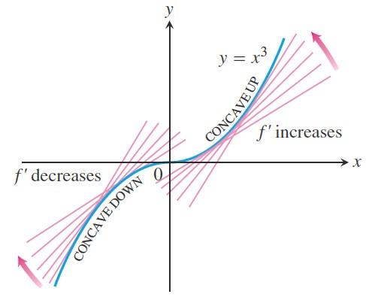

Concavity: As you can see in the figure, the curve $y=x^{3}$ rises as $x$ increases, but the portions defined on the intervals $(−∞,0)$ and $(0,∞)$ turn in different ways.
As we approach the origin from the left along the curve, the curve turns to our right and falls below its tangents. The slopes of the tangents are decreasing
on the interval $(−∞,0)$ .

Slide 4

As we move away from the origin along the curve to the right, the curve turns to our left and rises above its tangents. The slopes of the tangents are increasing on the interval $(0,∞)$. This turning or bending behavior defines the concavity of the curve.
Definition: The graph of a differentiable function $f$ is
  concave up on an open interval $I$ if $f´$ is increasing on $I$;
  concave down on an open interval $I$ if $f´$
  is decreasing on $I$.

Slide 5
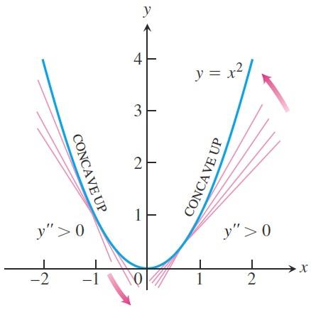

The Second Derivative Test for Concavity: Let $y=f(x)$ be twice-differentiable on an interval $I$.
  If $f´´>0$ on $I$, the graph of $f$ over $I$ is concave up.
  If $f´´>0$ on $I$, the graph of $f$ over $I$ is concave down.
Example: The curve $y=x^{2}$ below is concave up on $(−∞,∞)$ because its second derivative $y´´=2$ is always positive.

Slide 6
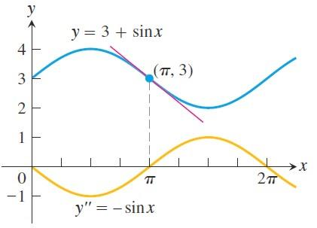

Example: Determine the concavity of
$y=3+\sin{x}$ on $\left[0,2π\right]$.
Solution: The first derivative of $y=3+\sin{x}$ is $y´=\cos{x}$ and the second derivative is $y´´=−sin{x}$. The graph of $y=3+\sin{x}$ is concave down on $(0,π)$ where $y´´=−sin{x}$
is negative. It is concave up
on $(π,2π)$ where $y´´=−sin{x}$ is positive.

Slide 7

Definition: A point where the graph of a function has a tangent line and where the concavity changes is a point of inflection.
Remark: At a point of inflection $\left(c,f\left(c\right)\right)$, either $f´´(c)=0$ or $f´´(c)$ fails to exist.
Example: Find the inflection points, if any, of the function $f\left(x\right)=x^{5/3}$.
Solution: The graph of $f\left(x\right)=x^{5/3}$ has a horizontal tangent at the origin because
$f´\left(x\right)=\frac{5}{3}x^{2/3}=0$ when $x=0$.

Slide 8
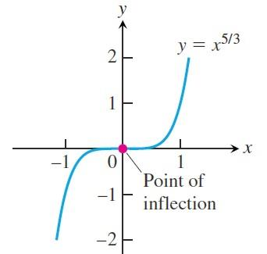

However, the second derivative
$f´´\left(x\right)=\frac{d}{dx}\left(\frac{5}{3}x^{2/3}\right)=\frac{10}{9}x^{−1/3}=\frac{10}{9\sqrt[3]{x}}$
fails to exist at $x=0$. Nevertheless, $f´´\left(x\right)<0$ for $x<0$ and $f´´\left(x\right)>0$ for $x>0$, so the second derivative changes sign at $x=0$ and there is a point of inflection at the origin.

Slide 9
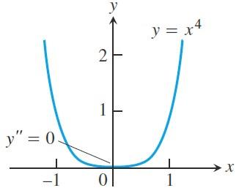

Here is an example showing that an inflection point need not occur even though both derivatives exist and $f´´=0$.
Example: Find the inflection points, if any, of the function $f\left(x\right)=x^{4}$.
Solution: The curve $y=x^{4}$ has no inflection point at . Even though the second derivative
$y´´=12x^{2}$ is zero there,
it does not change sign.

Slide 10
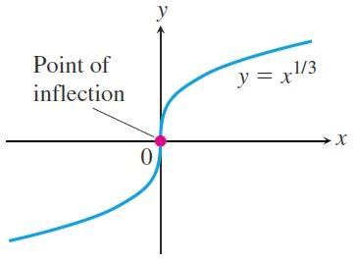

Example: Find the inflection points, if any, of the function $f\left(x\right)=x^{1/3}$.
Solution: The graph of $f\left(x\right)=x^{1/3}$ has a point of inflection at the origin because the second derivative is positive for $x<0$ and negative for $x>0$:
$$y´´=\frac{d^{2}}{dx^{2}}\left(x^{1/3}\right)=\frac{d}{dx}\left(\frac{1}{3}x^{−2/3}\right)=−\frac{2}{9}x^{−5/3}$$
However, both $y´=\frac{1}{3}x^{−2/3}$ and $y´´$ fail to exist at $x=0$, and there is a vertical tangent there.

Slide 11

Second Derivative Test for Local Extrema: Instead of looking for sign changes in $f´$ at critical points, we can sometimes use the following test to determine the presence and nature of local extrema.
Theorem: Suppose $f´´$ is continuous on an open interval that contains $x=c$.
  If $f´\left(c\right)=0$ and $f´´\left(c\right)<0$ , then $f$ has a local maximum at $x=c$.
  If $f´\left(c\right)=0$ and $f´´\left(c\right)>0$ , then $f$ has a local minimum at $x=c$ .
  If $f´\left(c\right)=0$ and $f´´\left(c\right)=0$ ,
  then the test fails. The function $f$ may have
  a local maximum, a local minimum, or neither.

Slide 12

Example: Discuss the curve $y=x^{4}−4x^{3}$ with respect to increasing, decreasing, concavity, points of inflection, and local maxima and minima. Use this information to sketch the curve.
Solution: The function $f$ is continuous since it is a polynomial. The domain of $f$ is $(−∞,∞)$ and the domain of $f´\left(x\right)=4x^{3}−12x^{2}$ is also $(−∞,∞)$ . Thus, the critical points of $f$ occur only at the zeros of $f´$. Since $f´\left(x\right)=4x^{3}−12x^{2}=4x^{2}(x−3)$, the first derivative is zero at $x=0$ and $x=3$. We use these critical points to define intervals
where $f$ is increasing or decreasing.

Slide 13
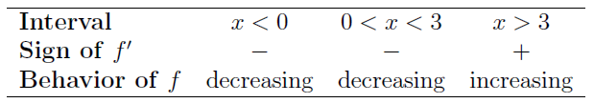

Using the First Derivative Test for local extrema and the table above, we see that there is no extremum at $x=0$ and a local minimum at $x=3$.
Using the table above, we see that $f$ is decreasing on $\left(−∞,3\right]$, and increasing on $\left[3,∞\right)$.
$f´´\left(x\right)=12x^{2}−24x=12x(x−2)$ is zero at $x=0$ and $x=2$. We use these points to define intervals where $f$ is concave
up or concave down.

Slide 14
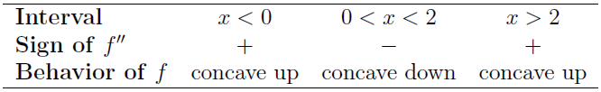
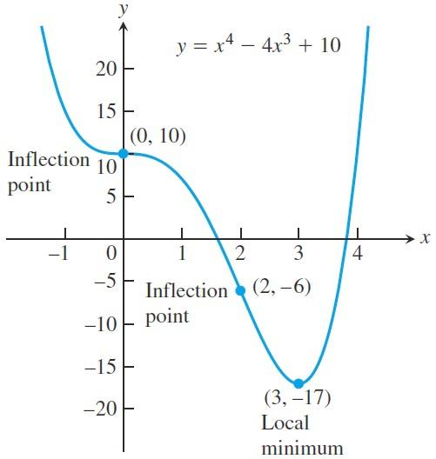

We see that $f$ is concave up on the intervals
$\left(∞,0\right) ∪ \left(2,∞\right)$
and concave down on $(0,2)$ .

Slide 15
Thank you for your Attention

