Slide 1

Indefinite Integrals

Slide 2

A special symbol is used to denote the collection of all antiderivatives of a function $f$.
Definition: The collection of all antiderivatives of $f$ is called the indefinite integral of $f$ with respect to $x$, and is denoted by
$\int{f\left(x\right)dx}$
The symbol $∫$ is an integral sign. The function $f$ is the integrand of the integral, and $x$ is the variable of integration.

Slide 3

In the following we list antiderivatives in the notation of indefinite integrals. Each formula is true because the derivative of the function in the right appears in the left. In particular, these formulas are the rules of integration.
Rule 1: The first formula says that the integration of a constant times a function is the constant times the integration of the function.
$$\int{cf\left(x\right)dx}=c\int{f\left(x\right)dx}$$

Slide 4

Rule 2: The second formula says that the integration of a sum (difference) is the sum (difference) of the integrations.
$$\int{\left[f\left(x\right)±g\left(x\right)\right]dx} =\int{f\left(x\right)dx }±\int{g\left(x\right)dx }$$
Rule 3: The integration of constant functions is the constant itself times .
$$\int{kdx}=kx+C where k is a constant$$
For example,$\int{\frac{1}{2}dx}=\frac{1}{2}x+C$
$$\int{πdx}=πx+C$$

Slide 5

Rule 4: The integration of power functions is given by
$\int{x^{n}dx}=\frac{x^{n}+1}{n+1}$ where $n≠−1$ .
In general,
$\int{{(ax+b)}^{n}dx }=\frac{{(ax+b)}^{n+1}}{a(n+1)}$ where $n≠−1$.
Example: Find the general indefinite integral
$\int{\left(x^{2}+\frac{1}{x^{2}}\right)dx}$

Slide 6
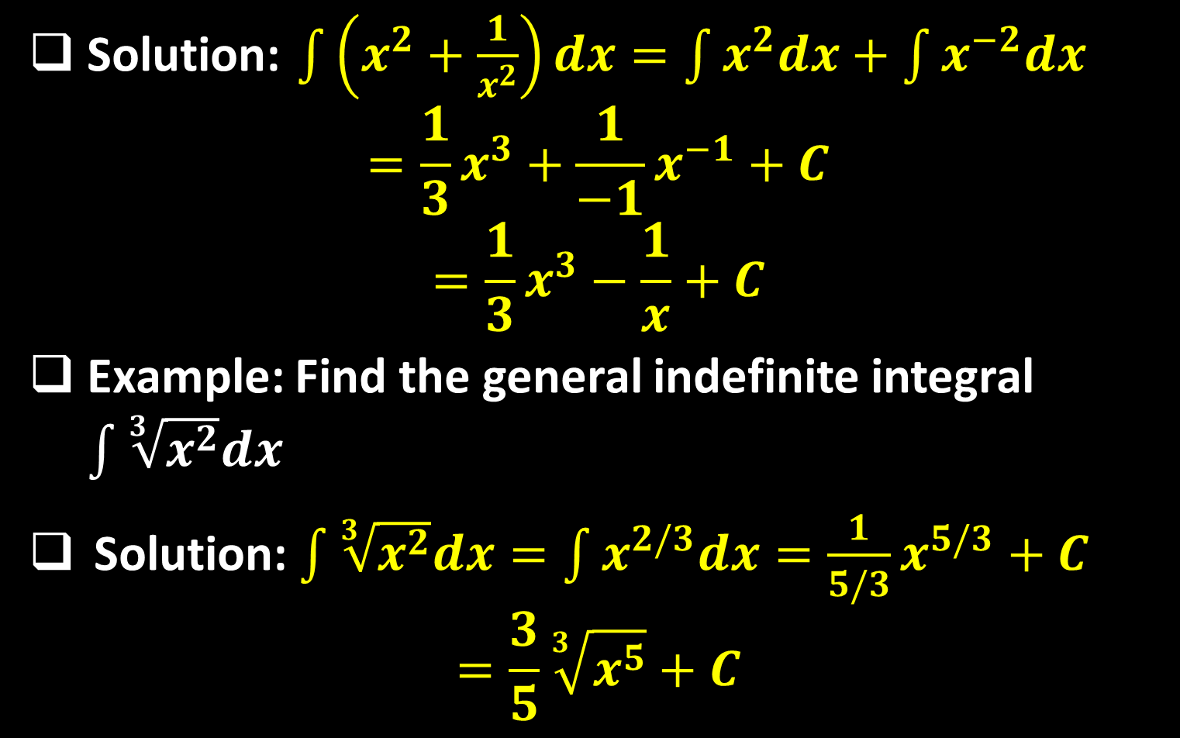
Solution: $\int{\left(x^{2}+\frac{1}{x^{2}}\right)dx}=\int{x^{2}dx}+\int{x^{−2}dx}$
$$=\frac{1}{3}x^{3}+\frac{1}{−1}x^{−1}+C$$
$$=\frac{1}{3}x^{3}−\frac{1}{x}+C$$
Example: Find the general indefinite integral $\int{\sqrt[3]{x^{2}}dx}$
Solution: $\int{\sqrt[3]{x^{2}}dx}=\int{x^{2/3}dx}=\frac{1}{5/3}x^{5/3}+C$
$$=\frac{3}{5}\sqrt[3]{x^{5}}+C$$

Slide 7

Example: Find the general indefinite integral
$\int{\left(x−1\right)\left(x+3\right)dx}$
Solution:
$$\int{\left(x−1\right)\left(x+3\right)dx}=\int{\left(x^{2}+2x−3\right)dx}$$
$$=\int{x^{2}dx}+2\int{xdx}−\int{3dx}$$
$$=\frac{1}{3}x^{3}+2×\frac{1}{2}x^{2}−3x+C$$
$$=\frac{1}{3}x^{3}+x^{2}−3x+C$$

Slide 8

Example: Find the general indefinite integral
$\int{{(1−2x)}^{99}dx}$
Solution:
$$\int{{(1−2x)}^{99}dx}=\frac{{(1−2x)}^{100}}{−2×100}+C =−\frac{{\left(1−2x\right)}^{100}}{200}+C$$

Slide 9
Example: Find the general indefinite integral
$$\int{\frac{x^{2}−3\sqrt{x}}{x}}dx$$
Solution:$\int{\frac{x^{2}−3\sqrt{x}}{x}}dx=\int{\left(\frac{x^{2}}{x} −\frac{3\sqrt{x}}{x}\right)dx}$
$$=\int{\left(x−3x^{−\frac{1}{2}}\right)}dx$$
$$=\frac{1}{2}x^{2}−3×\frac{1}{\frac{1}{2}}x^{\frac{1}{2}}+C$$
$$=\frac{1}{2}x^{2}−6\sqrt{x}+C$$

Slide 10

Rule 5: The fifth rule is the first rule we learn about the integration of the division of two functions.
$\int{\frac{1}{x}dx=\ln\left|x\right|}+C$
In general,
$\int{\frac{f´(x)}{f(x)}}dx=\ln\left|f(x)\right|+C$
Example: Find the general indefinite integral$\int{\frac{e^{x}}{9+e^{x}}}dx$
Solution: Since $\frac{d}{dx}\left(9+e^{x}\right)$ , then
$\int{\frac{e^{x}}{9+e^{x}}}dx=\ln\left|9+e^{x}\right|+c$

Slide 11
Example: Find the general indefinite integral
$\int{\frac{x}{1+x^{2}}}dx$
Solution: Notice $\frac{d}{dx}\left(1+x^{2}\right)=2x≠x$. So, multiply the integral by $\frac{2}{2}$ to obtain:
$$\int{\frac{x}{1+x^{2}}}dx=\frac{2}{2}\int{\frac{x}{1+x^{2}}}dx=\frac{1}{2}\int{\frac{2x}{1+x^{2}}}dx$$
$$=\frac{1}{2}\ln\left|1+x^{2}\right|+C$$

Slide 12
Example: Find the general indefinite integral $\int{\tan{x}dx}$.
Solution: To evaluate it, write $\tan{x}$ as
$\sin{x}/\cos{x}$. Thus,
$$\int{\tan{x}dx}=\int{\frac{\sin{x}}{\cos{x}}dx}=−\int{\frac{−\sin{x}}{\cos{x}}dx}$$
$$=−\ln\left|\cos{x}\right|+C=\ln\left|\sec{x}\right|+C$$
Rule 6: The rules of integration of exponential functions are as follows.
$\int{e^{x}dx}$ and $\int{a^{x}dx}=\frac{a^{x}}{\ln{a}}+C$

Slide 13
In general,
$\int{e^{αx+β}dx}=\frac{1}{α}e^{αx+β}+C$ and
$\int{e^{αx+β}dx}=\frac{a^{αx+β}}{α\ln{a}}+C$ .
Example: Find the general indefinite integral $\int{e^{8−6x}dx}$.
Solution:$\int{e^{8−6x}dx}=−\frac{2^{8−6x}}{6×\ln{2}}+C$.
Example: Find the general indefinite integral $\int{e^{2\ln{x}}dx}$.
Solution:
$\int{e^{2\ln{x}}dx}=\int{e^{\ln{{(x}^{2})}}}dx=\int{x^{2}dx}=\frac{1}{3}x^{3}+c$

Slide 14
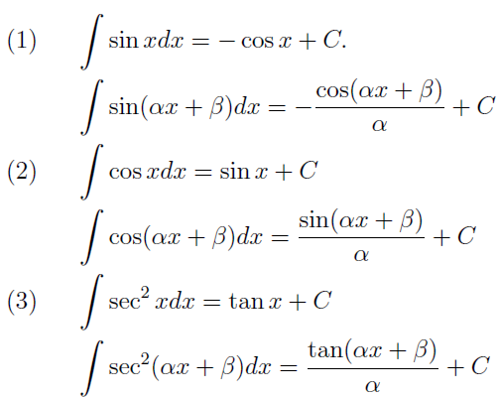
Rule 7: The following rules represent the rules of integrations of some trigonometric functions.

Slide 15
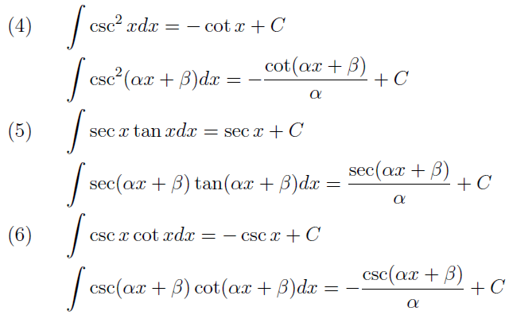

Slide 16
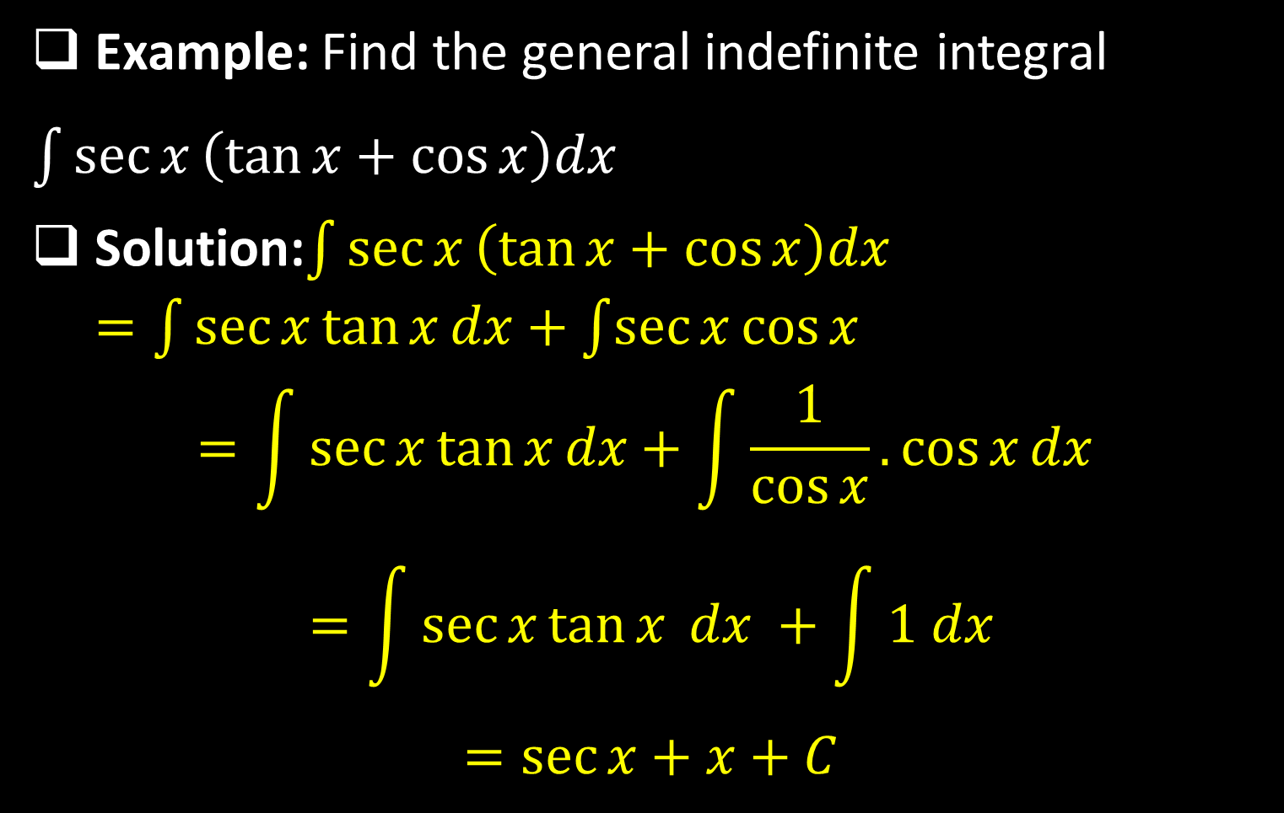
Example: Find the general indefinite integral
$\int{\sec{x}\left(\tan{x}+\cos{x}\right)dx }$
Solution:$\int{\sec{x}\left(\tan{x}+\cos{x}\right)dx} =\int{\sec{x}\tan{x}dx}+\int{\sec{x}\cos{x}}$
$$=\int{\sec{x}\tan{x}}dx+\int{\frac{1}{\cos{x}}.\cos{x}dx }$$
$$=\int{\sec{x}\tan{x} dx }+\int{1 dx}$$
$$=\sec{x}+x+C$$

Slide 17
Example: Find the general indefinite integral $\int{\sec{x}dx}$
Solution:
$$\int{\sec{x}dx}=\int{\sec{x}.\frac{\sec{x}+\tan{x}}{\sec{x}+\tan{x}}dx}$$
$$=\int{\frac{\sec{²x}+\sec{x}\tan{x}}{\sec{x}+\tan{x}}}=\ln\left|\sec{x}+\tan{x}\right|+C$$
Example: Find the general indefinite integral
$\int{\sin\left(3x−10\right)dx}$
Solution:
$\int{\sin\left(3x−10\right)dx}=−\frac{1}{3}\cos{(3x−10)}+C$

Slide 18
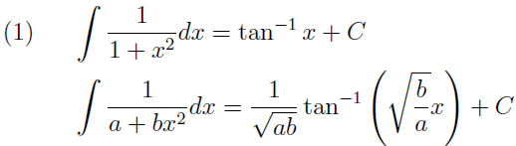
Example: Find the general indefinite integral $\int{tan²{x}dx}$
Solution:
$$\int{tan²{x}dx}=\int{\left(sec²{x}−1\right)dx}$$
$$=\int{sec²{x}dx−\int{1}dx}=\tan{x}−x+C$$
Rule 8: The integration rules of the main inverse trigonometric functions are:

Slide 19
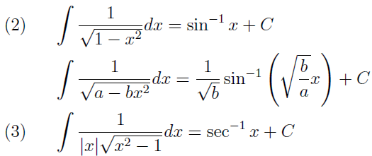
Example: Find the general indefinite integral $\int{\frac{1}{15+4x^{2}}dx}$
Solution:
$$\int{\frac{1}{15+4x^{2}}dx}=\frac{1}{\sqrt{25×4}}\tan^{−1}\left(\sqrt{\frac{4}{25}x}\right)+C$$
$$=\frac{1}{10}\tan^{−1}\left(\frac{2}{5}x\right)+C$$

Slide 20

Example: Find the general indefinite integral $\int{\frac{1}{\sqrt{16−9x^{2}}}dx}$
Solution:
$$\int{\frac{1}{\sqrt{16−9x^{2}}}}=\frac{1}{\sqrt{9}}\sin^{−1}\left(\sqrt{\frac{9}{16}x}\right)+C$$
$$=\frac{1}{3}\sin^{−1}\left(\frac{3}{4}x\right)+C$$

Slide 21
Thank you for your Attention

