Slide 1

Integration by Substitution

Slide 2

In this section we will study a technique, called substitution, that can often be used to transform complicated integration problems into simpler ones.
The method of substitution can be motivated by examining the chain rule from the viewpoint of anti-differentiation.
For this purpose, suppose that $F$ is an antiderivative of $f$ and that $g$ is a differentiable function.
The chain rule implies that the derivative of $F9g(x))$ can be expressed as
$\frac{d}{dx} F\left(g\left(x\right)\right)=F´(g\left(x\right))×g´(x)$

Slide 3

which we can write in integral form as
$\int{F´\left(g\left(x\right)\right)g´(x)dx}=F\left(g\left(x\right)\right)+C$
or since is an antiderivative of ,
$\int{f\left(g\left(x\right)\right)g´(x)dx}=F\left(g\left(x\right)\right)+C$ $…\left(1\right)$
For our purposes it will be useful to let $u=g(x)$ and to write $\frac{du}{dx}=g´(x)$ in the differential form $du=g´\left(x\right)dx$.
With this notation, equation (1) can be expressed as
$\int{f\left(u\right)du}=F\left(u\right)+C$ … (2)

Slide 4

The process of evaluating an integral of form (1) by converting it into form (2) with the substitution $u=g(x)$ and $du=g´\left(x\right)dx$ is called the method of $u−$substitution.
Here our emphasis is not on the interpretation of the expression $du=g´\left(x\right)dx$. Rather, the differential notation serves primarily as a useful bookkeeping device for the method of $u−$substitution.
The following example illustrates how the method works.

Slide 5

Example: Evaluate $\int{2x{(x^{2}+1)}^{50}dx}$.
Solution: If we let $u=x^{2}+1$, then $\frac{du}{dx}=2x$, which implies that $du=2xdx$. Thus, the given integral can be written as
$$\int{2x{(x^{2}+1)}^{50}dx}=\int{u^{50}du}=\frac{u^{51}}{51}+C$$
$$=\frac{{(x^{2}+1)}^{51}}{51}+C$$

Slide 6

Example: Evaluate $\int{\sin{²x}\cos{x}dx}$.
Solution: If we let $u=\sin{x}$ , then $\frac{du}{dx}=\cos{x}$ , so $du=\cos{x}dx$ . Thus,
$$\int{\sin{²x}\cos{x}dx}=\int{u^{2}du}=\frac{u^{3}}{3}+C=\frac{sin³{x}}{3}+C$$

Slide 7

Example: Evaluate $\int{\frac{e^{\sqrt{x}}}{\sqrt{x}}dx}$.
Solution: If we let $u=\sqrt{x}$, then
$\frac{du}{dx}=\frac{1}{2\sqrt{x}}$, so $du=\frac{1}{2\sqrt{x}}dx$ or $2du=\frac{1}{\sqrt{x}}$ .
Thus
$$\int{\frac{e^{\sqrt{x}}}{\sqrt{x}}dx}=\int{2e^{u}du}=2e^{u}+C=2e^{\sqrt{x}}+C$$

Slide 8
Example: Evaluate $\int{x^{4}\sqrt[3]{3−5x^{5}}dx}$.
Solution: If we let $u=3−5x^{5}$, then
$$\frac{du}{dx}=−25x^{4} so du=−25x^{4}dx or −\frac{1}{25}du=x^{4}dx$$
Thus
$$\int{x^{4}\sqrt[3]{3−5x^{5}}dx}=\int{−\frac{1}{25}\sqrt[3]{u}du}=−\frac{1}{25}\int{u^{1/3}}du$$
$=−\frac{1}{25}×\frac{3}{4}u^{\frac{4}{3}}+C=−\frac{3}{100}{\left(3−5x^{5}\right) }^{\frac{4}{3}}+C$

Slide 9
Example: Evaluate $\int{\frac{e^{x}}{\sqrt{1−e^{2x}}}}$.
Solution: Substituting $u=e^{x}$ and $du=e^{x}dx$ yields
$$\int{\frac{e^{x}}{\sqrt{1−e^{2x}}}}=\int{\frac{1}{\sqrt{1−u^{2}}}du}=\sin^{−1}{u}+C=\sin^{−1}{e^{x}}+C$$
The method of substitution is relatively straightforward, provided the integrand contains an easily recognized composition $f\left(g\left(x\right)\right)$ and the remainder of the integrand is a constant multiple of $g´(x)$ . If this is not the case,
the method may still apply but may require more computation.

Slide 10
Example: Evaluate $\int{x^{2}\sqrt{x−1}dx}$.
Solution: The composition $\sqrt{x−1}$ suggests the substitution $u=x−1$ so that $du=dx$. From the equality $u=x−1$ we have
$x^{2}={(u+1)}^{2}=u^{2}+2u+1$
so that
$$\int{x^{2}\sqrt{x−1}dx}=\int{(u^{2}+2u+1)\sqrt{u}du}=\int{u^{5/2}+2u^{3/2}+u^{1/2})du}=\frac{2}{7}u^{7/2}+2×\frac{2}{5}u^{5/2}+\frac{2}{3}u^{3/2}+C$$
$$=\frac{2}{7}{(x−1)}^{7/2}+\frac{4}{5}{(x−1)}^{5/2}+\frac{2}{3}{(x−1)}^{3/2}+C$$

Slide 11
Example: Evaluate $\int{\frac{\sin{(\frac{1}{t})}}{3t^{2}}dt}$
Solution: The substitution $y=1/t$ yields $du=−\frac{1}{t^{2}}dt$ and then $dt=−t^{2}dy$ .So,
$\int{\frac{\sin{(\frac{1}{t})}}{3t^{2}}dt}=\int{\frac{\sin{x}}{3t^{2}}\left({−t}^{2}\right)dy}=−\frac{1}{3}\int{\sin{y}dy}$
$$=−\frac{1}{3}×\left(−\cos{y}\right)+C$$
$$=\frac{1}{3}\cos{1/t}+C$$

Slide 12
Example: Evaluate $\int{\frac{t}{1+t^{4}}dt}$.
Solution: First we re-write the integration as follows.
$\int{\frac{t}{1+t^{4}}dt}=\int{\frac{t}{1+{(t}^{2})²}dt}$
Putting $y=t^{2}$ we obtain $dy=2tdt$ and then $dt=\frac{dy}{2t}$. Hence,
$\int{\frac{t}{1+t^{4}}dt}=\int{\frac{t}{1+{(t}^{2})²}dt}=\int{\frac{t}{1+y^{2}}\frac{dy}{2t}}$ $=\frac{1}{2}\int{\frac{1}{1+y^{2}}dy}=\frac{1}{2}\tan^{−1}{y}+C$
$=\frac{1}{2}\tan^{−1}{t^{2}}+C$

Slide 13
Example: Evaluate $\int{\sqrt{e^{t}}dt}$.
Solution:
$\int{\sqrt{e^{t}}dt}=\int{{(e^{t})}^{1/2}dt}=\int{e^{\frac{1}{2}t}dt}=2e^{\frac{1}{2}t}+C=2\sqrt{e^{t}}+C$
Example: Evaluate $\int{\frac{1}{t\ln{t}}dt}$
Solution: Let $y=\ln{t}$ to get $dy=1/tdt$ and then $dt=tdy$. So,$\int{\frac{1}{t\ln{t}}dt}=\int{\frac{1}{ty}}tdy=\int{\frac{1}{y}dy}$
$=\ln{y}+C=\ln{\ln{t}}+C$

Slide 14
Example: Evaluate $\int{\frac{{{(tan}^{−1}{t})}^{2}}{1+t^{2}}dt}$.
Solution: Put $y=\tan^{−1}{t}$ and get $dy=\frac{1}{1+t^{2}}dt$ or $dt=\left(1+t^{2}\right)dy$. Then,
$$\int{\frac{{{(tan}^{−1}{t})}^{2}}{1+t^{2}}dt}=\int{\frac{y^{2}}{1+t^{2}}\left(1+t^{2}\right)dy}$$
$$=\int{y^{2}dy}=\frac{1}{3}y^{3}+C=\frac{1}{3}{\tan^{−1}{t}}^{3}+C$$

Slide 15
Example: Evaluate $\int{\frac{1}{t+\sqrt{t}}dt}$.
Solution: We can use the substitution in solving this integration by putting $y=\sqrt{t}$ or equivalently $t=y^{2}$, and will get $dt=2ydy$. Hence,
$$\int{\frac{1}{t+\sqrt{t}}dt}=\int{\frac{1}{y^{2}+\sqrt{y^{2}}}2ydy}=\int{\frac{1}{y^{2}+y}}2ydy=\int{\frac{1}{y(y+1)}2ydy}=\int{\frac{2}{y+1}dy}$$
$=2\ln\left|1+y\right|+C=2\ln\left|1+\sqrt{t}\right|+C$

Slide 16
Example: Evaluate $\int{\frac{1}{t^{2}+2t+5}dt}$.
Solution: First we complete the square of $t^{2}+2t+5$ as follows.
$$t^{2}+2t+5=\left(t^{2}+2t+5\right)+1−1$$
$=\left(t^{2}+2t+5\right)+5−1$
$={(t+1)}^{2}+4$
Therefore, the integral will be:
$$\int{\frac{1}{t^{2}+2t+5}dt}=\int{\frac{1}{{(t+1)}^{2}+4}dt}$$

Slide 17
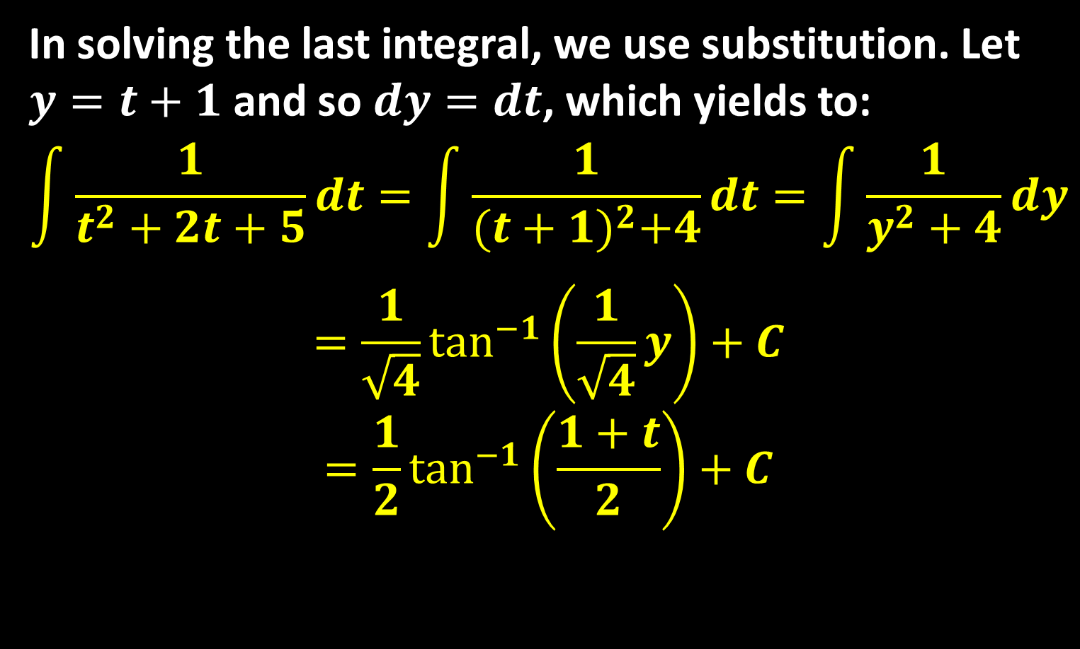
In solving the last integral, we use substitution. Let $y=t+1$ and so $dy=dt$, which yields to:
$$\int{\frac{1}{t^{2}+2t+5}dt}=\int{\frac{1}{{(t+1)}^{2}+4}dt}=\int{\frac{1}{y^{2}+4}dy}$$
$$=\frac{1}{\sqrt{4}}\tan^{−1}\left(\frac{1}{\sqrt{4}}y\right)+C$$
$$=\frac{1}{2}\tan^{−1}\left(\frac{1+t}{2}\right)+C$$

Slide 18
Thank you for your Attention

