Slide 1

The Definite Integral

Slide 2

In this sequence we define the definite integral of a function $f$ on an interval $I$.
Let us assume, for the time being, that $f(x)$ is defined and continuous on the closed, finite interval $[a,b]$. We no longer assume that the values of $f$ are nonnegative.
The symbol for the definite integral of $f(x)$ over the interval $[a,b]$ is
$\int_{b}^{a}{f\left(x\right)dx}$
which is read as the integral from $a$ to $b$ of $f$
of $x$ with respect to $x$.

Slide 3
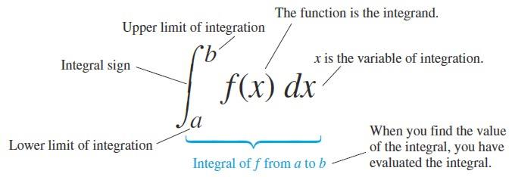
The component parts in the integral symbol also have names as shown in the figure below.

Slide 4

The following theorem says that if a function is continuous on a finite closed interval, then it is integrable on that interval, and its definite integral is the net signed area between the graph of the function and the interval.
Theorem: If a function $f$ is continuous on an interval $[a,b]$, then $f$ is integrable on $[a,b]$, and the net signed area $A$ between the graph of $f$ and the interval $\left[a,b\right]$is
$A=\int_{b}^{a}{f\left(x\right)dx}.$

Slide 5
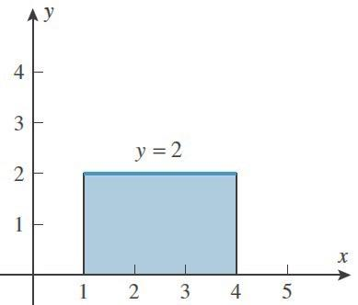

Example: Sketch the region whose area is represented by the definite integral
$\int_{1}^{4}{2dx}$
and evaluate the integral using an appropriate formula from geometry.
Solution: The graph of the integrand is the horizontal line $y=2$, so the region is a rectangle of height $2$ extending over the interval from to . Thus,
$\int_{1}^{4}{2dx}$ area of rectangle
$=2×3=6$

Slide 6
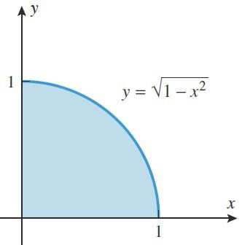

Example: Sketch the region whose area is represented by the definite integral
$\int_{0}^{1}{\sqrt{1−x^{2}}dx}$
and evaluate the integral using an appropriate formula from geometry.
Solution: The graph of $\sqrt{1−x^{2}}$ is the upper semicircle of radius $1$, centered at the origin, so the region is the right quarter-circle extending from $x=0$ to $x=1$.

Slide 7
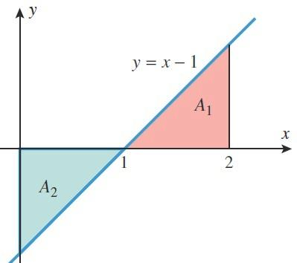

Thus, $\int_{0}^{1}{\sqrt{1−x^{2}}dx}$ area of quarter-circle
$$=\frac{1}{4}×{(1)}^{2}π=\frac{π}{4}$$
Example: Evaluate
  $\int_{0}^{2}{\left(x−1\right)dx}$
  $\int_{0}^{1}{\left(x−1\right)dx}$

Slide 8

Solution: The graph of $y=x−1$ is shown in the figure, and we leave it for you to verify that the shaded triangular regions both have area $1/2$.
Over the interval $[0,2]$ the net signed area is
$A_{1}−A_{2}=\frac{1}{2}−\frac{1}{2}=0$
and over the interval $[0,1]$ the net signed area is
$−A_{2}=−\frac{1}{2}$
Thus,
$\int_{1}^{2}{\left(x−1\right)dx}=0$ and $\int_{0}^{1}{\left(x−1\right)dx}=−\frac{1}{2}$.

Slide 9
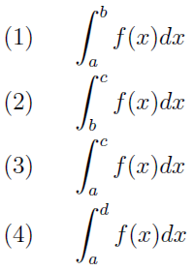
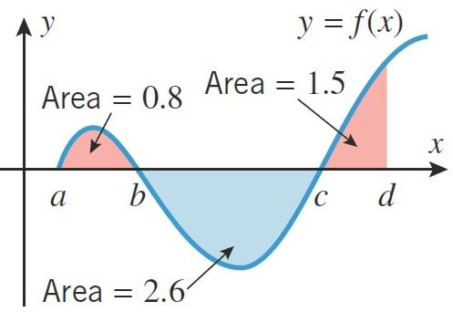

Example: Use the areas shown in the figure to find:
Solution:
  Over the interval $[a,b]$, the net signed area is $0.8$ and hence $\int_{a}^{b}{f\left(x\right)dx}=0.8$.

Slide 10
    Over the interval $[a,c]$ , the net signed area is $−2.6$ and hence $\int_{b}^{c}{f\left(x\right)dx}=−2.6$.
    Over the interval $[a,c]$ , the net signed area is $0.8−2.6=−1.8$ and hence $\int_{a}^{c}{f\left(x\right)dx}=−1.8$.
    Over the interval $[a,d]$ , the net signed area is $0.8−2.6+1.5=−0.3$ and hence $\int_{a}^{d}{f\left(x\right)dx}=−0.3$.

Slide 11
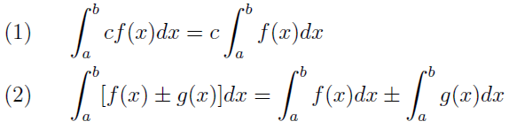

Properties of the Definite Integral:
  If $a$ is in the domain of $f$, we define $\int_{a}^{a}{f\left(x\right)dx}=0$.
  If $f$ is integrable on $[a,b]$, then we define $\int_{b}^{a}{f\left(x\right)dx}=−\int_{a}^{b}{f\left(x\right)dx}$
  3. If $f$ and $g$ are integrable on $[a,b]$ and if $c$ is a constant, then $cf$, $f+g$, and $f−g$ are integrable on $[a,b]$ and

Slide 12

  If $f$ is integrable on a closed interval containing the three points a,$b$ , and $c$ (no matter how the points are ordered), then
  $\int_{a}^{b}{f\left(x\right)dx}=\int_{a}^{c}{f\left(x\right)dx}+\int_{c}^{b}{f\left(x\right)dx}$
  If $f$ is integrable on $[a,b]$ and $f(x)≥0$ for all in $[a,b]$ , then
  $\int_{a}^{b}{f\left(x\right)dx}≥0$
  and if $f(x)≤0$ for all $x$ in $[a,b]$, then
  $\int_{a}^{b}{f\left(x\right)dx}≤0$

Slide 13
  If $f$ and $g$ are integrable on $[a,b]$ and $f(x)≥g(x)$ for all $x$ in $[a,b]$, then
  $\int_{a}^{b}{f\left(x\right)dx}≥\int_{a}^{b}{g\left(x\right)dx}$
Example: Find $\int_{−1}^{2}{\left[f\left(x\right)+2g\left(x\right)\right]}$ if
$\int_{−1}^{2}{f\left(x\right)dx}=5$ and $\int_{−1}^{2}{g\left(x\right)}dx=−3$.
Solution:
$$\int_{−1}^{2}{\left[f\left(x\right)+2g\left(x\right)\right]}=\int_{−1}^{2}{f\left(x\right)dx}+2\int_{−1}^{2}{g\left(x\right)}dx$$
$$=5+2×\left(−3\right)=−1$$

Slide 14

Example: Find $\int_{1}^{5}{f\left(x\right)dx}$ if
$\int_{0}^{1}{f\left(x\right)dx}=−2$ and $\int_{0}^{5}{f\left(x\right)dx}=1$.
Solution:
$$\int_{1}^{5}{f\left(x\right)dx}=\int_{0}^{1}{f\left(x\right)dx}+\int_{1}^{5}{f\left(x\right)dx}$$
$$1=−2+\int_{1}^{5}{f\left(x\right)dx}$$
$$\int_{1}^{5}{f\left(x\right)dx}=3$$

Slide 15
Example: Determine whether the value of the integral
$\int_{2}^{3}{\frac{\sqrt{x}}{1−x}dx}$
is positive or negative.
Solution: Since $\sqrt{x}>0$ and $1−x<0$ on $[2,3]$ then
$$\frac{\sqrt{x}}{1−x}<0 and\int_{2}^{3}{\frac{\sqrt{x}}{1−x}dx}<0$$

Slide 16
Thank you for your Attention

