Slide 1

The Fundamental Theorem of Calculus

Slide 2
In this sequence we will establish two basic relationships between definite and indefinite integrals that together constitute a result called the Fundamental Theorem of Calculus.
One part of this theorem will relate the antiderivative method for calculating areas, and the second part will provide a powerful method for evaluating definite integrals using antiderivatives.

Slide 3

The first part of the Fundamental Theorem of Calculus says that:
  The definite integral can be evaluated by finding any antiderivative of the integrand and then subtracting the value of this antiderivative at the lower limit of integration from its value at the upper limit of integration.
Theorem: If $f$ is continuous on $[a,b]$ and $F$ is any antiderivative of $f$ on $[a,b]$ , then
$$\int_{b}^{a}{f\left(x\right)dx}={\left.f(x)\right]}_{b}^{a}=F\left(b\right)−F(a)$$

Slide 4

Observe that in the preceding theorem we did not include a constant of integration in the antiderivatives.
In general, when applying the Fundamental Theorem of Calculus there is no need to include a constant of integration because it will drop out anyway.
Example: Evaluate $\int_{1}^{4}{3dx}$.
Solution:
$\int_{1}^{4}{3dx}={\left.3\right]}_{1}^{4}=3\left(4\right)−3\left(1\right)=9$

Slide 5

Example: Evaluate $\int_{1}^{9}{xdx}$.
Solution:
$$\int_{1}^{9}{xdx}={\left.\frac{1}{2}x^{2}\right]}_{1}^{9}=\frac{1}{2}9^{2}−\frac{1}{2}1^{2}=40$$
Example: Evaluate $\int_{0}^{π/3}{sec²{x}dx}$.
Solution:
$$\int_{0}^{π/3}{sec²{x}dx}={\left.\tan{x}\right]}_{0}^{π/3}=\tan{π/3}−\tan{0}=\sqrt{3}−0=\sqrt{3}$$

Slide 6

Example: Evaluate $\int_{0}^{\ln{3}}{5e^{x}dx}$.
Solution:
$\int_{0}^{\ln{3}}{5e^{x}dx}={\left.5e^{x}\right]}_{0}^{\ln{3}}=5e^{\ln{3}}−5e^{0}=5\left(3\right)−5\left(1\right)=10$
Example: Evaluate $\int_{−e}^{−1}{\frac{1}{x}dx}$.
Solution:
$$\int_{−e}^{−1}{\frac{1}{x}dx}=\ln{{\left.\left|x\right|\right]}_{−e}^{−1}}$$
$=\ln\left|−1\right|−\ln\left|−e\right|=0−1 =−1$

Slide 7
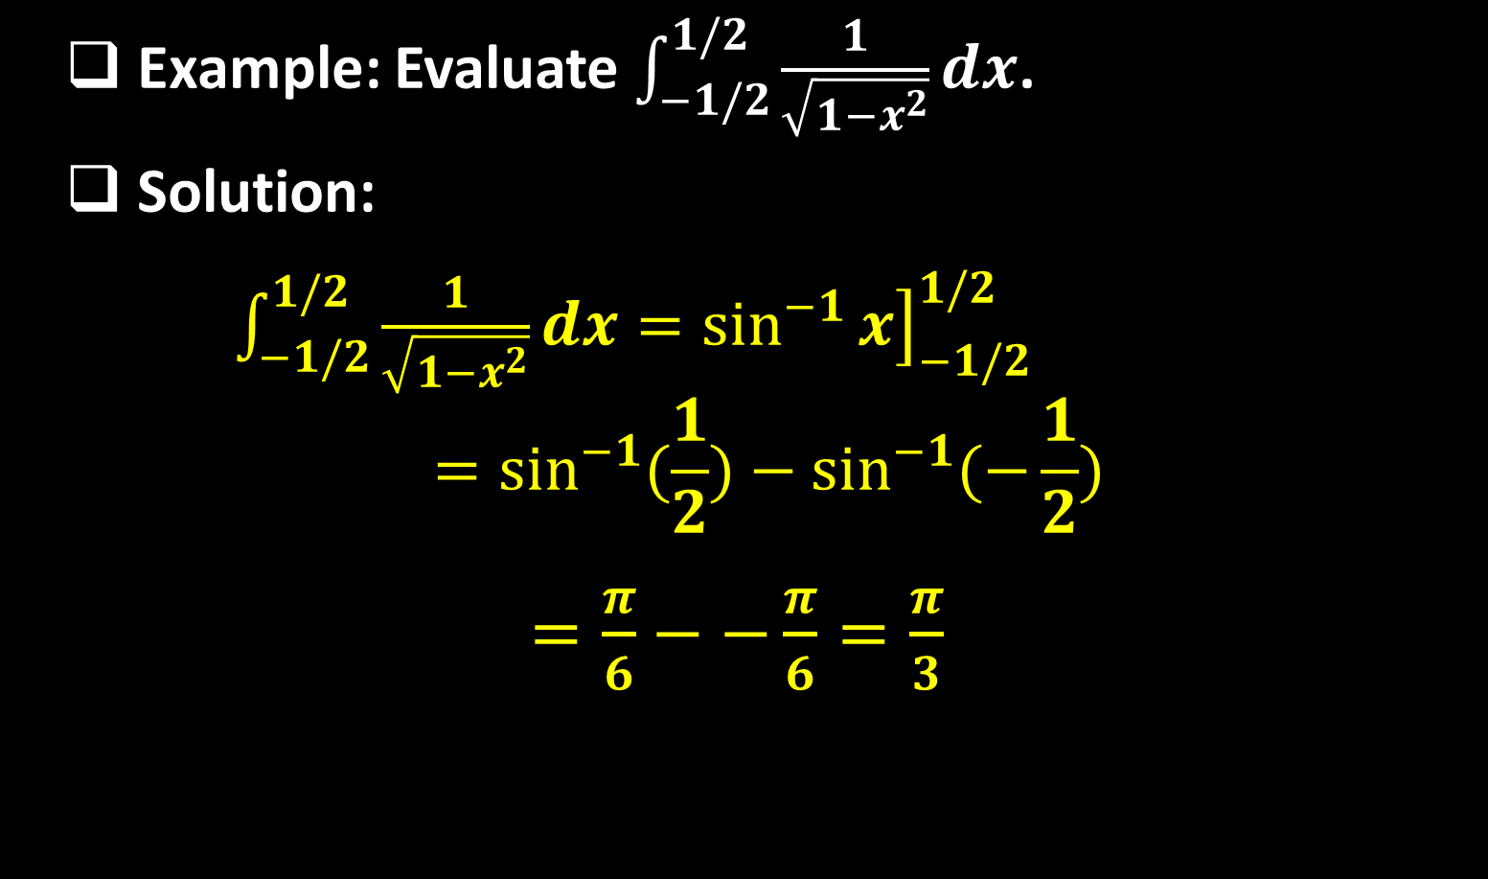
Example: Evaluate $\int_{−1/2}^{1/2}{\frac{1}{\sqrt{1−x^{2}}}dx}$.
Solution:
$\int_{−1/2}^{1/2}{\frac{1}{\sqrt{1−x^{2}}}dx}={\left.\sin^{−1}{x}\right]}_{−1/2}^{1/2}$
$$=\sin^{−1}{(\frac{1}{2})}−\sin^{−1}{(−\frac{1}{2})}$$
$=\frac{π}{6}−−\frac{π}{6}=\frac{π}{3}$

Slide 8
Example: Evaluate $\int_{0}^{3}{f\left(x\right)dx}$ if $f\left(x\right)=\left\{\begin{aligned}x^{2} , x<2 \\ 3x−2 , x≥2\end{aligned}\right.$
Solution: From the properties of definite integral we can integrate from $0$ to $2$ and from $2$ to $3$ separately and add the results. This yields
$$\int_{0}^{3}{f\left(x\right)dx}=\int_{0}^{2}{f\left(x\right)dx}+\int_{2}^{3}{f\left(x\right)dx}$$
$=\int_{0}^{2}{x^{2}}dx+\int_{2}^{3}{(3x−2)}dx$
$={\left.\frac{x^{3}}{3}\right]}_{0}^{2}+{\left.\left(\frac{3x^{2}}{2}−2x\right)\right]}_{2}^{3}$
$=\left(\frac{8}{3}−0\right)+\left(\frac{15}{2}−2\right)=\frac{49}{6}$

Slide 9
The next theorem describes the method for evaluating definite integrals in which a substitution is required.
Theorem: If $g´$ is continuous on $[a,b]$ and $f$ is continuous on an interval containing the values of $g(x)$ for $a≤x≤b$ , then
$$\int_{b}^{b}{f\left(g\left(x\right)\right)g´\left(x\right)dx}=\int_{g(a)}^{g(b)}{f\left(u\right)du}$$
Example: Evaluate $\int_{0}^{2}{x{(x^{2}+1)}^{3}dx}$.

Slide 10
Solution: If we let $u=x^{2}+1$ so that $du=2xdx$ or $\frac{1}{2}du=xdx$, then
$$if x=0 , u=1$$
$$if x=2 , u=5$$
Thus,
$$\int_{0}^{2}{x{(x^{2}+1)}^{3}dx}=\frac{1}{2}\int_{1}^{5}{u^{3}}$$
$$={\left.\frac{u^{4}}{8}\right]}_{1}^{5}=\frac{625}{8} −\frac{1}{8}=78$$

Slide 11
Example: Evaluate $\int_{0}^{π/8}{\sin^{5}x}2x\cos{2x}dx$.
Solution: If we let $u=\sin{2x}$ so that
$du=2\cos{2x}dx$or $\frac{1}{2}du=\cos{2x}dx$ then
$$if x=0 , u=\sin{0}=0$$
$$if x=\frac{π}{8}, u=\sin{π/8}=\frac{1}{\sqrt{2}}$$
Thus, $\int_{0}^{π/8}{\sin^{5}x}2x\cos{2x}dx=\frac{1}{2}\int_{0}^{1/\sqrt{2}}{u^{5}dx}$
$={\left.\frac{u^{6}}{12}\right]}_{0}^{1/\sqrt{2}}=\frac{1}{12{(\sqrt{2})}^{6}}−0=\frac{1}{96}$

Slide 12
Example: Find $\int_{−2}^{0}{xf(x^{2})}dx$ if $\int_{0}^{4}{f\left(x\right)dx}$.
Solution: If we let $u=x^{2}$ so that $du=2dx$ or $\frac{1}{2}du=dx$, then
$$if x=−2 , u=4$$
$$if x=0 , u=0$$
Thus,
$\int_{−2}^{0}{xf(x^{2})}=\frac{1}{2}\int_{0}^{4}{f\left(u\right)du}=\frac{1}{2}×1=\frac{1}{2}$

Slide 13
The second part of the Fundamental Theorem of Calculus says:
  If a definite integral has a variable upper limit of integration, a constant lower limit of integration, and a continuous integrand, then the derivative of the integral with respect to its upper limit is equal to the integrand evaluated at the upper limit.
Theorem: If $f$ is continuous on an interval, then $f$ has an antiderivative on that interval. In particular, if $a$ is any point in the interval, then the function $F$ defined by
$F\left(x\right)=\int_{a}^{x}{f\left(t\right)dt}$ is an antiderivative of $f$;

Slide 14
that is,$F´(x)=f(x)$ for each $x$ in the interval, or in an alternative notation
$$\frac{d}{dx}\left[\int_{a}^{x}{f\left(t\right)dt}\right]=f(x)$$
Corollary:
  $\frac{d}{dx}\left[\int_{a}^{h(x)}{f\left(t\right)dt}\right]=f\left(h\left(x\right)\right).h´(x)$
  $\frac{d}{dx}\left[\int_{a}^{h(x)}{f\left(t\right)dt}\right]=f\left(h\left(x\right)\right).h´\left(x\right)−f\left(l\left(x\right)\right).l´(x)$

Slide 15
Example: Find $\frac{d}{dx}\left[\int_{1}^{x}{t^{3}}dt\right]$.
Solution: The integrand is a continuous function, so
$\frac{d}{dx}\left[\int_{1}^{x}{t^{3}}dt\right]=x^{3}$
Example: Find $\frac{d}{dx}\left[\int_{1}^{x}{\frac{\sin{t}}{t}}dt\right]$ .
Solution: The integrand is a continuous on any interval that does not contain the origin, so on the interval $(0,∞)$ we have
$\frac{d}{dx}\left[\int_{1}^{x}{\frac{\sin{t}}{t}}dt\right]=\frac{\sin{x}}{x}$

Slide 16
Example: Use the part $2$ of the Fundamental Theorem of Calculus to find $\frac{d}{dx}\left[\int_{1}^{x^{2}}{e^{t}}dt\right]$.
Solution: The integrand is a continuous function, so
$$\frac{d}{dx}\left[\int_{1}^{x^{2}}{e^{t}}dt\right]=e^{x^{2}}\frac{d}{dx}\left(x^{2}\right)=2xe^{x^{2}}$$
Example: Use the part $2$ of the Fundamental Theorem of Calculus to find $\frac{d}{dx}\left[\int_{\sin{x}}^{\cos{x}}{t^{2}}dt\right]$.

Slide 17
Solution: The integrand is a continuous function, so
$$\frac{d}{dx}\left[\int_{\sin{x}}^{\cos{x}}{t^{2}}dt\right]=cos²{x}\frac{d}{dx}\left(\cos{x}\right)−sin²{x}\frac{d}{dx}(\sin{x})$$
$$=−\sin{x}cos²{x}−\cos{x}sin²{x}$$
Note: The two parts of the Fundamental Theorem of Calculus, when taken together, tell us that differentiation and integration are inverse processes in the sense that each undoes the effect of the other; that is
$\int_{a}^{x}{f´\left(t\right)dt}=f\left(x\right)−f(a)$ and $\frac{d}{dx}\left[\int_{a}^{x}{f(t)}dt\right]=f(x)$

Slide 18

Example: Find a function $f$ and a number $a$ such that
$6+\int_{a}^{x}{\frac{f\left(t\right)}{t^{2}}}=2\sqrt{x}$ for $x≥0$.
Solution: If we let $x=a≥0$ , we have
$$6+\int_{a}^{x}{\frac{f\left(t\right)}{t^{2}}}=2\sqrt{a}$$
$$6+0=2\sqrt{a}⇒a=9$$
To find $f$, differentiate both sides of the equation with respect to $x$:

Slide 19

$$\frac{d}{dx}\left[6+\int_{a}^{x}{\frac{f\left(t\right)}{t^{2}}}\right]=\frac{d}{dx}\left[2\sqrt{x}\right]$$
$$0+\frac{f\left(x\right)}{x^{2}}=\frac{1}{\sqrt{x}}$$
$$f\left(x\right)=\frac{x^{2}}{\sqrt{x}}=\sqrt{x^{3}} where x≥0$$

Slide 20
Thank you for your Attention

